Slide 1
소재수치해석 HW7
20110073 김용민

Slide 2
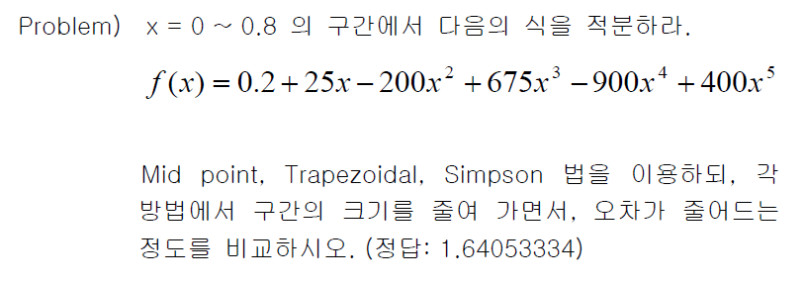
Problem

Slide 3
Theory

Slide 4
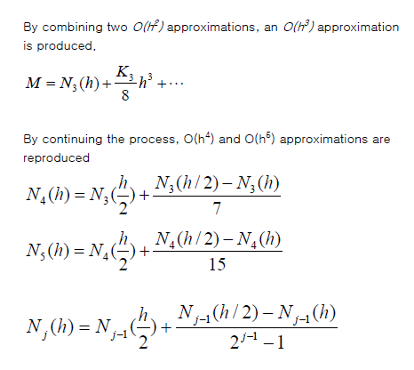
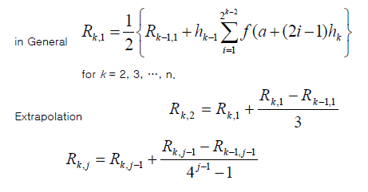
Theory

Slide 5
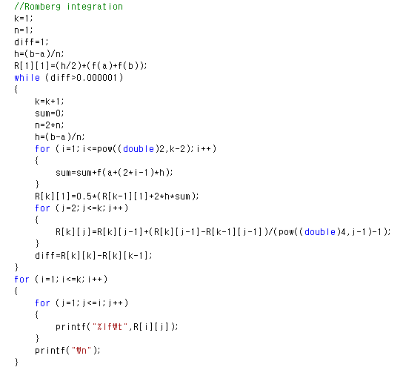
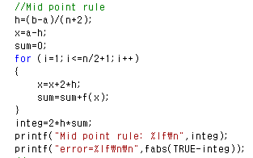
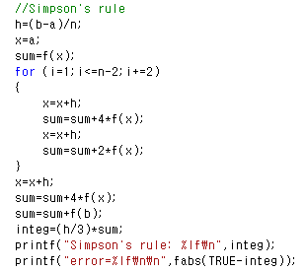
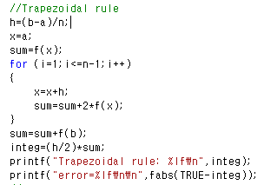
Code

Slide 6
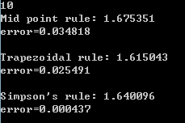
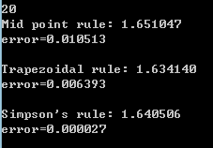
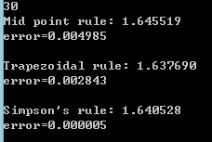
Result
Divide Rule | Mid point rule | Trapezoidal rule | Simpson’s rule
10 | 0.034818 | 0.025491 | 0.000437
20 | 0.010513 | 0.006393 | 0.000027
30 | 0.004985 | 0.002843 | 0.000005
40 | 0.002898 | 0.001600 | 0.000002
50 | 0.001891 | 0.001024 | 0.000001
60 | 0.001331 | 0.000711
70 | 0.000987 | 0.000522

Slide 7
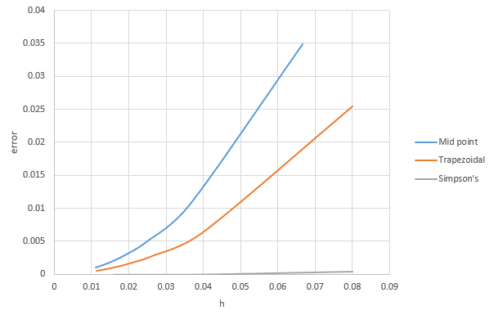
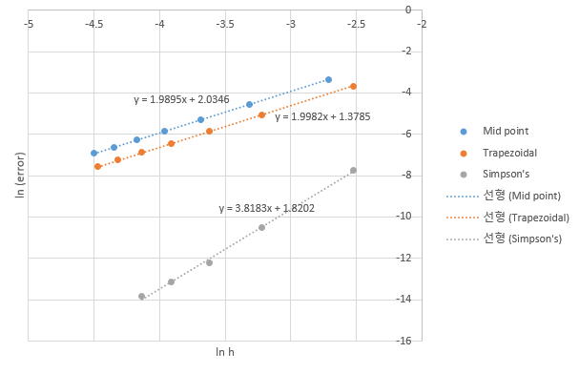
Result

Slide 8
Result
Romberg Integration diff>0.000001

