Slide 1
소재수치해석HW3
20110073 김용민

Slide 2
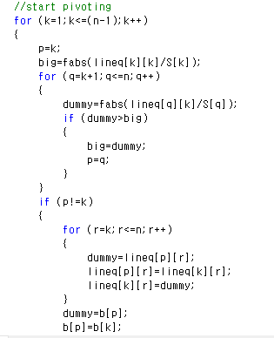
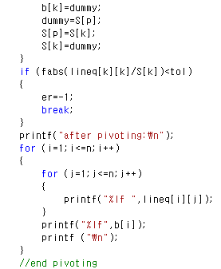
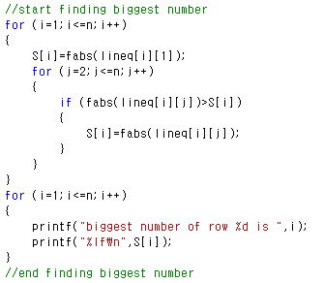
Gauss-Jordan Elimination
Code:

Slide 3
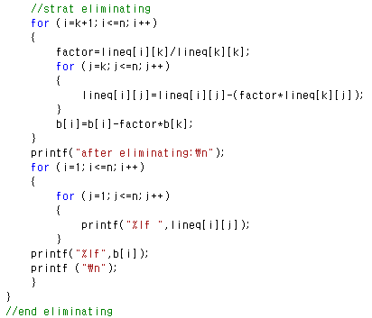
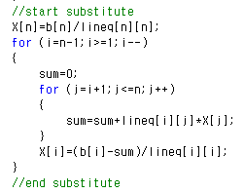
Gauss-Jordan Elimination
Code:

Slide 4
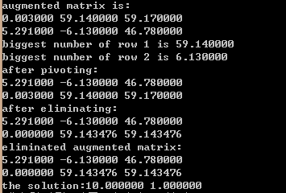
Gauss-Jordan Elimination
Example1
0.003000 | 59.14 | 59.17
5.291 | -6.130 | 46.78

Slide 5
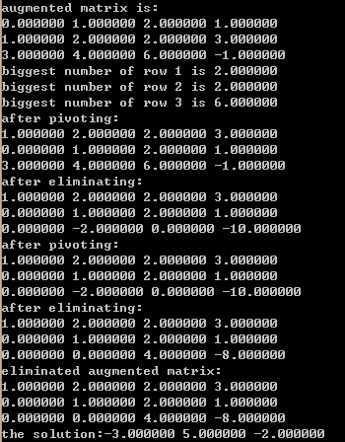
Gauss-Jordan Elimination
Example2
0 | 1 | 2 | 1
1 | 2 | 2 | 3
3 | 4 | 6 | -1

Slide 6
Gauss-Jordan Elimination
Example3
0.003000 | 59.14 | 59.17 | -2.455 | 0 | 1.235
5.291 | -6.130 | 46.78 | 4.321 | 56.21 | 5.789
0 | 23.26 | -69.21 | 0 | 1.000 | 5.678
7.855 | 56.60 | 0 | 2.000 | 0.06542 | 2.148
9.155 | 0 | 0 | 27.56 | -5.000 | 7.963

Slide 7
