Slide 1
소재수치해석 hw 9
20100091 서 현 선

Slide 2
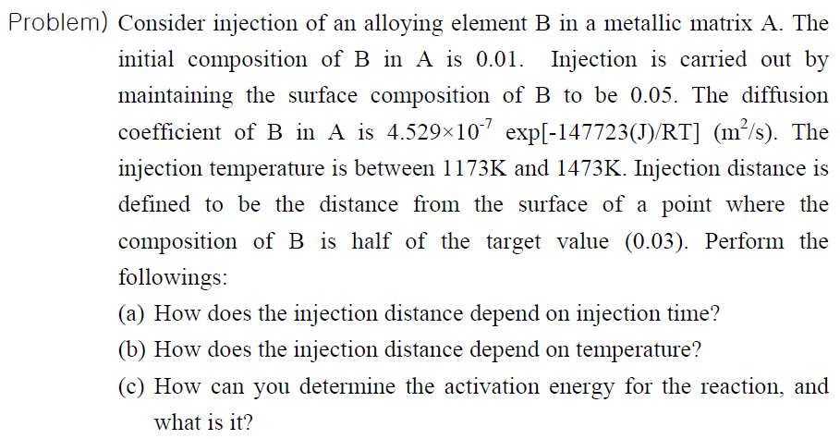
ASSIGNMENT

Slide 3
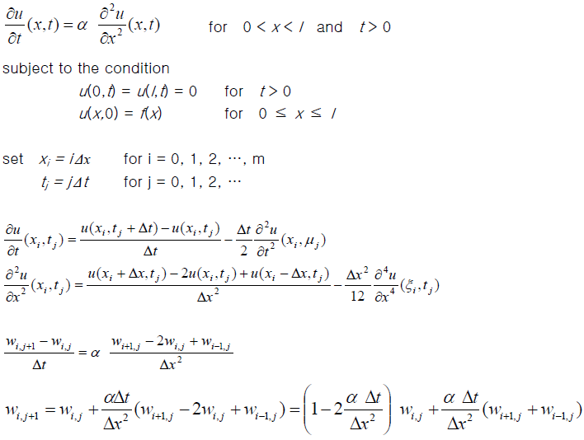
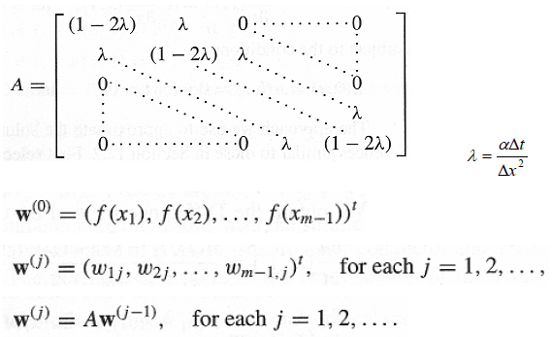
background
Finite Difference Methods for Parabolic Problems (Explicit method)

Slide 4
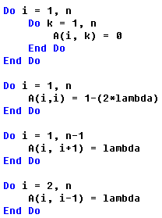
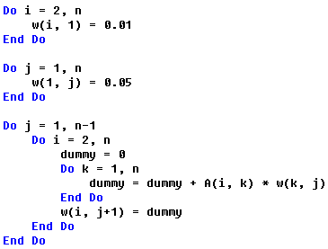
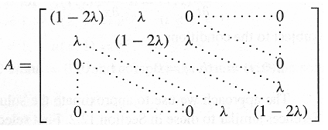
Key Code
Initial composition
Surface composition

Slide 5
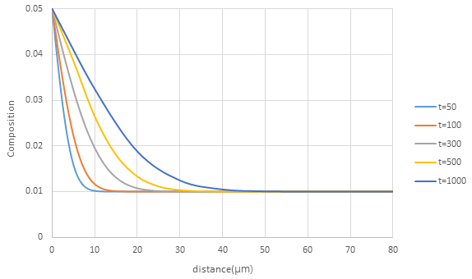
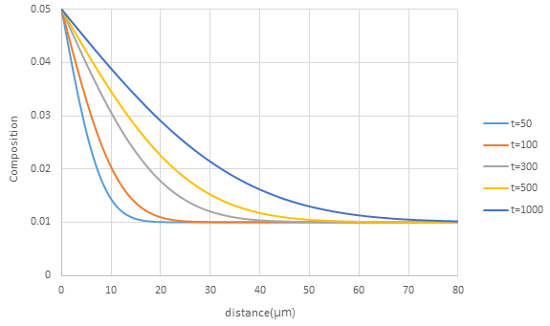
ResulT
(1) T=1173K
(2) T=1273K
dt = 1s, dx = 1μm, λ=0.1196479
dt = 1s, dx = 1μm, λ=0.3932285

Slide 6
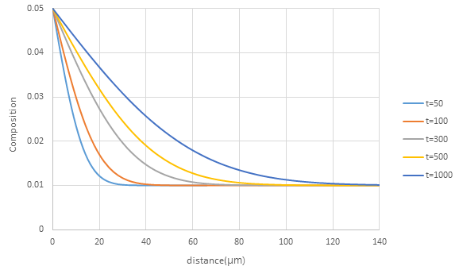
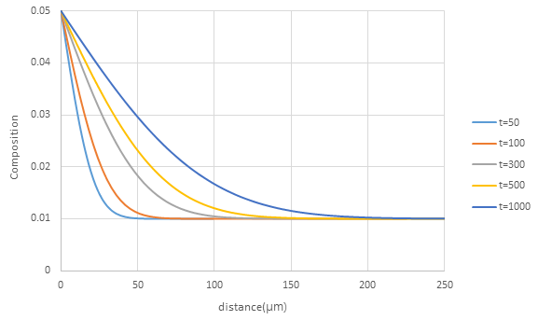
ResulT
(3) T=1373K
(4) T=1473K
dt = 1s, dx = 2μm, λ=0.2716771
dt = 1s, dx = 3μm, λ=0.290668

Slide 7
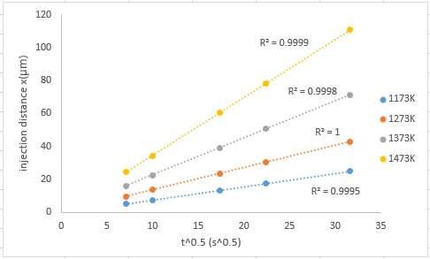
Analysis
(a) Injection distance vs Injection time

Slide 8
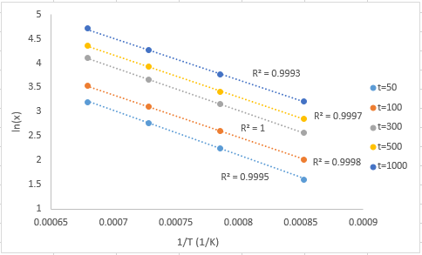
Analysis
(b) Injection distance vs temperature

Slide 9
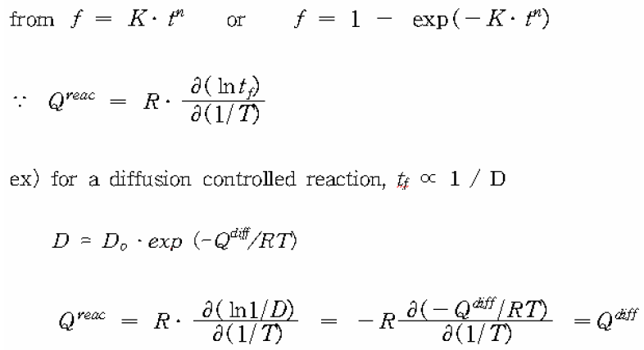
Analysis
(c) How can you determine the activation energy for the reaction, and what is it?
ln(t) – (1/T) 의 기울기를 통해 activation energy 구할 수 있다!
∴ Activation energy의 order를 확인함으로써 그 reaction의 mechanism을 파악할 수 있다!!!
Diffusion controlled reaction의 경우, 이 activation energy는 Qdiff와 같다!

Slide 10
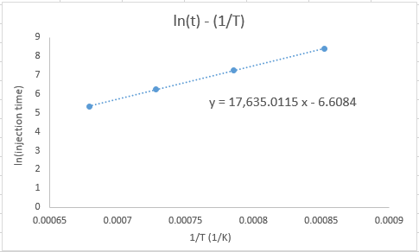
Analysis
(c) How can you determine the activation energy for the reaction, and what is it?
$$Q^{reac}=\left(8.3144621\right)×\left(17635.0115\right)$$
$$=146625.6347 J$$
$$Q^{diff}=147723 J$$
오차 : 0.743%
(Injection distance = 25μm, characteristic time = injection time)

Slide 11
conclusion
Finite Difference Method(Explicit method)를 사용하여 Diffusion equation을 성공적으로 풀 수 있었다.
Stability condition을 만족시키기 위해 dt를 작게 해주어야 하다 보니 계산 시간이 매우 오래 소요되었다.(Explicit method의 단점을 확인)

Slide 12
THANK YOU

