Slide 1
소재수치해석 #6
MSE 20100099 장민지.

Slide 2
Problem 1.
회귀분석을 이용하여
액상에 대한 enthalpy of mixing & activity data를 fitting해보고, 이를 실험값과 비교해 보아라.

Slide 3
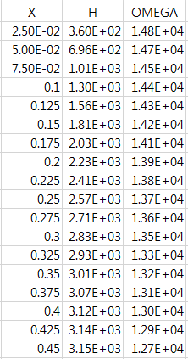
Introduction
Non-ideal solution
Regular solution
Sub-regular solution
Ideal solution
solution

Slide 4
Introduction
Enthalpy of mixing
Activity

Slide 5
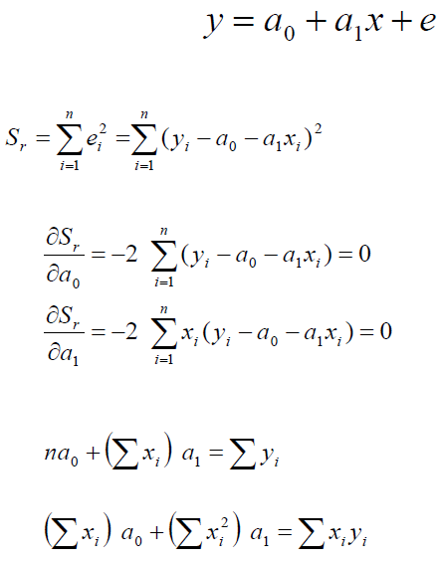
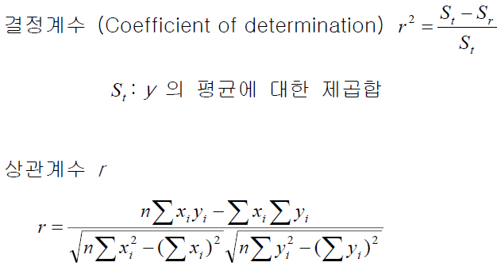
Introduction

Slide 7
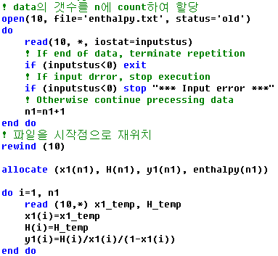
Algorithm & Coding

Slide 8
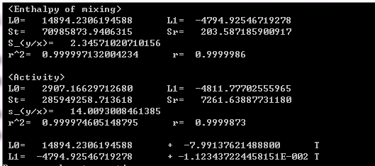
Results 1.

Slide 9
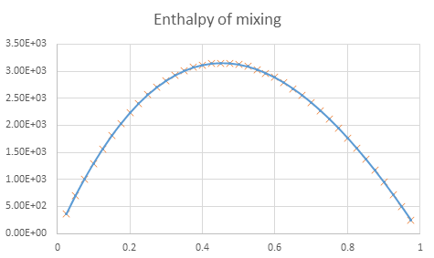
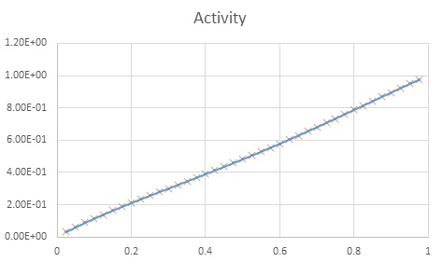
Results 2.

