Slide 1
Numerical Method
Mid-Term
20200552 이형진

Slide 2
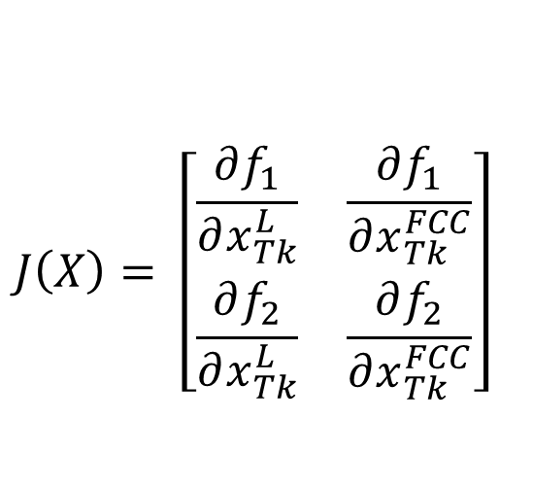
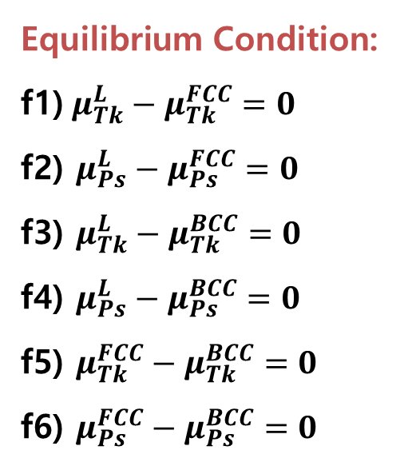
MIDTERM) Calculate the phase diagram of the Ps-Tk Binary System
Equilibrium Condition:
f1) $μ_{Tk}^{L}−μ_{Tk}^{FCC}=0$
f2) $μ_{Ps}^{L}−μ_{Ps}^{FCC}=0$
f3) $μ_{Tk}^{L}−μ_{Tk}^{BCC}=0$
f4) $μ_{Ps}^{L}−μ_{Ps}^{BCC}=0$
f5) $μ_{Tk}^{FCC}−μ_{Tk}^{BCC}=0$
f6) $μ_{Ps}^{FCC}−μ_{Ps}^{BCC}=0$
To solve Non-linear Equation System of 2 functions, We use Newton’s Method.
Liquid-FCC Equilibrium
Liquid-BCC Equilibrium
Liquid-FCC Equilibrium
FCC-BCC
Equilibrium
f1) $μ_{Tk}^{L}−μ_{Tk}^{FCC}=0$
$$μ_{Tk}^{L}−μ_{Tk}^{FCC}=°G_{Tk}^{FCC→liquid}+RTln\frac{x_{Tk}^{L}}{x_{Tk}^{FCC}}+{\left(1−x_{Tk}^{L}\right)}^{2}\left(L_{0}^{L}+\left(1−4x_{Tk}^{L}\right)L_{1}^{L}\right)−{\left(1−x_{Tk}^{FCC}\right)}^{2}\left(L_{0}^{FCC}+\left(1−4x_{Tk}^{FCC}\right)L_{1}^{FCC}\right)=0$$
f2) $μ_{Ps}^{L}−μ_{Ps}^{FCC}=0$
$$μ_{Ps}^{L}−μ_{Ps}^{FCC}=°G_{Ps}^{FCC→liquid}+RTln\frac{{1−x}_{Tk}^{L}}{1−x_{Tk}^{FCC}}+{\left(x_{Tk}^{L}\right)}^{2}\left(L_{0}^{L}+\left(3−4x_{Tk}^{L}\right)L_{1}^{L}\right)−{\left(x_{Tk}^{FCC}\right)}^{2}\left(L_{0}^{FCC}+\left(3−4x_{Tk}^{FCC}\right)L_{1}^{FCC}\right)=0$$
We already get L term at HW5
$$J\left(X\right)= \left[\begin{matrix}\frac{∂f_{1}}{∂x_{Tk}^{L}} & \frac{∂f_{1}}{∂x_{Tk}^{FCC}} \\ \frac{∂f_{2}}{∂x_{Tk}^{L}} & \frac{∂f_{2}}{∂x_{Tk}^{FCC}}\end{matrix}\right]$$
<L Values>
1) L^{L} ₀= 12496.77 - 8.00T
2) L^{L} ₁= 2397.463 + 0.00553T
3) L^{FCC} ₀= 8997.62 - 5.00T
4) L^{FCC} ₁= 3599.989 - 0.00596T
5) L^{BCC} ₀= 6999.023 – 3.914T

Slide 3
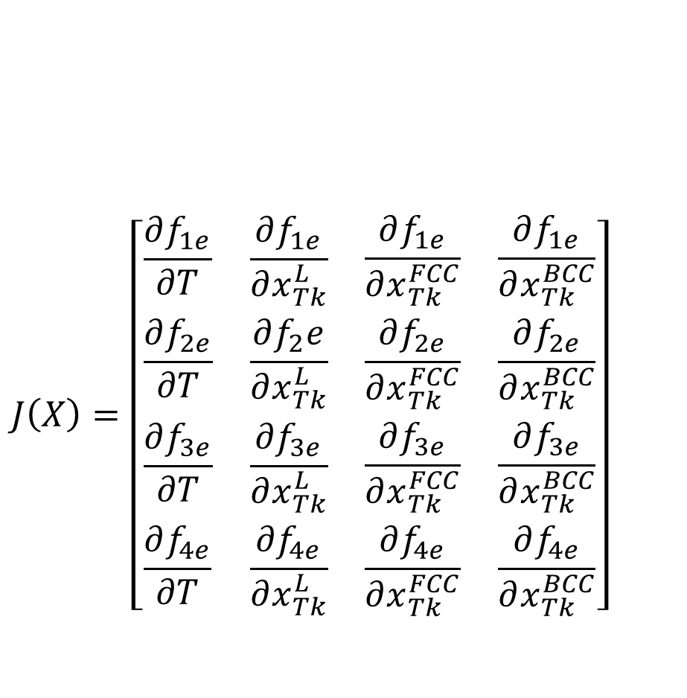
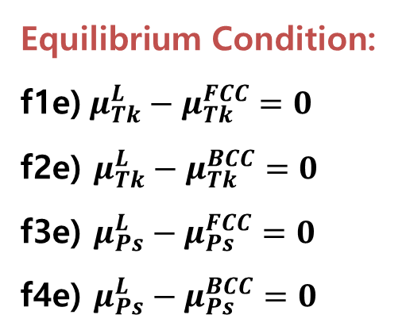
MIDTERM) Calculate the phase diagram of the Ps-Tk Binary System
$$J\left(X\right)=\left[\begin{matrix}\begin{matrix}\frac{∂f_{1e}}{∂T} & \frac{∂f_{1e}}{∂x_{Tk}^{L}} \\ \frac{∂f_{2e}}{∂T} & \frac{∂f_{2}e}{∂x_{Tk}^{L}}\end{matrix} & \begin{matrix}\frac{∂f_{1e}}{∂x_{Tk}^{FCC}} & \frac{∂f_{1e}}{∂x_{Tk}^{BCC}} \\ \frac{∂f_{2e}}{∂x_{Tk}^{FCC}} & \frac{∂f_{2e}}{∂x_{Tk}^{BCC}}\end{matrix} \\ \begin{matrix}\frac{∂f_{3e}}{∂T} & \frac{∂f_{3e}}{∂x_{Tk}^{L}} \\ \frac{∂f_{4e}}{∂T} & \frac{∂f_{4e}}{∂x_{Tk}^{L}}\end{matrix} & \begin{matrix}\frac{∂f_{3e}}{∂x_{Tk}^{FCC}} & \frac{∂f_{3e}}{∂x_{Tk}^{BCC}} \\ \frac{∂f_{4e}}{∂x_{Tk}^{FCC}} & \frac{∂f_{4e}}{∂x_{Tk}^{BCC}}\end{matrix}\end{matrix}\right]$$
In Binary System, There is Triple Equilibrium Point!!
To solve Non-linear Equation System of 2 functions, We use Newton’s Method.
Equilibrium Condition:
f1e) $μ_{Tk}^{L}−μ_{Tk}^{FCC}=0$
f2e) $μ_{Tk}^{L}−μ_{Tk}^{BCC}=0$
f3e) $μ_{Ps}^{L}−μ_{Ps}^{FCC}=0$
f4e) $μ_{Ps}^{L}−μ_{Ps}^{BCC}=0$
Liquid-FCC-BCC Equilibrium
Liquid-FCC-BCC Equilibrium
<Newton-Method Result>
Peritectic Temperature
X^L
X^FCC
X^BCC

Slide 4
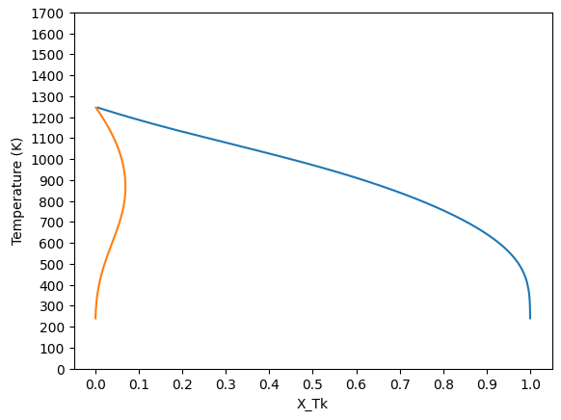
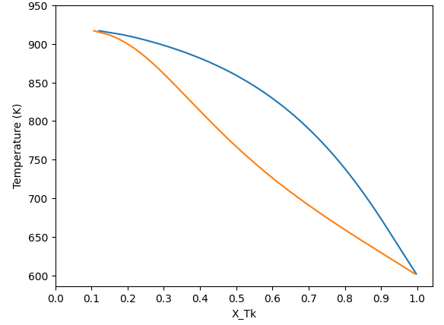
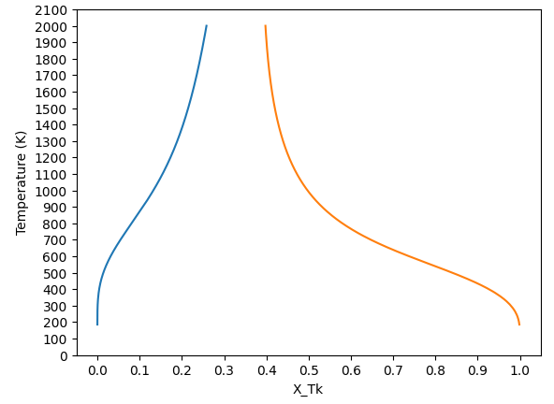
MIDTERM) Calculate the phase diagram of the Ps-Tk Binary System
Liquid-FCC Equilibrium
Liquid-BCC Equilibrium
FCC-BCC
Equilibrium
L
L
FCC
BCC
BCC + L
FCC
FCC + L
FCC+BCC
BCC

Slide 5
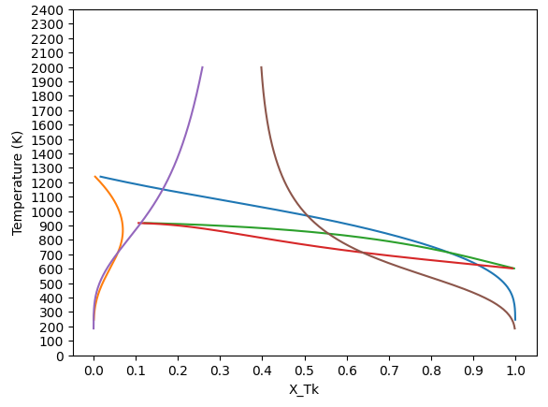
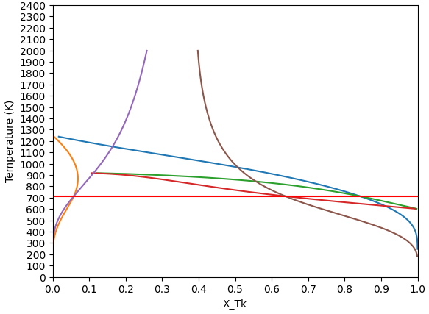
MIDTERM) Calculate the phase diagram of the Ps-Tk Binary System
2 phase equilbrium plotted
Phase Diagram w/ Peritectic Point

Slide 6
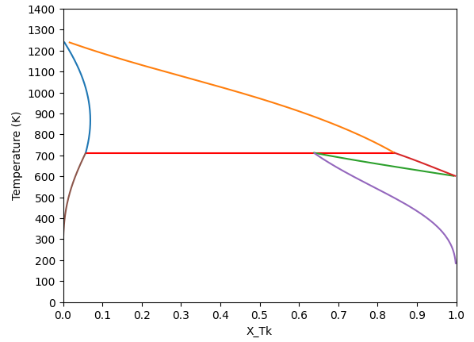
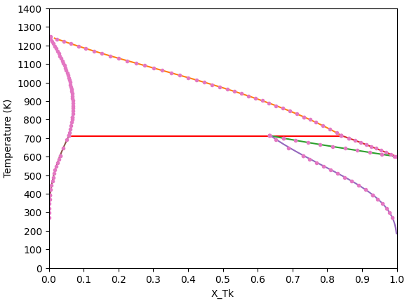
MIDTERM) Calculate the phase diagram of the Ps-Tk Binary System
L
FCC
FCC + L
BCC + L
BCC
FCC + BCC
Plotted With Data
Peritectic Temperature T = 712.42K
T_Peritectic
X^L
X^FCC
X^BCC
CALCULATION
DATA
715.203
0.840
0.058
0.633
RELATIVE ERROR
0.388%
0.238%
0.592%
0.632%

