Slide 1
소재수치해석
신소재공학과 박영훈

Slide 2
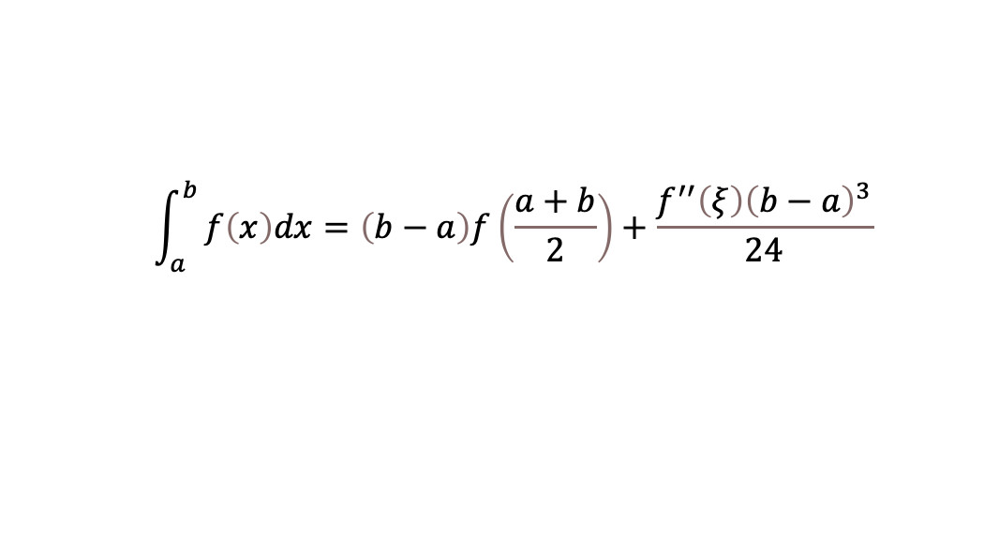
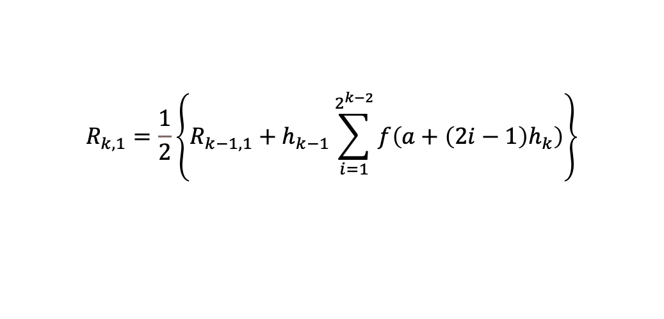
정해진 구간에서 주어진 식을 적분하라
HW6
주어진 식
구간
$$f\left(x\right)=0.2+25x−200x^{2}+675x^{3}−900x^{4}+400x^{5}$$
[0 , 0.8]
선택한 방법
1. Midpoint Rule
$$\int_{a}^{b}{f\left(x\right)dx=\left(b−a\right)f\left(\frac{a+b}{2}\right)+\frac{f^{′′}\left(ξ\right){\left(b−a\right)}^{3}}{24}}$$
2. Romberg Integration
$$R_{k,1}=\frac{1}{2}\left\{R_{k−1,1}+h_{k−1}\sum_{i=1}^{2^{k−2}}{f\left(a+\left(2i−1\right)h_{k}\right)}\right\}$$
$$R_{k,j}=R_{k,j−1}+\frac{R_{k,j−1}−R_{k−1,j−1}}{4^{j−1}−1}$$

Slide 3
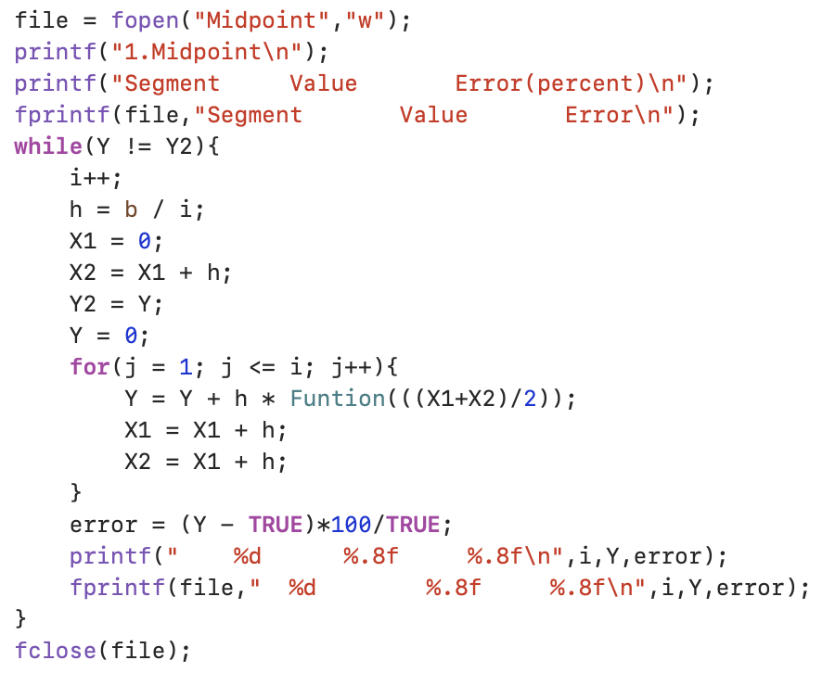
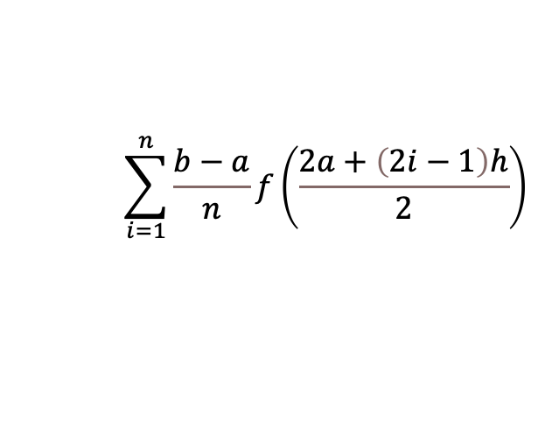
Midpoint Rule
PART1
$$y$$
$$\sum_{i=1}^{n}{\frac{b−a}{n}f\left(\frac{2a+\left(2i−1\right)h}{2}\right)}$$
$$f(x)$$
$$…$$
$$x$$
$$0$$
$$a$$
$$b$$

Slide 4
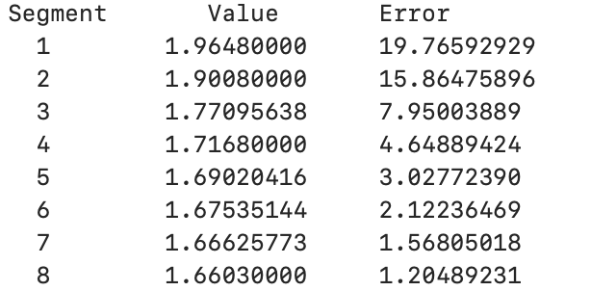
Midpoint Rule
PART1
…
…

Slide 5
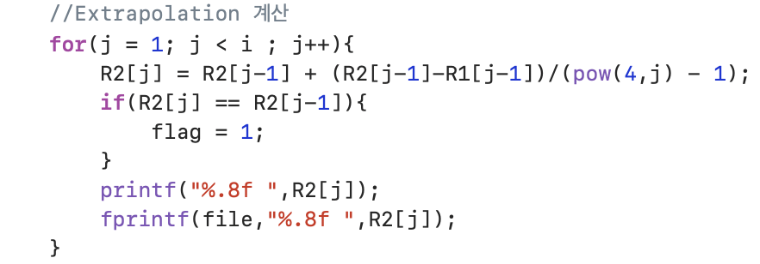
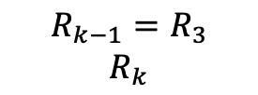
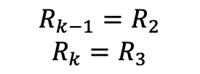
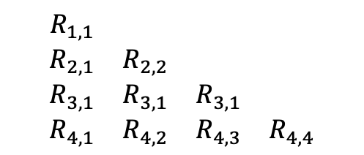
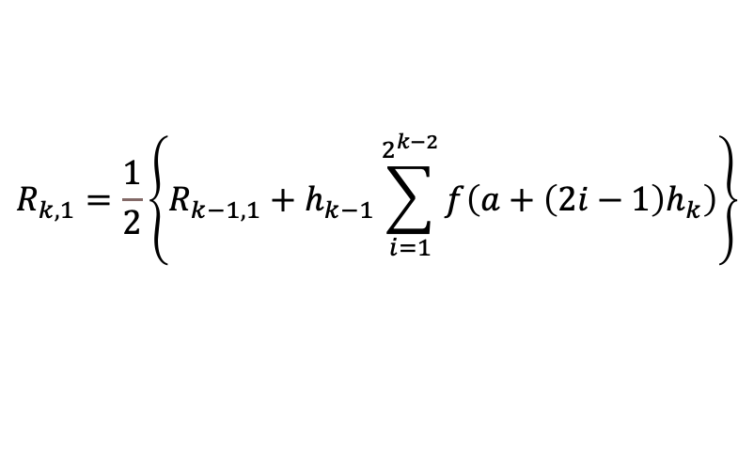
Romberg Integration
PART2
$$\begin{matrix}\begin{matrix}R_{1,1} & \\ R_{2,1} & R_{2,2}\end{matrix} & \begin{matrix} & \\ & \end{matrix} \\ \begin{matrix}R_{3,1} & R_{3,1} \\ R_{4,1} & R_{4,2}\end{matrix} & \begin{matrix}R_{3,1} & \\ R_{4,3} & R_{4,4}\end{matrix}\end{matrix}$$
$$R_{k,j}=R_{k,j−1}+\frac{R_{k,j−1}−R_{k−1,j−1}}{4^{j−1}−1}$$
$$\begin{matrix}R_{k−1}=R_{2} \\ R_{k}=R_{3}\end{matrix}$$
$$\begin{matrix}R_{k−1}=R_{3} \\ R_{k}\end{matrix}$$
$$R_{k,1}=\frac{1}{2}\left\{R_{k−1,1}+h_{k−1}\sum_{i=1}^{2^{k−2}}{f\left(a+\left(2i−1\right)h_{k}\right)}\right\}$$

Slide 6
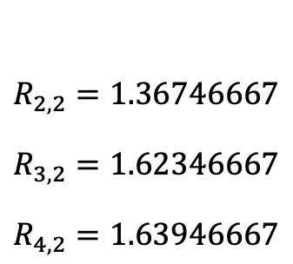
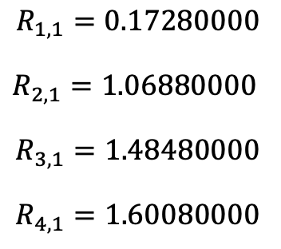


Romberg Integration
PART2
$$\begin{matrix}\begin{matrix}\begin{aligned}R_{1,1}=0.17280000 \\ \end{aligned} \\ \begin{aligned}R_{2,1}=\text{1.06880000 } \\ \end{aligned}\end{matrix} \\ \begin{matrix}\begin{aligned}R_{3,1}=1.48480000 \\ \end{aligned} \\ R_{4,1}=1.60080000\end{matrix}\end{matrix}$$
$$\begin{matrix}\begin{matrix}\begin{aligned} \\ \end{aligned} \\ \begin{aligned}R_{2,2}=1.36746667 \\ \end{aligned}\end{matrix} \\ \begin{matrix}\begin{aligned}R_{3,2}=1.62346667 \\ \end{aligned} \\ R_{4,2}=1.63946667\end{matrix}\end{matrix}$$
$$\begin{matrix}\begin{matrix}\begin{aligned} \\ \end{aligned} \\ \begin{aligned} \\ \end{aligned}\end{matrix} \\ \begin{matrix}\begin{aligned}R_{3,3}=1.64053333 \\ \end{aligned} \\ R_{4,3}=1.64053333\end{matrix}\end{matrix}$$
$$\begin{matrix}\begin{matrix}\begin{aligned} \\ \end{aligned} \\ \begin{aligned} \\ \end{aligned}\end{matrix} \\ \begin{matrix}\begin{aligned} \\ \end{aligned} \\ R_{4,4}=1.64053333\end{matrix}\end{matrix}$$

