Slide 1
소재수치해석 HW5
신소재 20140561 이창호

Slide 2
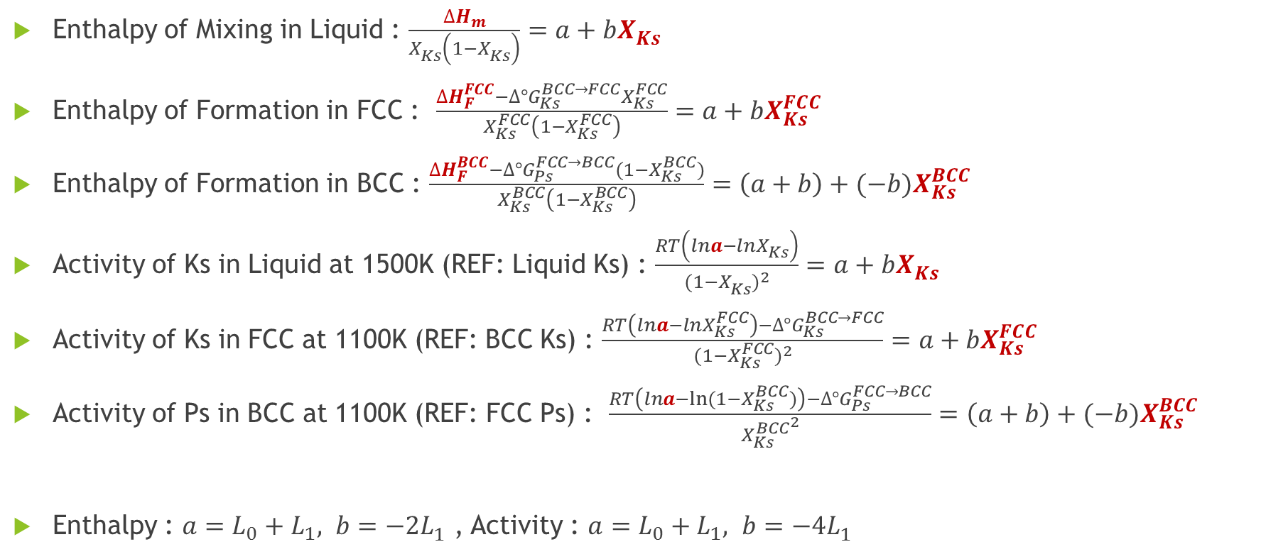
y = a + bx
$∆G^{xs}=X (1−X) (L_{0}+(1−2X)L_{1})$ $=X(1−X) (a+bX)$
Enthalpy of Mixing in Liquid : $\frac{∆H_{m}}{X_{Ks}^{}\left(1−X_{Ks}^{}\right)}=a+bX_{Ks}^{}$
Enthalpy of Formation in FCC : $\frac{∆H_{F}^{FCC}−∆{°G}_{Ks}^{BCC→FCC}X_{Ks}^{FCC}}{X_{Ks}^{FCC}\left(1−X_{Ks}^{FCC}\right)}=a+bX_{Ks}^{FCC}$
Enthalpy of Formation in BCC : $\frac{∆H_{F}^{BCC}−∆{°G}_{Ps}^{FCC→BCC}{(1−X}_{Ks}^{BCC})}{X_{Ks}^{BCC}\left(1−X_{Ks}^{BCC}\right)}=\left(a+b\right)+(−b)X_{Ks}^{BCC}$
Activity of Ks in Liquid at 1500K (REF: Liquid Ks) : $\frac{RT\left(lna−lnX_{Ks}^{}\right)}{(1−{X_{Ks}^{})}^{2}}=a+bX_{Ks}^{}$
Activity of Ks in FCC at 1100K (REF: BCC Ks) : $\frac{RT\left(lna−lnX_{Ks}^{FCC}\right)−∆{°G}_{Ks}^{BCC→FCC}}{(1−{X_{Ks}^{FCC})}^{2}}=a+bX_{Ks}^{FCC}$
Activity of Ps in BCC at 1100K (REF: FCC Ps) : $\frac{RT\left(lna−ln⁡(1−X_{Ks}^{BCC})\right)−∆{°G}_{Ps}^{FCC→BCC}}{{X_{Ks}^{BCC}}^{2}}=\left(a+b\right)+(−b)X_{Ks}^{BCC}$
Enthalpy : $a=L_{0}+L_{1}, b=−2L_{1}^{ }$ , Activity : $a=L_{0}+L_{1}, b=−4L_{1}^{ }$

Slide 3
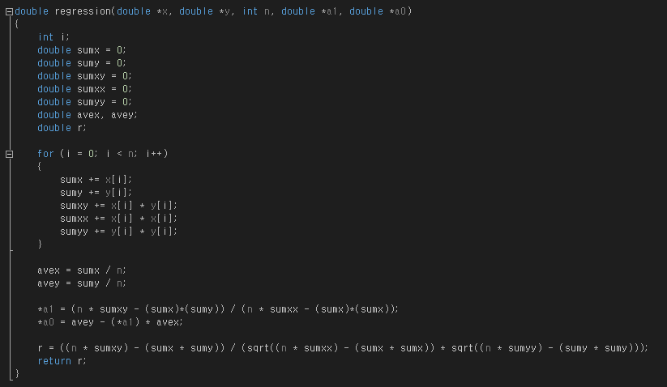
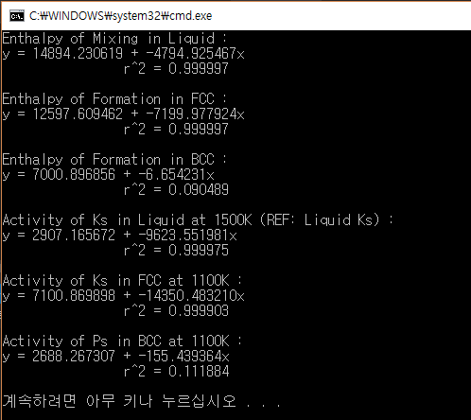

Slide 4
6995.6566
2599.8395

Slide 5

Data
Enthalpy : $a=L_{0}+L_{1}, b=−2L_{1}^{ }$ >> $L_{0}=a+\frac{1}{2}b,L_{1}=−\frac{1}{2}b$
Activity : $a=L_{0}+L_{1}, b=−4L_{1}^{ }$ >> $L_{0}=a+\frac{1}{4}b,L_{1}=−\frac{1}{4}b$
 | Liquid |  | FCC |  | BCC
 | Enthalpy | Activity | Enthalpy | Activity | Enthalpy | Activity
$$a$$ | 14894.2306 | 2907.1657 | 12597.6095 | 7100.8699 | 7000.8969 | 2688.2673
$$b$$ | -4794.9255 | -9623.5520 | -7199.9779 | -14350.4832 | -6.6542 | -155.4394
$$r^{2}$$ | 0.999997 | 0.999975 | 0.999997 | 0.999903 | 0.090489 | 0.111884
$$L_{1}$$ | 2397.4628 | 2405.8880 | 3599.9890 | 3587.6208 | 6995.6566 | 2599.8395
$$L_{0}$$ | 12496.7678 | 501.2777 | 8997.6205 | 6743.2491

Slide 6
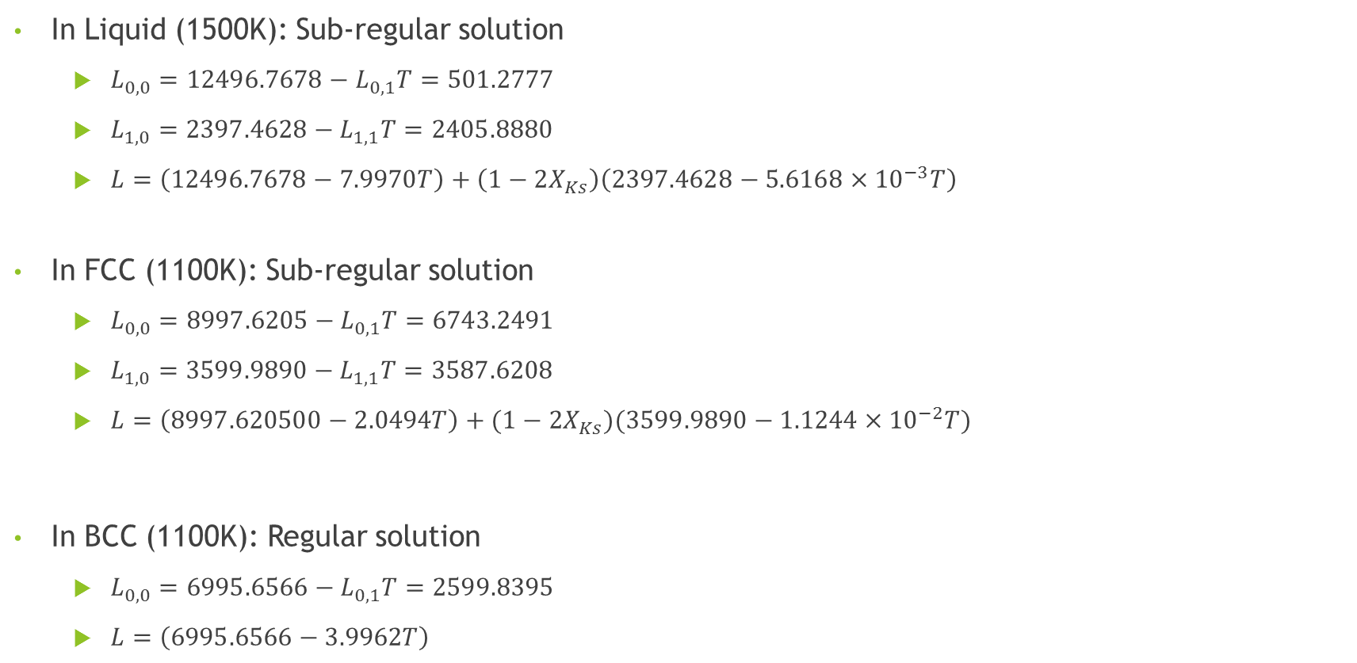
Analysis
In Liquid (1500K): Sub-regular solution
$L_{0,0}=12496.7678−L_{0,1}T=501.2777$
$L_{1,0}=2397.4628−L_{1,1}T=2405.8880$
$L=\left(12496.7678−7.9970T\right)+\left(1−2X_{Ks}\right)\left(2397.4628−5.6168×{10}^{−3}T\right)$
In FCC (1100K): Sub-regular solution
$L_{0,0}=8997.6205−L_{0,1}T=6743.2491$
$L_{1,0}=3599.9890−L_{1,1}T=3587.6208$
$L=\left(8997.620500−2.0494T\right)+(1−2X_{Ks})(3599.9890−1.1244×{10}^{−2}T)$
In BCC (1100K): Regular solution
$L_{0,0}=6995.6566−L_{0,1}T=2599.8395$
$L=\left(6995.6566−3.9962T\right)$

