Slide 1
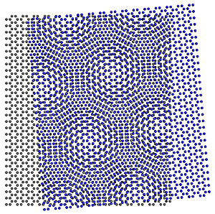
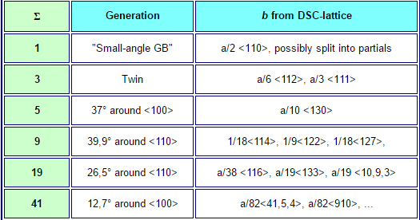
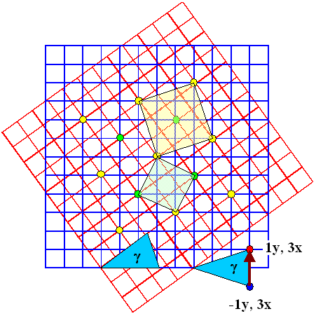
1. Coincidence Site Lattice
Mse 20110079 Hyeon-ryeol Cho
Coincidence Site Lattice(C.S.L) (fig 1)
For certain angles θ some lattice points of lattice 1 coincide exactly with some
Lattice points of lattice 2. A kind of superstructure, a coincidence site lattice (CSL) develops.
Notation : ∑(called Sigma)N means the relation between the number of lattice points in the unit cell of CSL and the number of lattice points in a unit cell of the generation lattice ;
It is the unit cell volume of the CSL in units of the unit cell volume of the elementary cells of crystal.
∑1 boundary : denote a perfect(or nearly perfect) crystal; i.e. there is no boundary at all.
∑1 boundary include low angle boundary.
∑(N=2n) boundary : There is no ∑ even boundary by result of O-lattice theory.(fig 3)
if N=2n, there is always an additional coincidence point in the center of lattice
θ
lattice 1
lattice 2

Slide 2
General multicomponent segregation equation
(1)식 $\frac{X_{i}^{φ}}{X_{n}^{φ}}=\frac{X_{i}^{B}}{X_{n}^{B}}e^{−∆G_{i}^{seg}/RT}$ 을 n-1개 원소에 대해 모두 합해보면
$\sum_{i=1}^{n−1}{\frac{X_{i}^{φ}}{X_{n}^{φ}}}=\sum_{i=1}^{n−1}{\frac{X_{i}^{B}}{X_{n}^{B}}e^{−∆G_{i}^{seg}/RT}}$=$\frac{1−X_{n}^{φ}}{X_{n}^{φ}}$ 이를 $X_{n}^{φ}$에 대해 정리해보면
$X_{n}^{φ}$=$\frac{1}{1+\sum_{1}^{n−1}{\frac{X_{i}^{B}}{X_{n}^{B}}e^{−∆G_{i}^{seg}/RT}}}$ (2)식이 얻어짐.
(1)식을 $X_{i}^{φ}에$ 대해 풀어보면
=>$X_{i}^{φ}$=$\frac{{X_{n}^{φ}X}_{i}^{B}}{X_{n}^{B}}e^{−∆G_{i}^{seg}/RT}$ (1)’여기에 (2)를 대입하면
$X_{i}^{φ}$=$\frac{X_{i}^{B}e^{−∆G_{i}^{seg}/RT}}{X_{n}^{B}+\sum_{1}^{n−1}{X_{i}^{B}e^{−∆G_{i}^{seg}/RT}}}$ (2)’이 얻어짐.
여기에 hint식$\sum_{i=1}^{n−1}{x_{i}^{φ}x_{n}^{B}}=\sum_{j=1}^{n−1}{x_{j}^{B}x_{n}^{φ}e^{{ΔG}_{j}^{seg}/RT}}$을 $X_{n}^{B}에 관$해 정리하여 대입하면
$X_{i}^{φ}$=$\frac{X_{i}^{B}e^{−∆G_{i}^{seg}/RT}}{1+\sum_{1}^{n−1}{X_{i}^{B}{(e}^{−∆G_{i}^{seg}/RT}−1)}}$ 이 구해진다. 끝.

Slide 3
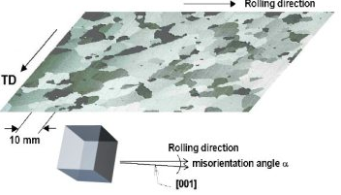
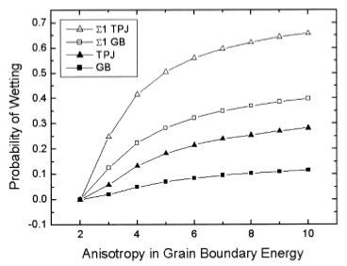
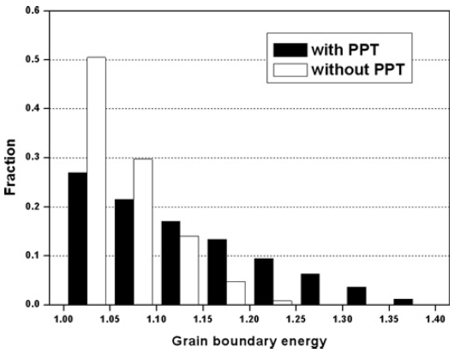
Abnormal Grain Growth Article Summary
Abnormal Grain Growth
-Abnormal grain growth (AGG) is also called the secondary recrystallization, often takes place after primary recrystallization of deformed polycrystalline materials (ex, Fe-3wt% Si steel)
Main reason of Abnormal grain growth
- Solid state wetting in triple junction due to isotropy of GB energy and GB mobility
- Grain growth inhibitor(precipitation) (ex, AIN, MnS)
inhibitor -> grain boundary ↑normal grain growth↓->solid state wetting ↑

