Slide 1
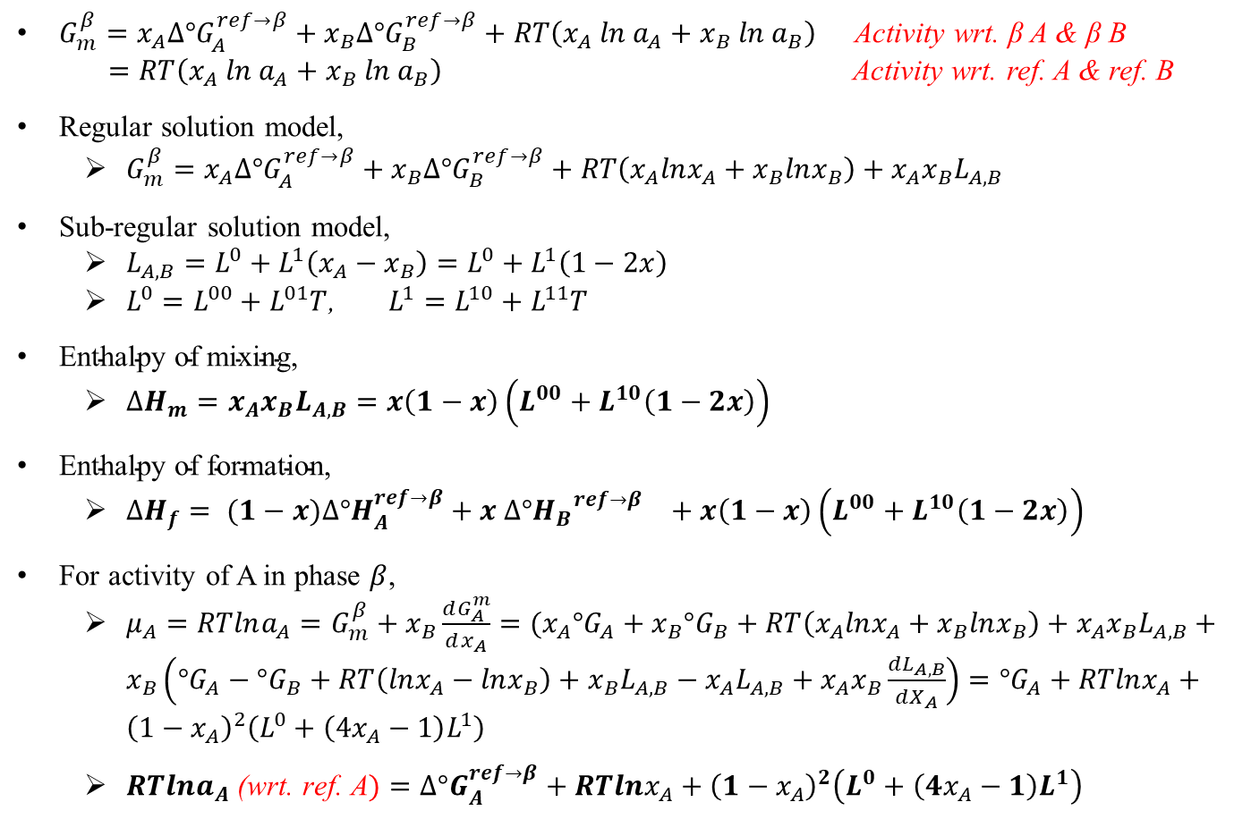
$G_{m}^{β}=x_{A}∆°G_{A}^{ref→β}+x_{B}{∆°G}_{B}^{ref→β}+RT\left(x_{A} ln{ a}_{A}+x_{B} ln{ a}_{B}\right)$ Activity wrt. β A & β B
$=RT\left(x_{A} ln{ a}_{A}+x_{B} ln{ a}_{B}\right)$ Activity wrt. ref. A & ref. B
Regular solution model,
$G_{m}^{β}=x_{A}∆°G_{A}^{ref→β}+x_{B}{∆°G}_{B}^{ref→β}+RT\left(x_{A}lnx_{A}+x_{B}lnx_{B}\right)+x_{A}x_{B}L_{A,B}$
Sub-regular solution model,
$L_{A,B}=L^{0}+L^{1}\left(x_{A}−x_{B}\right)=L^{0}+L^{1}\left(1−2x\right)$
$L^{0}=L^{00}+L^{01}T$, $L^{1}=L^{10}+L^{11}T$
$\text{Enthalpy} \text{of} \text{mixing}\text{,}$
$∆H_{m}=x_{A}x_{B}L_{A,B}=x\left(1−x\right)\left(L^{00}+L^{10}\left(1−2x\right)\right)$
$\text{E}\text{nthalpy} \text{of} \text{formation}\text{,}$
$∆H_{f}= (1−x)∆°H_{A}^{ref→β}+{x ∆°{H_{B}}^{ref→β}}_{}+x\left(1−x\right)\left(L^{00}+L^{10}\left(1−2x\right)\right)$
For activity of A in phase $β$,
$μ_{A}=RTlna_{A}=G_{m}^{β}+x_{B}\frac{dG_{A}^{m}}{dx_{A}}=(x_{A}{°G}_{A}+x_{B}°G_{B}+RT\left(x_{A}lnx_{A}+x_{B}lnx_{B}\right)+x_{A}x_{B}L_{A,B}+x_{B}\left({°G}_{A}−°G_{B}+RT\left(lnx_{A}−lnx_{B}\right)+x_{B}L_{A,B}−x_{A}L_{A,B}+x_{A}x_{B}\frac{dL_{A,B}}{dX_{A}}\right)=°G_{A}+RTlnx_{A}+{\left(1−x_{A}\right)}^{2}\left(L^{0}+\left(4x_{A}−1\right)L^{1}\right)$
$RTlna_{A}\text{ (}\text{wrt}\text{. }\text{ref}\text{. }\text{A})=∆°G_{A}^{ref→β}+RTlnx_{A}+{\left(1−x_{A}\right)}^{2}\left(L^{0}+\left(4x_{A}−1\right)L^{1}\right)$

