Slide 1
Numerical Analysis for Materials (AMSE318-01)
HOmework #7
Doan Minh Quan - 49004023

Slide 2
Given: $y′={4e}^{0.8x}−0.5y, y\left(0\right)=2$. Calculate $y(4)$ using 3 different methods
General Solver
Define function, initial values to solve
function solve(f::Function, method::Function, x0, y0, xn, n)
h = (xn - x0) / n
x = zeros(n + 1)
y = zeros(n + 1)
x[1] = x0
y[1] = y0
for i in 1:n
x[i+1], y[i+1] = method(f, x[i], y[i], h)
end
return x, y
end
f(x, y) = 4 * exp(0.8x) - 0.5y
y_true(x) = 40/13 * exp(0.8x) - 14/13 * exp(-0.5x)
n = 4
x0 = 0; y0 = 2
xn = 4
x1, y1 = solve(f, Euler, x0, y0, xn, n)
x2, y2 = solve(f, Heun, x0, y0, xn, n)
x3, y3 = solve(f, RK2, x0, y0, xn, n)
x4, y4 = solve(f, RK3, x0, y0, xn, n)
x5, y5 = solve(f, RK4, x0, y0, xn, n)
$$\frac{dy}{dx}=f(x, y)$$
$$x_{i+1}, {y_{i+1}←x}_{i}, y_{i}$$
function Heun(f::Function, x1, y1, h)
x2 = x1 + h
_y2 = y1 + f(x1, y1) * h
y2 = y1 + (f(x1, y1) + f(x2, _y2)) / 2 * h
return x2, y2
end
function Euler(f::Function, x1, y1, h)
x2 = x1 + h
y2 = y1 + f(x1, y1) * h
return x2, y2
end
$$y_{i+1}=y_{i}+f\left(x_{i}, y_{i}\right)+h$$
$$y_{i+1}=y_{i}+\frac{f\left(x_{i}, y_{i}\right)+f(x_{i+1},{ y}_{i+1}^{o})}{2}h$$
$$y_{i+1}^{o}=y_{i}+f\left(x_{i}, y_{i}\right)+h,$$

Slide 3
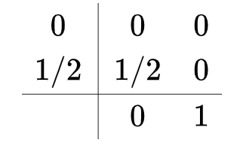
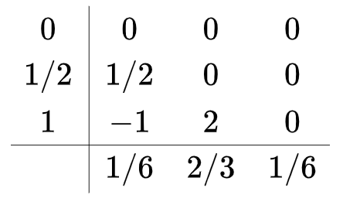
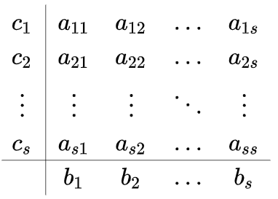
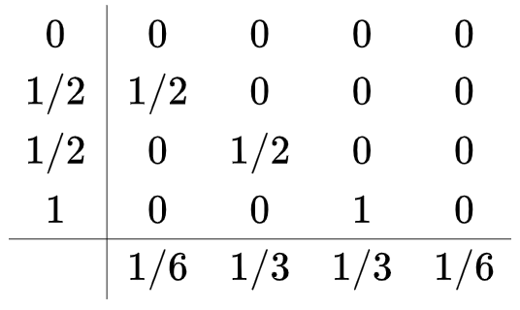
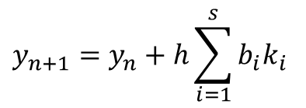
Runge–Kutta methods
function RK(f::Function, x1, y1, h, a, b, c)
k = zeros(s)
for i in 1:s
yi = 0
for j in 1:(i-1)
yi += h * a[i, j] * k[j]
end
k[i] = f(x1 + c[i] * h, y1 + yi)
end
x2 = x1 + h
y2 = y1 + h * (b’k)
return x2, y2
end
function RK2(f::Function, x1, y1, h)
a = [[0 0]; [1 / 2 0]]
b = [0, 1]
c = [0, 1 / 2]
return RK(f, x1, y1, h, a, b, c)
end
function RK3(f::Function, x1, y1, h)
a = [[0 0 0]; [1 / 2 0 0]; [-1 2 0]]
b = [1 / 6, 2 / 3, 1 / 6]
c = [0, 1 / 2, 1]
return RK(f, x1, y1, h, a, b, c)
end
function RK4(f::Function, x1, y1, h)
a = [[0 0 0 0]
[1/2 0 0 0]
[0 1/2 0 0]
[0 0 1 0]]
b = [1/6, 1/3, 1/3, 1/6]
c = [0, 1/2, 1/2, 1]
return RK(f, x1, y1, h, a, b, c)
end
$$y_{n+1}=y_{n}+h\sum_{i=1}^{s}{{b_{i}k}_{i}}$$
$$k_{i}=f\left(x_{n}+c_{i}h, y_{n}+{h\sum_{j=1}^{i−1}{a_{ij}}k}_{j}\right)$$

Slide 4
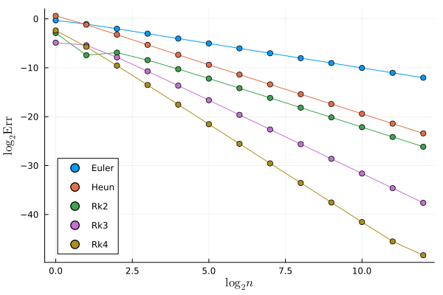
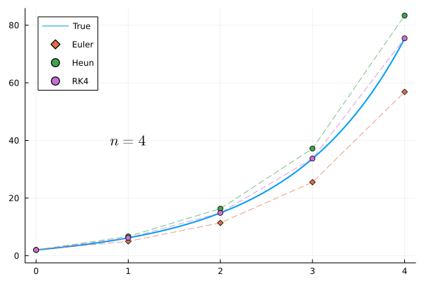
Results
y_TRUE = [6.194631, 14.843922, 33.677172, 75.338963]
y_Euler = [2.0, 5.0, 11.402164, 25.513212, 56.849311]
err_Euler = [0.0, 0.015857, 0.045684, 0.108363, 0.24542]
y_Heun = [2.0, 6.701082, 16.319782, 37.199249, 83.337767]
err_Heun = [0.0, 0.006722, 0.01959, 0.04675, 0.106171]
y_RK4 = [2.0, 6.201037, 14.862484, 33.721348, 75.439172]
err_RK4 = [0.0, 8.5e-5, 0.000246, 0.000586, 0.00133]
Errors (relative)
$$O(h)$$
$$O(h^{2})$$
$$O(h^{3})$$
$$O(h^{4})$$

