Slide 1
과제 7 : 상미분 방정식
Kyungmi Noh (*Email :{nkyungmi}@postech.ac.kr)
Department of Materials Science and Engineering, POSTECH
AI & NEUROMORPHIC DEVICE LAB

Slide 2
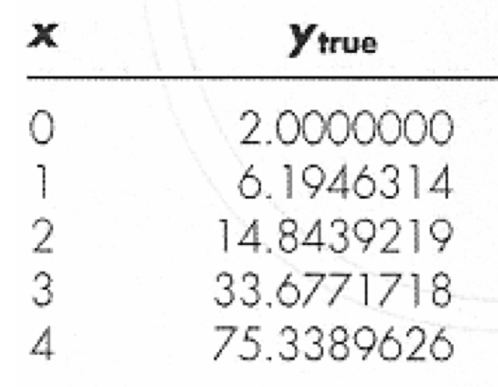
0. Problem
AI & NEUROMORPHIC DEVICE LAB

Slide 3
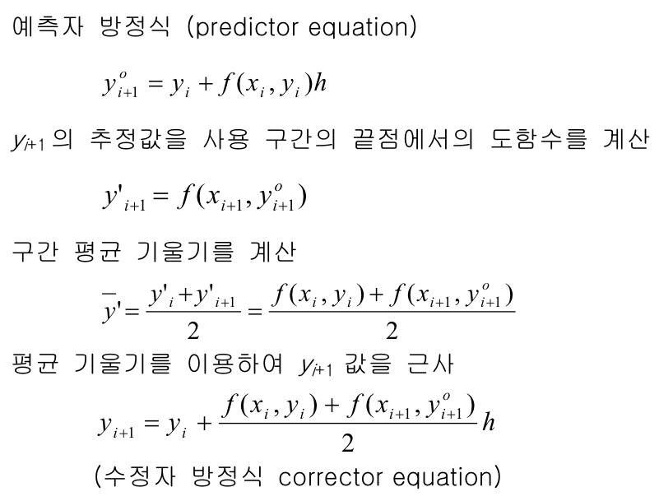
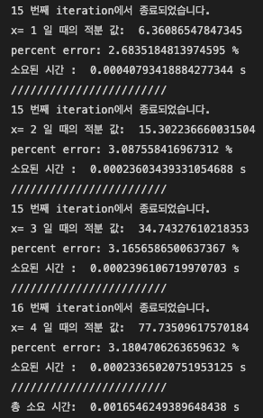
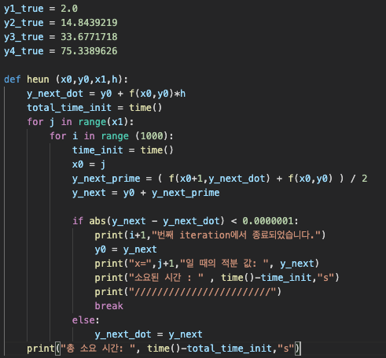
1. Heun Method
Threshold = 1e-7
Percent error when x = 4 = 3.18%
Total iteration taken = 61
Total time taken = 1.6ms
AI & NEUROMORPHIC DEVICE LAB

Slide 4
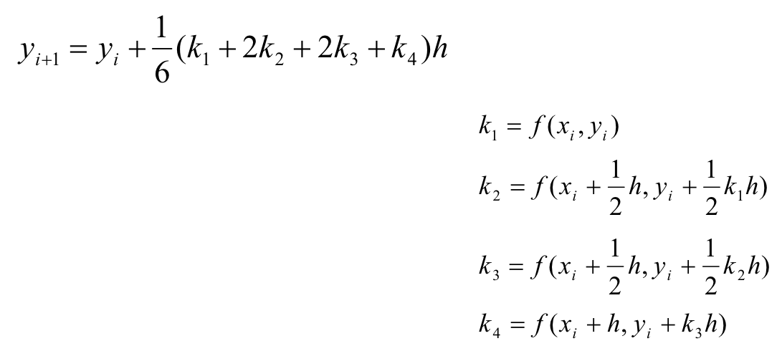
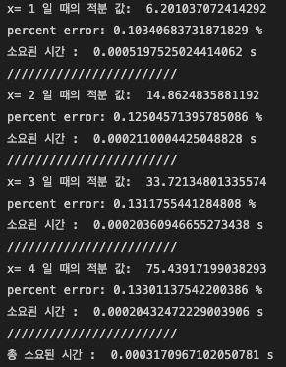
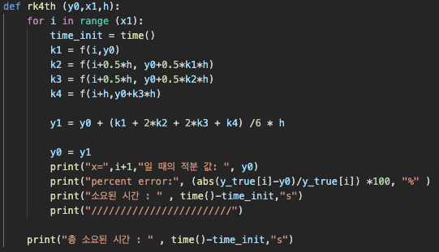
2. 4차 Runge-Kutta Method
Percent error when x = 4 = 0.13%
Total iteration taken = 4
Total time taken = 0.32ms
AI & NEUROMORPHIC DEVICE LAB

Slide 5
2. 4차 Runge-Kutta Method
Heun Method 대비
Percent error 3% 감소 (24배 감소)
Iteration 57회 감소 (15배 감소)
Total time 1.28ms 감소 (5배 감소)
Percent error when x = 4 = 0.13%
Total iteration taken = 4
Total time taken = 0.32ms
AI & NEUROMORPHIC DEVICE LAB

Slide 6
Thank you!
AI & NEUROMORPHIC DEVICE LAB

