Slide 1
Numerical Integration
Midpoint, Trapezoidal, Simpson, Romberg
Seungpyo Hong
Flow Physics and Engineering Lab.
Department of Mechanical Engineering
POSTECH

Slide 2
Problem
1. Integrate following function numerically by using Mid point, Trapezoidal, Simpson rule.
2. Integrate following function numerically by using Romberg integration.
Integration section :

Slide 3
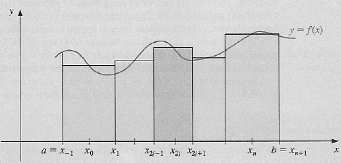
Mid point rule
n must be even
h = (b-a)/(n+2)
x_{j} = a + (j+1)*h j = -1, 0, . . . , n+1

Slide 4
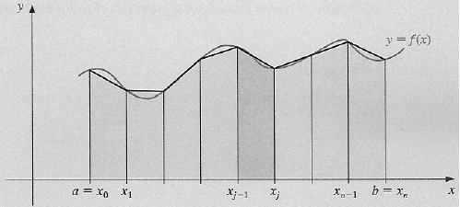
Trapezoidal rule
h = (b-a)/n
x_{j} = a + j*h j = 0, . . . , n

Slide 5
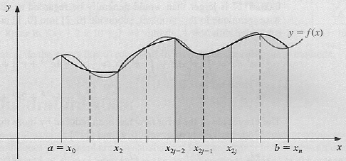
Simpson’s rule
n must be even
h = (b-a)/n
x_{j} = a + j*h j = 0, . . . , n

Slide 6
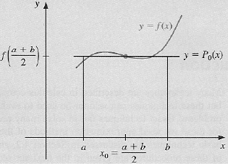
Order of Accuracy
Locally 3
Intermediate Value Theorem
Globally 2

Slide 7
Order of Accuracy
Locally 5
Globally 4
Locally 3
Globally 2

Slide 8
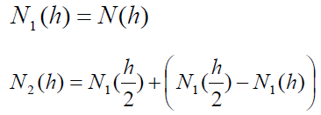
Romberg Integration
Numerical Integration(Mid or Trap or Simp)
+ Richardson Extrapolation
Increasing oreder of accuracy

Slide 9
Romberg Integration
Numerical Integration(Mid or Trap or Simp)
+ Richardson Extrapolation
Numerical Integration
Richardson
Extrapolation
Romberg
Integration
+
=

Slide 10
Structure of the program
PROGRAM Compquad
1. Mid
2. Trap
3. Simp
4. Romb
1 or 2 or 3 (Numerical Intgration)
END PROGRAM Compquad
Select the method (1: Mid 2: Trap 3: Simp 4: Romb)
Assign section of intg and the number of step
Write results

Slide 11
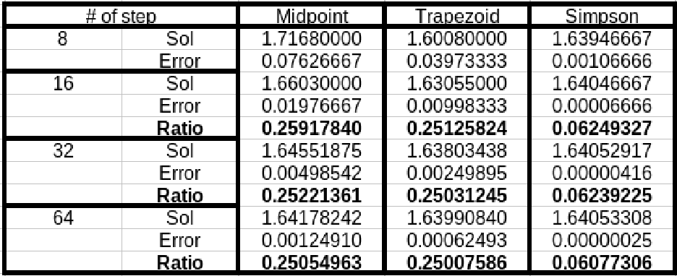
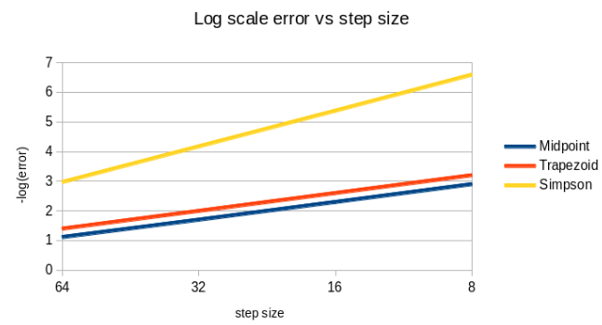
Results

Slide 12
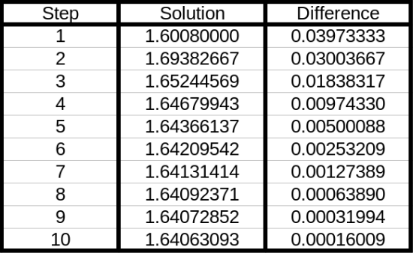
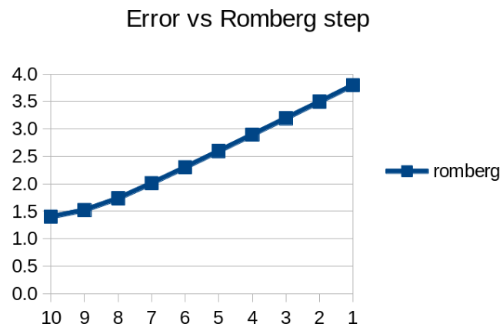
Results
Not zero
Modifying coefficients

