Slide 1
Final Term Report
20071050
오승재

Slide 2
Contents
지정 주제
Computer Simulation of Darken’s Uphill Diffusion
자유 주제
Diffusion couple
(Sudoku)

Slide 3
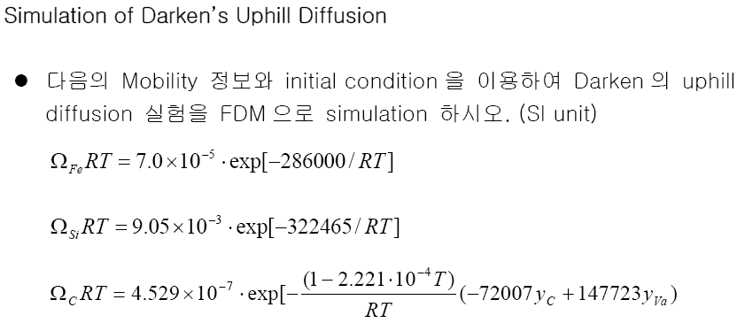
Problem
Si : 3.8wt%
C : 0.478wt%
Si : 0.005wt%
C : 0.441wt%
열처리 온도 : 1323K
열처리 시간 : 13days
50mm
50mm

Slide 4
Thermodynamics
다원 합금계에서 Diffusion Coefficient 는 (n-1) 차원의 행렬 형태가 되며, Fe-M-C 3 원계에서 용질 C 와 M 의 확산 유속은 다음과 같이 표현된다.
Fcc Fe-M-C 침입형 고용상은 (Fe,M)₁(Va,C)₁ 의 formula unit 을 이용하여 1 mol of formula unit 당 Gibbs free energy 를 다음과 같이 표현한다.

Slide 5
Thermodynamics
Gibbs Energy 식으로부터 각 원소의 Chemical Potential 을 얻는 공식은 다음과 같다.
For substitutional M,
For interstitial C,

Slide 6
Finite Differential Method
Diffusion equation

Slide 7
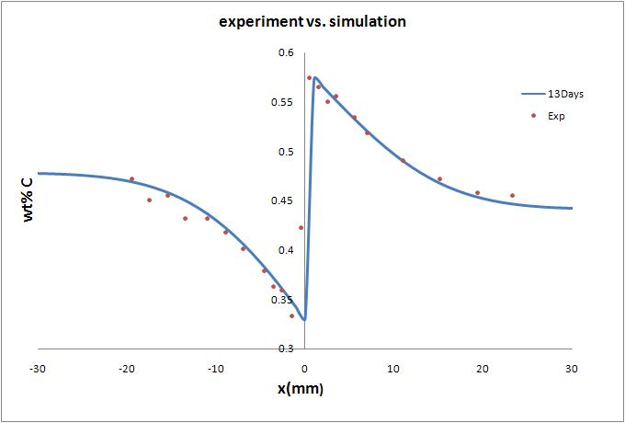
Result

Slide 8
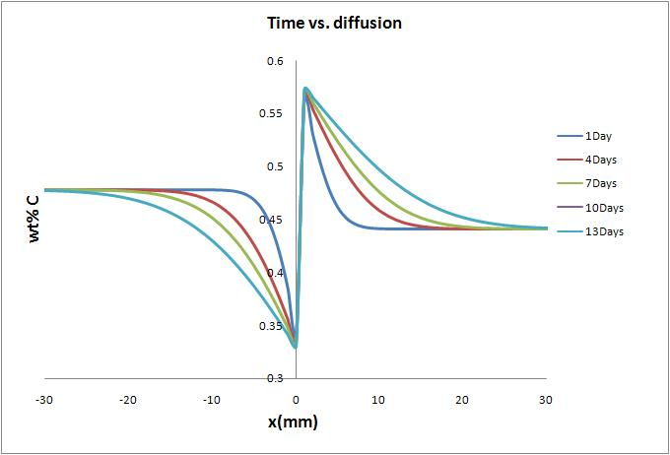
Result

Slide 9
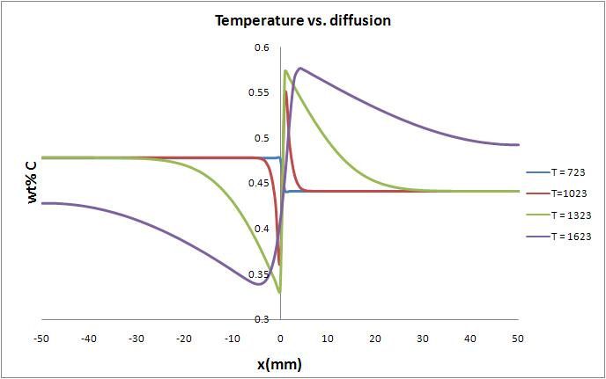
Result

Slide 10
Free Topic
Diffusion couple
Calculate concentration profile by solving 2nd differential equation
(ref. Young-won Chang, phase transformations in metals and alloys강의 자료, chap 2.)

Slide 11
Solutions of diffusion equation
c
ex) H₂ gas tank
c_{o}
(1) Steady state solution
c(x)=A₁ x+A₂
D: const
0
x
(2) Non-steady state solution
δ
- bounded solution in an infinite medium:
with the initial condition; c(x,0) = g(x)
- Use the Fourier transformation method
Fourier transformation
of Fick’s 2nd law
AMSE 312 Diffusion & Phase transitions

Slide 12
- Partial integration of the right hand side term twice yields transformed diffusion eq.
c(x’,0)
- Inverse transformation
I (x’)
η²/Dt
1.0
0
η
Gaussian error fcn
- bounded solution in an infinite medium
AMSE 312 Diffusion & Phase transitions

Slide 13
Diffusion couple
c_{s}
c_{o}
c
t=0
c_{s}
c_{o}
t=t₁
o
x
erf(z)
+1
0.5
-0.5
0.5
z
-0.5
erf(0)=0, erf(0.5)=0.5,
erf( )=1.0, erf(-z)= - erf(z)
-1
AMSE 312 Diffusion & Phase transitions

Slide 14
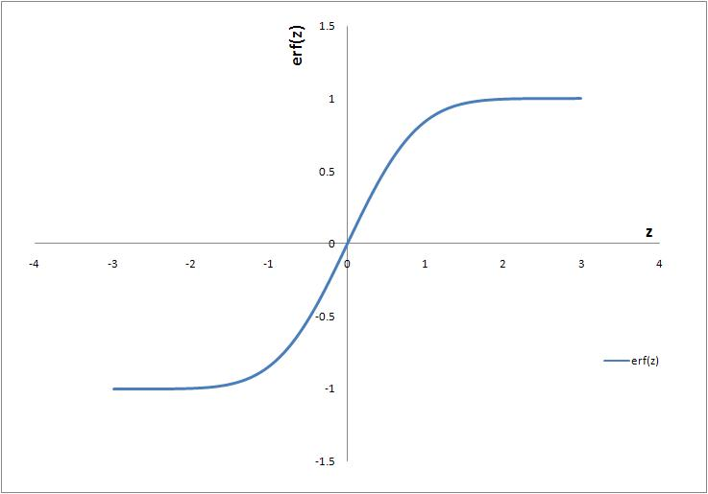
Diffusion couple
Error function
Integrated by RK4 method

Slide 15
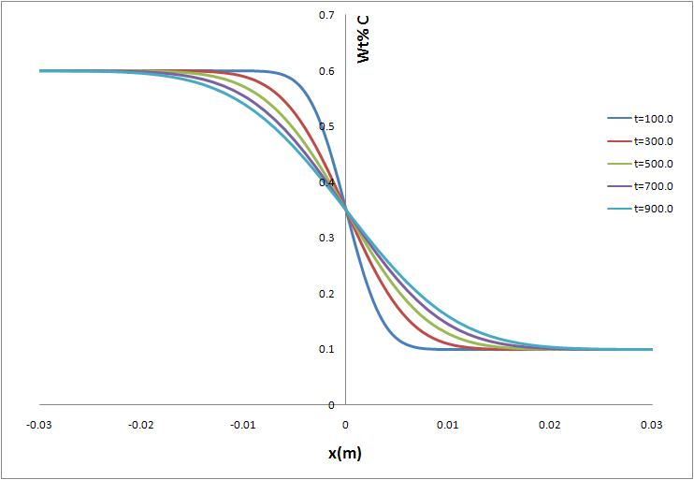
Diffusion couple
Initial condition
Left side : 0.6wt% C
Right side : 0.1wt% C
D = 4x10⁻⁸m²/s
(Random value)

Slide 16
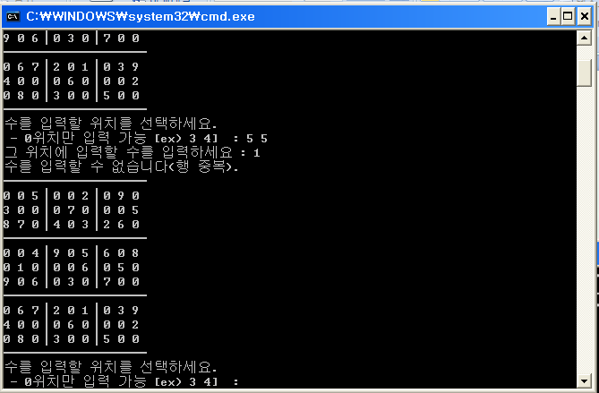
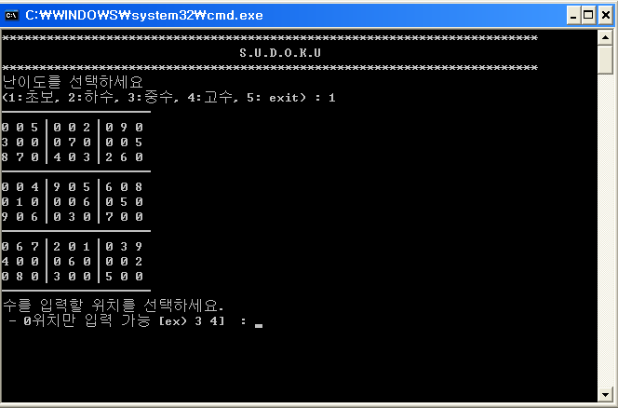
번외 - Sudoku

Slide 17
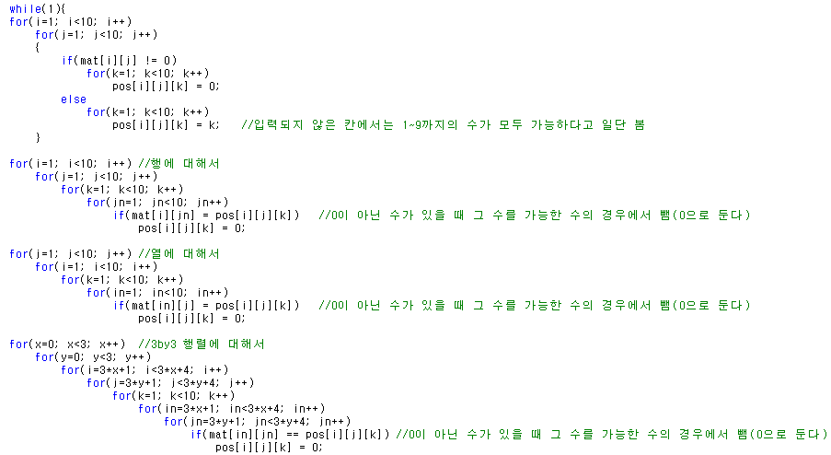
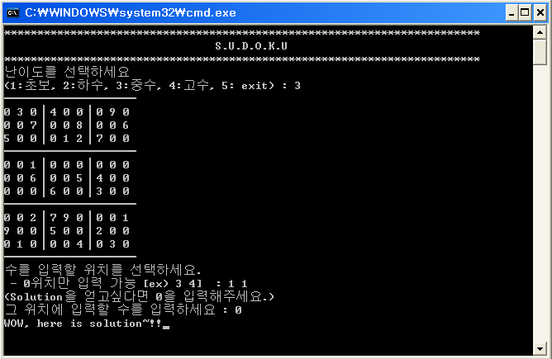
번외 - Sudoku
Code to find solution….
But…. Failed
.
.
.
.
.
.

