Slide 1
AMSE318 HW4 with python
49004547 Seokjee SHIN

Slide 2
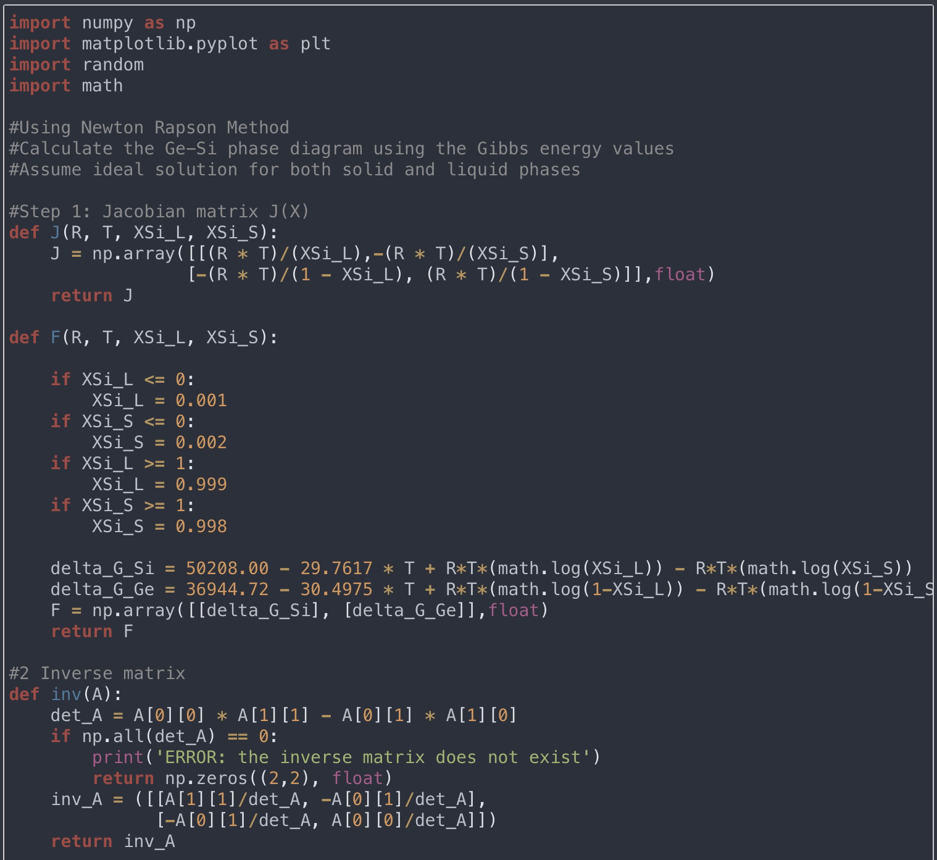
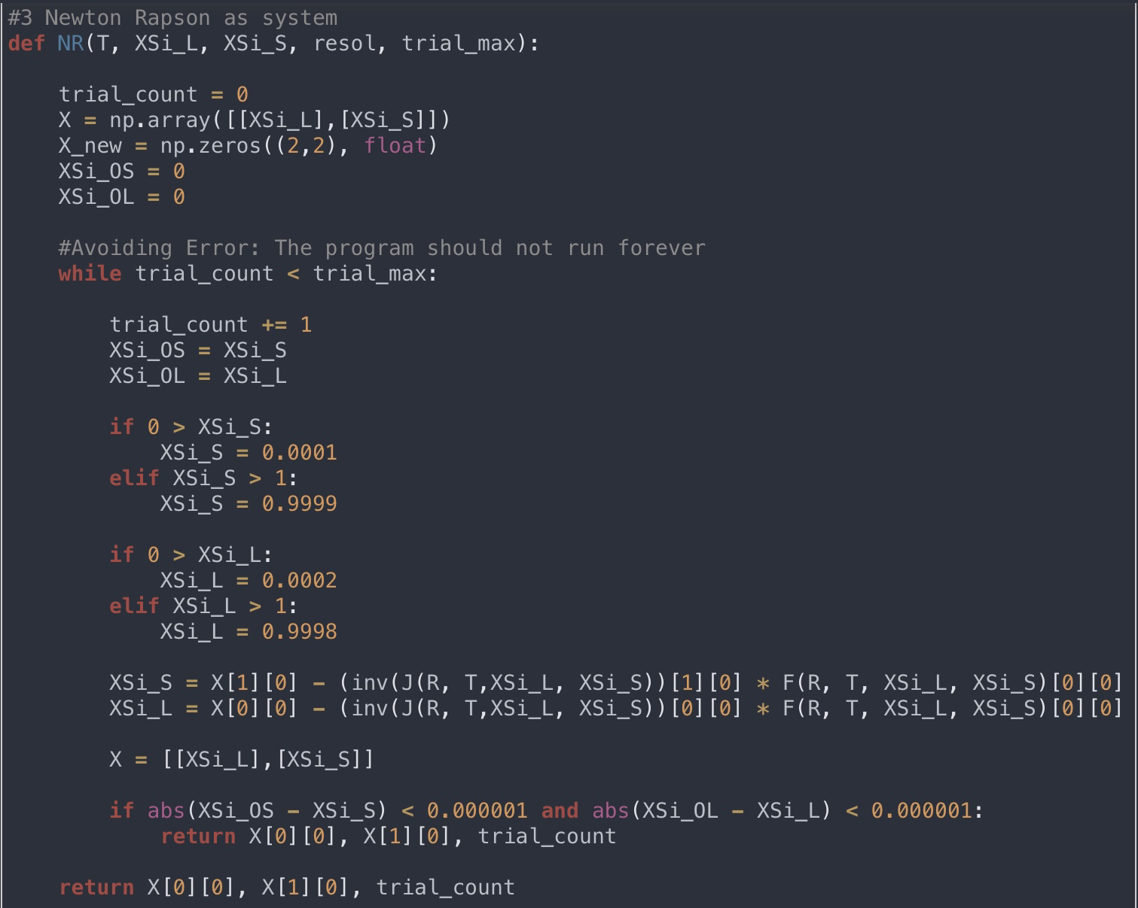
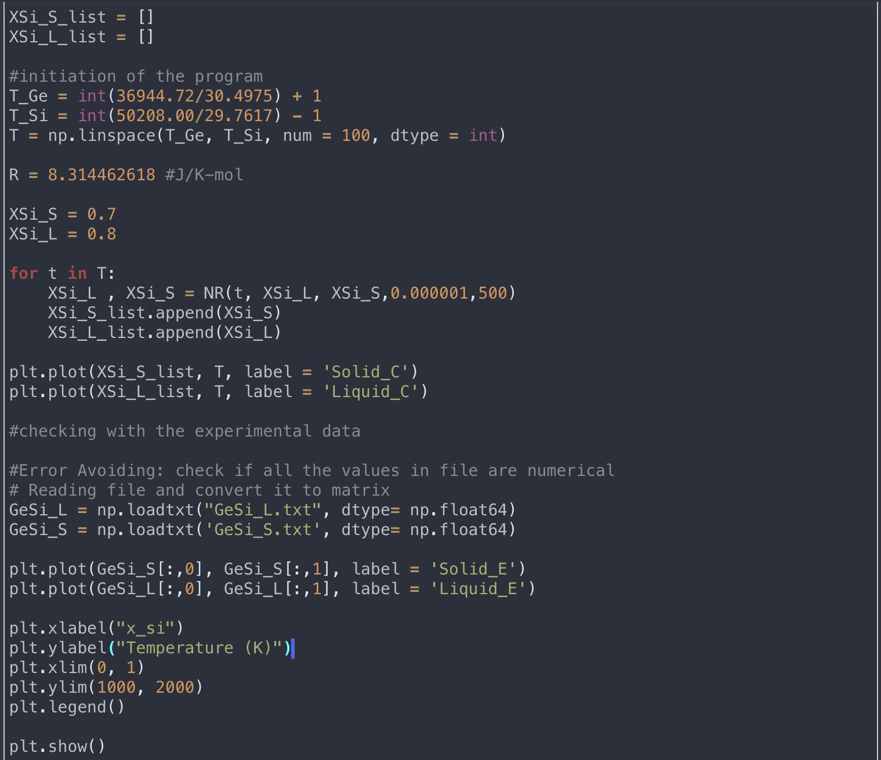
The logic Step 1: Formation of J(X) Step 2: Inverse matrix Step 3: Newton Raphson

Slide 3
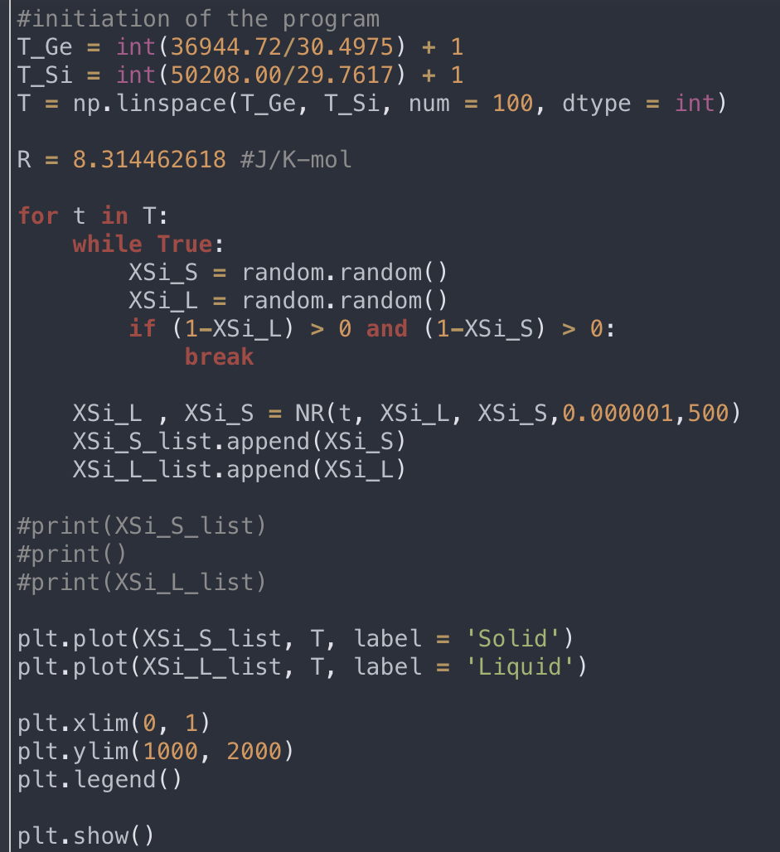
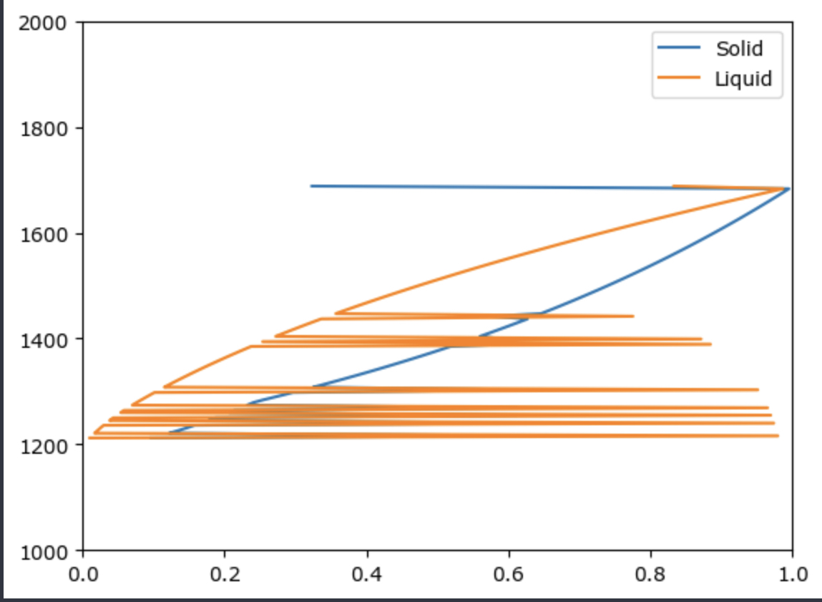
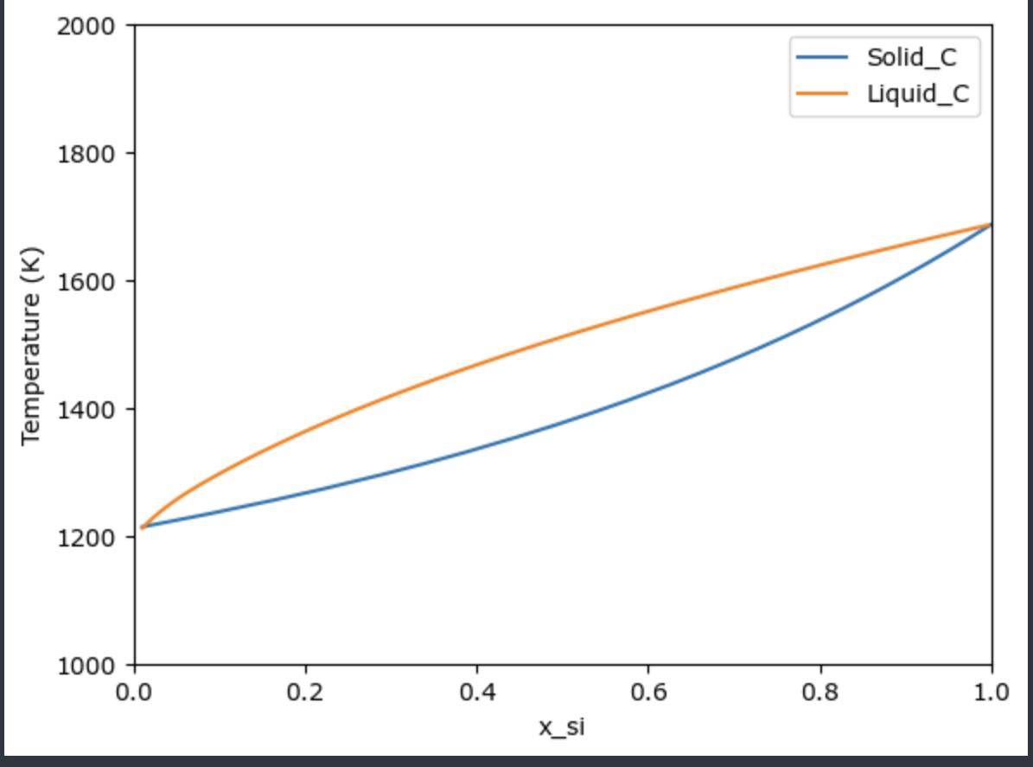
Fixing the error
Last week, used random number without saving previous iteration -> cannot control the values and had spikes with numerical error
To fix the error, gave the initial values for XSi_S and Xsi_L then in the loop, added a code to save and use the previous iteration. Still, the error is not fully fixed

Slide 4
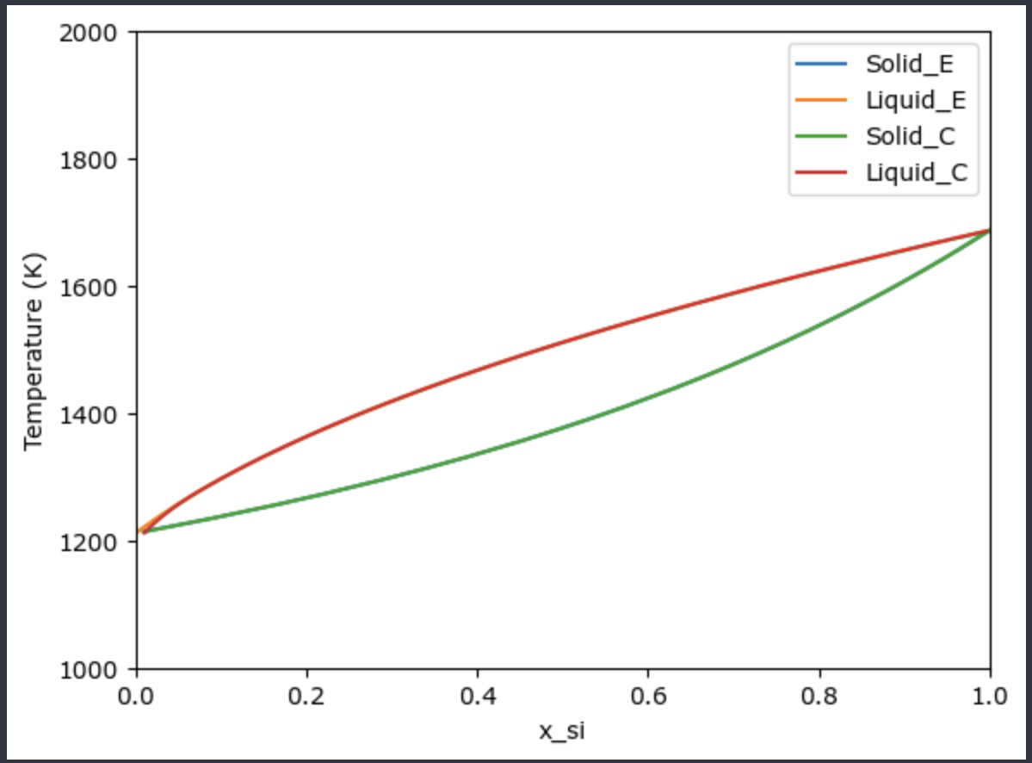
Conclusion of HW4
After a few trial an error, was able to plot the phase diagram of GeSI and compare the calculation values with given experimental values by plotting them together
However, the code is not currently perfect.
Method of comparison:Sub the array of experimental temperature into the program and compare the outcome with experimental result -> did not work!

