Slide 1
소재수치해석 Mid term
대학원 20162548 신소재공학과 김진수
Notes:
program binary_phase_diagram
use chemical_potentials
implicit none
double precision :: T, x_L_Tk, x_fcc_Tk, x_bcc_Tk, activity,a, T_eutectic, x_L_Tk_eu, x_fcc_Tk_eu, x_bcc_Tk_eu
!double precision :: mu_L_Ps, mu_L_Tk, mu_fcc_Ps, mu_fcc_Tk, mu_bcc_Ps, mu_bcc_Tk
double precision, allocatable, dimension(:,:) :: Jacobian, inverse_Jacobian
double precision, dimension(2) :: x_old, x_new, f
integer :: i,j,k,iter,clock, n
integer, dimension(1) :: seed
double precision, parameter :: tol=1e-6
!double precision, dimension(4,4) :: eutectic_Jacobian, eutectic_inverse_Jacobian
double precision, dimension(4) :: xold, xnew, fnt, D
! T=1500.0
! x_L_Tk=0.025
! do i=1,40
! activity=exp((mu_liquid_Tk(x_L_Tk,T))/(R*T))
! print *, x_L_Tk, activity
! x_L_Tk=x_L_Tk+0.025
! end do
open(unit=10, file="Ps-Tk.txt", status='replace')
!eutectic point start
write(10,*) "Eutectic point"
write(10,*) "x_liquid_Tk ", "x_fcc_Tk ", "x_bcc_Tk ", "Temperature"
x_L_Tk=0.5
x_fcc_Tk=0.3
x_bcc_Tk=0.8
T=700
xold(1) = x_L_Tk
xold(2) = x_fcc_Tk
xold(3) = x_bcc_Tk
xold(4) = T
xnew(1) = 0.0
xnew(2) = 0.0
xnew(3) = 0.0
xnew(4) = 0.0
n=4
allocate(Jacobian(n,n))
allocate(inverse_Jacobian(n,n))
! print*, R
do iter=1,500
fnt(1) = liquid_fcc_Ps(xold(1), xold(2), xold(4))
fnt(2) = liquid_bcc_Ps(xold(1), xold(3), xold(4))
fnt(3) = liquid_fcc_Tk(xold(1), xold(2), xold(4))
fnt(4) = liquid_bcc_Tk(xold(1), xold(3), xold(4))
! print *, "T= ", xold(4), "x_L_Tk = ", xold(1), "x_fcc_Tk = ", xold(2), "x_bcc_Tk = ", xold(3)
! do i=1,4
! print *, fnt(i)
! end do
Jacobian(1,1) = -(R*xold(4))/(1-xold(1)) + 2.0*xold(1)*(12496.55-8.0*xold(4)+2397.45*(3-4.0*xold(1))) - xold(1)*xold(1)*(4.0*2397.45)
Jacobian(1,2) = (R*xold(4))/(1-xold(2)) - 2*xold(2)*(8998-5.0*xold(4)+3600.0*(3-4.0*xold(2))) + xold(2)*xold(2)*(4.0*3600.0)
Jacobian(1,3) = 0.0
Jacobian(1,4) = -10 + R*log(1-xold(1)) - R*log(1-xold(2)) + xold(1)*xold(1)*(-8) - xold(2)*xold(2)*(-5)
Jacobian(2,1) = -(R*xold(4))/(1-xold(1)) + 2*xold(1)*(12496.55-8*xold(4) + 2397.45*(3-4*xold(1))) + xold(1)*xold(1)*(-4*2397.45)
Jacobian(2,2) = 0.0
Jacobian(2,3) = (R*xold(4))/(1-xold(3)) - 2*xold(3)*(7000-4*xold(4))
Jacobian(2,4) = -10 + R*log(1-xold(1)) - R*log(1-xold(3)) + xold(1)*xold(1)*(-8)
Jacobian(3,1) = (R*xold(4))/(xold(1)) - 2*(1-xold(1))*(12496.55-8*xold(4)+2397.45*(1-4*xold(1))) + (1-xold(1))*(1-xold(1))*(-4*2397.45)
Jacobian(3,2) = -(R*xold(4))/(xold(2)) + 2*(1-xold(2))*(8998-5*xold(4)+3600*(1-4*xold(2))) - (1-xold(2))*(1-xold(2))*(-4*3600)
Jacobian(3,3) = 0.0
Jacobian(3,4) = -10.0 + R*log(xold(1)) - R*log(xold(2)) + (1-xold(1))*(1-xold(1))*(-8) - (1-xold(2))*(1-xold(2))*(-5)
Jacobian(4,1) = (R*Xold(4))/(xold(1)) - 2*(1-xold(1))*(12496.55-8*xold(4)+2397.45*(1-4*xold(1))) + (1-xold(1))*(1-xold(1))*(-4*2397.45)
Jacobian(4,2) = 0.0
Jacobian(4,3) = -(R*xold(4))/(xold(3)) + 2*(1-xold(3))*(7000-4*xold(4))
Jacobian(4,4) = -10.0 + R*log(xold(1)) - R*log(xold(3)) + (1-xold(1))*(1-xold(1))*(-8) - (1-xold(3))*(1-xold(3))*(-4)
call inverseJ(Jacobian, inverse_Jacobian, n)
do i=1,n
do j=1,n
D(j) = inverse_Jacobian(i,j)*fnt(j)
end do
xnew(i) = xold(i) - (D(1)+D(2)+D(3)+D(4))
end do
fnt(1) = liquid_fcc_Ps(xnew(1), xnew(2), xnew(4))
fnt(2) = liquid_bcc_Ps(xnew(1), xnew(3), xnew(4))
fnt(3) = liquid_fcc_Tk(xnew(1), xnew(2), xnew(4))
fnt(4) = liquid_bcc_Tk(xnew(1), xnew(3), xnew(4))
if(abs(fnt(1))<tol .and. abs(fnt(2))<tol .and. abs(fnt(3))<tol .and. abs(fnt(4))<tol) then
write(10,2000) xnew(1), xnew(2), xnew(3), xnew(4)
2000 format (F9.3, 5x, F9.3, 5x, F9.3, 5x, F9.3)
! print *, iter
T_eutectic = xnew(4)
x_L_Tk_eu = xnew(1)
x_fcc_Tk_eu = xnew(2)
x_bcc_Tk_eu = xnew(3)
exit
end if
do i=1,3
if(xnew(i)<0.0 .or. xnew(i)>1.0) then
seed=iter+i
call random_seed(put=seed)
call random_number(xnew(i))
end if
end do
if(xnew(4)<0.0) then
seed=iter
call random_seed(put=seed)
call random_number(a)
xnew(4)=120*a+900
end if
do i=1,n
xold(i) = xnew(i)
end do
end do
deallocate(Jacobian)
deallocate(inverse_Jacobian)
!eutectic point end
! liquid-fcc start
n=2
allocate(Jacobian(n,n))
allocate(inverse_Jacobian(n,n))
write(10, *) "x_liquid_Tk ", "x_fcc_Tk ", "Temperature"
x_old(1) = x_L_Tk_eu
x_old(2) = x_fcc_Tk_eu
x_new(1) = 0.0
x_new(2) = 0.0
! going up from eutectic temperature
do T=T_eutectic, 1500, 10
do iter=1, 500
f(1) = liquid_fcc_Ps(x_old(1), x_old(2), T)
f(2) = liquid_fcc_Tk(x_old(1), x_old(2), T)
! print *, "x_L_Tk ", "X_fcc_Tk ", "T ", x_old(1), x_old(2), T
Jacobian(1,1) = -(R*T)/(1-x_old(1)) + 2.0*x_old(1)*(12496.55-8.0*T+2397.4627*(3-4.0*x_old(1))) + (x_old(1))*(x_old(1))*(-4.0*2397.4627)
Jacobian(1,2) = (R*T)/(1-x_old(2)) - 2.0*x_old(2)*(8997.62-5.0*T+3600.0*(3-4.0*x_old(2))) - (x_old(2))*(x_old(2))*(-4.0*3600.0)
Jacobian(2,1) = (R*T)/(x_old(1)) -2.0*(1-x_old(1))*(12496.55-8.0*T+2397.4627*(1-4.0*x_old(1))) + (1-x_old(1))*(1-x_old(1))*(-4.0*2397.4627)
Jacobian(2,2) = -(R*T)/(x_old(2)) + 2.0*(1-x_old(2))*(8997.62-5.0*T+3600.0*(1-4.0*x_old(2))) - (1-x_old(2))*(1-x_old(2))*(-4.0*3600.0)
!inverse_Jacobian = inverseJ(Jacobian, n)
call inverseJ(Jacobian, inverse_Jacobian, n)
x_new(1) = x_old(1) - (inverse_Jacobian(1,1)*f(1)+inverse_Jacobian(1,2)*f(2))
x_new(2) = x_old(2) - (inverse_Jacobian(2,1)*f(1)+inverse_Jacobian(2,2)*f(2))
f(1) = liquid_fcc_Ps(x_new(1), x_new(2), T)
f(2) = liquid_fcc_Tk(x_new(1), x_new(2), T)
if(abs(f(1))<tol .and. abs(f(2))<tol) then
write(10,2001) x_new(1), x_new(2), T
2001 format (F9.3, 4x, F9.3, 4x F9.3)
! print*, iter
exit
end if
do i=1,2
if(x_new(i)<0.0 .or. x_new(i)>1.0) then
seed=iter+i
call random_seed(put=seed)
call random_number(x_new(i))
end if
end do
do i=1,2
x_old(i) = x_new(i)
end do
end do
end do
! going down from eutectic temperature
x_old(1) = x_L_Tk_eu
x_old(2) = x_fcc_Tk_eu
do T=T_eutectic, 100, -10
do iter=1, 500
f(1) = liquid_fcc_Ps(x_old(1), x_old(2), T)
f(2) = liquid_fcc_Tk(x_old(1), x_old(2), T)
! print *, "x_L_Tk ", "X_fcc_Tk ", "T ", x_old(1), x_old(2), T
Jacobian(1,1) = -(R*T)/(1-x_old(1)) + 2.0*x_old(1)*(12496.55-8.0*T+2397.4627*(3-4.0*x_old(1))) + (x_old(1))*(x_old(1))*(-4.0*2397.4627)
Jacobian(1,2) = (R*T)/(1-x_old(2)) - 2.0*x_old(2)*(8997.62-5.0*T+3600.0*(3-4.0*x_old(2))) - (x_old(2))*(x_old(2))*(-4.0*3600.0)
Jacobian(2,1) = (R*T)/(x_old(1)) -2.0*(1-x_old(1))*(12496.55-8.0*T+2397.4627*(1-4.0*x_old(1))) + (1-x_old(1))*(1-x_old(1))*(-4.0*2397.4627)
Jacobian(2,2) = -(R*T)/(x_old(2)) + 2.0*(1-x_old(2))*(8997.62-5.0*T+3600.0*(1-4.0*x_old(2))) - (1-x_old(2))*(1-x_old(2))*(-4.0*3600.0)
!inverse_Jacobian = inverseJ(Jacobian, n)
call inverseJ(Jacobian, inverse_Jacobian, n)
x_new(1) = x_old(1) - (inverse_Jacobian(1,1)*f(1)+inverse_Jacobian(1,2)*f(2))
x_new(2) = x_old(2) - (inverse_Jacobian(2,1)*f(1)+inverse_Jacobian(2,2)*f(2))
f(1) = liquid_fcc_Ps(x_new(1), x_new(2), T)
f(2) = liquid_fcc_Tk(x_new(1), x_new(2), T)
if(abs(f(1))<tol .and. abs(f(2))<tol) then
write(10,2001) x_new(1), x_new(2), T
! print*, iter
exit
end if
do i=1,2
if(x_new(i)<0.0 .or. x_new(i)>1.0) then
seed=iter+i
call random_seed(put=seed)
call random_number(x_new(i))
end if
end do
do i=1,2
x_old(i) = x_new(i)
end do
end do
end do
!liquid-fcc end
!liquid-bcc start
write(10, *) "x_liquid_Tk ", "x_bcc_Tk ", "Temperature"
x_old(1) = x_L_Tk_eu
x_old(2) = x_bcc_Tk_eu
x_new(1) = 0.0
x_new(2) = 0.0
! going up from eutectic temperature
do T=T_eutectic, 1500, 10
do iter=1, 500
f(1) = liquid_bcc_Ps(x_old(1), x_old(2), T)
f(2) = liquid_bcc_Tk(x_old(1), x_old(2), T)
Jacobian(1,1) = -(R*T)/(1-x_old(1)) + 2*x_old(1)*(12496.55-8*T+2397.45*(3-4*x_old(1))) + x_old(1)*x_old(1)*(-4*2397.45)
Jacobian(1,2) = (R*T)/(1-x_old(2)) - 2*x_old(2)*(7000-4*T)
Jacobian(2,1) = (R*T)/x_old(1) - 2*(1-x_old(1))*(12496.55-8*T+2397.45*(1-4*x_old(1))) + (1-x_old(1))*(1-x_old(1))*(-4*2397.45)
Jacobian(2,2) = -(R*T)/x_old(2) + 2*(1-x_old(2))*(7000-4*T)
call inverseJ(Jacobian, inverse_Jacobian, n)
x_new(1) = x_old(1) - (inverse_Jacobian(1,1)*f(1)+inverse_Jacobian(1,2)*f(2))
x_new(2) = x_old(2) - (inverse_Jacobian(2,1)*f(1)+inverse_Jacobian(2,2)*f(2))
f(1) = liquid_bcc_Ps(x_new(1), x_new(2), T)
f(2) = liquid_bcc_Tk(x_new(1), x_new(2), T)
if(abs(f(1))<tol .and. abs(f(2))<tol) then
write(10,2001) x_new(1), x_new(2), T
exit
end if
do i=1,2
if(x_new(i)<0.0 .or. x_new(i)>1.0) then
seed=iter+i
call random_seed(put=seed)
call random_number(x_new(i))
end if
end do
do i=1,2
x_old(i) = x_new(i)
end do
end do
end do
! going down from eutectic temperature
x_old(1) = x_L_Tk_eu
x_old(2) = x_bcc_Tk_eu
do T=T_eutectic, 200, -10
do iter=1, 500
f(1) = liquid_bcc_Ps(x_old(1), x_old(2), T)
f(2) = liquid_bcc_Tk(x_old(1), x_old(2), T)
Jacobian(1,1) = -(R*T)/(1-x_old(1)) + 2*x_old(1)*(12496.55-8*T+2397.45*(3-4*x_old(1))) + x_old(1)*x_old(1)*(-4*2397.45)
Jacobian(1,2) = (R*T)/(1-x_old(2)) - 2*x_old(2)*(7000-4*T)
Jacobian(2,1) = (R*T)/x_old(1) - 2*(1-x_old(1))*(12496.55-8*T+2397.45*(1-4*x_old(1))) + (1-x_old(1))*(1-x_old(1))*(-4*2397.45)
Jacobian(2,2) = -(R*T)/x_old(2) + 2*(1-x_old(2))*(7000-4*T)
call inverseJ(Jacobian, inverse_Jacobian, n)
x_new(1) = x_old(1) - (inverse_Jacobian(1,1)*f(1)+inverse_Jacobian(1,2)*f(2))
x_new(2) = x_old(2) - (inverse_Jacobian(2,1)*f(1)+inverse_Jacobian(2,2)*f(2))
f(1) = liquid_bcc_Ps(x_new(1), x_new(2), T)
f(2) = liquid_bcc_Tk(x_new(1), x_new(2), T)
if(abs(f(1))<tol .and. abs(f(2))<tol) then
write(10,2001) x_new(1), x_new(2), T
exit
end if
do i=1,2
if(x_new(i)<0.0 .or. x_new(i)>1.0) then
seed=iter+i
call random_seed(put=seed)
call random_number(x_new(i))
end if
end do
do i=1,2
x_old(i) = x_new(i)
end do
end do
end do
!liquid-bcc end
!fcc-bcc start
write(10, *) "x_fcc_Tk ", "x_bcc_Tk ", "Temperature"
x_old(1) = x_fcc_Tk_eu
x_old(2) = x_bcc_Tk_eu
x_new(1) = 0.0
x_new(2) = 0.0
! going up from T_eu
do T=T_eutectic, 2000, 10
do iter=1, 500
f(1) = fcc_bcc_Ps(x_old(1), x_old(2), T)
f(2) = fcc_bcc_Tk(x_old(1), x_old(2), T)
Jacobian(1,1) = -(R*T)/(1-x_old(1)) + 2*x_old(1)*(8998-5*T+3600*(3-4*x_old(1))) + x_old(1)*x_old(1)*(-4*3600)
Jacobian(1,2) = (R*T)/(1-x_old(2)) - 2*x_old(2)*(7000-4*T)
Jacobian(2,1) = (R*T)/x_old(1) - 2*(1-x_old(1))*(8998-5*T+3600*(1-4*x_old(1))) + (1-x_old(1))*(1-x_old(1))*(-4*3600)
Jacobian(2,2) = -(R*T)/x_old(2) + 2*(1-x_old(2))*(7000-4*T)
!inverse_Jacobian = inverseJ(Jacobian, n)
call inverseJ(Jacobian, inverse_Jacobian, n)
x_new(1) = x_old(1) - (inverse_Jacobian(1,1)*f(1)+inverse_Jacobian(1,2)*f(2))
x_new(2) = x_old(2) - (inverse_Jacobian(2,1)*f(1)+inverse_Jacobian(2,2)*f(2))
f(1) = fcc_bcc_Ps(x_new(1), x_new(2), T)
f(2) = fcc_bcc_Tk(x_new(1), x_new(2), T)
if(abs(f(1))<tol .and. abs(f(2))<tol) then
write(10,2001) x_new(1), x_new(2), T
exit
end if
do i=1,2
if(x_new(i)<0.0 .or. x_new(i)>1.0) then
seed=iter+i
call random_seed(put=seed)
call random_number(x_new(i))
end if
end do
do i=1,2
x_old(i) = x_new(i)
end do
end do
end do
! going down from T_eu
x_old(1) = x_fcc_Tk_eu
x_old(2) = x_bcc_Tk_eu
do T=T_eutectic, 100, -10
do iter=1, 500
f(1) = fcc_bcc_Ps(x_old(1), x_old(2), T)
f(2) = fcc_bcc_Tk(x_old(1), x_old(2), T)
Jacobian(1,1) = -(R*T)/(1-x_old(1)) + 2*x_old(1)*(8998-5*T+3600*(3-4*x_old(1))) + (x_old(1))*(x_old(1))*(-4*3600)
Jacobian(1,2) = (R*T)/(1-x_old(2)) - 2*x_old(2)*(7000-4*T)
Jacobian(2,1) = (R*T)/x_old(1) - 2*(1-x_old(1))*(8998-5*T+3600*(1-4*x_old(1))) + (1-x_old(1))*(1-x_old(1))*(-4*3600)
Jacobian(2,2) = -(R*T)/x_old(2) + 2*(1-x_old(2))*(7000-4*T)
!inverse_Jacobian = inverseJ(Jacobian, n)
call inverseJ(Jacobian, inverse_Jacobian, n)
x_new(1) = x_old(1) - (inverse_Jacobian(1,1)*f(1)+inverse_Jacobian(1,2)*f(2))
x_new(2) = x_old(2) - (inverse_Jacobian(2,1)*f(1)+inverse_Jacobian(2,2)*f(2))
f(1) = fcc_bcc_Ps(x_new(1), x_new(2), T)
f(2) = fcc_bcc_Tk(x_new(1), x_new(2), T)
if(abs(f(1))<tol .and. abs(f(2))<tol) then
write(10,2001) x_new(1), x_new(2), T
exit
end if
do i=1,2
if(x_new(i)<0.0 .or. x_new(i)>1.0) then
seed=iter+i
call random_seed(put=seed)
call random_number(x_new(i))
end if
end do
do i=1,2
x_old(i) = x_new(i)
end do
end do
end do
!fcc-bcc end
contains
function liquid_fcc_Tk(x_L_Tk, x_fcc_Tk, T)
double precision :: liquid_fcc_Tk, x_L_Tk, x_fcc_Tk, T
liquid_fcc_Tk = mu_liquid_Tk(x_L_Tk,T) - mu_fcc_Tk(x_fcc_Tk,T)
end function liquid_fcc_Tk
function liquid_fcc_Ps(x_L_Tk, x_fcc_Tk, T)
double precision :: liquid_fcc_Ps, x_L_Tk, x_fcc_Tk, T
liquid_fcc_Ps = mu_liquid_Ps(x_L_Tk,T) - mu_fcc_Ps(x_fcc_Tk, T)
end function liquid_fcc_Ps
function liquid_bcc_Tk(x_L_Tk, x_bcc_Tk, T)
double precision :: liquid_bcc_Tk, x_L_Tk, x_bcc_Tk, T
liquid_bcc_Tk = mu_liquid_Tk(x_L_Tk,T) - mu_bcc_Tk(x_bcc_Tk,T)
end function liquid_bcc_Tk
function liquid_bcc_Ps(x_L_Tk, x_bcc_Tk, T)
double precision :: liquid_bcc_Ps, x_L_Tk, x_bcc_Tk, T
liquid_bcc_Ps = mu_liquid_Ps(x_L_Tk,T) - mu_bcc_Ps(x_bcc_Tk,T)
end function liquid_bcc_Ps
function fcc_bcc_Tk(x_fcc_Tk, x_bcc_Tk, T)
double precision :: fcc_bcc_Tk, x_fcc_Tk, x_bcc_Tk, T
fcc_bcc_Tk = mu_fcc_Tk(x_fcc_Tk,T) - mu_bcc_Tk(x_bcc_Tk,T)
end function fcc_bcc_Tk
function fcc_bcc_Ps(x_fcc_Tk, x_bcc_Tk, T)
double precision :: fcc_bcc_Ps, x_fcc_Tk, x_bcc_Tk, T
fcc_bcc_Ps = mu_fcc_Ps(x_fcc_Tk,T) - mu_bcc_Ps(x_bcc_Tk,T)
end function fcc_bcc_Ps
subroutine inverseJ(Jacobian, inverse_Jacobian, n)
double precision, dimension(:,:), intent(inout) :: Jacobian, inverse_Jacobian
double precision, allocatable, dimension(:,:) :: Aug
double precision, allocatable, dimension(:) :: s
integer :: i,j,k,p,n
double precision :: dummy, big, factor
!allocate(Jacobian(n,n))
!allocate(inverse_Jacobian(n,n))
allocate(Aug(n,2*n))
allocate(s(n))
do i=1, n
do j=1, 2*n
if(j<=n) then
Aug(i,j)=Jacobian(i,j)
else if(j==i+n) then
Aug(i,j) = 1
else
Aug(i,j) = 0
end if
end do
end do
! do i=1, n
! print *, Aug(i,1:n)
! end do
do i=1, n
s(i) = abs(Aug(i,1))
do j=2, n
if(abs(Aug(i,j))>s(i)) then
s(i) = abs(Aug(i,j))
end if
end do
end do
do i=1, n
do j=1, 2*n
Aug(i,j) = Aug(i,j)/s(i)
end do
end do
do k=1, n
p=k
big = abs(Aug(k,k))
do i=k+1, n
if (abs(Aug(i,k)) > big) then
big = abs(Aug(i,k))
p=i
end if
end do
if (p/=k) then
do j=k, 2*n
dummy = Aug(p,j)
Aug(p,j) = Aug(k,j)
Aug(k,j) = dummy
end do
end if
do i=k+1, n
factor = Aug(i,k)/Aug(k,k)
do j=k, 2*n
Aug(i,j) = Aug(i,j) - factor*Aug(k,j)
end do
end do
end do
do k=n, 1, -1
do i=k-1, 1, -1
factor = Aug(i,k)/Aug(k,k)
do j=1, 2*n
Aug(i,j) = Aug(i,j) - factor*Aug(k,j)
end do
end do
end do
do i=1, n
factor = Aug(i,i)
do j=1, 2*n
Aug(i,j) = Aug(i,j)/factor
end do
end do
! do i=1,n
! print *, Aug(i, 1:n)
! end do
! do i=1,n
! print *, Aug(i,n+1:2*n)
! end do
do i=1, n
do j=1, n
inverse_Jacobian(i,j) = Aug(i, j+n)
end do
end do
deallocate(Aug)
deallocate(s)
end subroutine inverseJ
end program binary_phase_diagram
---------------------------------------------------------------------------------------------------------------

Slide 2
Chemical potentials, L parameter
$${μ_{Tk}}^{L}=∆{G_{Tk}}^{Bcc→L}+RTlnx_{Tk}+{(1−x_{Tk})}^{2} \{{L_{0}}^{L}+ \left(1−4x_{Tk}\right)∗{L_{1}}^{L}\}$$
$${μ_{Tk}}^{Fcc}=∆{G_{Tk}}^{Bcc→Fcc}+RTlnx_{Tk}+{(1−x_{Tk})}^{2} \{{L_{0}}^{Fcc}+ \left(1−4x_{Tk}\right)∗{L_{1}}^{Fcc}\}$$
$${μ_{Tk}}^{Bcc}=RTlnx_{Tk}+{(1−x_{Tk})}^{2} \{{L_{0}}^{Bcc}+ \left(1−4x_{Tk}\right)∗{L_{1}}^{Bcc}\}$$
$${μ_{Ps}}^{L}=∆{G_{Ps}}^{Fcc→L}+RTln(1−x_{Tk})+{\left(x_{Tk}\right)}^{2} \{{L_{0}}^{L}+ \left(3−4x_{Tk}\right)∗{L_{1}}^{L}\}$$
$${μ_{Ps}}^{Fcc}=RTln(1−x_{Tk})+{\left(x_{Tk}\right)}^{2} \{{L_{0}}^{Fcc}+ \left(3−4x_{Tk}\right)∗{L_{1}}^{Fcc}\}$$
$${μ_{Ps}}^{Bcc}=∆{G_{Ps}}^{Fcc→Bcc}+RTln(1−x_{Tk})+{\left(x_{Tk}\right)}^{2} \{{L_{0}}^{Bcc}+ \left(3−4x_{Tk}\right)∗{L_{1}}^{Bcc}\}$$
$$L_{0}^{L}=12496.55−8×T$$
$$L_{1}^{L}=2397.45$$
$$L_{0}^{FCC}=8998−5×T$$
$$L_{1}^{FCC}=3600$$
$$L_{0}^{BCC}=7000−4×T$$
$$L_{1}^{BCC}=0$$
Notes:
module chemical_potentials
implicit none
double precision, parameter :: R=8.3145
contains
function mu_liquid_Ps(x_L_Tk, T)
double precision :: mu_liquid_Ps, L0, L1, x_L_Tk, T
L0 = 12496.767886 - 7.9969*T
L1 = 2397.462734
mu_liquid_Ps = 12000-10.0*T + R*T*log(1-x_L_Tk) + (x_L_Tk)*(x_L_Tk)*(L0+L1*(3-4.0*x_L_Tk))
end function mu_liquid_Ps
function mu_liquid_Tk(x_L_Tk, T)
double precision :: mu_liquid_Tk, L0, L1, x_L_Tk, T
L0 = 12496.767886 - 7.9969*T
L1 = 2397.462734
mu_liquid_Tk = 6000-10.0*T + R*T*log(x_L_Tk) + (1-x_L_Tk)*(1-x_L_Tk)*(L0+L1*(1-4.0*x_L_Tk))
end function mu_liquid_Tk
function mu_fcc_Ps(x_fcc_Tk, T)
double precision :: mu_fcc_Ps, L0, L1, x_fcc_Tk, T
L0 = 8997.6205 - 4.99469*T
L1 = 3600.0
mu_fcc_Ps = R*T*log(1-x_fcc_Tk) + (x_fcc_Tk)*(x_fcc_Tk)*(L0+L1*(3-4.0*x_fcc_Tk))
end function mu_fcc_Ps
function mu_fcc_Tk(x_fcc_Tk, T)
double precision :: mu_fcc_Tk, L0, L1, x_fcc_Tk, T
L0 = 8997.6205 - 4.99469*T
L1 = 3600.0
mu_fcc_Tk = 7500.0 + R*T*log(x_fcc_Tk) + (1.0-x_fcc_Tk)*(1.0-x_fcc_Tk)*(L0+L1*(1.0-4.0*x_fcc_Tk))
end function mu_fcc_Tk
function mu_bcc_Ps(x_bcc_Tk, T)
double precision :: mu_bcc_Ps, L0, x_bcc_Tk, T
L0 = 7000.0 - 4.0*T
mu_bcc_Ps = 4000.0 + R*T*log(1-x_bcc_Tk) + (x_bcc_Tk)*(x_bcc_Tk)*L0
end function mu_bcc_Ps
function mu_bcc_Tk(x_bcc_Tk, T)
double precision :: mu_bcc_Tk, L0, x_bcc_Tk, T
L0 = 7000.0 - 4.0*T
mu_bcc_Tk = R*T*log(x_bcc_Tk) + (1-x_bcc_Tk)*(1-x_bcc_Tk)*L0
end function mu_bcc_Tk
end module chemical_potentials

Slide 3
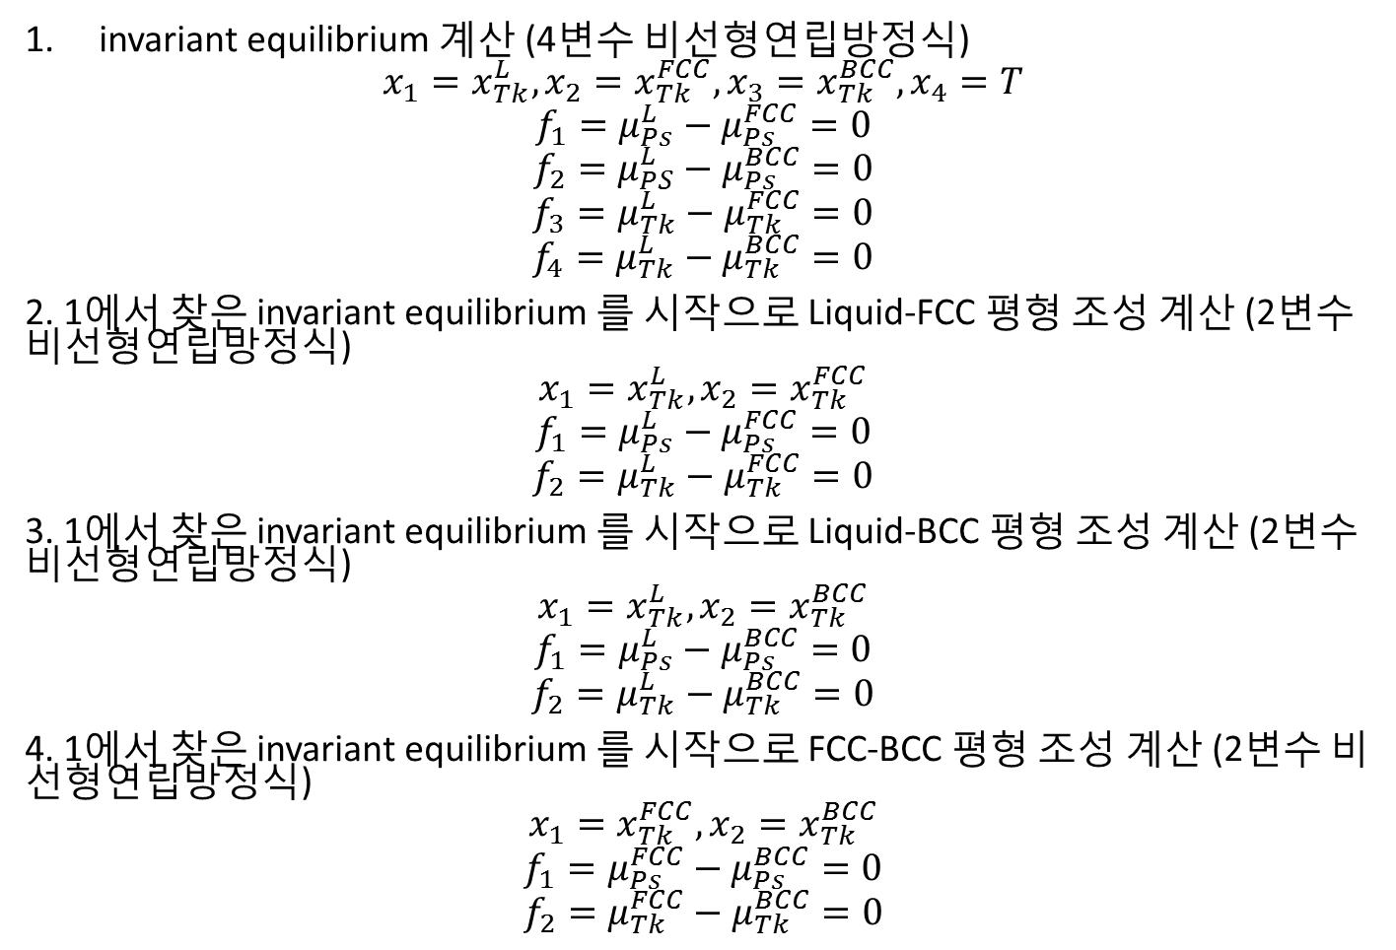
Algorithm
invariant equilibrium 계산 (4변수 비선형연립방정식)
$$x_{1}=x_{Tk}^{L}, x_{2}=x_{Tk}^{FCC}, x_{3}=x_{Tk}^{BCC}, x_{4}=T$$
$$f_{1}=μ_{Ps}^{L}−μ_{Ps}^{FCC}=0$$
$$f_{2}=μ_{PS}^{L}−μ_{Ps}^{BCC}=0$$
$$f_{3}=μ_{Tk}^{L}−μ_{Tk}^{FCC}=0$$
$$f_{4}=μ_{Tk}^{L}−μ_{Tk}^{BCC}=0$$
2. 1에서 찾은 invariant equilibrium 를 시작으로 Liquid-FCC 평형 조성 계산 (2변수 비선형연립방정식)
$$x_{1}=x_{Tk}^{L}, x_{2}=x_{Tk}^{FCC}$$
$$f_{1}=μ_{Ps}^{L}−μ_{Ps}^{FCC}=0$$
$$f_{2}=μ_{Tk}^{L}−μ_{Tk}^{FCC}=0$$
3. 1에서 찾은 invariant equilibrium 를 시작으로 Liquid-BCC 평형 조성 계산 (2변수 비선형연립방정식)
$$x_{1}=x_{Tk}^{L}, x_{2}=x_{Tk}^{BCC}$$
$$f_{1}=μ_{Ps}^{L}−μ_{Ps}^{BCC}=0$$
$$f_{2}=μ_{Tk}^{L}−μ_{Tk}^{BCC}=0$$
4. 1에서 찾은 invariant equilibrium 를 시작으로 FCC-BCC 평형 조성 계산 (2변수 비선형연립방정식)
$$x_{1}=x_{Tk}^{FCC}, x_{2}=x_{Tk}^{BCC}$$
$$f_{1}=μ_{Ps}^{FCC}−μ_{Ps}^{BCC}=0$$
$$f_{2}=μ_{Tk}^{FCC}−μ_{Tk}^{BCC}=0$$

Slide 4
Jacobian

Slide 5
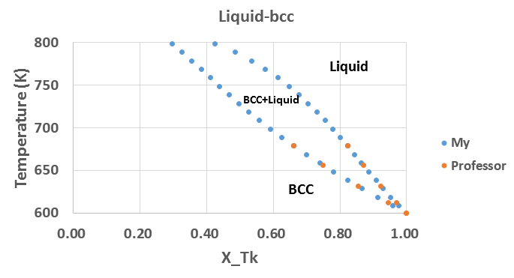
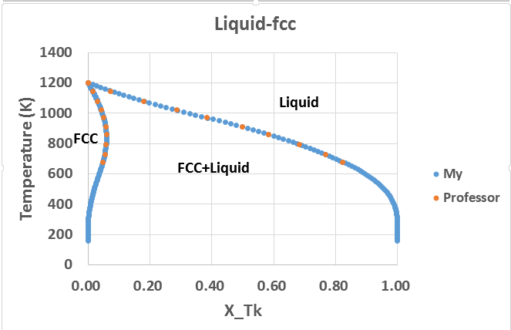
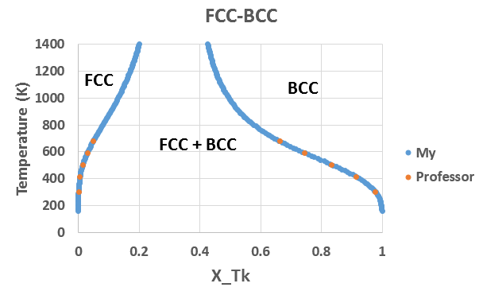
$ INVARIANT EQUILIBRIUM
BLOCK X=C1; Y=C2; GOC=C3,WAD;
8.2303357124E-01 6.7871173096E+02 M
6.6220688820E-01 6.7871173096E+02
8.2303357124E-01 6.7871173096E+02 M
4.8932533711E-02 6.7871173096E+02
6.6220688820E-01 6.7871173096E+02 M
4.8932533711E-02 6.7871173096E+02

Slide 6
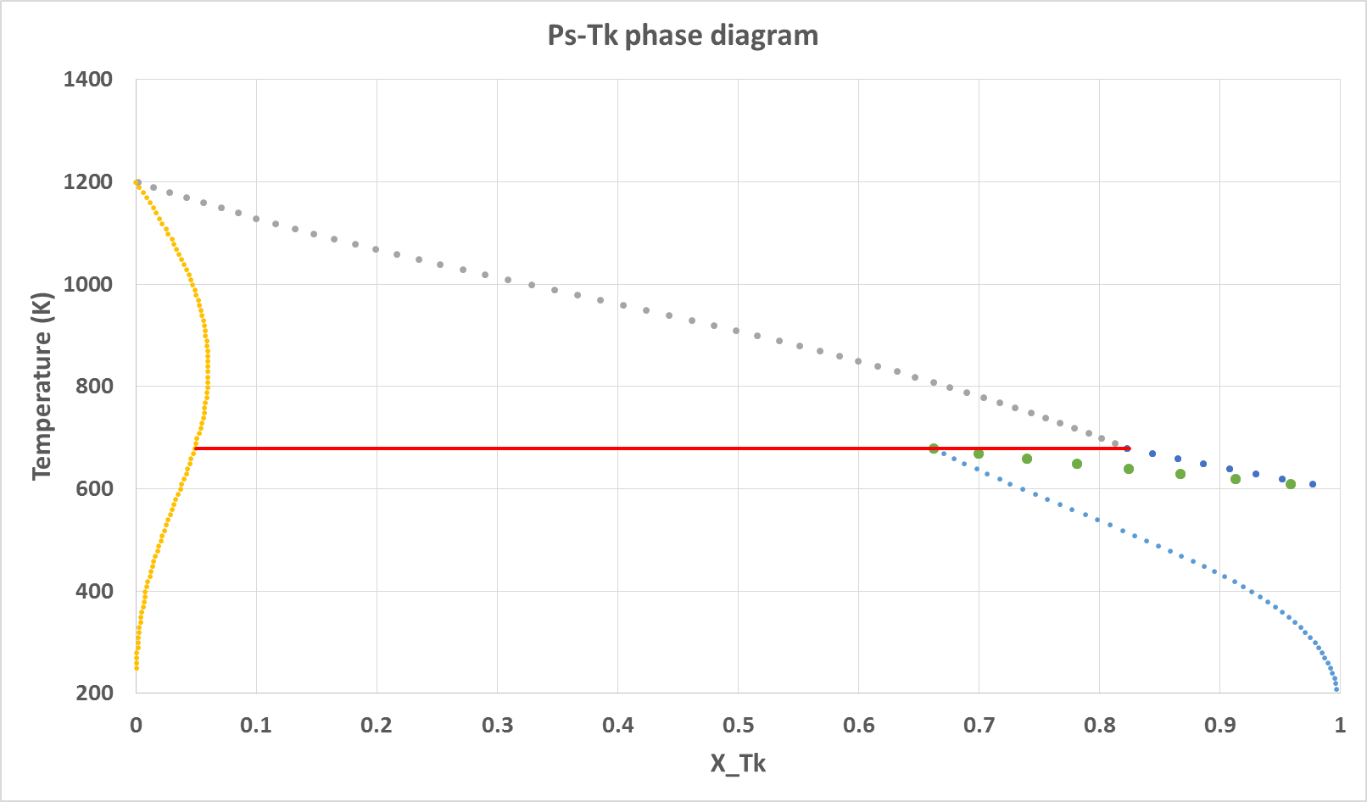
Liquid
Liquid +BCC
FCC
Liquid+FCC
Peritectic point
BCC
FCC+BCC

