Slide 1
Numerical Method HW #6
20110450 엄지섭

Slide 2
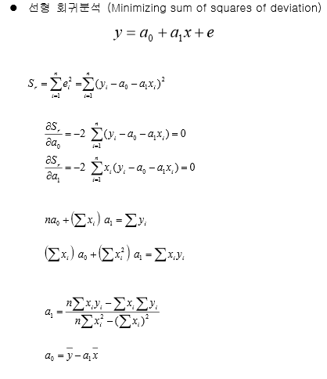
Main Concepts-Regression

Slide 3
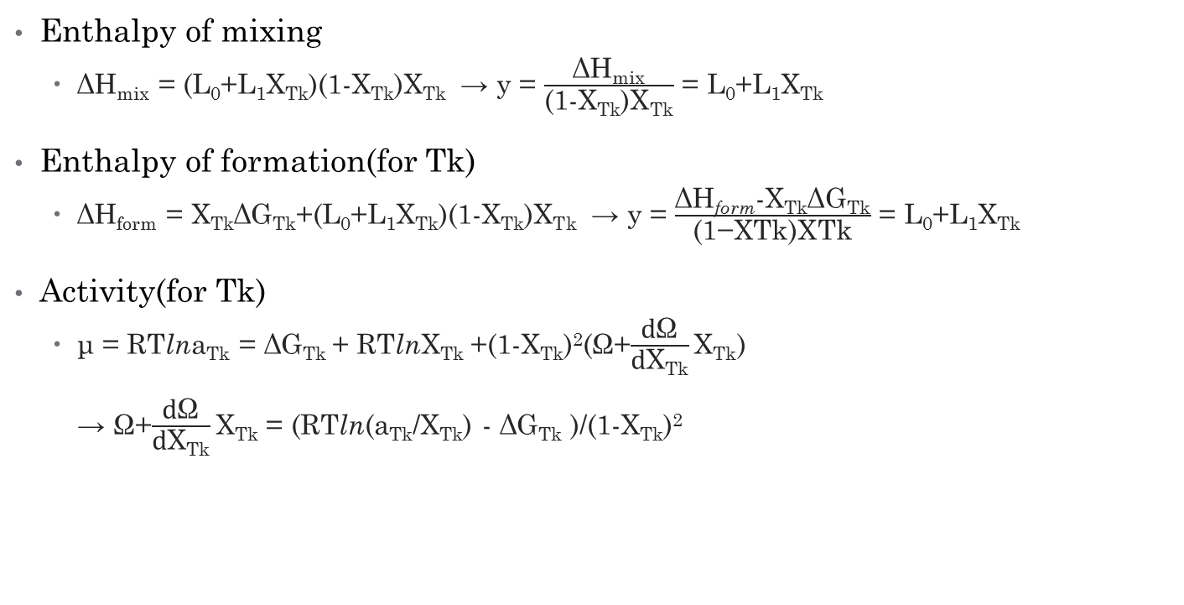
Main Concepts-Regression
Enthalpy of mixing
ΔH_{mix} = (L₀+L₁X_{Tk})(1-X_{Tk})X_{Tk} → y = $\frac{\text{ΔH}\text{mix}}{\text{(1-}\text{XTk}\text{)}\text{XTk}}$ = L₀+L₁X_{Tk}
Enthalpy of formation(for Tk)
ΔH_{form} = X_{Tk}ΔG_{Tk}+(L₀+L₁X_{Tk})(1-X_{Tk})X_{Tk} → y = $\frac{\text{ΔH}\text{form}\text{-}\text{XTk}\text{ΔG}\text{Tk}}{\text{(1−}\text{XTk}\text{)}\text{XTk}}$ = L₀+L₁X_{Tk}
Activity(for Tk)
μ = RTlna_{Tk} = ΔG_{Tk} + RTlnX_{Tk} +(1-X_{Tk})²($\text{Ω}$+$\frac{\text{d}\text{Ω}}{\text{d}\text{X}\text{Tk}}\text{X}\text{Tk}$) → $\text{Ω}$+$\frac{\text{d}\text{Ω}}{\text{d}\text{X}\text{Tk}}\text{X}\text{Tk}$ = (RTln(a_{Tk}/X_{Tk}) - ΔG_{Tk} )/(1-X_{Tk})²
선형방정식꼴 유도

Slide 4
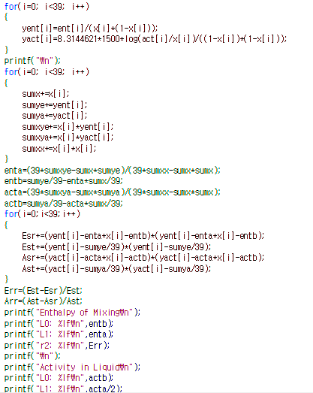
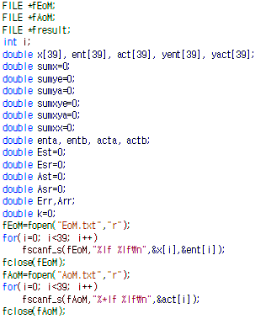
Code
Regression
Process

Slide 5
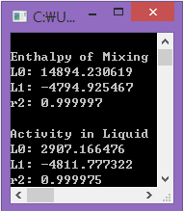
Results
L₀ & L₁ : temperature dependent
L₀ = L₀₀ + L₀₁T
L₁ = L₁₀ + L₁₁T
Ω = (L₀₀+L₀₁T)+(L₁₀+L₁₁T)X_{Tk}
= (14894-7.99T)+(-4795-0.11T)X_{Tk}

Slide 6
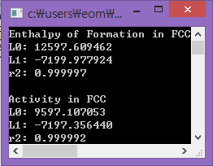
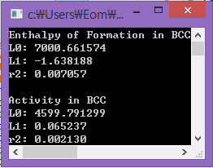
Results

