Slide 1
Midterm
Ps-Ks Phase Diagram
2021-10-26
지원재

Slide 2
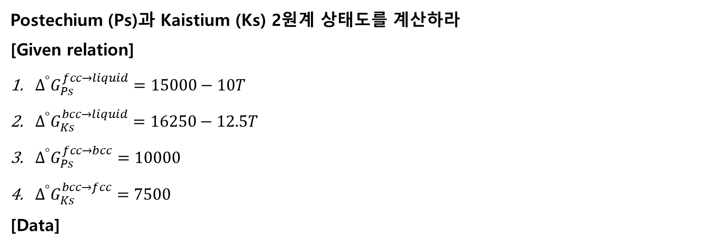
1. Problem
Postechium (Ps)과 Kaistium (Ks) 2원계 상태도를 계산하라
[Given relation]
$Δ^{°}G_{Ps}^{fcc→liquid}=15000−10T$
$Δ^{°}G_{Ks}^{bcc→liquid}=16250−12.5T$
$Δ^{°}G_{Ps}^{fcc→bcc}=10000$
$Δ^{°}G_{Ks}^{bcc→fcc}=7500$
[Data]
L
=
( L00
+
L01 * T )
+
( L10
+
L11 * T )
X

Slide 3
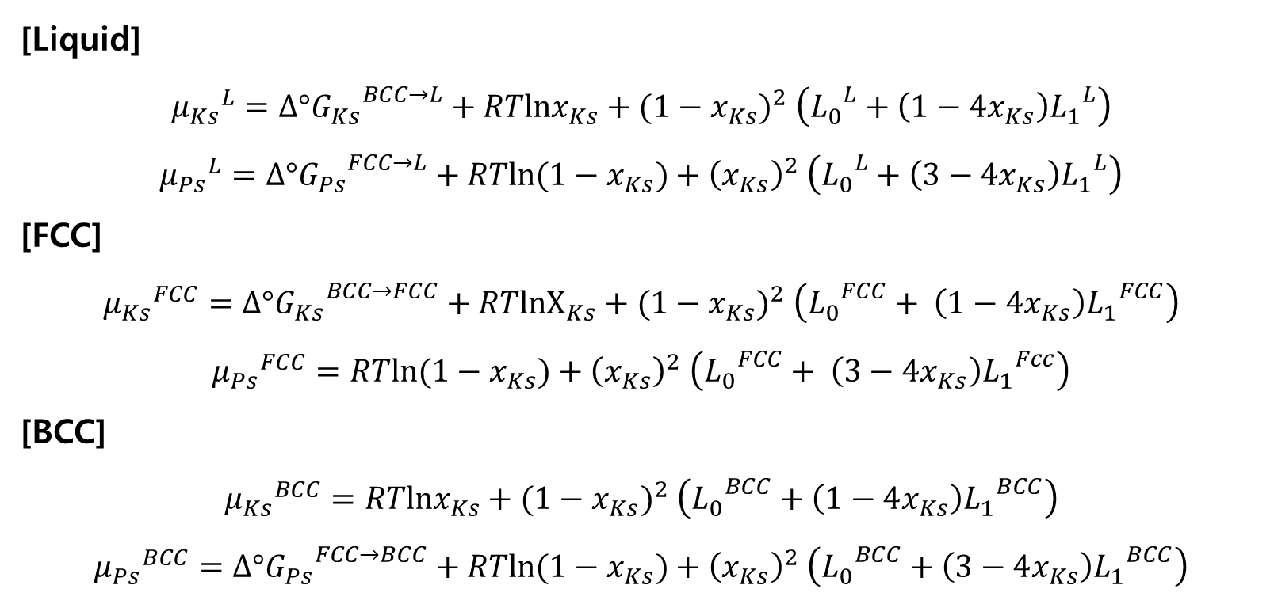
2. Chemical Potential Formulation of Liquid, FCC, BCC
[Liquid]
$${μ_{Ks}}^{L}=∆{{°G}_{Ks}}^{BCC→L}+RTlnx_{Ks}+{(1−x_{Ks})}^{2} \left({L_{0}}^{L}+\left(1−4x_{Ks}\right){L_{1}}^{L}\right)$$
$${μ_{Ps}}^{L}=∆°{G_{Ps}}^{FCC→L}+RTln(1−x_{Ks})+{\left(x_{Ks}\right)}^{2} \left({L_{0}}^{L}+\left(3−4x_{Ks}\right){L_{1}}^{L}\right)$$
[FCC]
$${μ_{Ks}}^{FCC}=∆{{°G}_{Ks}}^{BCC→FCC}+RTlnX_{Ks}+{(1−x_{Ks})}^{2} \left({L_{0}}^{FCC}+ \left(1−4x_{Ks}\right){L_{1}}^{FCC}\right)$$
$${μ_{Ps}}^{FCC}=RTln(1−x_{Ks})+{\left(x_{Ks}\right)}^{2} \left({L_{0}}^{FCC}+ \left(3−4x_{Ks}\right){L_{1}}^{Fcc}\right)$$
[BCC]
$${μ_{Ks}}^{BCC}=RTlnx_{Ks}+{(1−x_{Ks})}^{2} \left({L_{0}}^{BCC}+\left(1−4x_{Ks}\right){L_{1}}^{BCC}\right)$$
$${μ_{Ps}}^{BCC}=∆{{°G}_{Ps}}^{FCC→BCC}+RTln(1−x_{Ks})+{\left(x_{Ks}\right)}^{2} \left({L_{0}}^{BCC}+\left(3−4x_{Ks}\right){L_{1}}^{BCC}\right)$$

Slide 4
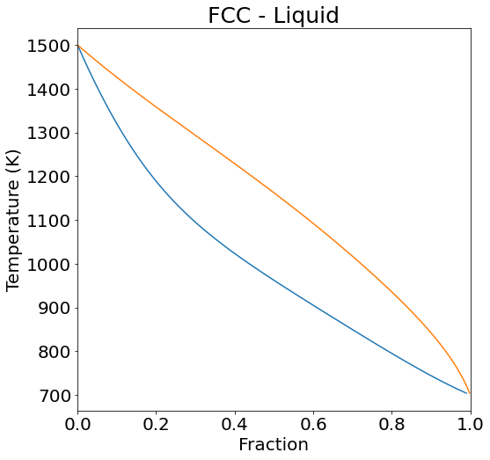
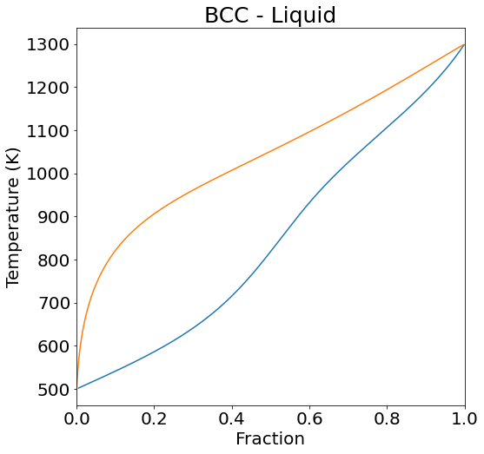
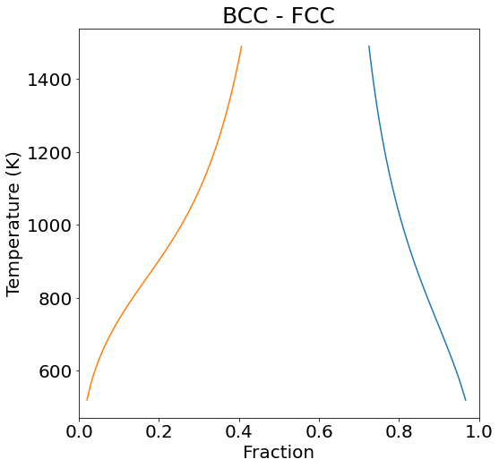
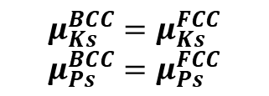
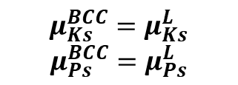
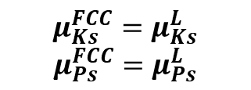
3. Each Phase Equilibrium of Liquid, FCC, BCC
$$μ_{Ks}^{FCC}=μ_{Ks}^{L}$$
$$μ_{Ps}^{FCC}=μ_{Ps}^{L}$$
$$μ_{Ks}^{BCC}=μ_{Ks}^{L}$$
$$μ_{Ps}^{BCC}=μ_{Ps}^{L}$$
$$μ_{Ks}^{BCC}=μ_{Ks}^{FCC}$$
$$μ_{Ps}^{BCC}=μ_{Ps}^{FCC}$$
1498K
1297K
FCC
BCC
Liquid
Liquid
Liquid+FCC
FCC+BCC
Liquid+BCC
FCC
BCC
703K
504K

Slide 5
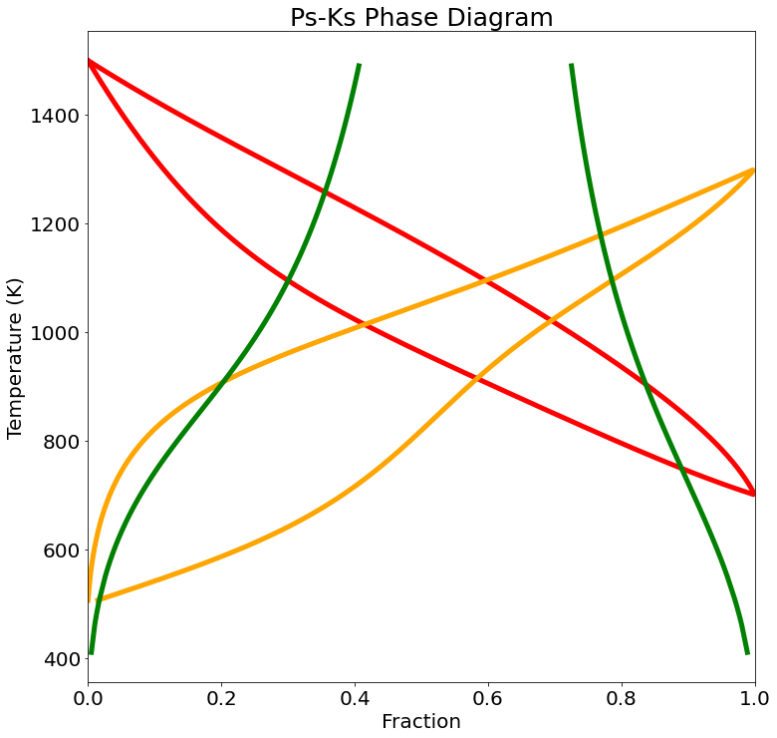
3. Each Phase Equilibrium of Liquid, FCC, BCC

Slide 6
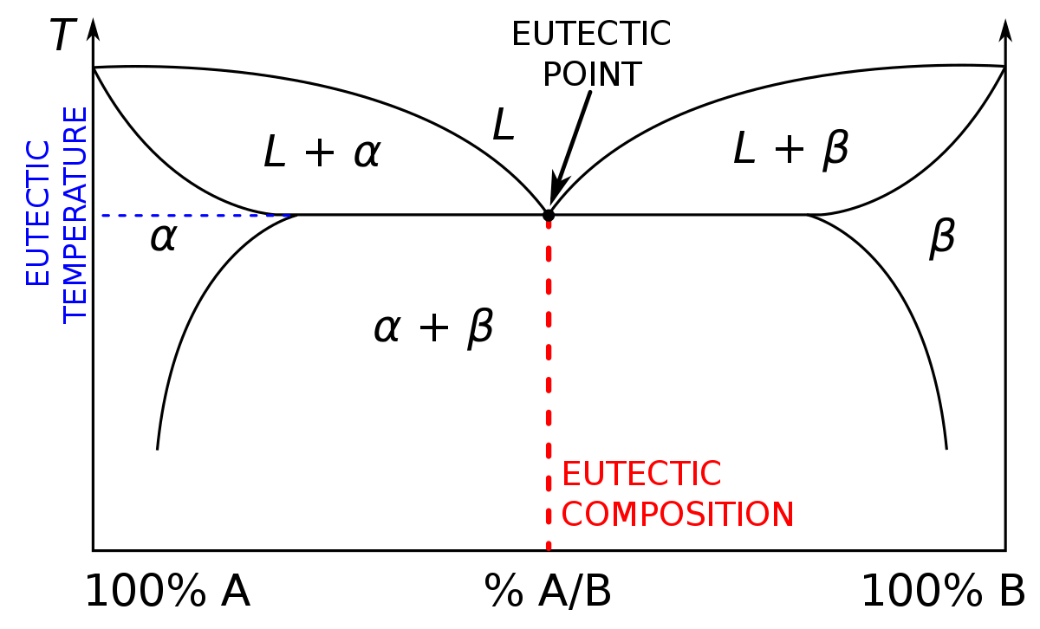
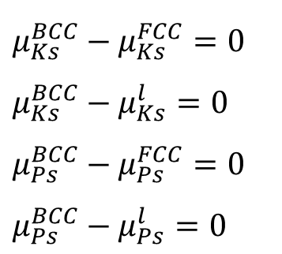
4. Eutectic Point
[Eutectic Point Formation]
$$μ_{Ks}^{L}=μ_{Ks}^{FCC}=μ_{Ks}^{BCC}$$
➔ Find $\left[\begin{aligned}X_{Ks}^{BCC} \\ X_{Ks}^{FCC} \\ X_{Ks}^{l} \\ T\end{aligned}\right]$ , where all phase is equilibrium
$μ_{Ks}^{BCC}−μ_{Ks}^{FCC}=0$
$μ_{Ks}^{BCC}−μ_{Ks}^{l}=0$
$μ_{Ps}^{BCC}−μ_{Ps}^{FCC}=0$
$μ_{Ps}^{BCC}−μ_{Ps}^{l}=0$
➔

Slide 7
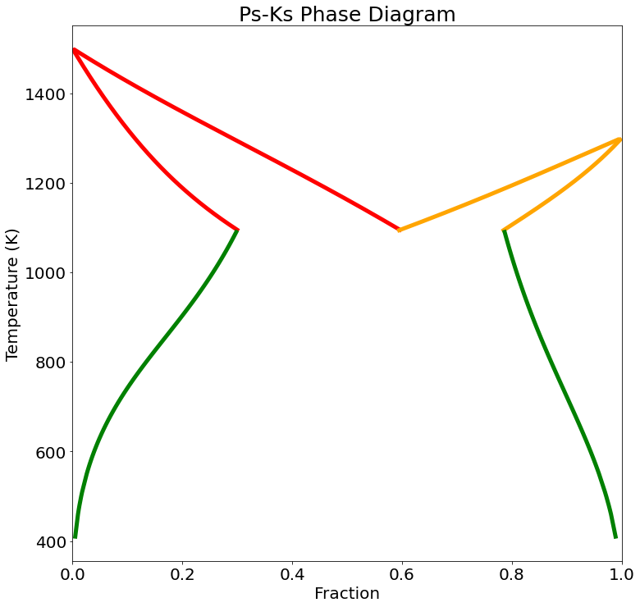
5. Phase Diagram Result
Liquid
Liquid+FCC
Liquid+BCC
1095K
FCC
BCC
$X_{Ks}^{L}=0.59$
$$X_{Ks}^{L}=0.30$$
$$X_{Ks}^{L}=0.78$$
FCC+BCC

Slide 8
Thank You

