Slide 1
Mid-term
20190312 신소재공학과 김서현

Slide 2
Formulas_1
1. Liquid chemical potential
2. FCC chemical potential
3. BCC chemical potential

Slide 3
Formulas_2
Liquid-FCC
Liquid-BCC
FCC-BCC

Slide 4
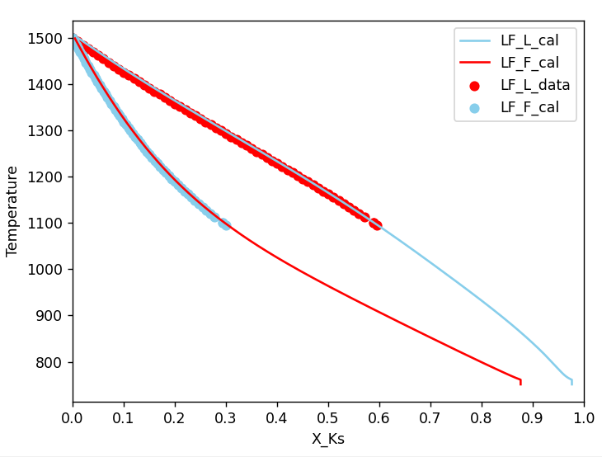
Liquid-FCC

Slide 5
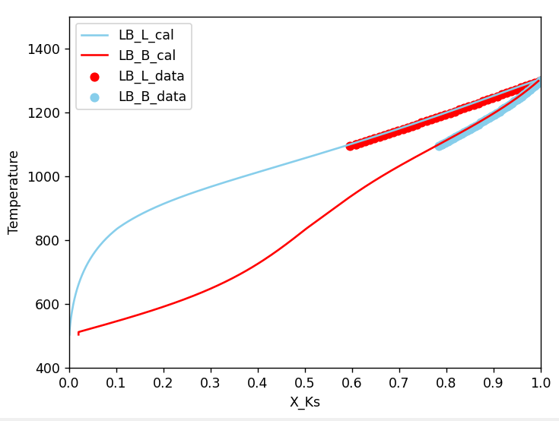
Liquid-BCC

Slide 6
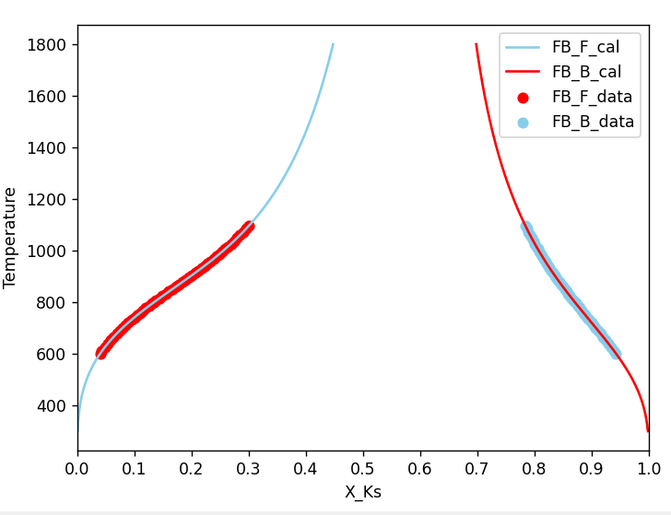
FCC-BCC

Slide 7
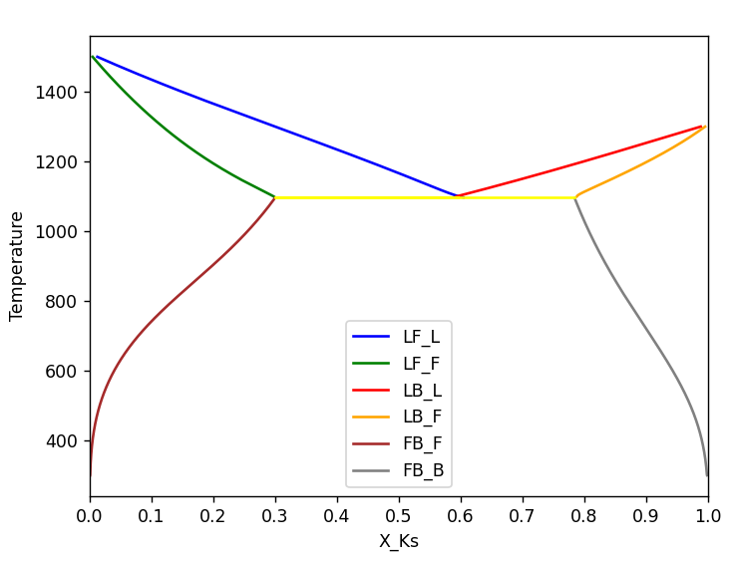
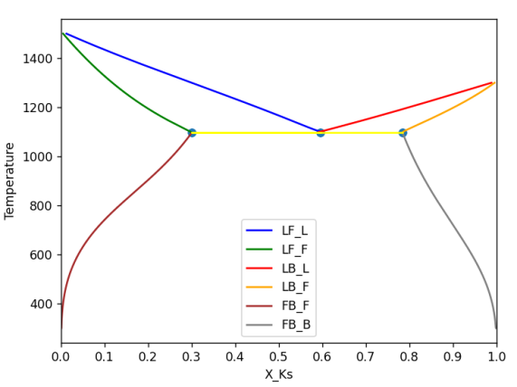
Phase diagram

