Slide 1
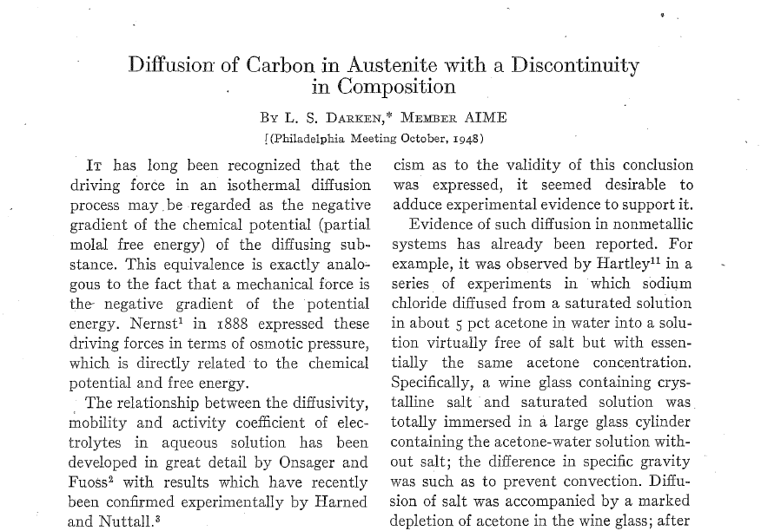
Final Term
20071023
문현우

Slide 2
Thermodynamics
We need
But, using some calculation results in....

Slide 3
Thermodynamics
For Substitutional M
For Interstitial C
Equation
Leads....

Slide 4
Thermodynamics
Then, we need only

Slide 5
Thermodynamics

Slide 6
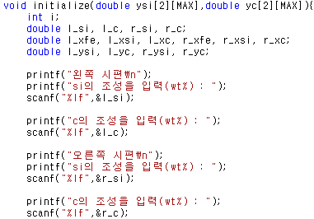
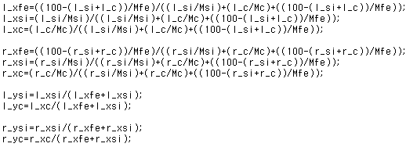
Coding
Input Initial conditions and
Transform weight percent into y fraction.

Slide 7
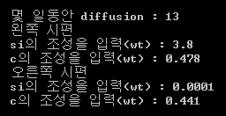
Coding
Get diffusivity values and use FDM.
Diffusivities of left specimen
Diffusivities of right specimen
If we use dt = 2808s, dx = 0.001m then, maximum lamda ~ 0.028
dt times 400 is 13 days

Slide 8
Coding
Transform y fraction into weight percent.
Save the data.

Slide 9
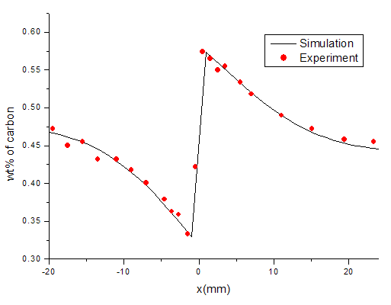
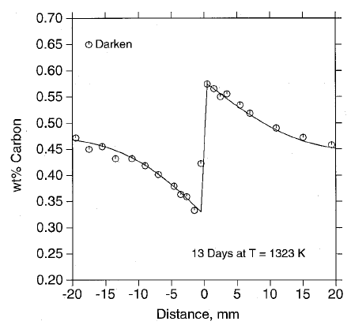
Results

Slide 10
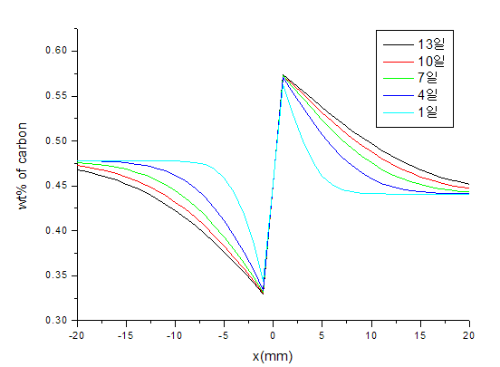
Results

Slide 11
자유주제
Efficiency of Solar Cell
20071023
문현우

Slide 12
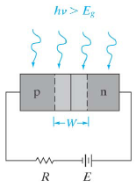
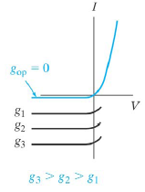
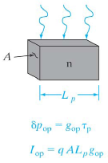
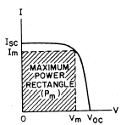
Current
where

Slide 13
Minority Carrier Distribution
With Continuity Equation,

Slide 14
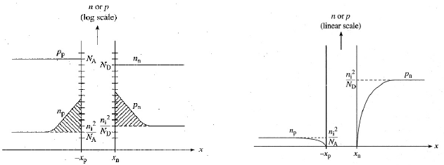
Minority Carrier Distribution

Slide 15
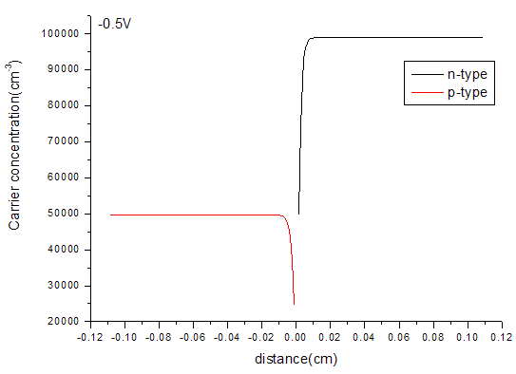
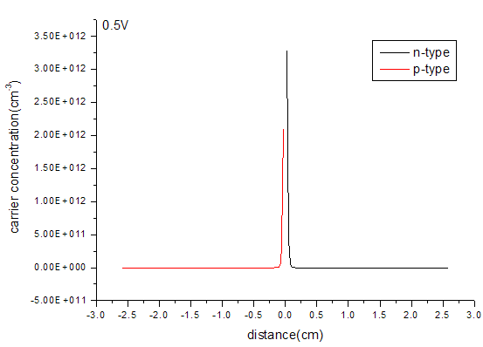
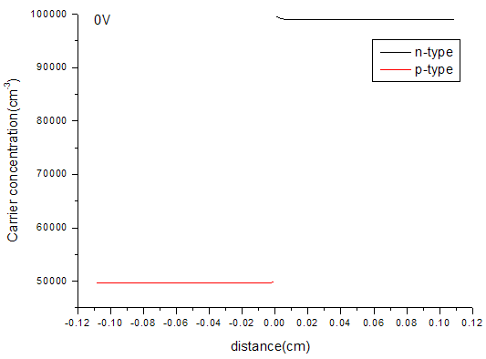
Minority Carrier Distribution

Slide 16
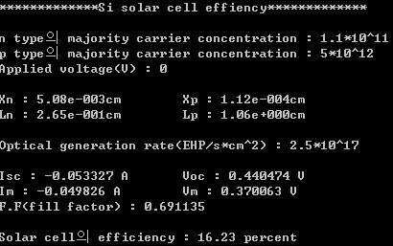
Efficiency of Solar Cell
where
→ Newton Method

