Slide 1
소재수치해석
HW#8
신소재 공학과 20170977 이사민

Slide 2
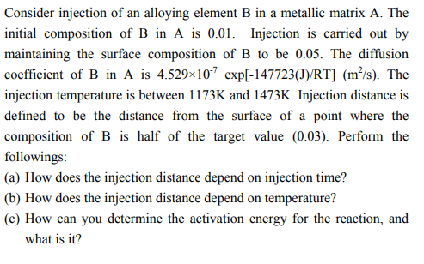
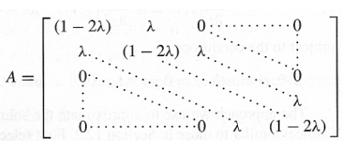
Problem
Finite Difference Methods
$$\text{α}=D=4.529×{10}^{−7}\exp\left[\frac{−147723\left(J\right)}{RT}\right]\left({m^{2}}/s\right)$$
dt=1s
dx=5µm

Slide 3
Result
λ=0.004785
λ=0.0157280
Injection distance
Injection distance
λ=0.043464
λ=0.104631
Injection distance
Injection distance

Slide 4
Injection distance vs injection time
$x∝\sqrt{t}$

Slide 5
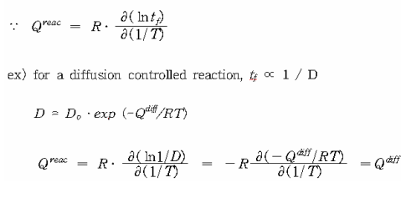
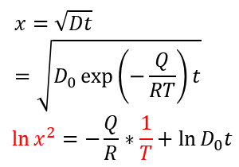
Injection distance vs temperature
$$x=\sqrt{Dt}=\sqrt{D_{0}\exp\left(−\frac{Q}{RT}\right)t}$$
$$\ln{x^{2}=−\frac{Q}{R}∗\frac{1}{T}+ln{D_{0}t}}$$
기울기 평균=-17750=$−\frac{Q}{R}$
Q=17750*R=147580.6
실제 값: 147723
상대 오차: 0.0964%

