Slide 1
HW6 Regression
20100366 이원태

Slide 2
Homework 6 – Liquid, FCC, BCC
Purpose :
회귀 분석을 사용하여 Liquid, FCC, BCC에 대한 정보(Enthalpy of mixing, Activity)로부터 Gibbs energy of mixing을 표현하라.
Given condition
액상에서의 Enthalpy of mixing
1500K Liquid에서의 Tk의 Activity
Enthalpy of Formation in FCC and BCC
Activity of Ps in BCC, Activity of 싸 in FCC at 600K
순수 Ps, Tk의 Gibbs energy

Slide 3
Background information
Enthalpy of Mixing – Liquid phase
L1 = 0 이면 Regular solution
L1 ≠ 0 이면 Sub regular solution
Activity – Liquid phase
Linear Regression을 하기 위해 y = ax+b꼴로 만들어 줘야 함

Slide 4
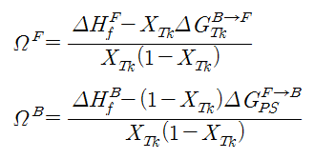
Background information
Enthalpy of Mixing and Formation – Liquid & FCC & BCC phase
$$∆{G_{l}}^{}=RT\left(X_{Ps}lnX_{Ps}+X_{Tk}lnX_{Tk}\right)+[X_{Ps}{G^{0}}_{Ps}+X_{Tk}{{ΔG}^{0}}_{Tk}+Ω^{L}X_{Ps}X_{Tk}]$$
$$∆H_{}^{M}$$
$$∆{G_{F}}^{}=RT\left(X_{Ps}lnX_{Ps}+X_{Tk}lnX_{Tk}\right)+[X_{Ps}G_{Ps}^{F→F}+X_{Tk}{ΔG}_{Tk}^{B→F}{+Ω}^{F}X_{Ps}X_{Tk}]$$
$$∆H_{f}^{F}$$
$$∆{G_{B}}^{}=RT\left(X_{Ps}lnX_{Ps}+X_{Tk}lnX_{Tk}\right)+[X_{Tk}G_{Tk}^{B→B}+X_{Ps}G_{Ps}^{F→B}+Ω^{B}X_{Ps}X_{Tk}]$$
$$∆H_{f}^{B}$$

Slide 5
Background
Activity of FCC & BCC
$$μ_{Ps}^{F}=RTlna_{Ps}^{F}=ΔG^{F→F}+RTln(1−X_{Tk}^{F})+[(L_{0}+L_{1}(2X_{Tk}^{F}−1)]{(X_{Tk}^{F})}^{2}$$
$$μ_{Tk}^{F}=RTlna_{Tk}^{F} =ΔG^{B→F}+RTln(X_{Tk}^{F})+[L_{0}+L_{1}∗2X_{Tk}^{F}]{(1−X_{Tk}^{F})}^{2}$$
$$μ_{Ps}^{B}=RTlna_{Ps}^{B}=ΔG^{F→B}+RTln(1−X_{Tk}^{B})+[(L_{0}+L_{1}(2X_{Tk}^{B}−1)]{(X_{Tk}^{B})}^{2}$$
$$μ_{Tk}^{B}=RTlna_{Tk}^{B}=ΔG^{B→B}+RTln(X_{Tk}^{B})+[(L_{0}+L_{1}(2X_{Tk}^{B})]{(1−X_{Tk}^{B})}^{2}$$
Activity of Tk in FCC
Activity of Ps in BCC

Slide 6
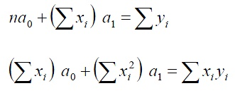
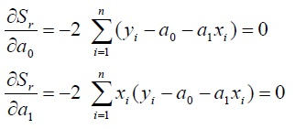
Background Information
Linear Regression
error²의 summation값을 최소로

Slide 7
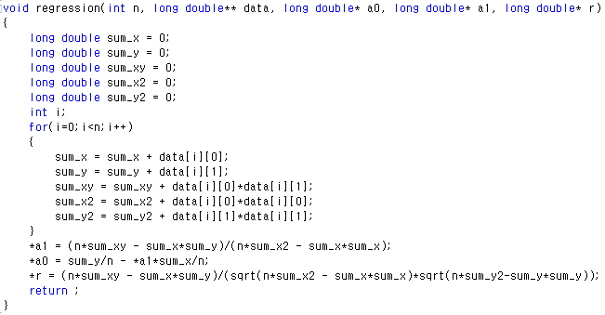
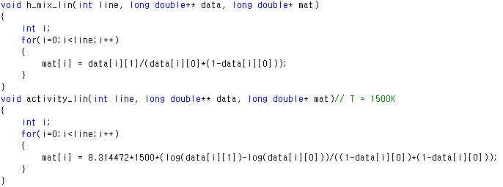
Code
Regression Function
n = data 개수, y = a0 + a1X

Slide 8
Code

Slide 9
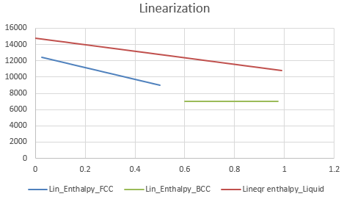
Result
Liquid = Sub regular solution
FCC = Sub regular solution
BCC = Regular solution

Slide 10
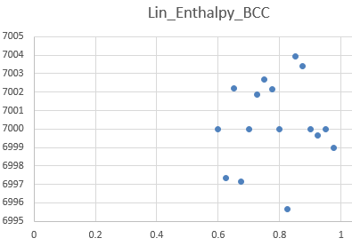
Result
$$Ω^{L}=14894.230619 −7.991374T+\left(−4794.925467 −0.011238T\right)X_{Tk}$$
$Ω^{F}=12597.609462 −5.000808T+(−7199.977924+0.004399T)$ $X_{Tk}$
$$Ω^{B}=6999.023386 −3.998341T$$

Slide 11
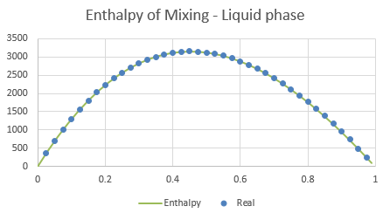
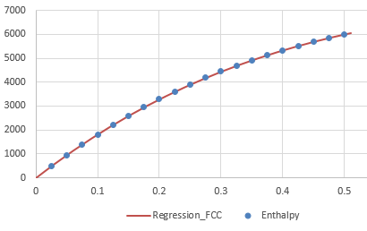
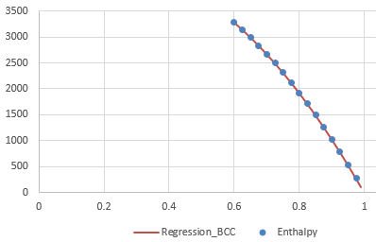
(R=8.314472)

Slide 12
Final Goal
Liquid FCC BCC의 L parameter와 주어진 Data(Enthalpy, Activity, Gibbs energy)를 이용하여 Ps-Tk phase diagram을 그리는 것!
Thank you!!

