Slide 1
AMSE318 HW7 with python
49004547 Seokjee SHIN

Slide 2
Result
$$y^{′}(4)=4e^{0.8x}−0.5y$$
$x_{0}=0 \& y_{0}=2,$interval = 1
 | Y_true | Heun1 |  | Heun15 |  | Rk4
x |  | Result | Error% | Result | Error% | Result | Error%
0 | 2.0000000 | 2.0000000 | 0.00 | 2.0000000 | 0.00 | 2.0000000 | 0.00
1 | 6.1946314 | 6.7010818 | 8.18 | 6.3608655 | 2.68 | 6.2010371 | 0.10
2 | 14.8439219 | 16.3197819 | 9.94 | 15.3022366 | 3.09 | 14.8624836 | 0.13
3 | 33.6771718 | 37.1992489 | 10.5 | 34.7432761 | 3.17 | 33.7213480 | 0.13
4 | 75.3389626 | 83.3377673 | 10.6 | 77.7350962 | 3.18 | 75.4391720 | 0.13
As we increase the number of iteration, the error % decreases for the Heun’s method. Still, Rk4 method is much accurate than Heun’s method

Slide 3
Result
$$y^{′}(4)=4e^{0.8x}−0.5y$$
$$x_{0}=0 \& y_{0}=2$$
 |  | Y_true | Heun1 |  | Heun15 |  | Rk4
H | x |  | Result | Error% | Result | Error% | Result | Error%
0.01 | 4 | 75.3389626 | 75.3396709 | 9.40e-4 | 75.3392096 | 3.27e-4 | 75.3389626 | 1.35e-8
0.05 | 4 | 75.3389626 | 75.3567834 | 0.02 | 75.3453676 | 8.20e-3 | 75.3389632 | 8.50e-7
0.1 | 4 | 75.3389626 | 75.4108085 | 0.10 | 75.3636535 | 0.03 | 75.3389727 | 1.34e-5
0.5 |  |  | 77.2385235 | 2.52 | 75.9517054 | 0.81 | 75.3453361 | 8.46e-3
1 |  |  | 83.3377673 | 10.6 | 77.7350962 | 3.18 | 75.4391720 | 0.13
2 |  |  | 108.536186 | 44.1 | 84.1434191 | 11.7 | 76.7696647 | 1.90
As we increase the size of interval, the error % increases for all the methods. Still, Rk4 method is much accurate than Heun’s method

Slide 4
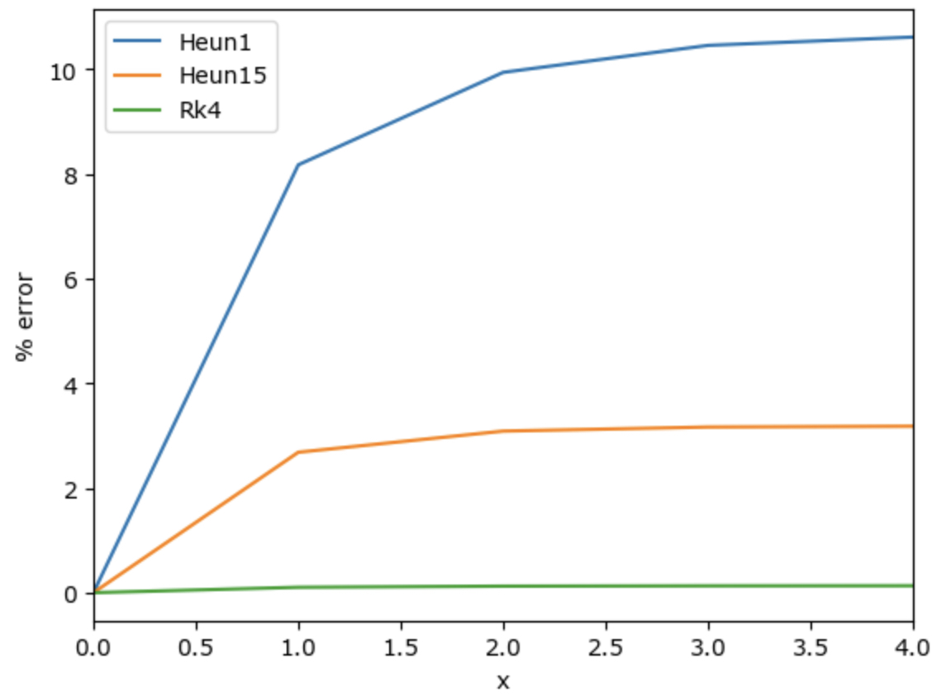
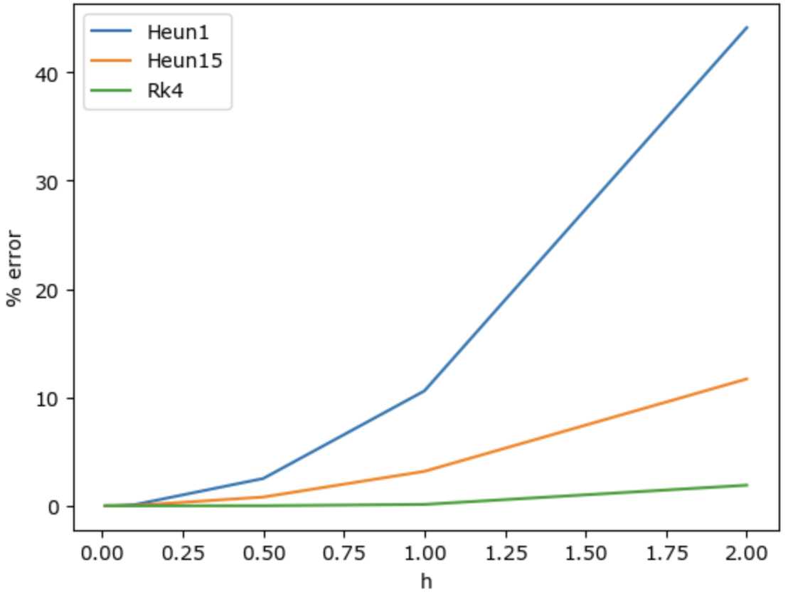
Conclusion of HW7
Rk4 method is significantly accurate and efficient compared to Heun’s method.
Increasing the number of iteration or decreasing the size of interval helped Heun’s method to have smaller %error (max. order of 4), but if we apply same variation to Rk4 method, they have much improvements (max. order of 8).

