Slide 1
소재수치해석HW8
20110073 김용민

Slide 2
Problem
1차 Runge-Kutta Method
Euler method
2차 Runge-Kutta Method
Huen method
Midpoint method
4차 Runge-Kutta Method

Slide 3
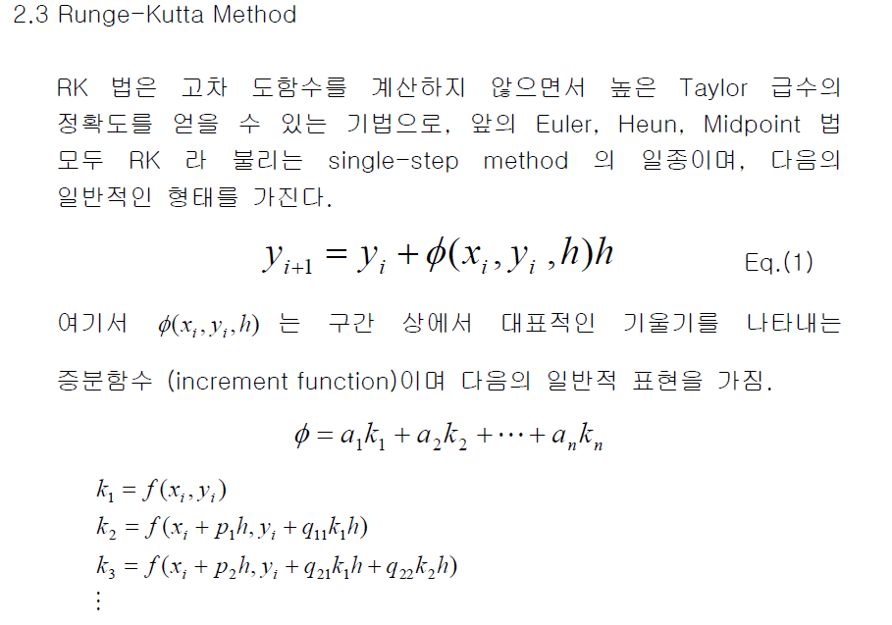
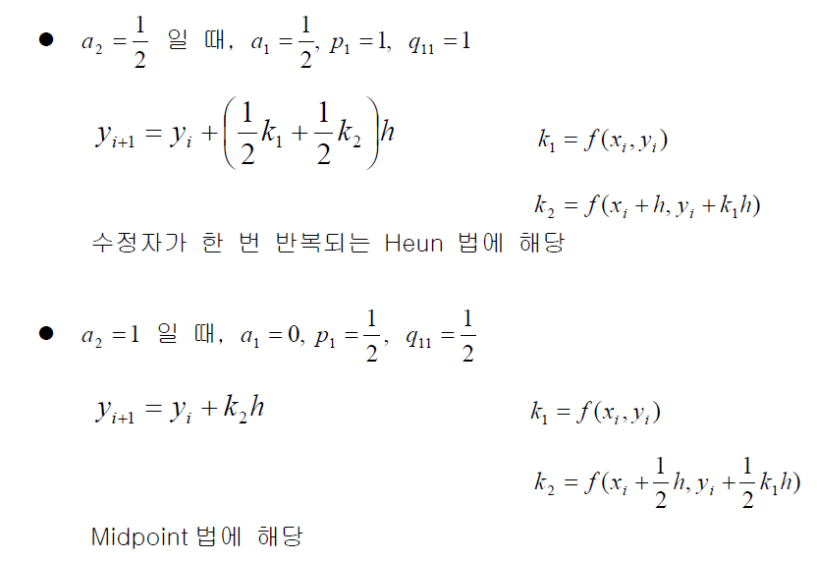
Theory

Slide 4
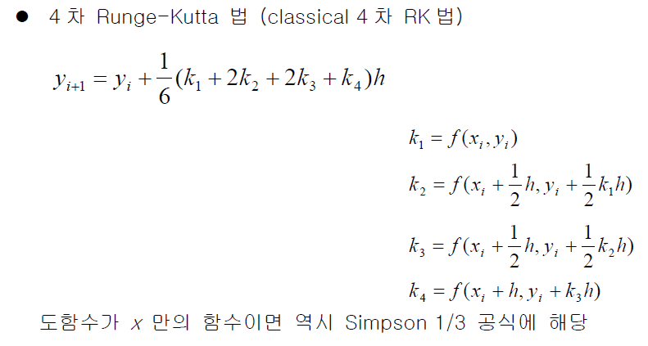
Theory

Slide 5
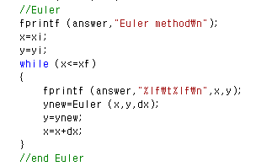
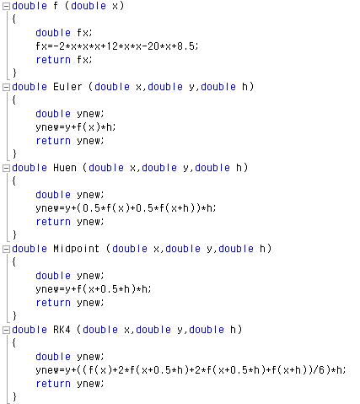
Code

Slide 6
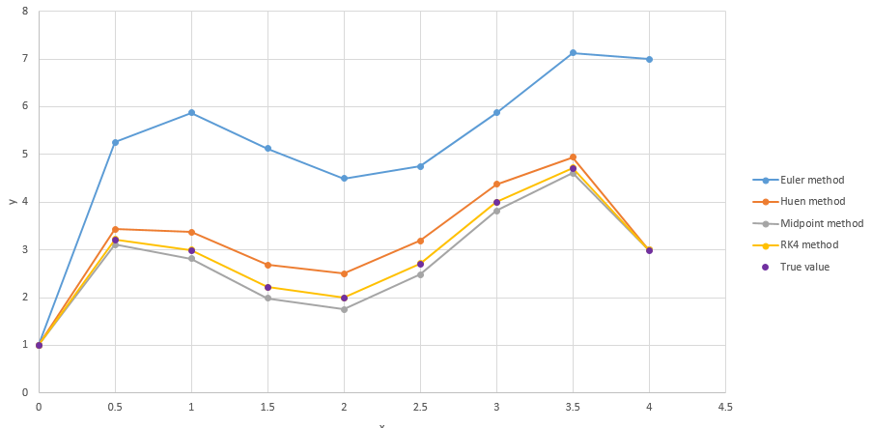
Result
$$y=−0.5x^{4}+4x^{3}−10x^{2}+8.5x+1$$

