Slide 1
Partial Differential Equation
AMSE318 Numerical Methods
2012. 11. 20
Materials Science and Engineering
20090428 Ji-yun Kang

Slide 2
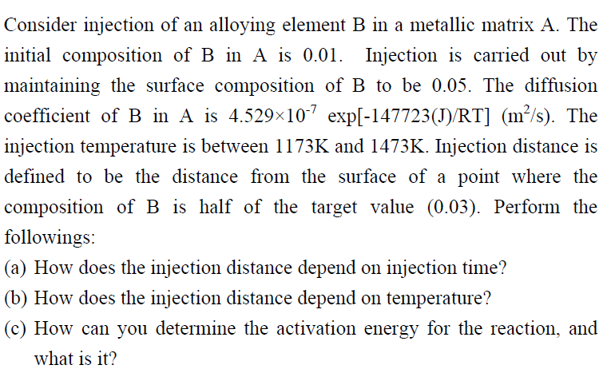
Homework#9
- Diffusion Problem -
Initial composition of B in A : 0.01
Surface composition of B : 0.05
Diffusion coefficient of B in A : 4.529×10⁻⁷ exp[-147723(J)/RT] (m²/s)
Injection temperature : 1173~1473K
Injection distance : A의 표면 B농도가 0.03이 되는 지점(목표치의 절반이 주입된 거리)

Slide 3
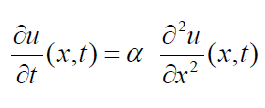
Background Information
1. Diffusion problem
Diffusion Partial Differential Equation :
(u : composition, α : diffusion coefficient )
surface
semi-infinite
composition
0.05
0.01
distance

Slide 4
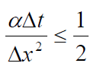
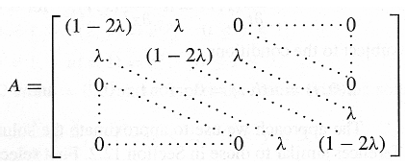
Background Information
2. Explicit method(Forward difference method)
: For stability

Slide 5
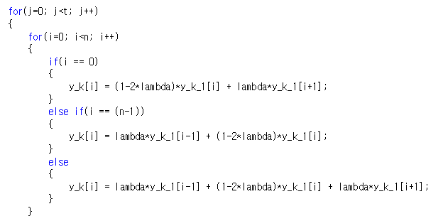
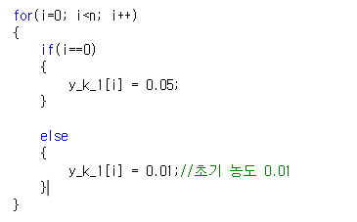
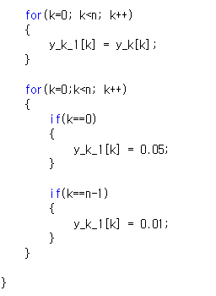
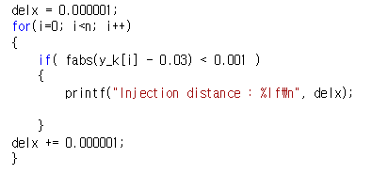
Common codes

Slide 6
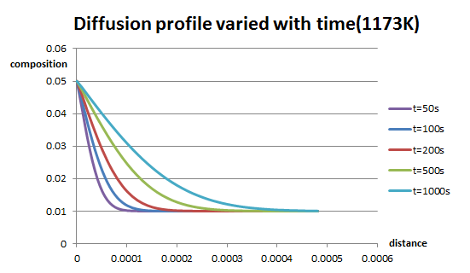
Results
1. Injection distance – injection time
λ=0.001196
dt=1
dx=0.00001
Injection time이 커질 수록 injection distance가 증가하고 있음

Slide 7
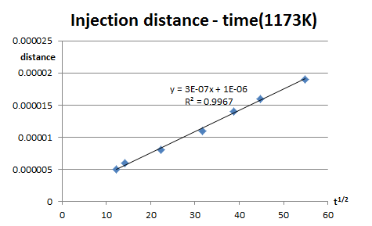
Results
1. Injection distance – injection time
λ=0.001196
dt=1
dx=0.00001

Slide 8
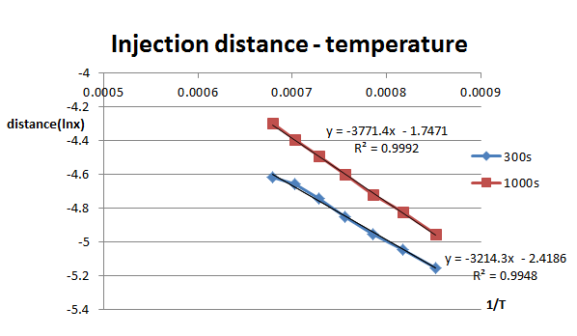
Results
2. Injection distance – injection temperature
λ=0.066631
dt=0.1
dx=0.000001

Slide 9
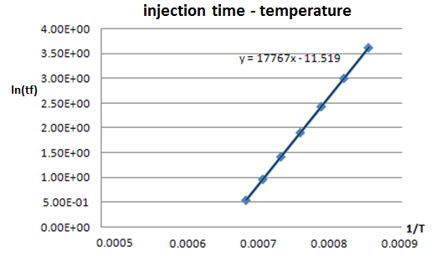
Results
3. Activation energy for the reaction
즉, ln(t)-1/T의 기울기를 통해 reaction의 activation energy를 알 수 있다!
→ 그리고 이 값은 Qdiff와 같다!
→ Diffusion coefficient of B in A : 4.529×10⁻⁷ exp[-147723(J)/RT] (m²/s)
$Q^{reac}$= (8.3144) × (17767) = 147721.9448 (J)
→ Error : 7.1431 × 10⁻⁴

Slide 10
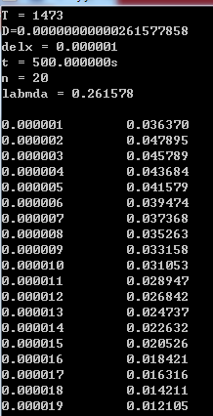
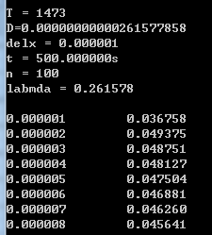
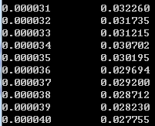
Discussion
High temperature, long injection time에서 n(mesh points개수)이 충분하지 않을 경우(diffusion profile의 꼬리가 매우 긴 경우),
→ 계산 상의 오류가 생김
→ Semi-infinite하게 n값을 크게 늘려주어야

