Slide 1
AMSE 318 Numerical Methods
Final term homework
Simulation of darken’s uphill diffusion
2013/12/17
Jongwon, Lee

Slide 2
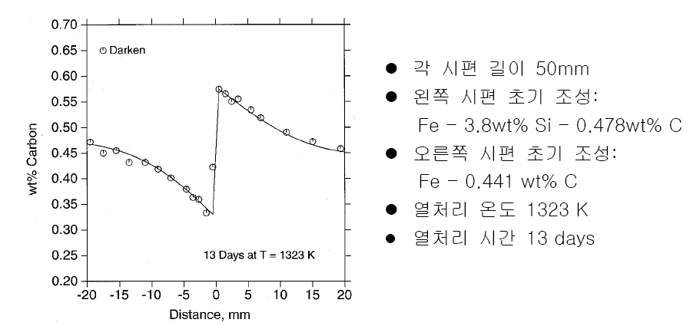
Assignment

Slide 3
Thermodynamics
Fe-M-C 3원계에서 용질 C 와 M 의 확산 유속 J
Fcc Fe-M-C 침입형 고용상은 (Fe,M)₁(Va,C)₁ 의 formula unit 을 이용,
1 mol of formula unit 당 Gibbs free energy 를 다음과 같이 표현한다.

Slide 4
Thermodynamics
Gibbs Energy 식으로부터 각 원소의 Chemical Potential 을 얻는 공식은 다음과 같다.
For substitutional M,
For interstitial C,

Slide 5
Thermodynamics
Diffusion equation

Slide 6
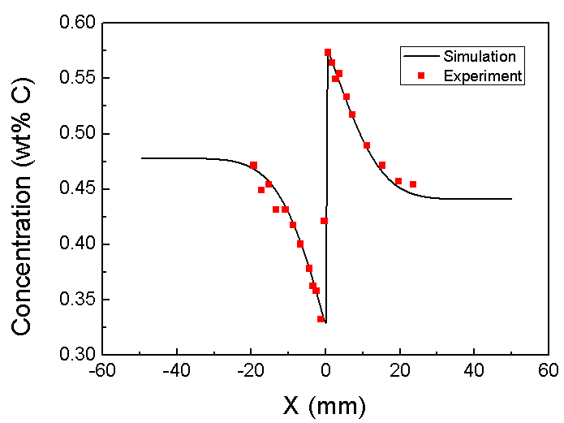
Results
Si : 3.8wt%
C : 0.478wt%
Si : 0.005wt%
C : 0.441wt%
열처리 온도 : 1323K
열처리 시간 : 13days
50mm
50mm

Slide 7
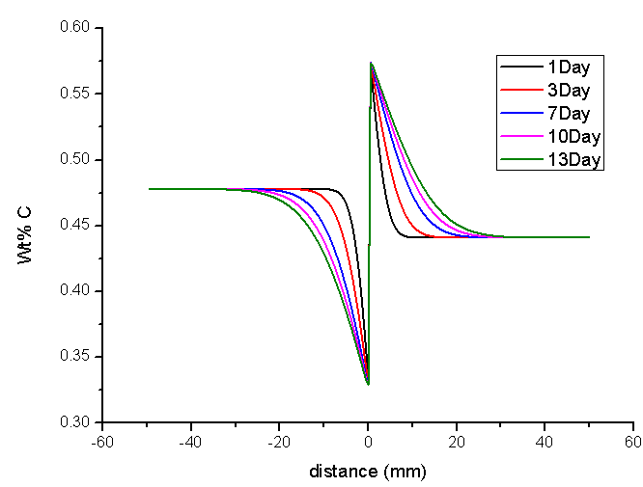
Results
Time 변화

Slide 8
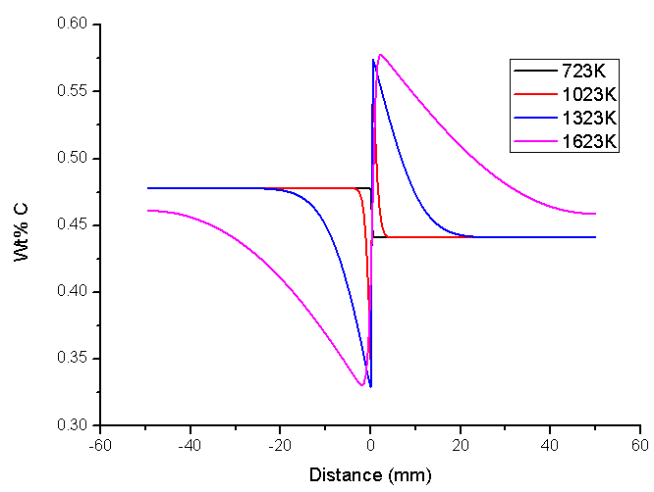
Results
Temperature변화

Slide 9
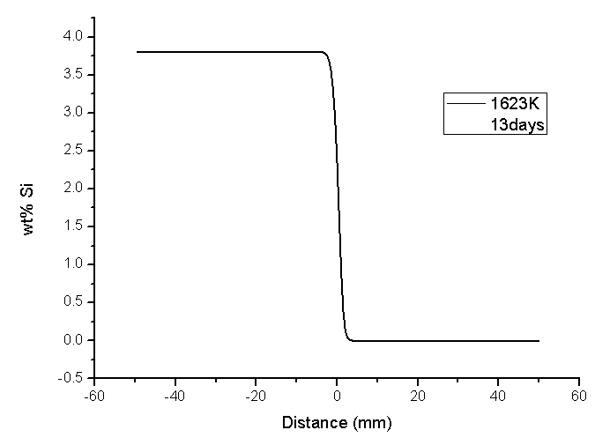
Results
Si Diffusion
No difference (small diffusion) occurs

Slide 10
- 하면 시간 가는 줄 모를 만큼 재미 있을만한 것 - 답이 정해져 있는 진부한 문제가 아닌 것 - 실제로 나중에 유용하게 쓰일 것 - 내 연구에 대한 자극제가 될 수 있을 만한 것
Free problem

Slide 11
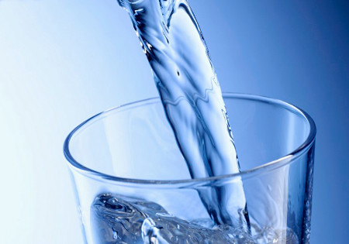
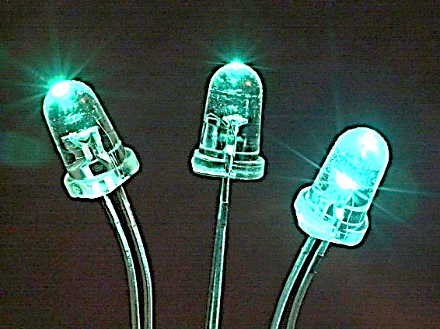
High efficiency Deep UV LEDs
- The simulation for light extraction way of DUV LEDs with Al side reflector
AMSE 318 재료수치해석 (Numerical methods)
Notes:
Hello.

Slide 12
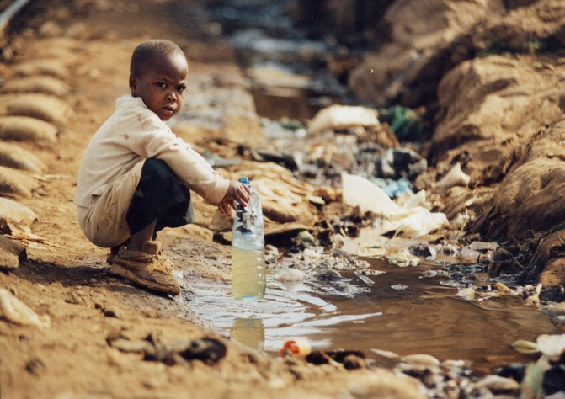
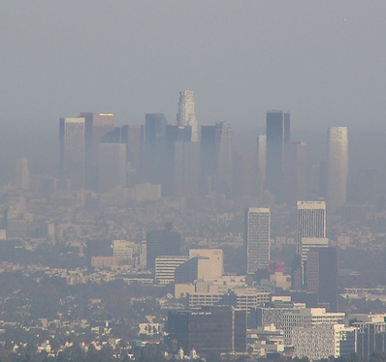
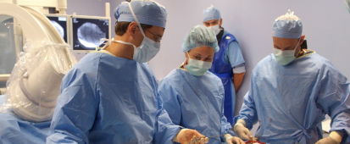
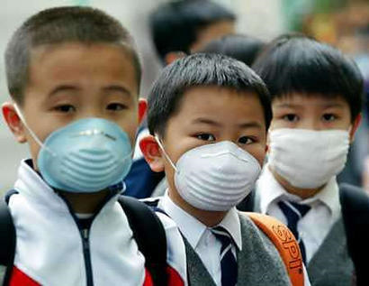
Threatens
for life & health
Solution for the problems
Deep UV light
LET’S MOVE ON MORE DETAIL OF DUV LED

Slide 13
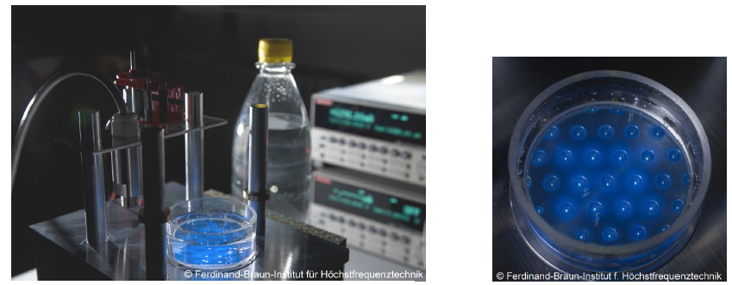
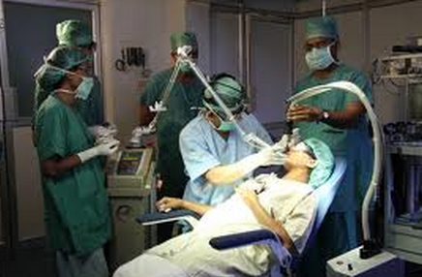
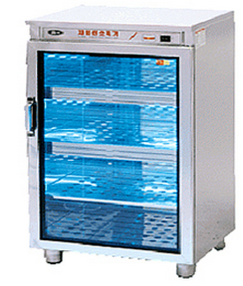
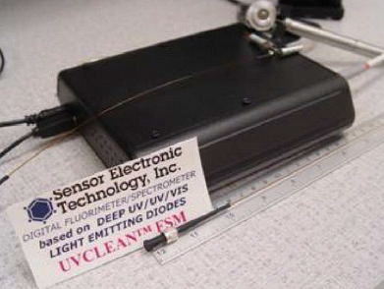
Introduction
Ultraviolet light can be used everywhere
Water purification
Light surgery
Fertilization
Light source
AMSE 318 재료수치해석 (Numerical methods)

Slide 14
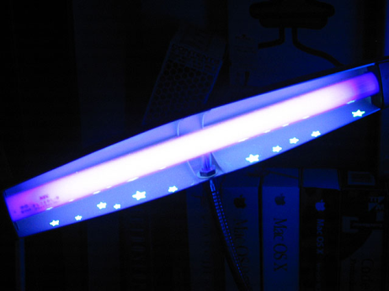
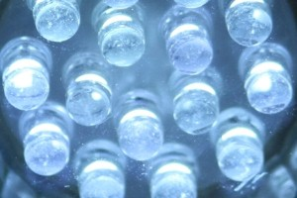
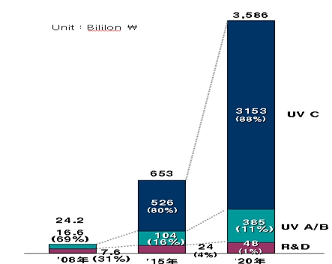
Light sources for DUV Lights
Energy-efficient
Eco-friendly way
Yole development 社 “UV LED Market 2009”
DUV Hg Lamp
DUV LED
Toxic (Hg vapor)
Hazardous waste
High voltage
Produce ozone
Short lifetime (8,000 h)
Broad wavelength
No Toxic elements
No hazardous waste
Low voltage (6-12 V)
No ozone
Lifetime ~ 100,000 h
Narrow wavelength
CAGR ~ 50%
AMSE 318 재료수치해석 (Numerical methods)

Slide 15
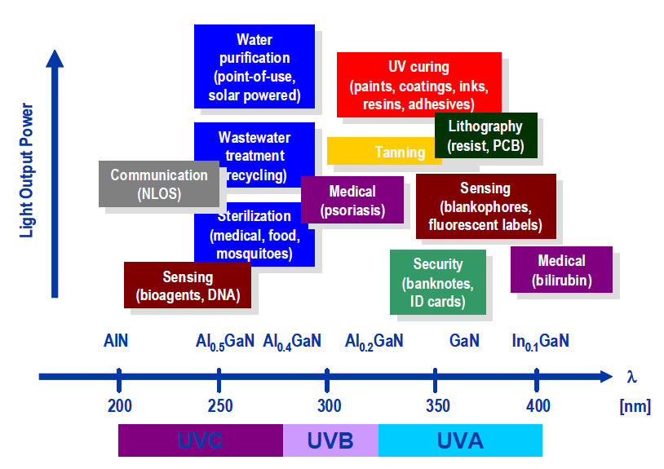
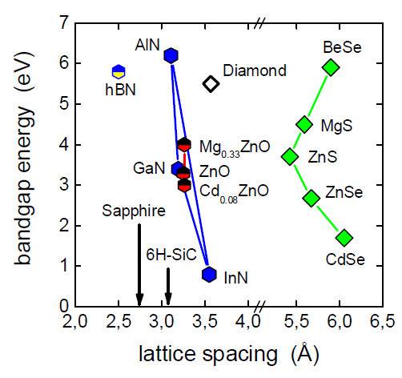
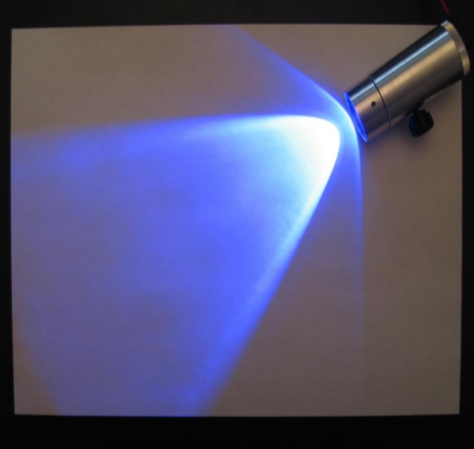
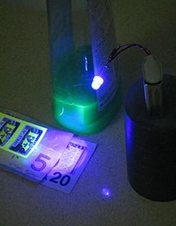
Materials for DUV LED
UVC region (290nm~100nm)
AlGaN system
AMSE 318 재료수치해석 (Numerical methods)

Slide 16
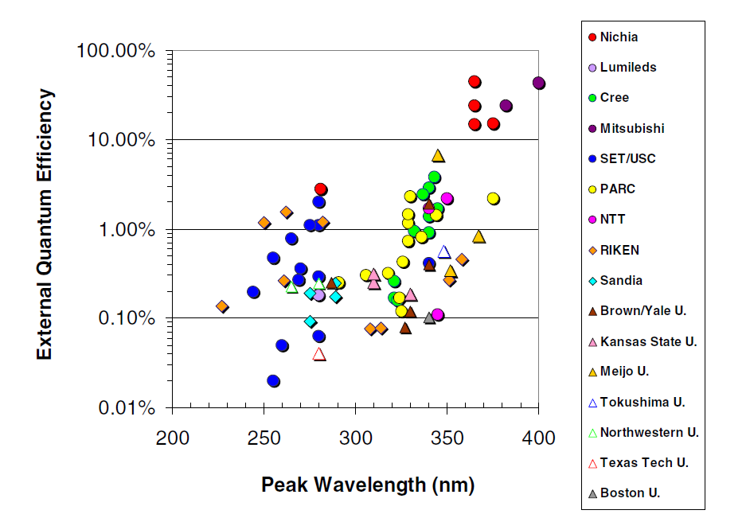
Low efficiency of DUV LEDs
M Kneissl et al. Semicond. Sci. Technol. 26 (2011) 014036 (6pp)
DUV
AMSE 318 재료수치해석 (Numerical methods)

Slide 17
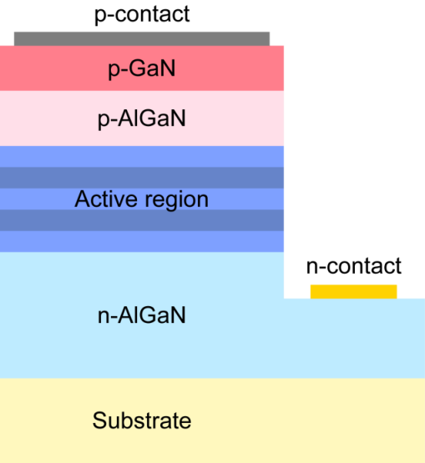
Low efficiency of DUV LEDs
Low hole concentration
Narrow band gap of p-GaN layer
Poor injection efficiency (< 10%)
Poor extraction efficiency (< 10%)
`
`
AMSE 318 재료수치해석 (Numerical methods)

Slide 18
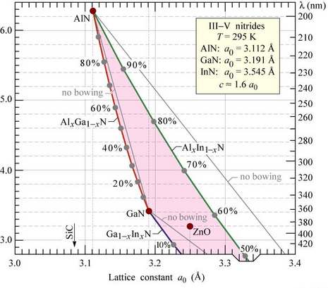
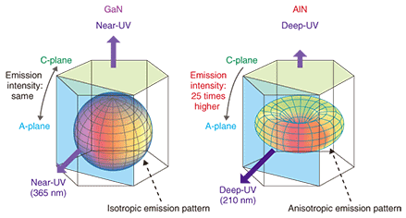
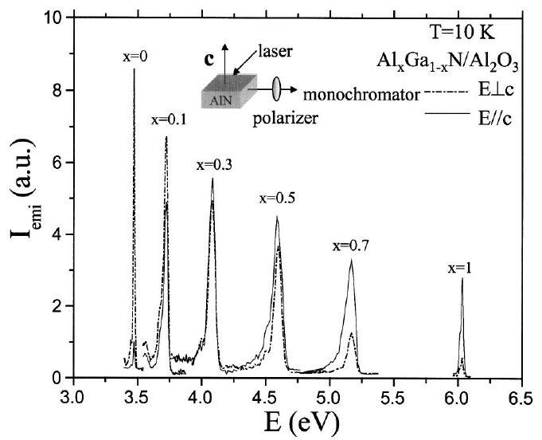
Low efficiency of DUV LEDs
Polarization effects
As GaN → AlN (Al contects increases in AlGaN),
Top-most polarized light is dominant
Edge emission is much stronger than surface emission
If we can change edge emitted light to top emitted light, light efficiency of DUV LED will be higher
Appl. Phys. Lett, (2004)
AMSE 318 재료수치해석 (Numerical methods)
Notes:
Low injection eff.
Low extraction eff.
Eff definition

Slide 19
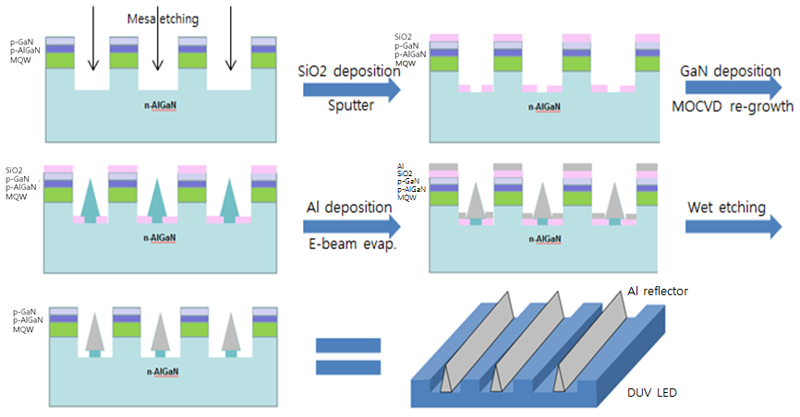
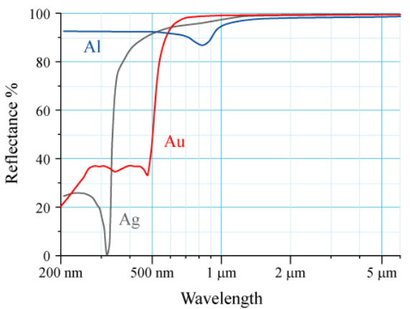
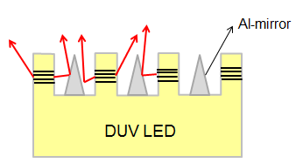
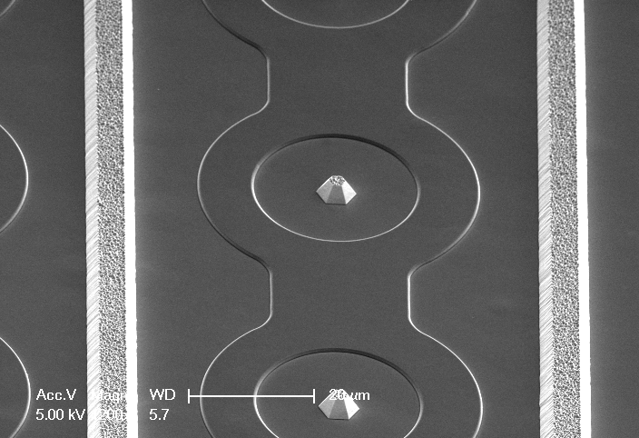
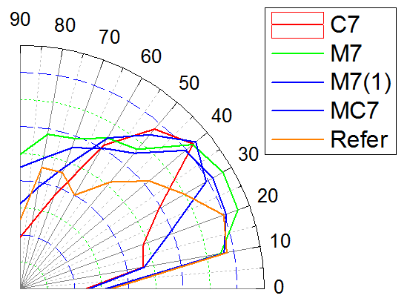
Using Al reflector to enhance top emission
Al pyramid reflector to enhance top emission
In our research,
Direction changed but
Not much increased
AMSE 318 재료수치해석 (Numerical methods)
Notes:
Low injection eff.
Low extraction eff.
Eff definition

Slide 20
P-GaN light loss in DUV LEDs
Narrow band gap of p-GaN layer
Poor extraction efficiency (< 10%)
Most Researchers try to extract light to the bottom emission
I want to use Al reflector
But,
How to apply, fabricate Al reflector to reflect bottom side?
`
`
AMSE 318 재료수치해석 (Numerical methods)
Notes:
Low injection eff.
Low extraction eff.
Eff definition

Slide 21
New IDEA
ICP etching
PR
PR
PR
PR
Thermal Reflow
Thermal Reflow
DUV LED
AlGaN MQW
PR
PR
PR
PR
DUV LED
AlGaN MQW
AlGaN MQW
AMSE 318 재료수치해석 (Numerical methods)
Notes:
Low injection eff.
Low extraction eff.
Eff definition

Slide 22
New IDEA
PR
PR
DUV LED
Dielectric layer
Al reflector layer
light is Reflected by
Al reflector
Total Internal reflection between AlGaN (n=2.5) and dielectric material
AMSE 318 재료수치해석 (Numerical methods)
Notes:
Low injection eff.
Low extraction eff.
Eff definition

Slide 23
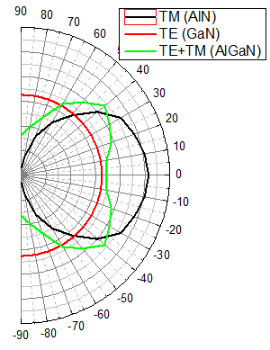
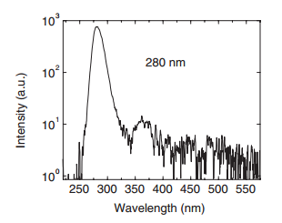
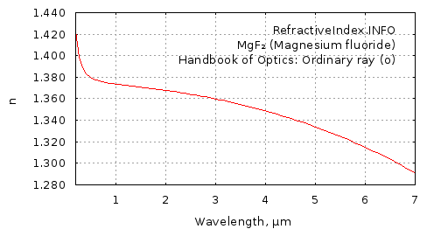
Input data
Polarization (direction)
TE mode (isotropic)
TM mode (anisotropic)
TE+TM mode (partially isotropic)
2. Light (wavelength) portion
DUV, UV region
250nm ~ 420nm
Dielectric layer
3. Refrective index depending on λ
Al reflector layer
4. Tilt angle (θ) of PR 5. Transparency of dielectric material
θ
AMSE 318 재료수치해석 (Numerical methods)
Notes:
Low injection eff.
Low extraction eff.
Eff definition

Slide 24
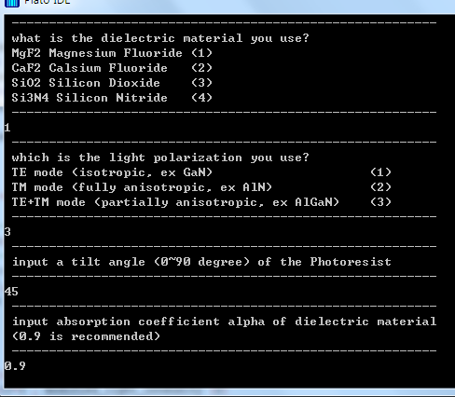
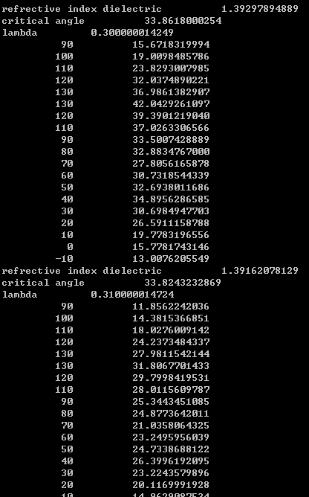
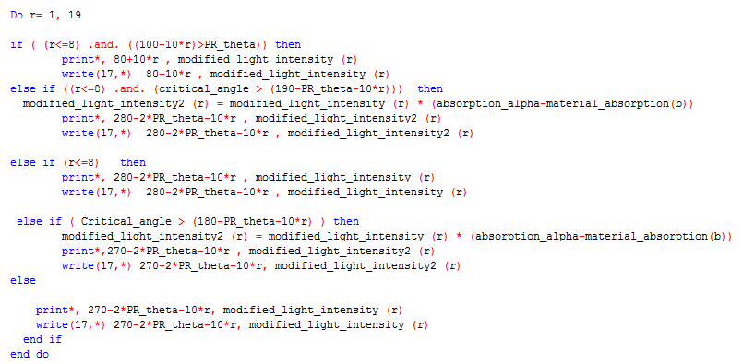
Fortran Code
TE polarization
Choose Polar mode
Choose λ (250-420)
λ portion 적용
Reflective index, Critical angle 계산
Angle 변화시키면서 이에 따른 도착 angle checking
TIR
180-2θ-ф
θ
Reflector가 충분히 커서 모든 빛에 영향을 미친다는 가정!
No count
Reflected by Al some light is absorbed
TIR
θ
θ
AMSE 318 재료수치해석 (Numerical methods)
Notes:
Low injection eff.
Low extraction eff.
Eff definition

Slide 25
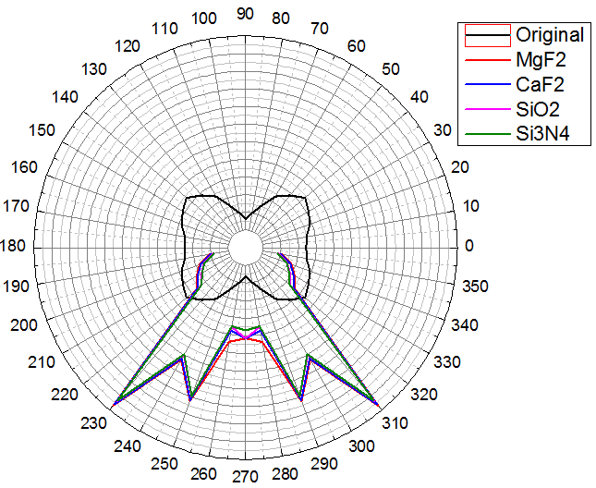
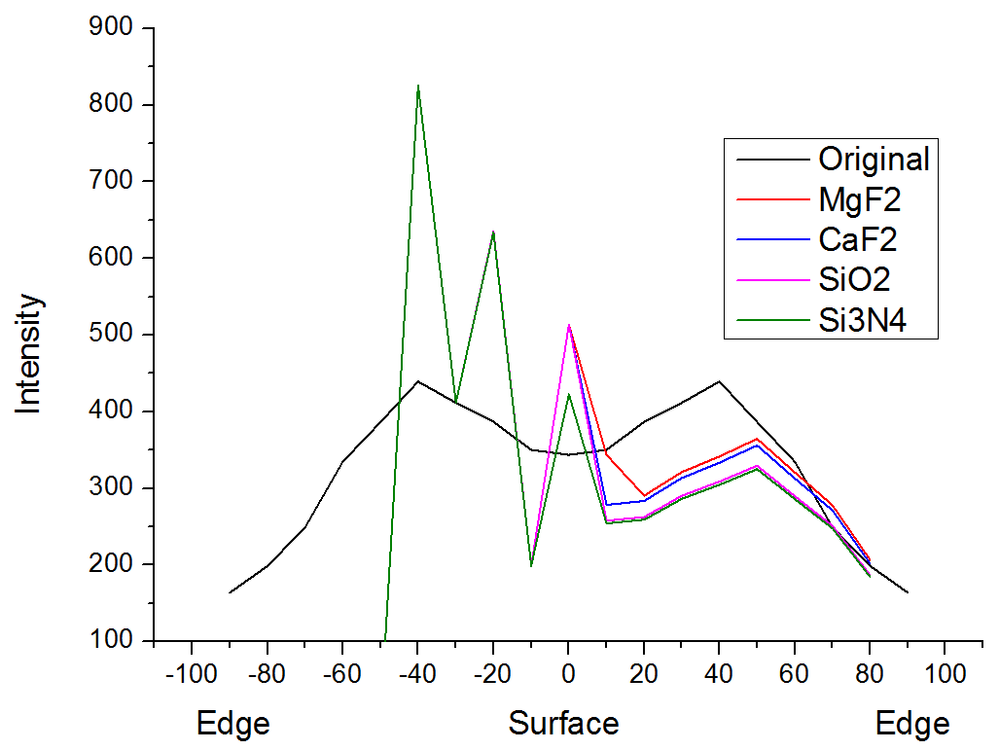
Results
Change dielectric material (MgF2, CaF2, SiO2, Si3N4)
(PR_tilt angle : 45 degree, TE+TM polarization)
Narrow range
TE+TM polarization
Efficiency (light output / light input)
MgF2 : 81.68%
CaF2 : 79.80%
SiO2 : 76.99%
Si3N4 : 75.02%
TIR
180-2θ-ф
θ
AMSE 318 재료수치해석 (Numerical methods)
Notes:
Low injection eff.
Low extraction eff.
Eff definition

Slide 26
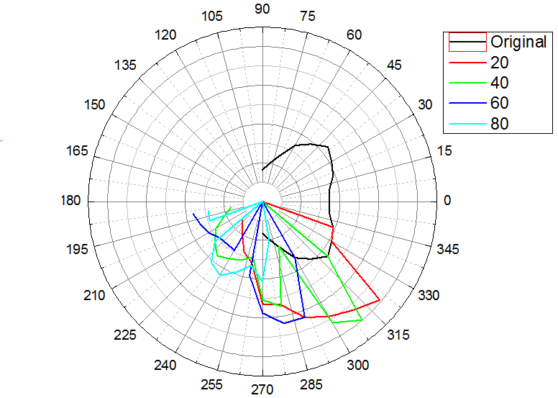
Results
2. Change PR_tilt angle θ (20, 40, 60, 80 degree)
(dielectric : MgF2, TE+TM polarization)
TE+TM polarization
TIR
180-2θ-ф
θ
Efficiency (light output / light input)
20 degree : 93.99%
40 degree : 89.77%
60 degree : 72.17%
80 degree : 49.80%
As tilt angle decreases,
Efficiency increases due to high percent of TIR
But not good at low angle emission
AMSE 318 재료수치해석 (Numerical methods)
Notes:
Low injection eff.
Low extraction eff.
Eff definition

Slide 27
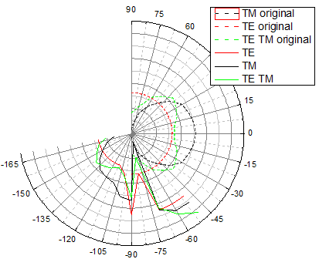
Results
3. Change Polarization mode (TE, TM, TE+TM mode)
(dielectric : MgF2, PR_tilt angle: 45 degree)
TE
TM
TE+TM polarization
TIR
180-2θ-ф
θ
Efficiency (light output / light input)
TE : 83.20%
TM : 90.70%
TE/TM : 87.10%
At some angle, light decreases
As TE → TM , more lights are reflected
AMSE 318 재료수치해석 (Numerical methods)
Notes:
Low injection eff.
Low extraction eff.
Eff definition

Slide 28
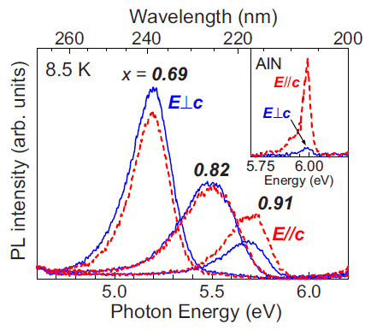
Conclusion & discussion
Conclusion
NEW IDEA를 이용한 bottom emission experiment 는 가능성이 있어 보인다
Dielectric material로는 MgF2를 쓰는 것이 좋다
PR_Tilt angle은 최대한 작으면 좋음 → viscosity가 작은 PR을 이용하여 Lithography를 해야 함
For more detail simulation…
Al composition 증가할 때 마다 Intensity 변화 고려
Fresnel reflection
defect, dislocation 에 의한 non-radiative recombination
Theta값, 파장 값 더 자세히 나누어야 함
모든 빛은 reflector 와 interaction한다는 가정을 고쳐야 함
Dielectric, reflector에 의한 흡수율 고려
AMSE 318 재료수치해석 (Numerical methods)
Notes:
Low injection eff.
Low extraction eff.
Eff definition

