Slide 1
소재수치해석
HW#6
이종관
Computational Materials Science and Engineering Lab.
Pohang University of Science and Technology

Slide 2
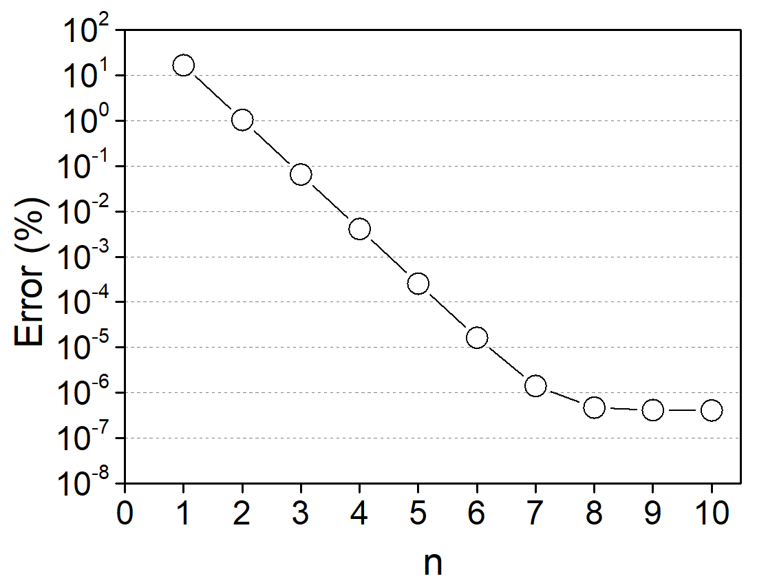
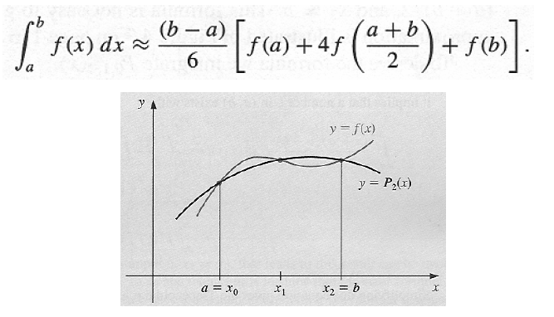
수치 적분
Simpson’s rule
$$h=0.8 × {(\frac{1}{2})}^{n−1}$$

Slide 3
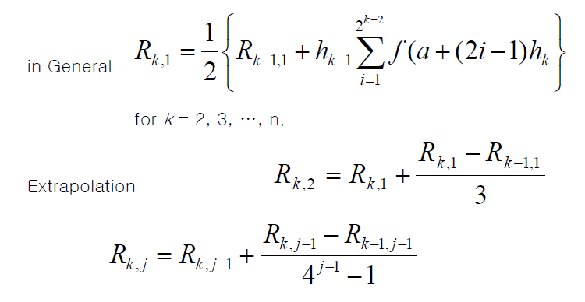
수치 적분
Romberg Integration
n=6, Answer = 1.64053334

