Slide 1
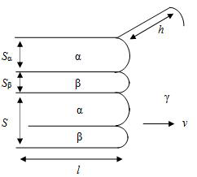
1. The Formation of Lamellar
Why the tip of each layer has a curvature?
→ The curvature is balance between surface tension and surface energy in local equilibrium. The slope of side of tip is fixed by surface tension,( ∵ force balance) and the nature want to lowest free energy at equilibrium, so the interface has smooth curve to reach the lowest free energy with given conditions.
b) Estimate the radius of curvature
Assume that each tip has a constant curvature.
r_{α}=-S_{α}/(2cosθ_{α}), r_{β}=-S_{β}/(2cosθ_{β})
We can get 2 equations from the force balance.
γ_{α}sin(π-θ_{α}) = γ_{β}sin(π-θ_{β})
γ_{αβ} = γ_{α}cos(π-θ_{α}) + γ_{β}cos(π-θ_{β})
We can get the relation of the angle and surface energies
cos θ_{α} = (γ_{β}²-γ_{α}²-γ_{αβ}²)/(2γ_{α}γ_{αβ})
cos θ_{α} = (γ_{α}²-γ_{β}²-γ_{αβ}²)/(2γ_{β}γ_{αβ})
∴ r_{α} = S_{α}γ_{α}γ_{αβ}/(γ_{αβ}²+γ_{α}²-γ_{β}²),
r_{β} = S_{β}γ_{β}γ_{αβ}/(γ_{αβ}²+γ_{β}²-γ_{α}²)
(S_{α} and S_{β} are proportional to S with coefficient determined by lever rule and phase diagram.)
Figure1. Force balance diagram
c) Show that ΔG_{capillarity}(S) = ΔG_{interfacial}(S)
Let δ is length of growth of tip.
ΔG_{capillarity}(S) = (γ_{α}/r_{α})S_{α}hδ+ (γ_{β}/r_{β})S_{β}hδ
= hδ{(γ_{αβ}²+γ_{α}²-γ_{β}²)/γ_{αβ}+(γ_{αβ}²+γ_{β}²-γ_{α}²)/γ_{αβ}}
= hδ(2γ_{αβ})
ΔG_{interfacial}(S) = hδ(2γ_{αβ})
∴ ΔG_{capillarity}(S) = ΔG_{interfacial}(S)
γ_{αβ}
γ_{α}
θ_{α}
δ
↔
θ_{β}
γ_{β}

Slide 2
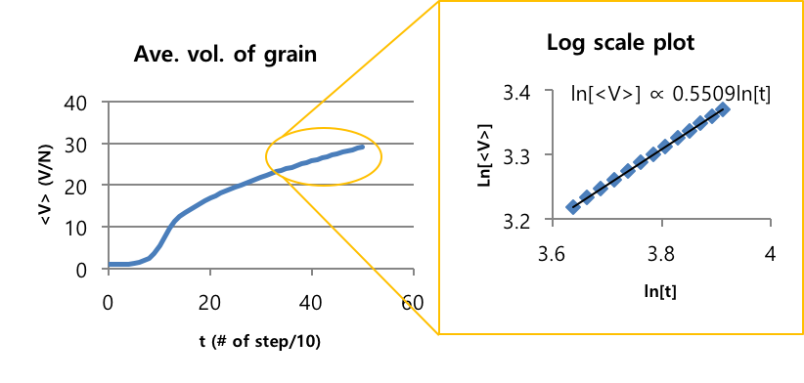
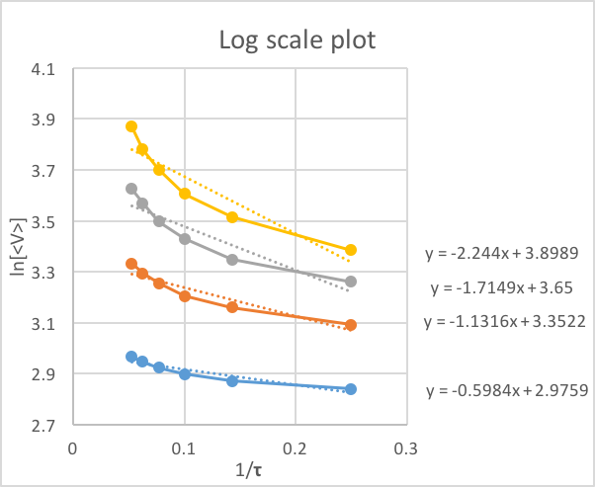
2. The Grain Growth with Monte Carlo Simulation
<V> = k₀exp(-ε/τ)t^{n} → ln[<V>] = ln[k₀] - ε/τ +n ln[t] ※ Bold letters are variables
a) Find the time dependence of the average grain size
Simulation setting:
Initial # of grains(N)= 512000
Total volume(V) = 512000
Total steps(10t) = 500
Sampling frequency = 10
Temperature level(τ) = 4
∴ n = 0.55
Find the temperature dependence of grain growth and the activation energy
Simulation setting:
Step1: prebaking
Initial # of grains = 64000
Total steps = 100
Temperature level = 4
Step2: grain growth
Initial # of grains = 11274
Total steps = 400
Sampling frequency = 100
Temperature level = 1,4,7,10,13,16,19
∴ The activation energy is increased as high temperature level
and time duration. It is related to the surface flatness.
# of steps
400
300
200
100

Slide 3
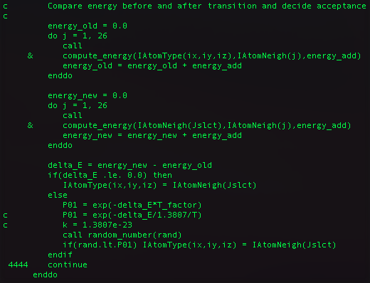
Appendix

Slide 4
Appendix

