Slide 1
소재수치해석
HW8
20100425 조 규 봉

Slide 2
1
HW 8
Problem

Slide 3
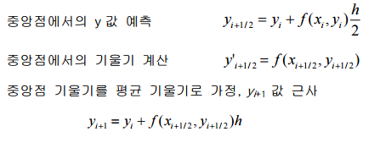
2
HW 8
Basic Concept
Euler method
Midpoint method

Slide 4
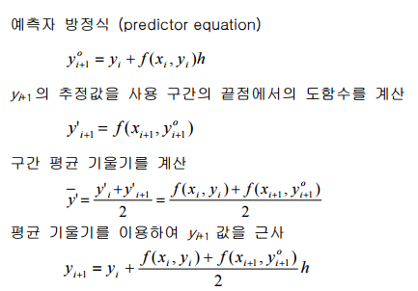
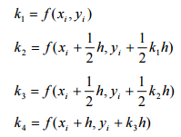
2
HW 8
Basic Concept
Heun method
Runge Kutta(4th) method

Slide 5
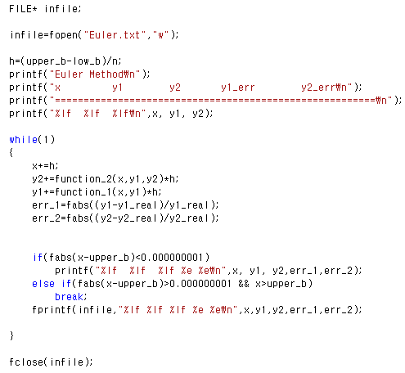
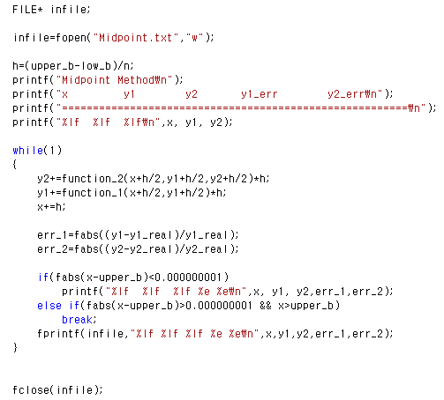
3
HW 8
Codes
Euler method
Midpoint method

Slide 6
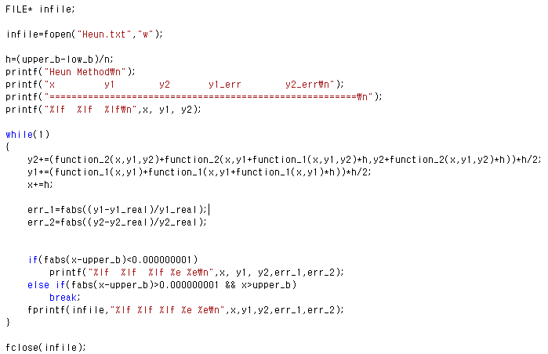
3
HW 8
Codes
Heun method

Slide 7
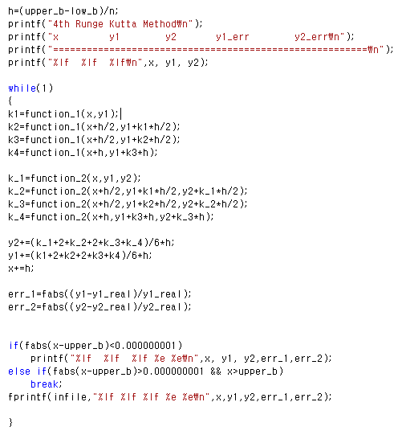
3
HW 8
Codes
4th RK method
y1
y2

Slide 8
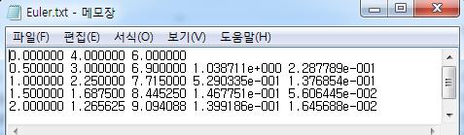
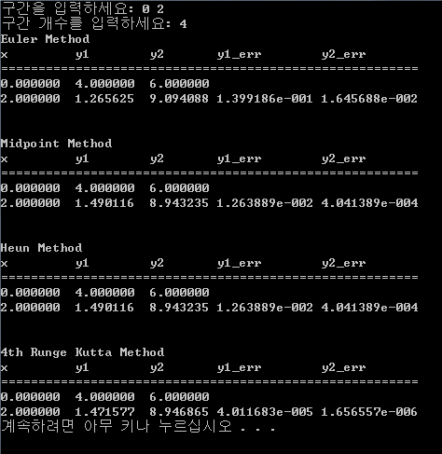
4
HW 8
Results
x=2일 때 y1=1.471517765, y2=8.946850279
h=0.5일 때

Slide 9
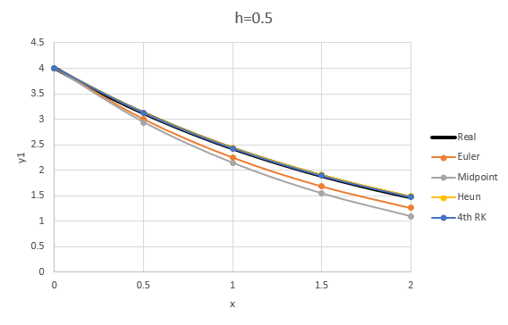
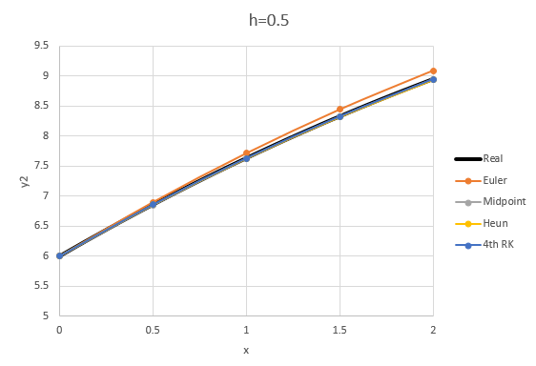
4
HW 8
Results

Slide 10
4
HW 8
Results
h 간격에 따라
Euler | y1 | y2
h=0.5 | 1.40E-01 | 1.65E-02
h=0.25 | 6.60E-02 | 7.98E-03
h=0.125 | 3.21E-02 | 3.93E-03
Heun | y1 | y2
h=0.5 | 1.26E-02 | 4.04E-04
h=0.25 | 2.86E-03 | 1.05E-04
h=0.125 | 6.83E-04 | 2.67E-05
4th RK | y1 | y2
h=0.5 | 4.01E-05 | 1.66E-06
h=0.25 | 2.26E-06 | 8.93E-08
h=0.125 | 1.34E-07 | 5.15E-09

Slide 11
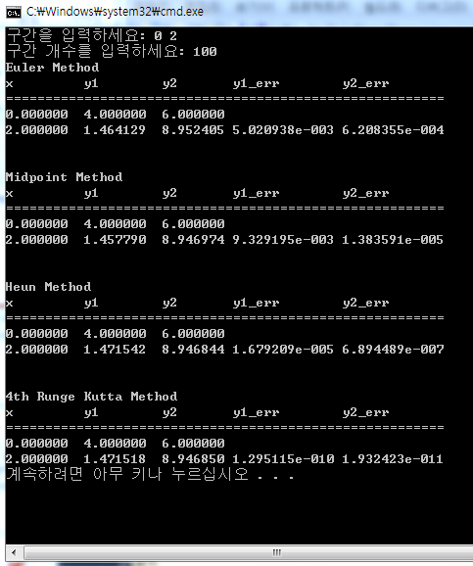
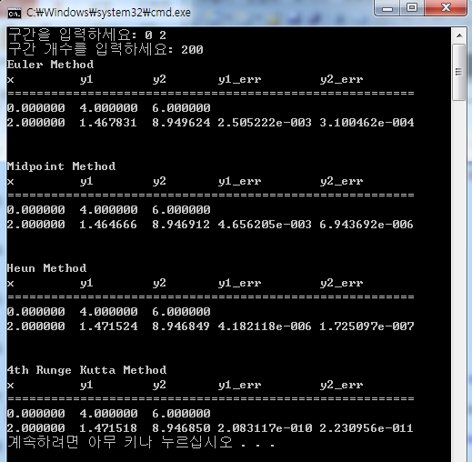
4
HW 8
Results

Slide 12
5
HW 8
Conclusion
4차 RK>Heun, Midpoint>Euler순으로 정확한 값을 예측한다.
구간의 크기가 작을수록 더 정확한 값을 예측한다.

Slide 13
감사합니다.

