Slide 1
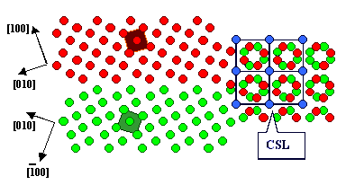
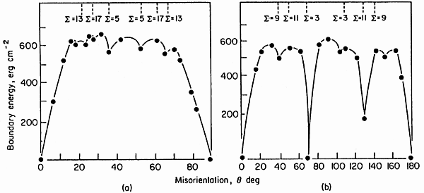
Problem 1. CSL boundary
20152027 조민국
Coincidence Site Lattice boundary
Special high-angle boundary
Partially coinciding points set
Low misfit strain energy because of good atomic fitting
Low grain boundary energy albeit high-angle boundary
Σ# : The reciprocal density of coincident lattice site

Slide 2

Problem 2. General multicomponent form of solute composition in surface
$$\sum_{i=1}^{n−1}{x_{i}^{φ}x_{n}^{B}}=\sum_{j=1}^{n−1}{x_{i}^{φ}x_{n}^{B}}e^{−ΔG_{j}^{seg}/RT} (from Hint)$$
$$x_{n}^{B}\left(1−x_{n}^{φ}\right)=\sum_{j=1}^{n−1}{x_{i}^{φ}x_{n}^{B}}e^{−ΔG_{j}^{seg}/RT} ∵\sum_{i=1}^{n}{x_{i}^{φ}}=1$$
$$\frac{x_{n}^{B}}{x_{n}^{φ}}=x_{n}^{B}+\sum_{j=1}^{n−1}{x_{j}^{B}e^{−ΔG_{j}^{seg}/RT}}$$
$$\frac{x_{n}^{B}}{x_{n}^{φ}}=1+\sum_{j=1}^{n−1}{x_{j}^{B}(e^{−ΔG_{j}^{seg}/RT}−1)} ∵\sum_{j=1}^{n}{x_{j}^{B}}=1$$
$$x_{i}^{φ}=\frac{x_{i}^{B}e^{−ΔG_{j}^{seg}/RT}}{\frac{x_{n}^{B}}{x_{n}^{φ}}} ∵\frac{x_{i}^{φ}}{x_{n}^{φ}}=\frac{x_{i}^{B}}{x_{n}^{B}}e^{−ΔG_{j}^{seg}/RT}$$
$$∴x_{i}^{φ}=\frac{x_{i}^{B}e^{−ΔG_{i}^{seg}/RT}}{1+\sum_{j=1}^{n−1}{x_{j}^{B}(e^{−\frac{ΔG_{j}^{seg}}{RT}}−1)}}$$

Slide 3
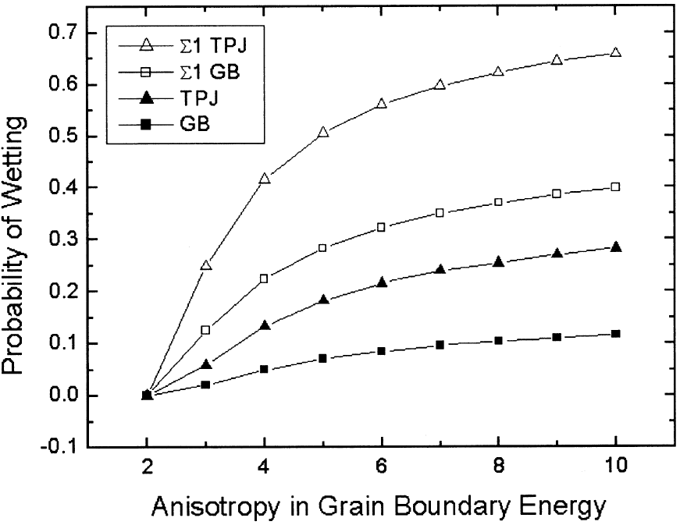
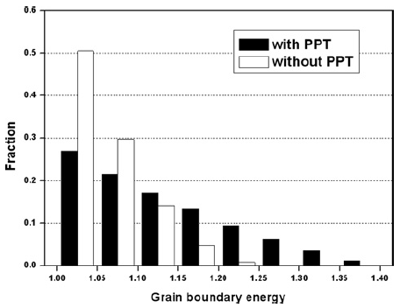
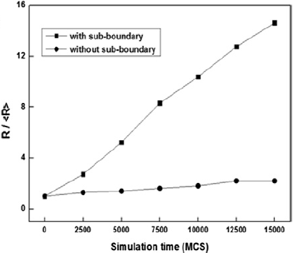
Problem 3. Abnormal grain growth
20152027 조민국
Grain growths affect by GB energy and GB mobility
AGG occurs at low grain boundary energy and high grain boundary mobility
Anisotropic grain boundary energy causes solid state wetting
Ex) for grain A :
Triple junction wetting is a mechanism of AGG
Precipitates inhibits NGG by pinning effect at grain boundary -> Increasing high energy grain boundaries promote AGG possibility
Sub-boundaries increase triple junction wetting possibility by containing low energy grain boundaries -> Increasing AGG possibility

