Slide 1
재료수치해석 HW.7
20100114 박재혁

Slide 2
Mid-Term

Slide 3
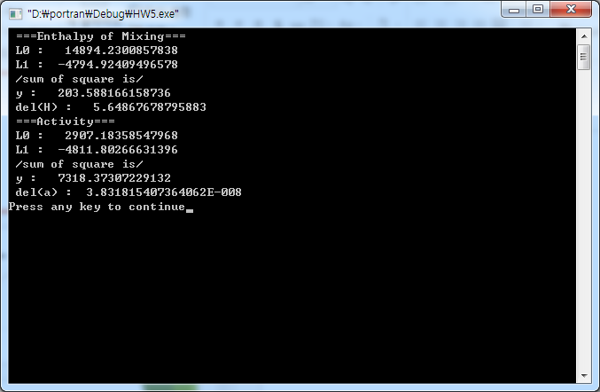
Liquid
$$L_{0}^{0}=14894.23…$$
$$L_{0}^{0}+L_{0}^{1}∗1500=2908.1836….$$
$$L_{1}^{0}=−4794.9241…$$
$$L_{1}^{0}+L_{1}^{1}∗1500=−4811.80267….$$
$$Ω_{L}=\left(14894.2306−7.9914T\right)−(4794.9255+0.0112T)X_{Tk}$$

Slide 4
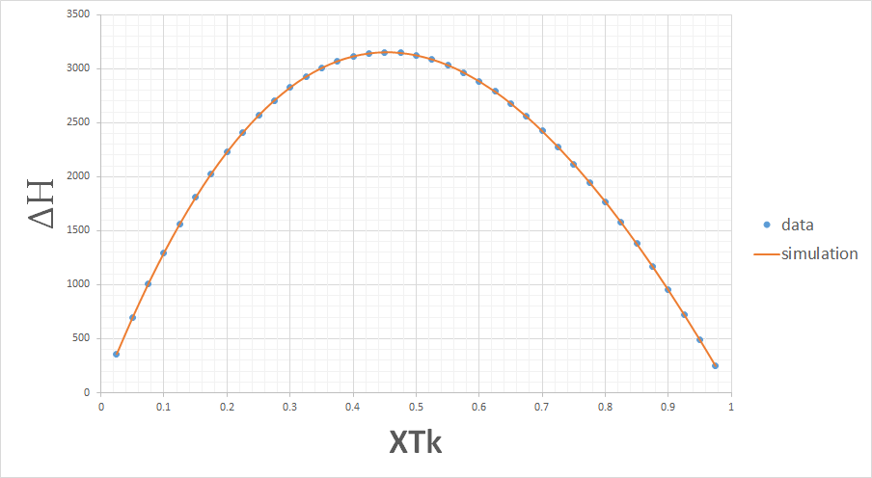
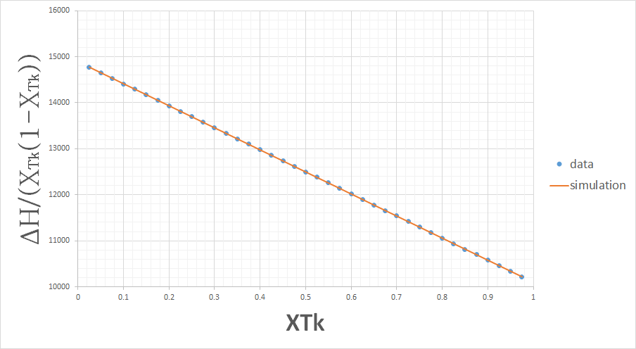
결과 값
<Enthalpy of mixing>

Slide 5
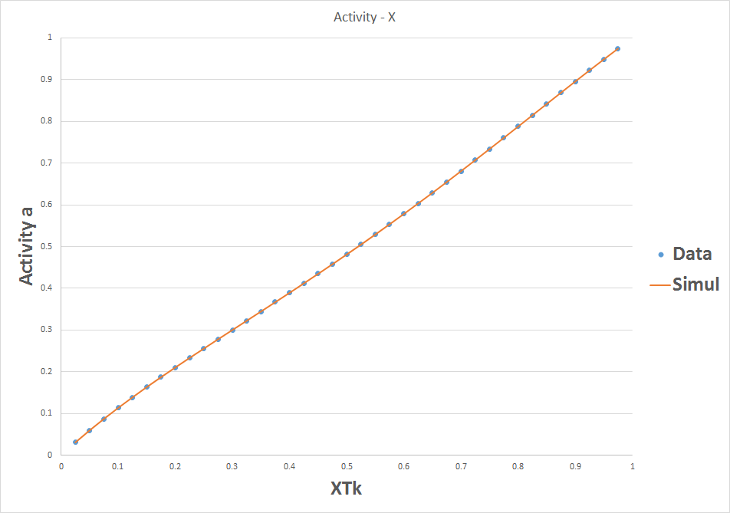
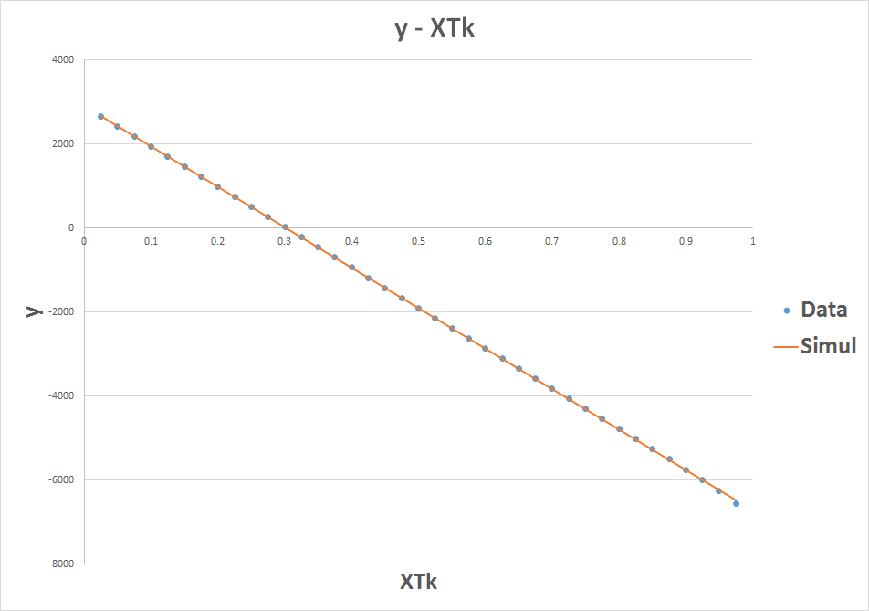
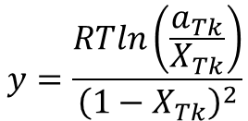
결과 값
<Activity>
$$y=\frac{RTln\left(\frac{a_{Tk}}{X_{Tk}}\right)}{{\left(1−X_{Tk}\right)}^{2}}$$

Slide 6
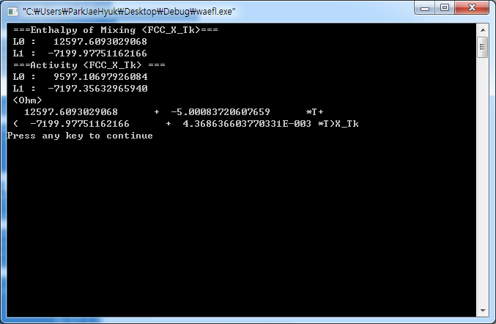
FCC
<Enthalpy>
y = $\frac{∆H^{f}−X_{Tk}∆G_{Tk}^{bcc→fcc}}{ X_{Tk}(1−X_{Tk})}=L_{0}+L_{1}X_{Tk}$
<Activity>
y = $\frac{RTln(\frac{a_{Tk}}{X_{Tk}})−∆G_{Tk}^{bcc→fcc}}{ {\left(1−X_{Tk}\right)}^{2}}=L_{0}+{2L}_{1}X_{Tk}$
$$Ω_{FCC}=\left(12597.6093−5.0008T\right)+\left(−7199.9775+0.004369T\right)X_{Ps}$$

Slide 7
결과 값
<Enthalpy of mixing>

Slide 8
결과 값
<Activity>

Slide 9
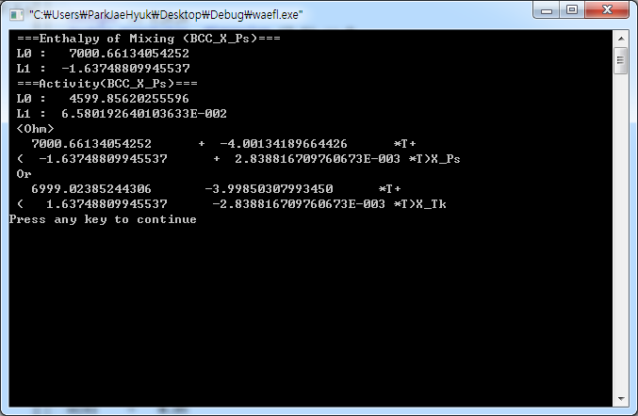
BCC
<Enthalpy>
y = $\frac{∆H^{f}−X_{Ps}∆G_{Ps}^{fcc→bcc}}{ X_{Ps}(1−X_{Ps})}=L_{0}+L_{1}X_{Ps}$
<Activity>
y = $\frac{RTln(\frac{a_{Ps}}{X_{Ps}})−∆G_{Ps}^{fcc→bcc}}{ {\left(1−X_{Ps}\right)}^{2}}=L_{0}+{2L}_{1}X_{Ps}$
$$Ω_{BCC}=\left(7000.6613−4.0013T\right)+\left(−1.6375+0.00284T\right)X_{Ps}$$
$$Ω_{BCC}=\left(6999.0239−3.9985T\right)+\left(1.6375−0.00284T\right)X_{Tk}$$

Slide 10
결과 값
<Enthalpy of mixing>

Slide 11
결과 값
<Activity>

Slide 12
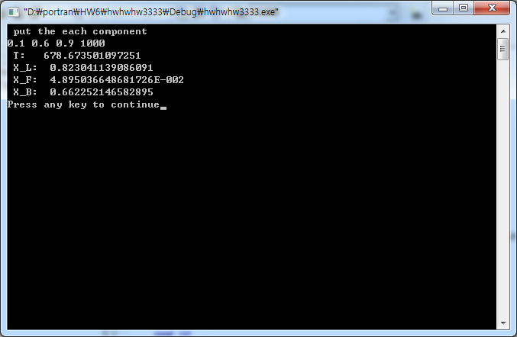
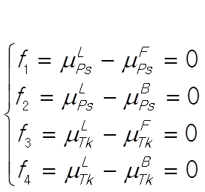
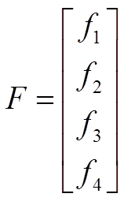
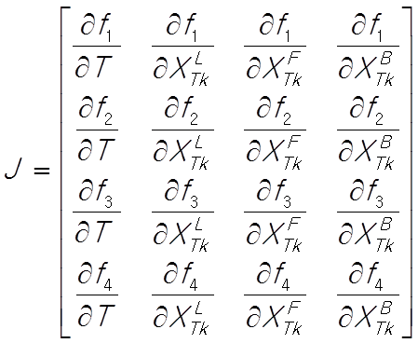
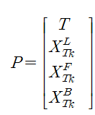
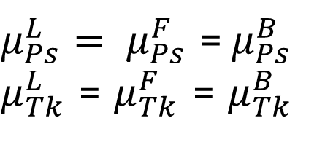
Peritectic point
$μ_{Ps}^{L}= μ_{Ps}^{F}$ =$μ_{Ps}^{B}$ $μ_{Tk}^{L}$ = $μ_{Tk}^{F}$ = $μ_{Tk}^{B}$

Slide 13
