Slide 1
HW9 Finite Difference Methods
20100366 이원태

Slide 2
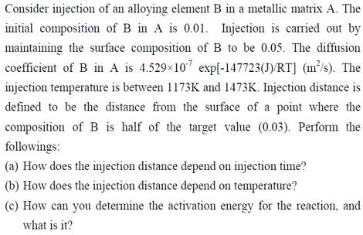
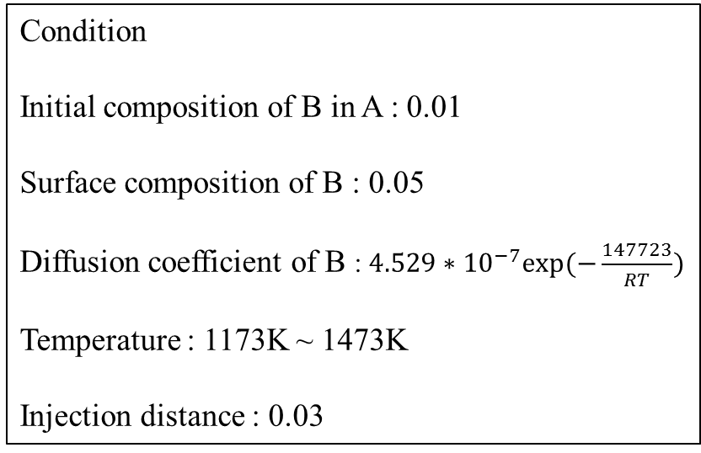
HW#9
Condition
Initial composition of B in A : 0.01
Surface composition of B : 0.05
Diffusion coefficient of B : $4.529∗{10}^{−7}exp⁡(−\frac{147723}{RT})$
Temperature : 1173K ~ 1473K
Injection distance : 0.03

Slide 3
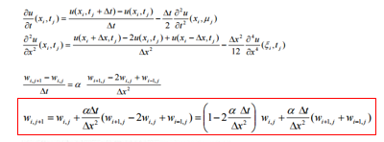
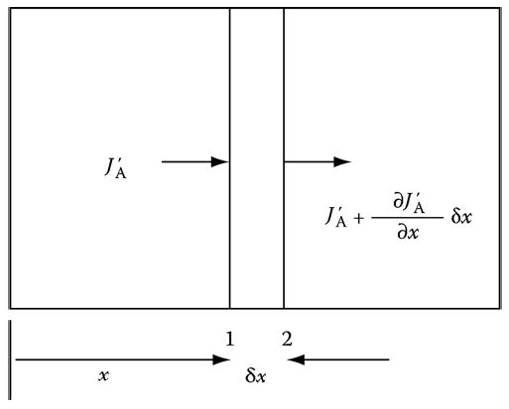
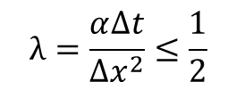
Background
When i=0, W_{i,j} = 0.05 for boundary condition
When i=n
$$λ=\frac{α∆t}{{∆x}^{2}}≤\frac{1}{2}$$
$$J_{2}=J_{1}+∆x∗\frac{∂J}{∂x} → w_{n+1}^{k}=w_{n}^{k}+∆x∗g(t)$$
When i=0 & i=n, How we can determine the w_{i,j}??

Slide 4
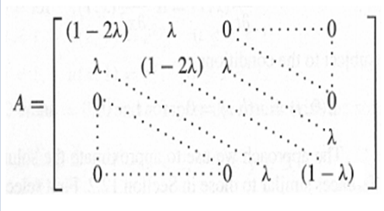
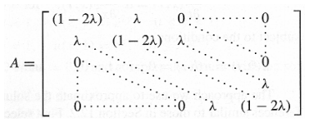
Background
$${1) w}_{n+1}^{k}=w_{n}^{k}+∆x∗g(t)$$
${2) w}_{n}^{k+1}={Aw}_{n}^{k}+g$(t)
$${ w}_{n}^{k+1}={Aw}_{n}^{k}(g\left(t\right)=0)$$

Slide 5
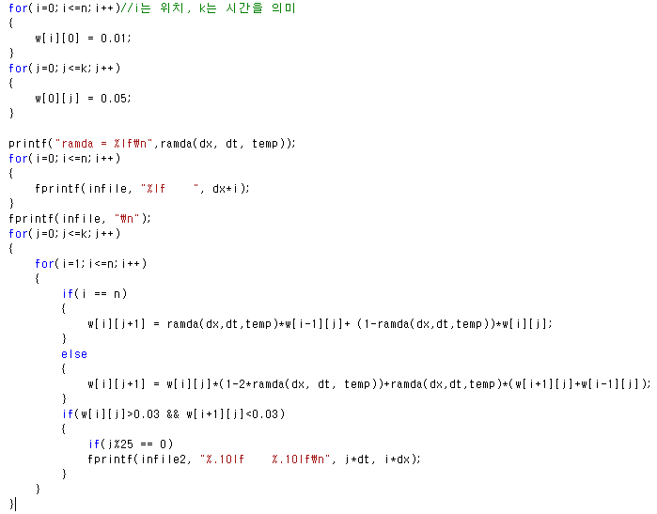
Key Code
Boundary condition & Initial condition
$${ w}_{n}^{k+1}={Aw}_{n}^{k}$$

Slide 6
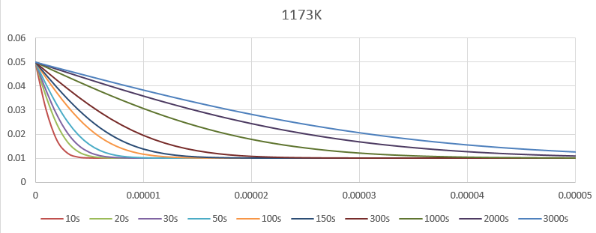
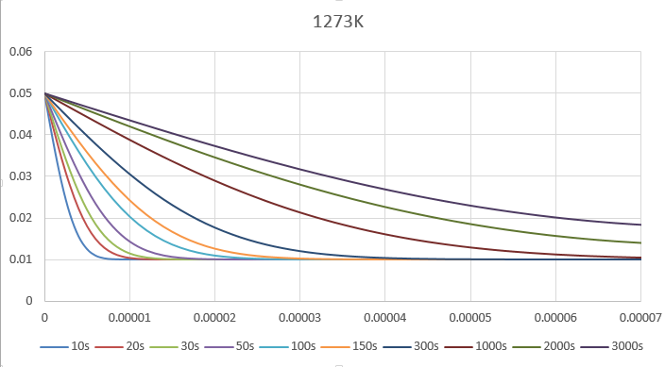
Results
1173K, dx = 0.000001, dt = 1
1273K, dx = 0.000001, dt = 1

Slide 7
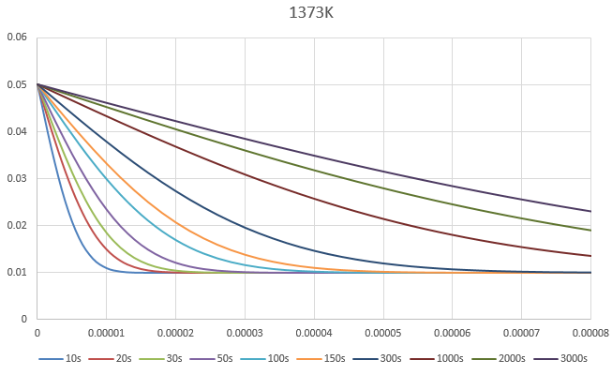
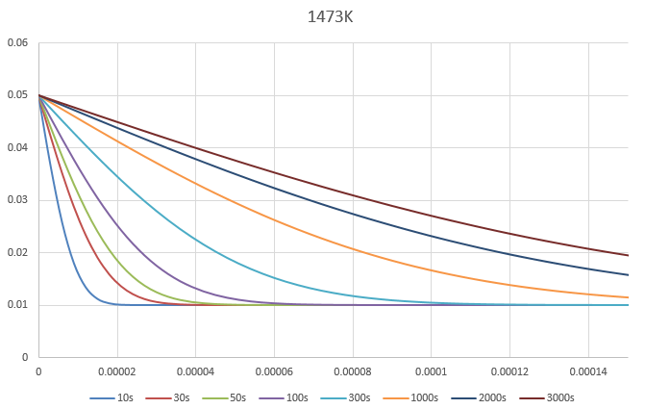
1373K, dx = 0.000002, dt = 1
1473K, dx = 0.000003, dt = 1

Slide 8
Results
a) How does the injection distance depend on injection time?
Linear!!
Injection distance(m)
$$\sqrt{Time}$$

Slide 9
Results
b) How does the injection distance depend on Temperature

Slide 10
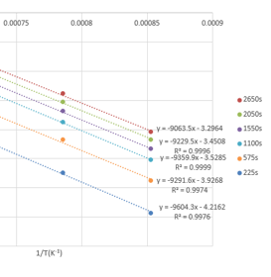
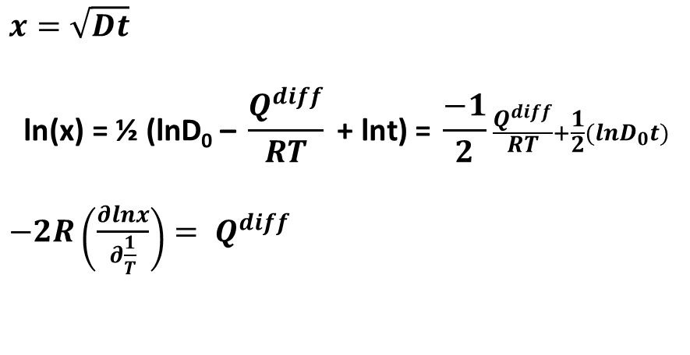
Results
c) How can you determine the activation energy?(Two method)
1) Using ln(x) & 1/T graph
$$x=\sqrt{Dt}$$
$$\text{ln}\text{(}\text{x}\text{) = ½ (}\text{lnD}\text{0}\text{ – }\frac{Q^{diff}}{RT}\text{ + }\text{lnt}\text{) = }\frac{−1}{2}\frac{Q^{diff}}{RT}+\frac{1}{2}(lnD_{0}t)$$
$−2R\left(\frac{∂lnx}{∂\frac{1}{T}}\right)= Q^{diff}$
Activation Energy = 154809.8J, Error = 4.797%(Real value = 147723J)

Slide 11
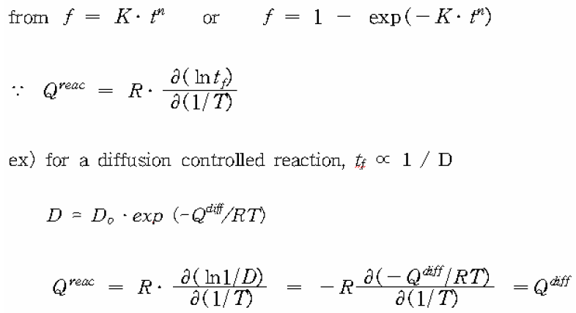
Results
2) Using ln(tf) & 1/T graph

Slide 12
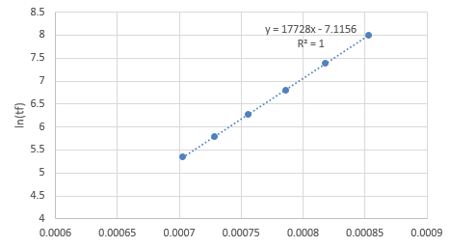
Results
$$Activation Energy : R∗17728=147398.6J, Real value=147723J (Error=0.219\%)$$

Slide 13
Conclusion
Explicit method를 이용하여, 특정 시간의, 시편 내 원소 농도를 성공적으로 구할 수 있다.
ɑ 값이 0.5보다 커지면, 프로그램 자체가 돌아가지 않았으며, Temperature가 높을수록, Injection time이 길 수록, Injection distance가 커지는 것을 알 수 있었다.

Slide 14
Thank you

