Slide 1
소재수치해석 Mid-term Report
20150060 김영우

Slide 2
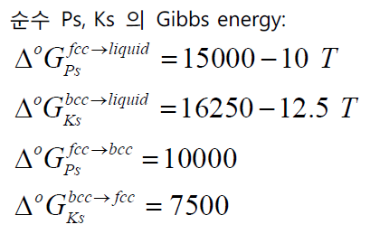
Problem
주어진 실험 정보
Regression을 이용해 L parameter구하기(HW5)
Equilibrium condition 의 Chemical potential 을 이용하여 식 만들기
Newton’s method: Raw한 phase diagram 그리기
Eutectic point의 condition 을 이용해 식 만들기
Newton’s method: Eutectic point 구하기
Phase diagram 완성!!!
액상에서의 Enthalpy of mixing (J/mol)
1500K 액상에서 Ks의 활동도 (ref : Liq Ks)
Enthalpy of Formation in FCC and BCC
Activity of Ps in BCC at 1100K (ref : FCC Ps)
Activity of Ks in FCC at 1100K (ref : BCC Ks)

Slide 3
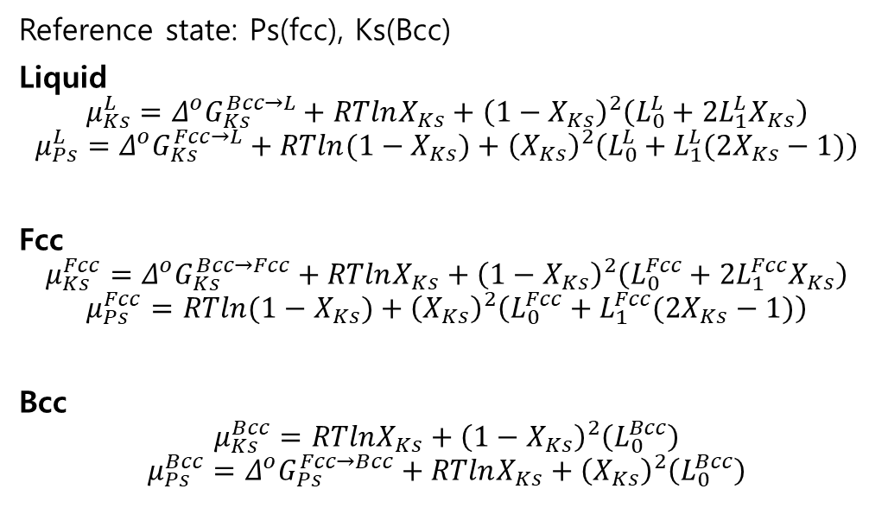
Equation
HW5
Reference state: Ps(fcc), Ks(Bcc)
Liquid
$$μ_{Ks}^{L}=Δ^{o}G_{Ks}^{Bcc→L}+RTlnX_{Ks}+{\left(1−X_{Ks}\right)}^{2}\left(L_{0}^{L}+2L_{1}^{L}X_{Ks}\right)$$
$$μ_{Ps}^{L}=Δ^{o}G_{Ks}^{Fcc→L}+RTln{(1−X}_{Ks})+{\left(X_{Ks}\right)}^{2}\left(L_{0}^{L}+L_{1}^{L}(2X_{Ks}−1)\right)$$
Fcc
$$μ_{Ks}^{Fcc}=Δ^{o}G_{Ks}^{Bcc→Fcc}+RTlnX_{Ks}+{\left(1−X_{Ks}\right)}^{2}\left(L_{0}^{Fcc}+2L_{1}^{Fcc}X_{Ks}\right)$$
$$μ_{Ps}^{Fcc}=RTln{(1−X}_{Ks})+{\left(X_{Ks}\right)}^{2}\left(L_{0}^{Fcc}+L_{1}^{Fcc}(2X_{Ks}−1)\right)$$
Bcc
$$μ_{Ks}^{Bcc}=RTlnX_{Ks}+{\left(1−X_{Ks}\right)}^{2}\left(L_{0}^{Bcc}\right)$$
$$μ_{Ps}^{Bcc}=Δ^{o}G_{Ps}^{Fcc→Bcc}+RTlnX_{Ks}+{\left(X_{Ks}\right)}^{2}\left(L_{0}^{Bcc}\right)$$
Liquid
$$Ω=14894.2306−7.9913T+\left(−4794.9255−0.0112T \right)X_{Ks}$$
FCC
$$Ω=12597.609−4.9978T+\left(−7199.9779−0.0003T \right)X_{Ks}$$
BCC
$$Ω=6995.6566−3.9960T$$
Liquid-FCC
Liquid-BCC
BCC-FCC
Equilibrium condition
$$μ_{Ps}^{L}=μ_{Ps}^{F}$$
$$μ_{Ps}^{L}=μ_{Ps}^{B}$$
$$μ_{Ps}^{B}=μ_{Ps}^{F}$$
$$μ_{Ks}^{L}=μ_{Ks}^{F}$$
$$μ_{Ks}^{L}=μ_{Ks}^{B}$$
$$μ_{Ks}^{B}=μ_{Ks}^{F}$$

Slide 4
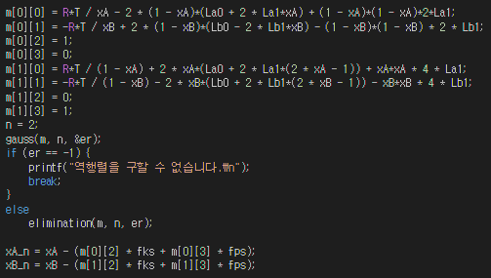
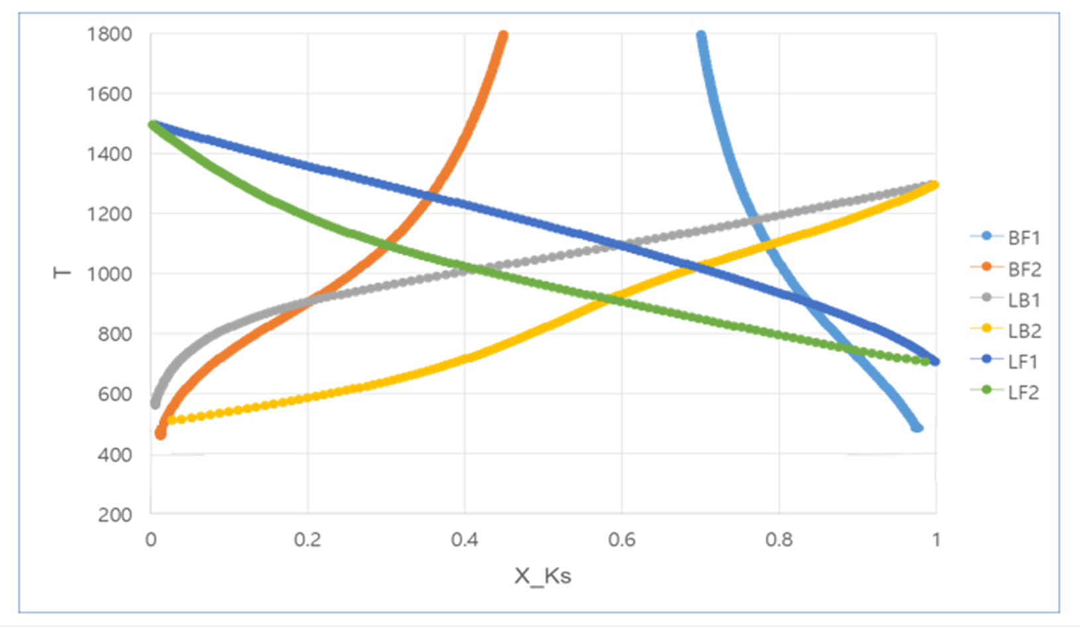
Result
Eutectic temperature

Slide 5
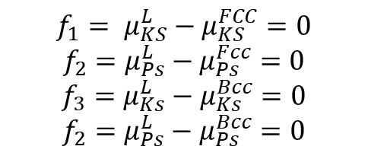
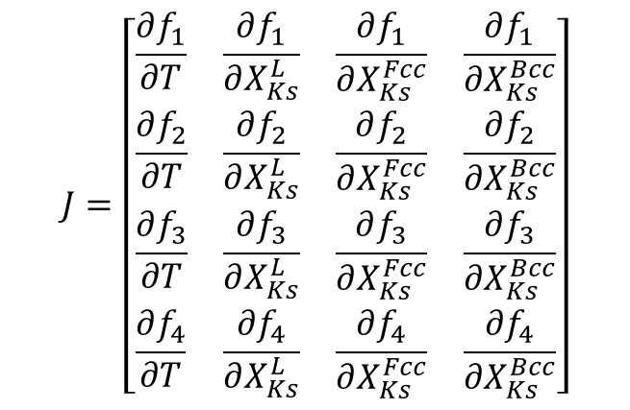
Eutectic Point
$$J=\left[\begin{matrix}\begin{matrix}\frac{∂f_{1}}{∂T} & \frac{∂f_{1}}{∂X_{Ks}^{L}} \\ \frac{∂f_{2}}{∂T} & \frac{∂f_{2}}{∂X_{Ks}^{L}}\end{matrix} & \begin{matrix}\frac{∂f_{1}}{∂X_{Ks}^{Fcc}} & \frac{∂f_{1}}{∂X_{Ks}^{Bcc}} \\ \frac{∂f_{2}}{∂X_{Ks}^{Fcc}} & \frac{∂f_{2}}{∂X_{Ks}^{Bcc}}\end{matrix} \\ \begin{matrix}\frac{∂f_{3}}{∂T} & \frac{∂f_{3}}{∂X_{Ks}^{L}} \\ \frac{∂f_{4}}{∂T} & \frac{∂f_{4}}{∂X_{Ks}^{L}}\end{matrix} & \begin{matrix}\frac{∂f_{3}}{∂X_{Ks}^{Fcc}} & \frac{∂f_{3}}{∂X_{Ks}^{Bcc}} \\ \frac{∂f_{4}}{∂X_{Ks}^{Fcc}} & \frac{∂f_{4}}{∂X_{Ks}^{Bcc}}\end{matrix}\end{matrix}\right]$$
$$f_{1}= μ_{KS}^{L}−μ_{KS}^{FCC}=0$$
$$f_{2}=μ_{Ps}^{L}−μ_{Ps}^{Fcc}=0$$
$$f_{3}=μ_{Ks}^{L}−μ_{Ks}^{Bcc}=0$$
$$f_{2}=μ_{Ps}^{L}−μ_{Ps}^{Bcc}=0$$
$x_{Ks}^{L}$, $x_{Ks}^{FCC}$, $x_{Ks}^{BCC}$, T

Slide 6
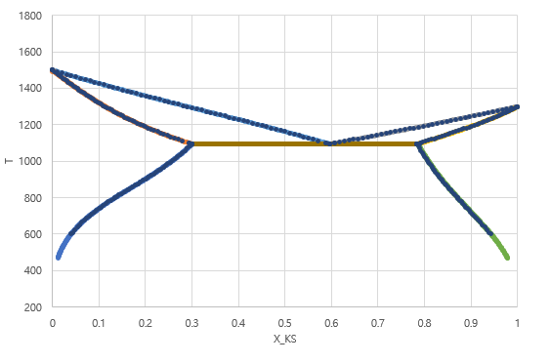
Ps – Ks Phase Diagram
 | $$x_{Ks}^{L}$$ | $$x_{Ks}^{FCC}$$ | $$x_{Ks}^{BCC}$$ | T
실제 값 | 0.595539 | 0.299879 | 0.783979 | 1095.4077
구한 값 | 0.596029 | 0.299871 | 0.784936 | 1095.1091
상대 오차 | 0.082278% | 0.002668% | 0.122070% | 0.027259%
Liquid
FCC+Liquid
Liquid+BCC
FCC
BCC
Ps의 melting point: 1500 K
Ks의 melting point: 1300 K
Eutectic temperature: 1095 K
Eutectic composition: 0.60
FCC+BCC

Slide 7
Discussion & Conclusion
T 시작점: melting point를 정확히 알 수 없음
->eutectic point에서 시작
Jacobian matrix 를 만들 수 있는 미분 코딩은 불가능할까…
전체는 힘들더라도 식의 구조를 단순화 해서 반복하면 좋을 것 같다. 일일이 입력하다 보니 오타문제로 인한 오류에 고생했다.

