Slide 1
소재수치해석 HW6
20100507 장재덕

Slide 2
problem
Liquid, Fcc, Bcc에 대한 정보를 바탕으로 회귀 분석을 사용하여 Gibbs energy of mixing을 표현하라.

Slide 3
concept
Solution Model
Non-ideal Solution
Regular Solution
Sub-regular Solution
Ideal Solution

Slide 4
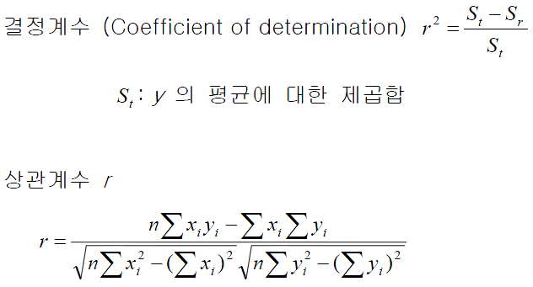
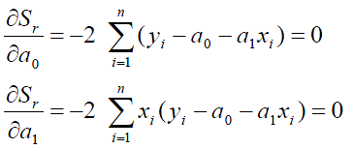
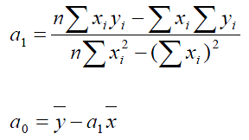
Concept
Linear Regression
: deviation
: minimizing sum of squares of deviation
오차의 정량화

Slide 5
Concept
Enthalpy of mixing
Activity

Slide 6
Concept
In Fcc, Enthalpy of formation
In Fcc, Activity
$$=L_{0}+L_{1}X_{Tk}$$
$$\frac{RTln\left(\frac{a_{Tk}}{X_{Tk}}\right)−∆G_{Tk}^{B→F}}{{{(1−X}_{Tk})}^{2}}=L_{0}+{2L}_{1}X_{Tk}$$

Slide 7
Concept
In Bcc, Enthalpy of formation
In Bcc, Activity
$$=L_{0}+L_{1}X_{Tk}$$
$$\frac{RTln\left(\frac{a_{ps}}{{1−X}_{Tk}}\right)−∆G_{ps}^{F→B}}{{X_{Tk}}^{2}}=L_{0}+{2L}_{1}X_{Tk}$$

Slide 8
Code

Slide 9
Code

Slide 10
Result - liquid

Slide 11
Result - liquid
$$r^{2}=0.999997132$$
$$r^{2}=0.999974605$$

Slide 12
Result - Fcc

Slide 13
Result - Fcc
$$r^{2}=0.999997431$$
$r^{2}=0.99999$4074

Slide 14
Result - Bcc

Slide 15
Result - Bcc
$$r^{2}=0.00705652$$
$$r^{2}=0.13881539$$

Slide 16
Thank you~!
회귀 분석을 통하여 phase별로 enthalpy와 activity에 대한 수식을 성공적으로 구할 수 있었다.

