Slide 1
소재수치해석 HW 4
20110073 김용민

Slide 2
HW

Slide 3
비선형 연립방정식
$L^{P}$=0 (ideal solution)
$μ_{Si}^{L}=μ_{Si}^{dia}, μ_{Ge}^{L}=μ_{Ge}^{dia}$
$∆^{°}G_{Si}^{dia→L}+RTln x_{Si}^{L}=RTln x_{Si}^{dia}, ∆^{°}G_{Ge}^{dia→L}+RTln x_{Ge}^{L}=RTln x_{Ge}^{dia}$
$\begin{matrix}50208.00−29.7617T+RTln x_{1}−RTln x_{2} \\ 50208.00−29.7617T+RTln (1−x_{1})−RTln (1−x_{2})\end{matrix}=0$

Slide 4
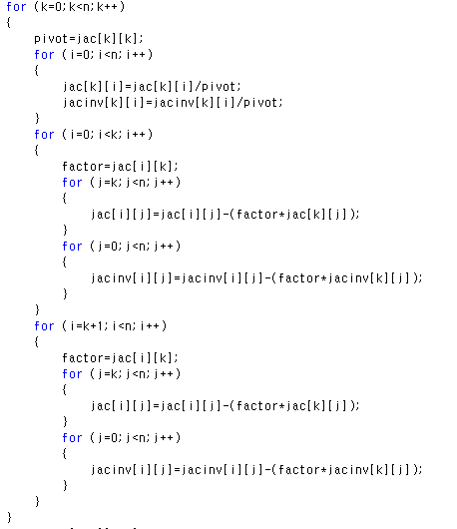
Code1: inverse matrix
2
1
3

Slide 5
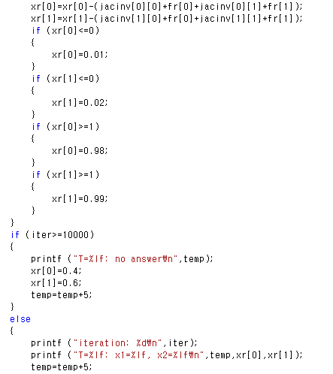
Code2: nonlinear equation

Slide 6
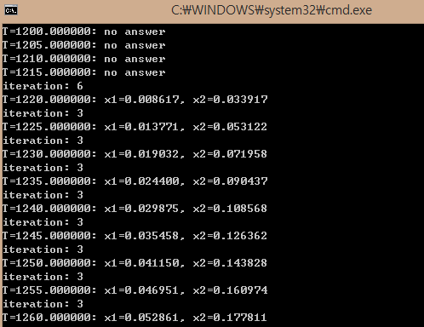
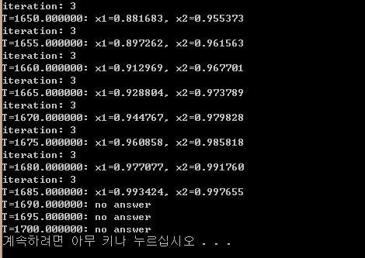
result

Slide 7
Result

