Slide 1
Interpolation
Lagrange polynomial and Cubic spline
Seungpyo Hong
Flow Physics and Engineering Lab.
Department of Mechanical Engineering
POSTECH

Slide 2
Problem
Make a program that interpolates arbitrary data points.
Demonstrate the program with natural logarithm curve.
ln 1 = 0
ln 3 = 1.09861228866811
ln 4 = 1.38629436111989
ln 6 = 1.79175946922805
Compare the value at 2 by using Lagrange interpolation and cubic spline.

Slide 3
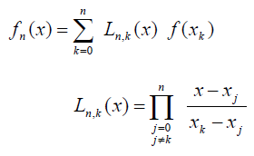
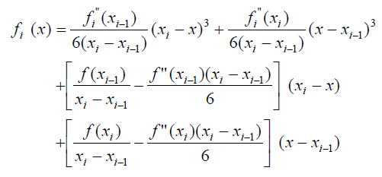
Formulation
Lagrange polynomial
Integration
Cubic Spline
TDMA

Slide 4
Structure of the program
PROGRAM LagSpline
END PROGRAM LagSpline
Choose the datafile to read and the method (Lagrange or Cubic)
Allocate arrays
1: Lagrange polynomial
- Calculate the basis function for each data point.
- Summation over the values of the function multiplied by basis functions.
- Write the values over the prescribed domain
2: Cubic Spline
- Make tridiagonal matrix for getting second derivatives of the function
- Use gauss elimination to get the values
- By using those values, form polynomials in each section
- Write the values over the prescribed domain
Deallocate arrays

Slide 5
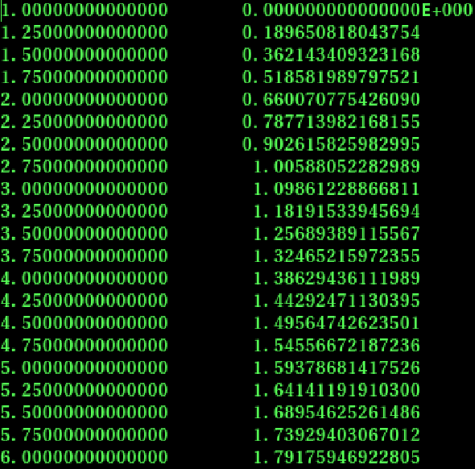
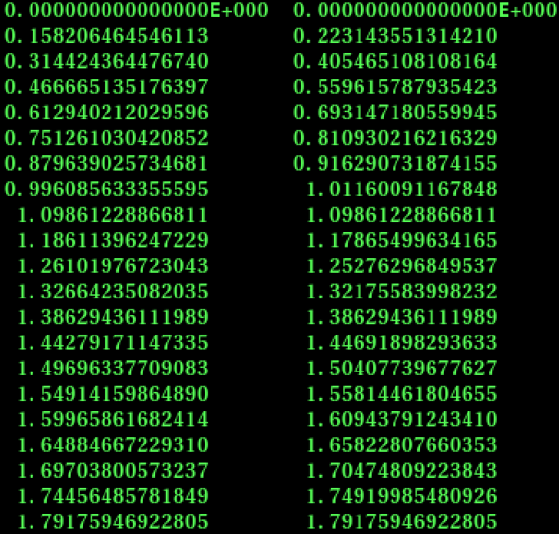
Results
Data points Lagrange Cubic Exact

Slide 6
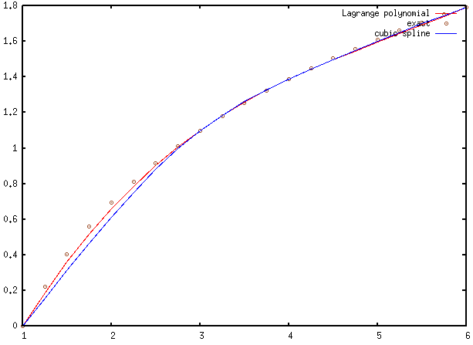
Results

