Slide 1
HW5
20190312 신소재공학과 김서현

Slide 2
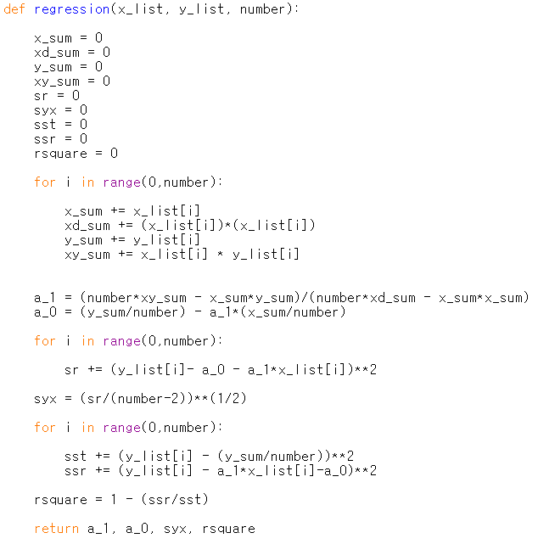
Regression

Slide 3
Formulas_Liquid
Enthalpy of mixing
Activity
1
2

Slide 4
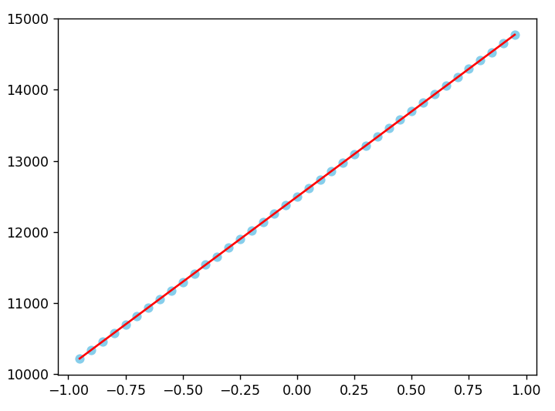
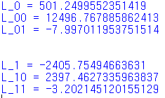
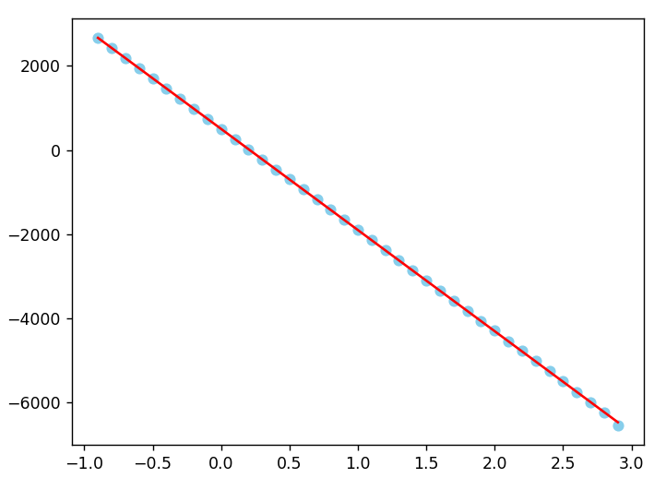
Result1_Liquid at 1500K
1
표준편차
R^2
2
표준편차
R^2

Slide 5
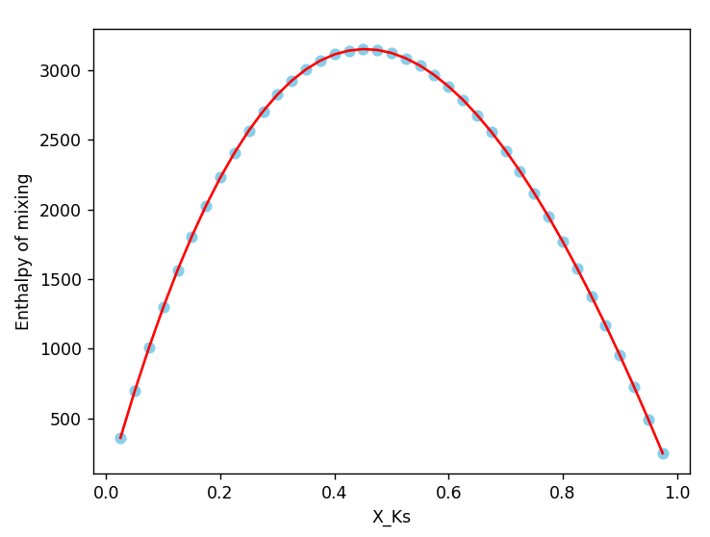
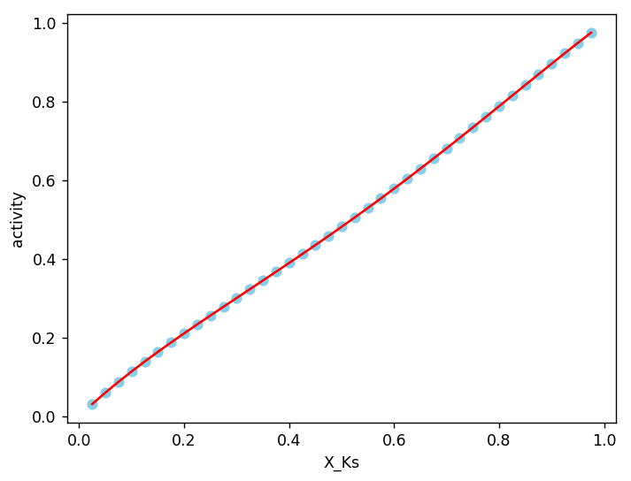
Result2_Liquid at 1500K
1
2

Slide 6
Formulas_FCC
Enthalpy of formation
Activity
1
2

Slide 7
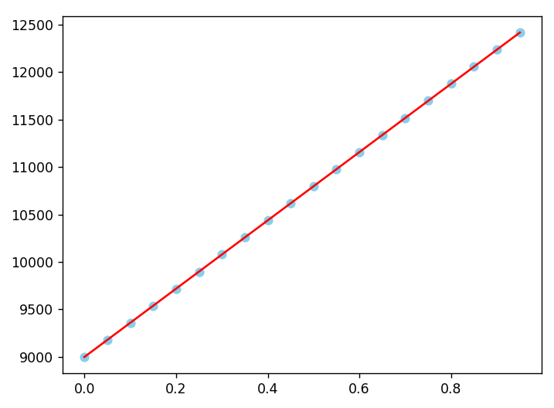
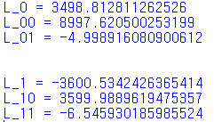
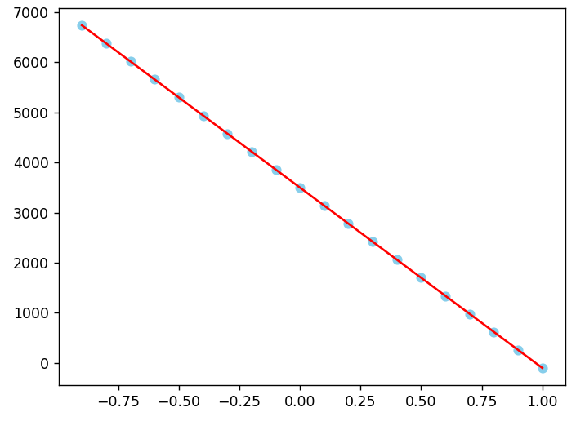
Result1_FCC at 1100K
1
표준편차
R^2
2
표준편차
R^2

Slide 8
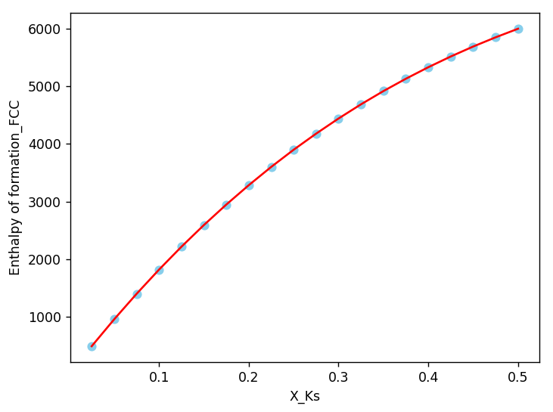
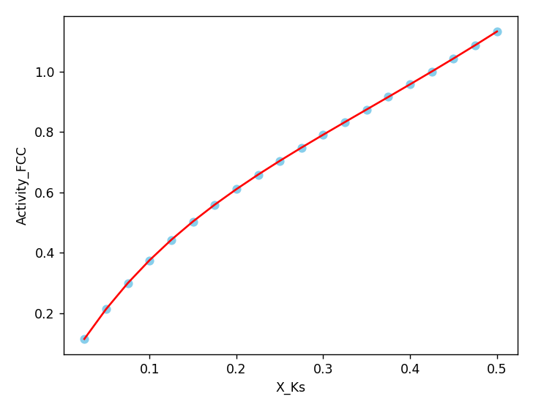
Result2_FCC at 1100K
1
2

Slide 9
Formulas_BCC
Enthalpy of formation
Activity
1
2

Slide 10
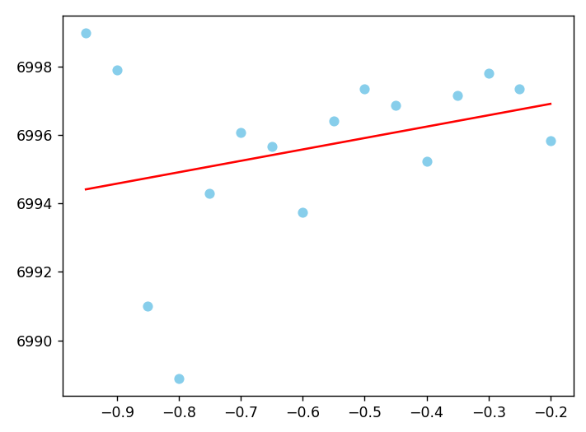
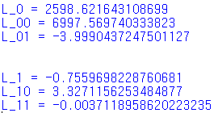
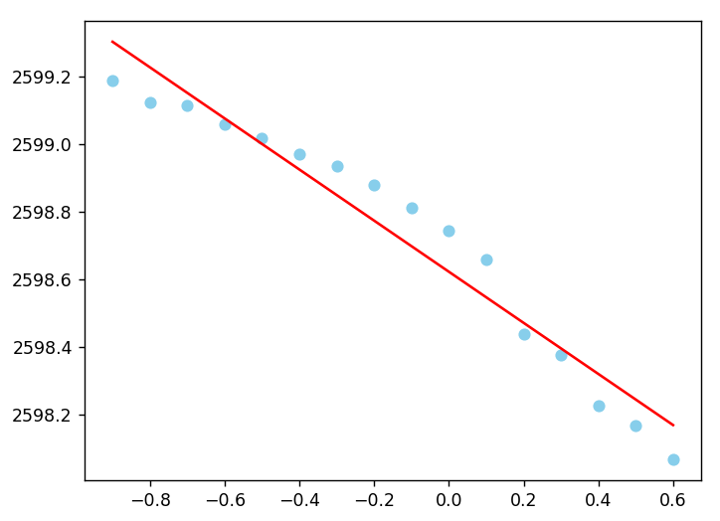
Result1_BCC at 1100K
1
표준편차
R^2
2
표준편차
R^2

Slide 11
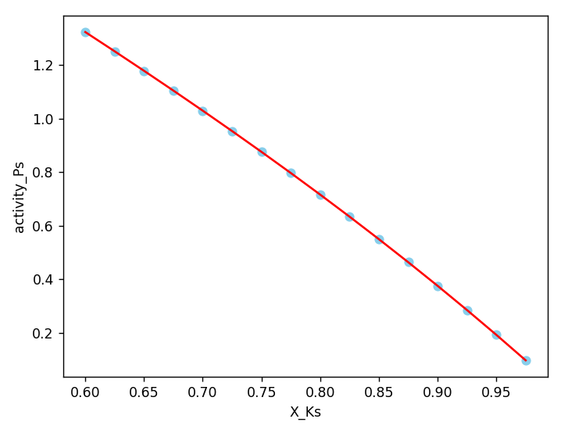
Result2_BCC at 1100K
1
2

