Slide 1
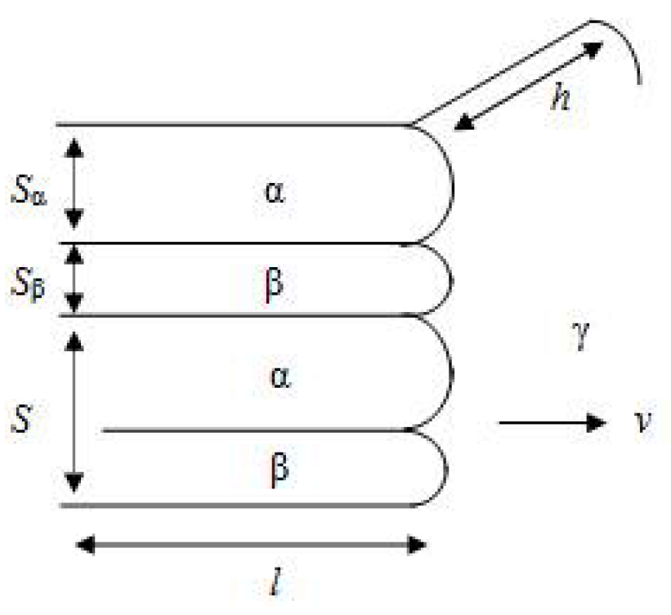
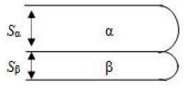
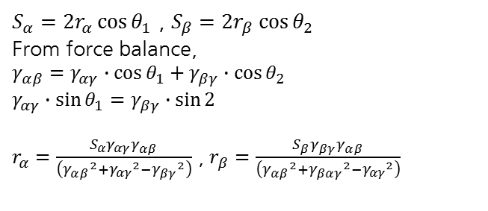
Problem Set #4 The formation of lamellar eutectic/eutectoid
20162559 박명주
(a) Why the tip of each layer has a curvature?
Force balance at the interface
γ_{αβ} + γ_{αβ} + γ_{αβ} = 0
To satisfy above equation, γ_{αβ} is naturally generated with certain curvature which induces capillary effect.
γ_{αβ}
γ_{αγ}
γ_{βγ}
(b) Estimate the radius of curvature for each layer as a function of layer thickness.
$S_{α}=2r_{α}\cos{θ_{1}}$ , $S_{β}=2r_{β}\cos{θ_{2}}$
From force balance,
$γ_{αβ}=γ_{αγ}∙\cos{θ_{1}}+γ_{βγ}∙\cos{θ_{2}}$
$γ_{αγ}∙\sin{θ_{1}}=γ_{βγ}∙\sin{2}$
$r_{α}=\frac{S_{α}γ_{αγ}γ_{αβ}}{\left({γ_{αβ}}^{2}+{γ_{αγ}}^{2}−{γ_{βγ}}^{2}\right)}$ , $r_{β}=\frac{S_{β}γ_{βγ}γ_{αβ}}{\left({γ_{αβ}}^{2}+{γ_{βαγ}}^{2}−{γ_{αγ}}^{2}\right)}$
γ_{αγ}
γ_{αβ}
r_{α}
θ₁
r_{β}
θ₂
γ_{βγ}
(c) Show that the free energy increase due to the capillarity effects is exactly the same as that obtained by considering the α/β interfacial energy.
$∆G_{IF}\left(S\right)=\frac{2γ_{αβ}}{S}∙{V_{m}}^{L}=γ_{αβ}hδ$
$∆G_{capillary}\left(S\right)=\frac{γ}{r}V_{m}=\frac{γ_{αγ}}{r_{α}}V_{α}+\frac{γ_{βγ}}{r_{β}}V_{β}=\frac{γ_{αγ}}{r_{α}}S_{α}hδ+\frac{γ_{βγ}}{r_{β}}S_{β}hδ=\left(\frac{\left({γ_{αβ}}^{2}+{γ_{αγ}}^{2}−{γ_{βγ}}^{2}\right)}{γ_{αβ}}+\frac{\left({γ_{αβ}}^{2}+{γ_{βγ}}^{2}−{γ_{αγ}}^{2}\right)}{γ_{αβ}}\right)hδ=γ_{αβ}hδ$

Slide 2
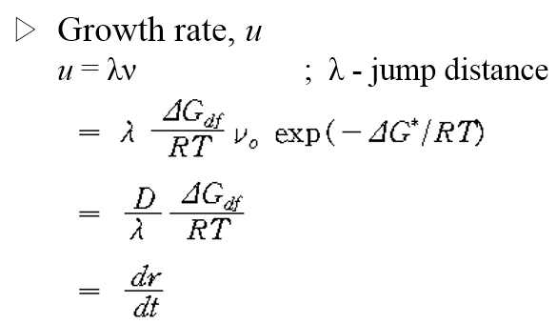
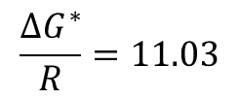
Problem Set #4 Monte Carlo simulation
20162559 박명주
(a) Find the time dependence of the average grain size
$\overline{R}=kt^{n}$ → $\ln{\overline{R}}=\ln{k}+n\ln{t}$
Temperature 10
n = 0.8494
(b) Find the temperature dependence of grain growth and the activation energy
$$\frac{∆G^{∗}}{R}=11.03$$
$\ln\left(Tknt^{n−1}\right)=\ln{C}−\frac{∆G^{∗}}{RT}$

