Slide 1
Numerical Methods #8
20150164 신소재공학과 김성진

Slide 2
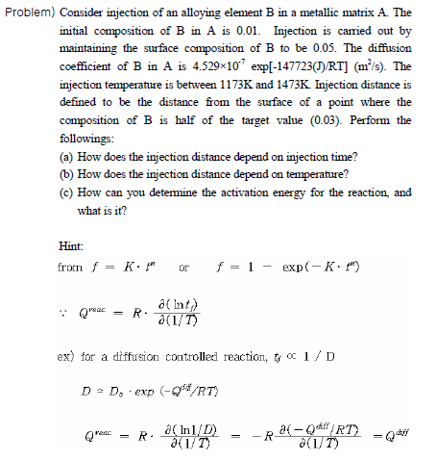
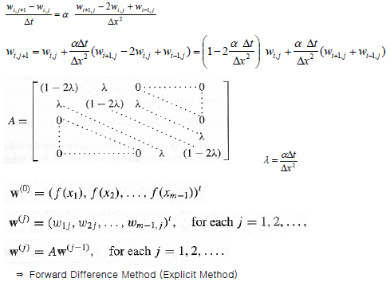
Theoretical Background

Slide 3
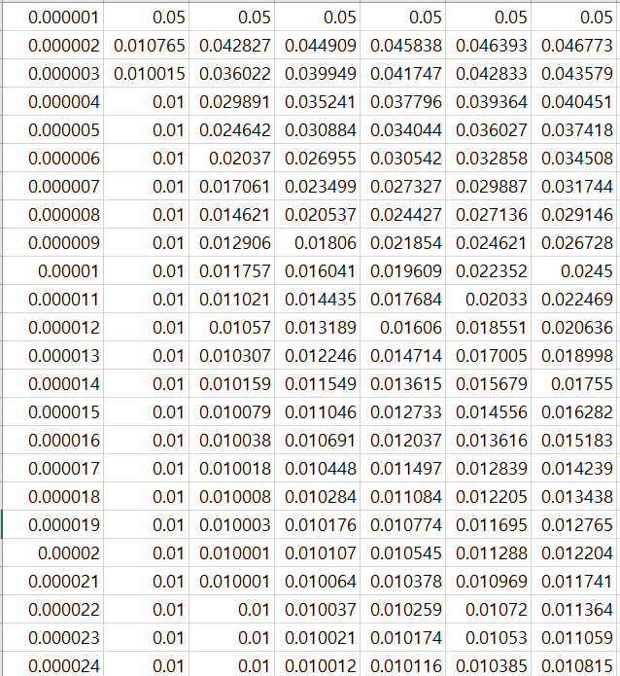
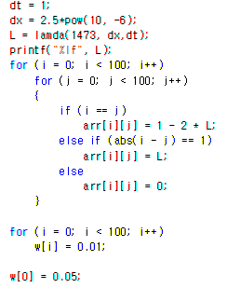
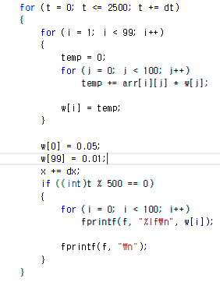
Code

Slide 4
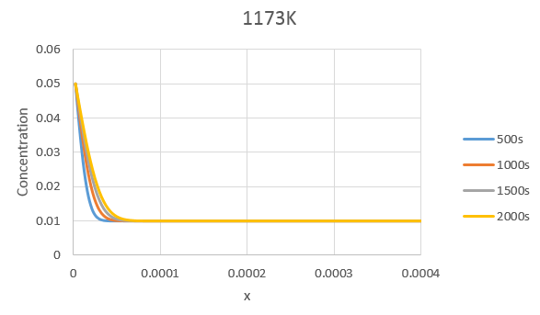
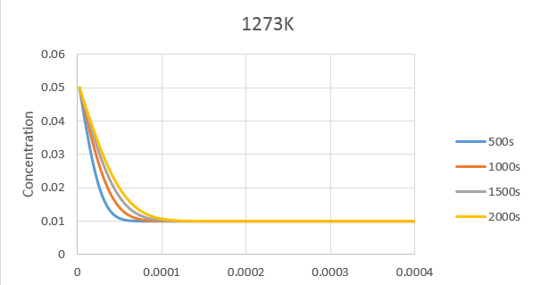
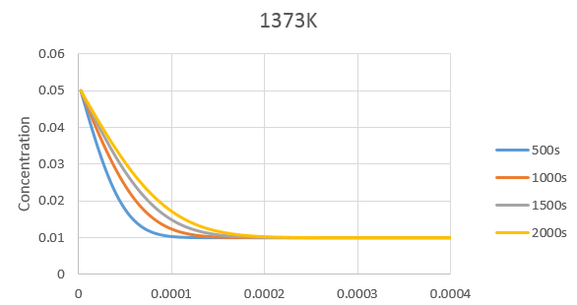
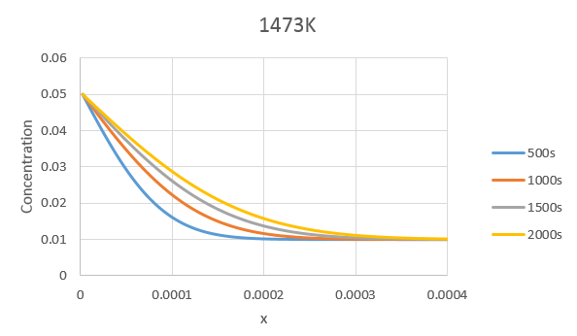
Analysis
dt = 1
dx = 0.0000025
λ = 0.019128
dt = 1
dx = 0.0000025
λ = 0.062868
dt = 1
dx = 0.0000025
λ = 0.173148
dt = 1
dx = 0.0000025
λ = 0.418282

Slide 5
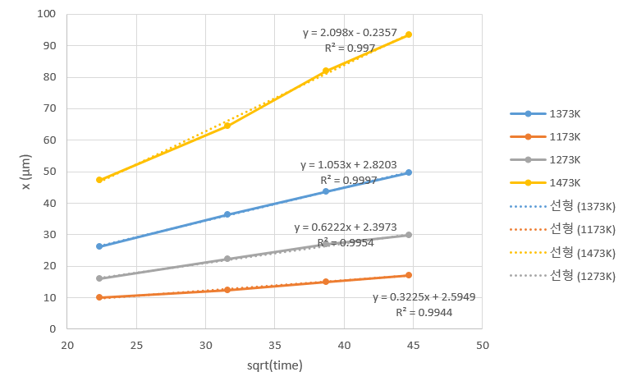
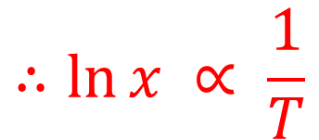
Analysis
$$∴\ln{x} ∝ \frac{1}{T}$$

Slide 6
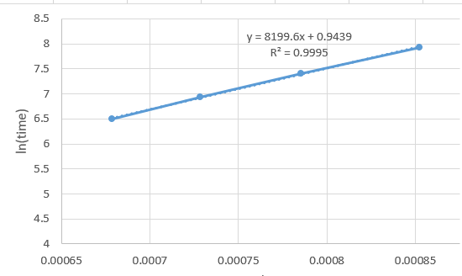
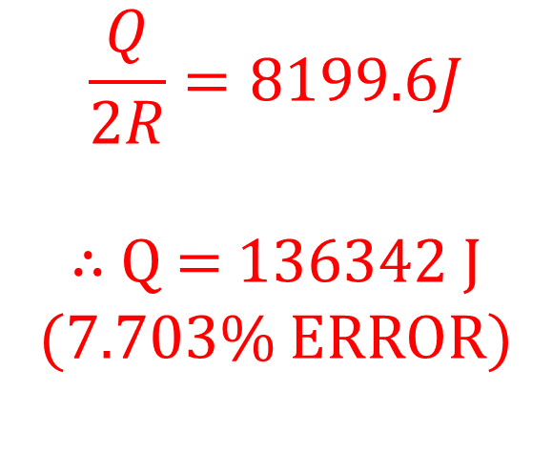
Analysis
ln(t) vs 1/T
$$\frac{Q}{2R}=8199.6J$$
∴ Q = 136342 J (7.703% ERROR)

