Slide 1
AMSE318 midterm with python
49004547 Seokjee SHIN

Slide 2
Liquid State of Ks sub-regular solution
FCC of Ks sub-regular solution
BCC of Ps regular solution (L1 = 0)

Slide 3
Liquid to FCC
$μ_{Ks}^{liquid}$- $μ_{Ks}^{fcc}=$0
$μ_{Ps}^{liquid}\text{−} μ_{Ps}^{fcc}=\text{0}$
Liquid to BCC
$μ_{Ks}^{liquid}$- $μ_{Ks}^{bcc}=$0
$μ_{Ps}^{liquid}\text{−} μ_{Ps}^{bcc}=\text{0}$
FCC to BCC
$μ_{Ks}^{fcc}$- $μ_{Ks}^{bcc}=$0
$μ_{Ps}^{fcc}\text{−} μ_{Ps}^{bcc}=\text{0}$
$${μ_{Ks}}^{L}=∆{{°G}_{Ks}}^{BCC→L}+RTlnx_{Ks}+{(1−x_{Ks})}^{2} \left({L_{0}}^{L}+\left(1−4x_{Ks}\right){L_{1}}^{L}\right)$$
$${μ_{Ps}}^{L}=∆°{G_{Ps}}^{FCC→L}+RTln(1−x_{Ks})+{\left(x_{Ks}\right)}^{2} \left({L_{0}}^{L}+\left(3−4x_{Ks}\right){L_{1}}^{L}\right)$$
$${μ_{Ks}}^{FCC}=∆{{°G}_{Ks}}^{BCC→FCC}+RTlnX_{Ks}+{(1−x_{Ks})}^{2} \left({L_{0}}^{FCC}+ \left(1−4x_{Ks}\right){L_{1}}^{FCC}\right)$$
$${μ_{Ps}}^{FCC}=RTln(1−x_{Ks})+{\left(x_{Ks}\right)}^{2} \left({L_{0}}^{FCC}+ \left(3−4x_{Ks}\right){L_{1}}^{Fcc}\right)$$
$${μ_{Ks}}^{BCC}=RTlnx_{Ks}+{(1−x_{Ks})}^{2} \left({L_{0}}^{BCC}+\left(1−4x_{Ks}\right){L_{1}}^{BCC}\right)$$
$${μ_{Ps}}^{BCC}=∆{{°G}_{Ps}}^{FCC→BCC}+RTln(1−x_{Ks})+{\left(x_{Ks}\right)}^{2} \left({L_{0}}^{BCC}+\left(3−4x_{Ks}\right){L_{1}}^{BCC}\right)$$
$$x=X_{Ks}$$
$$∆°G_{Ps}^{fcc→liquid}=15000 −10T$$
$$∆°G_{Ks}^{bcc→liquid}=16250 −12.5T$$
$$∆°G_{Ps}^{fcc→bcc}=10000$$
$$∆°G_{Ks}^{bcc→fcc}=7500$$

Slide 4
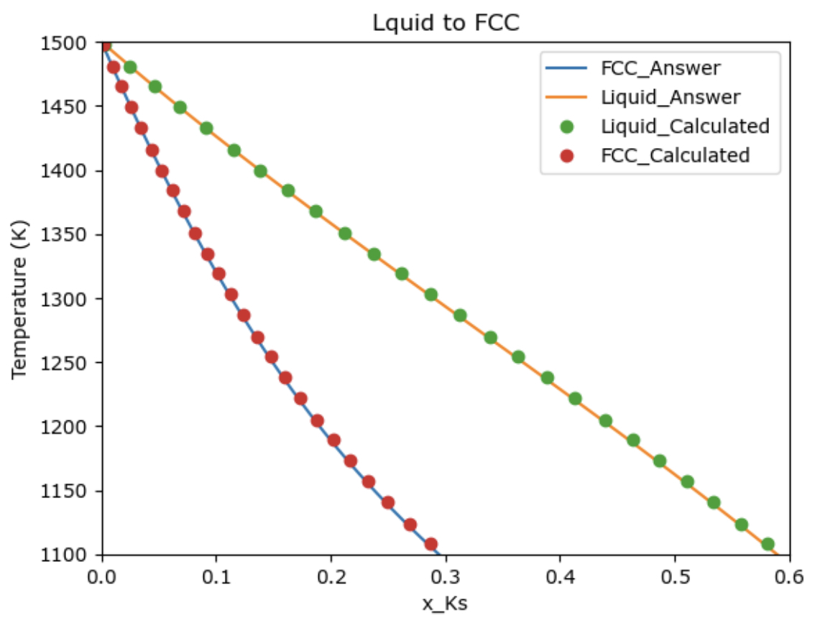
Liquid to FCC

Slide 5
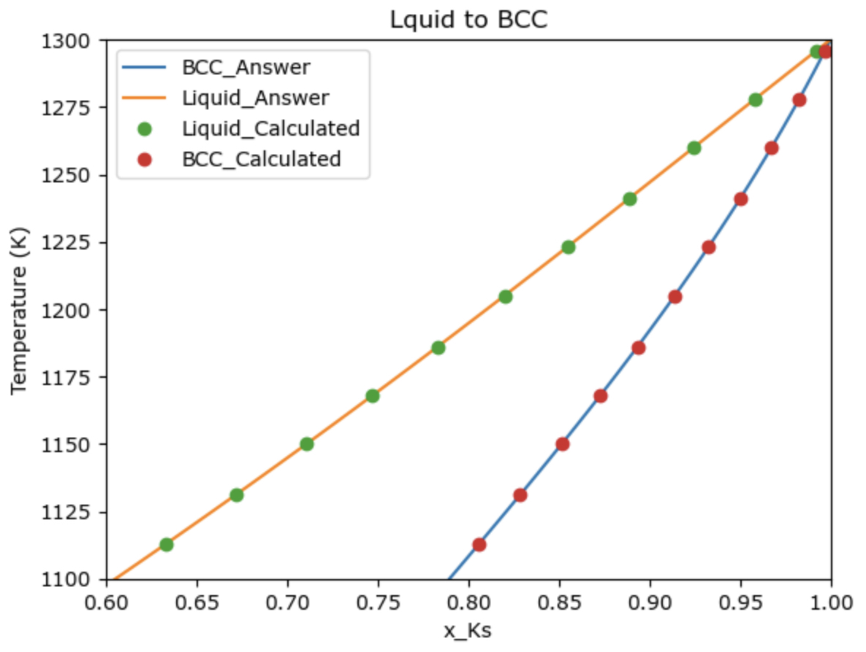
Liquid to bCC

Slide 6
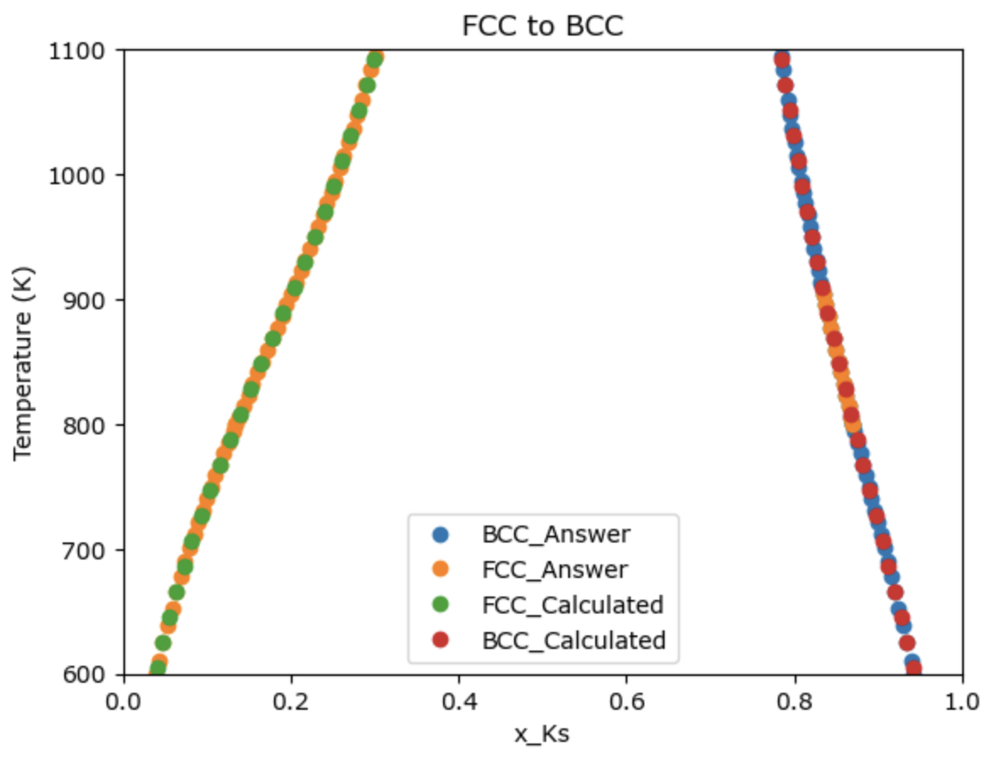
FCC to bCC

Slide 7
$f_{1}=μ_{Ps}^{liquid}$- $μ_{Ps}^{fcc}=0$
$f_{2}=μ_{Ps}^{fcc}$- $μ_{Ps}^{bcc}=0$
$f_{3}=μ_{Ks}^{liquid}$- $μ_{Ks}^{fcc}=0$
$f_{4}=μ_{Ks}^{fcc}$- $μ_{Ks}^{bcc}=0$
$${μ_{Ks}}^{L}=∆{{°G}_{Ks}}^{BCC→L}+RTlnx_{Ks}+{(1−x_{Ks})}^{2} \left({L_{0}}^{L}+\left(1−4x_{Ks}\right){L_{1}}^{L}\right)$$
$${μ_{Ps}}^{L}=∆°{G_{Ps}}^{FCC→L}+RTln(1−x_{Ks})+{\left(x_{Ks}\right)}^{2} \left({L_{0}}^{L}+\left(3−4x_{Ks}\right){L_{1}}^{L}\right)$$
$${μ_{Ks}}^{FCC}=∆{{°G}_{Ks}}^{BCC→FCC}+RTlnX_{Ks}+{(1−x_{Ks})}^{2} \left({L_{0}}^{FCC}+ \left(1−4x_{Ks}\right){L_{1}}^{FCC}\right)$$
$${μ_{Ps}}^{FCC}=RTln(1−x_{Ks})+{\left(x_{Ks}\right)}^{2} \left({L_{0}}^{FCC}+ \left(3−4x_{Ks}\right){L_{1}}^{Fcc}\right)$$
$${μ_{Ks}}^{BCC}=RTlnx_{Ks}+{(1−x_{Ks})}^{2} \left({L_{0}}^{BCC}+\left(1−4x_{Ks}\right){L_{1}}^{BCC}\right)$$
$${μ_{Ps}}^{BCC}=∆{{°G}_{Ps}}^{FCC→BCC}+RTln(1−x_{Ks})+{\left(x_{Ks}\right)}^{2} \left({L_{0}}^{BCC}+\left(3−4x_{Ks}\right){L_{1}}^{BCC}\right)$$
$$X_{1}=T$$
$$X_{2}=x_{Ks_liquid}$$
$$X_{3}=x_{Ks_fcc}$$
$$X_{4}=x_{Ks_bcc}$$
$$J=\left[\begin{matrix}\frac{∂f_{1}}{∂T} & \frac{∂f_{1}}{∂x_{liquid}} & \frac{∂f_{1}}{∂x_{fcc}} & \frac{∂f_{1}}{∂x_{bcc}} \\ \frac{∂f_{2}}{∂T} & \frac{∂f_{2}}{∂x_{liquid}} & \frac{∂f_{2}}{∂x_{fcc}} & \frac{∂f_{2}}{∂x_{bcc}} \\ \frac{∂f_{3}}{∂T} & \frac{∂f_{3}}{∂x_{liquid}} & \frac{∂f_{3}}{∂x_{fcc}} & \frac{∂f_{3}}{∂x_{bcc}} \\ \frac{∂f_{4}}{∂T} & \frac{∂f_{4}}{∂x_{liquid}} & \frac{∂f_{4}}{∂x_{fcc}} & \frac{∂f_{4}}{∂x_{bcc}}\end{matrix}\right]$$

Slide 8
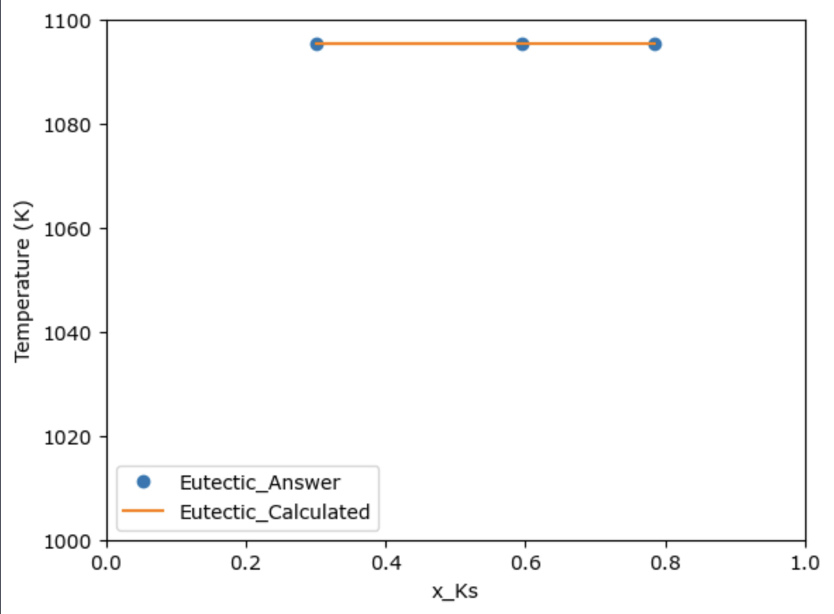
Liquid
Liquid + FCC
Liquid + BCC
Eutectic system
FCC
FCC + BCC
BCC
Temperature (K) | 1.09540816e+03
X_Ks_Liquid | 5.95540091e-01
X_Ks_FCC | 2.99877542e-01
X_Ks_BCC | 7.83979642e-01

Slide 9
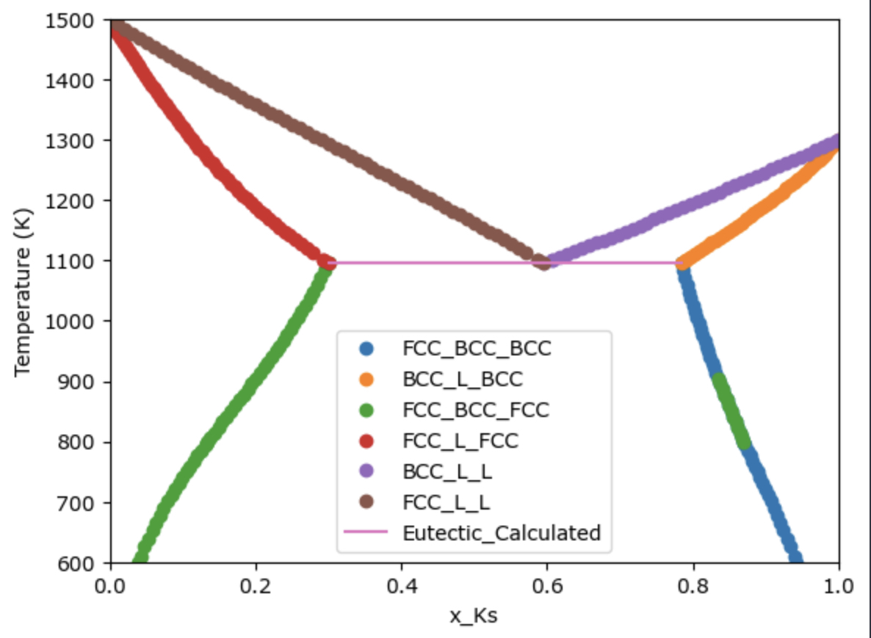
conclusion
Conclusion
Liquid
Liquid + FCC
Liquid + BCC
Temperature (K) | 1.09540816e+03
X_Ks_Liquid | 5.95540091e-01
X_Ks_FCC | 2.99877542e-01
X_Ks_BCC | 7.83979642e-01
FCC
FCC + BCC
BCC
The cause of the errors were typo and mis-derivation of equations in the code

