Slide 1
Midterm Project
Ps-Ks 2원계 상태도
학번: 20130280
학과: 신소재공학과
이름: 장경현

Slide 2
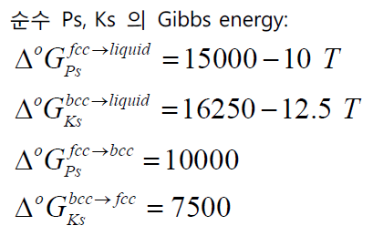
Problem
Ps-Ks 2원계 상태도
Postechium (Ps)과 Kaistium (Ks) 2 원계에 대한 실험 정보는 다음과 같이 발표되어있다. 이를 바탕으로 Liquid, fcc, bcc 각 상에 대한 열역학 수식화를 수행하고 Ps-Ks 2 원계 상태도를 계산하시오.
주어진 조건
액상에서의 Enthalpy of mixing (J/mol)
1500K 액상에서 Ks의 활동도 (ref : Liq Ks)
Enthalpy of Formation in FCC and BCC
Activity of Ps in BCC at 1100K (ref : FCC Ps)
Activity of Ks in FCC at 1100K (ref : BCC Ks)

Slide 3
Process algorithm
Ps-Ks 2원계 상태도
주어진 data에 대한 관계식 선형화
회귀분석을 이용하여 L0, L1 값 구하기
Gibbs free energy, Chemical potential equation 관계 정리
Equilibrium condition을 이용해 non-linear equation 풀기
Phase diagram 도시

Slide 4
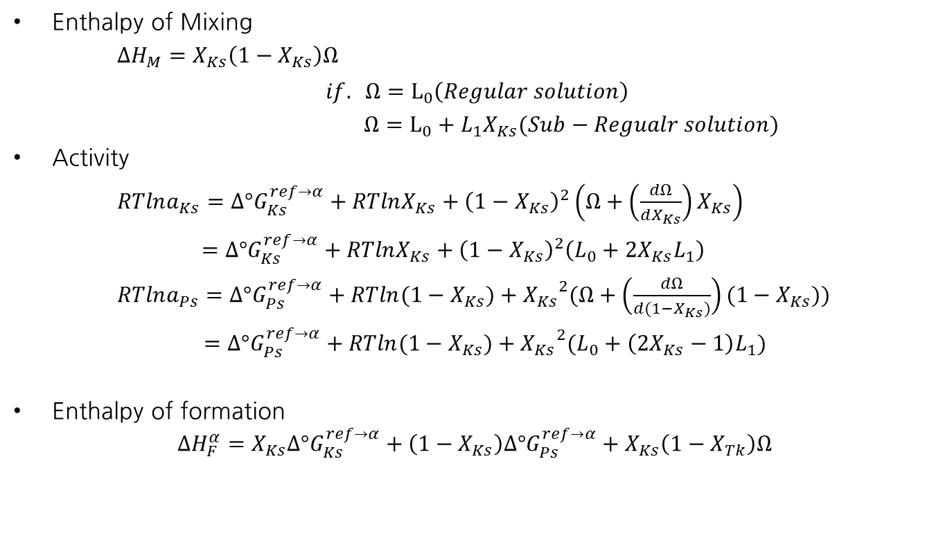
관계식의 선형화(1)
Ps-Ks 2원계 상태도
Enthalpy of Mixing
$∆H_{M}=X_{Ks}\left(1−X_{Ks}\right)Ω$
$$if. Ω=L_{0}\left(Regular solution\right)$$
$Ω=L_{0}+L_{1}X_{Ks}(Sub−Regualr solution)$
Activity
$RTlna_{Ks}=∆°G_{Ks}^{ref→α}+RTlnX_{Ks}+{\left(1−X_{Ks}\right)}^{2}\left(Ω+\left(\frac{dΩ}{dX_{Ks}}\right)X_{Ks}\right)$
$=∆°G_{Ks}^{ref→α}+RTlnX_{Ks}+{\left(1−X_{Ks}\right)}^{2}\left(L_{0}+2X_{Ks}L_{1}\right)$
$RTlna_{Ps}=∆°G_{Ps}^{ref→α}+RTln({1−X}_{Ks})+{X_{Ks}}^{2}(Ω+\left(\frac{dΩ}{d{(1−X}_{Ks})}\right){(1−X}_{Ks}))$
$=∆°G_{Ps}^{ref→α}+RTln(1−X_{Ks})+{X_{Ks}}^{2}(L_{0}+\left(2X_{Ks}−1\right)L_{1})$
Enthalpy of formation
$$∆H_{F}^{α}=X_{Ks}∆°G_{Ks}^{ref→α}+\left(1−X_{Ks}\right)∆°G_{Ps}^{ref→α}+X_{Ks}\left(1−X_{Tk}\right)Ω$$
$L_{0}=L_{0}^{0}+L_{0}^{1}$T
$L_{1}=L_{1}^{0}+L_{1}^{1}$T

Slide 5
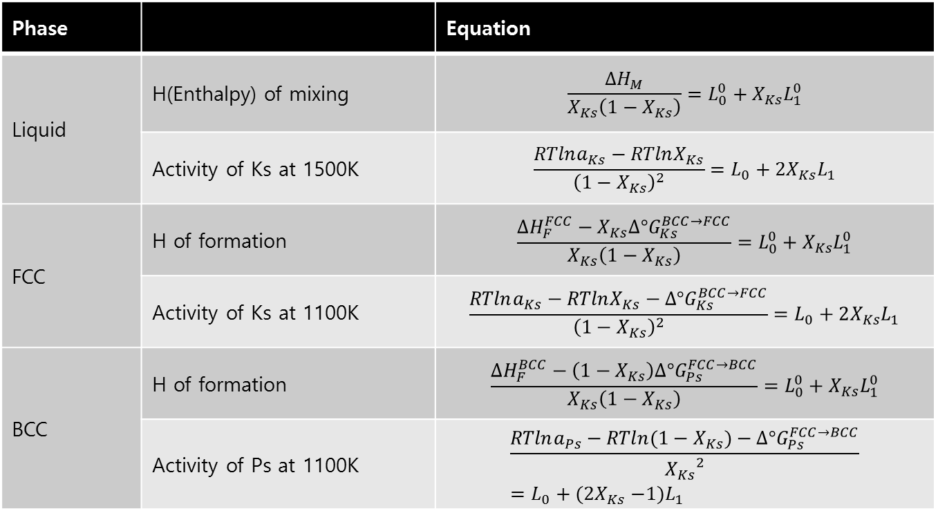
관계식의 선형화(2)
Ps-Ks 2원계 상태도
For sub-regular solution Model로 가정하고 풀자!
𝛀=𝐿0+𝐿1𝑋𝑇𝑘+𝐿2𝑋𝑇𝑘2+𝐿3𝑋𝑇𝑘3≅𝑳𝟎+𝑳𝟏𝑿𝑻𝒌
Phase |  | Equation
Liquid | H(Enthalpy) of mixing | $$\frac{∆H_{M}}{X_{Ks}\left(1−X_{Ks}\right)}=L_{0}^{0}+X_{Ks}L_{1}^{0}$$
 | Activity of Ks at 1500K | $$\frac{RTlna_{Ks}−RTlnX_{Ks}}{{\left(1−X_{Ks}\right)}^{2}}=L_{0}+2X_{Ks}L_{1}$$
FCC | H of formation | $$\frac{∆H_{F}^{FCC}−X_{Ks}∆°G_{Ks}^{BCC→FCC}}{X_{Ks}\left(1−X_{Ks}\right)}=L_{0}^{0}+X_{Ks}L_{1}^{0}$$
 | Activity of Ks at 1100K | $$\frac{RTlna_{Ks}−RTlnX_{Ks}−∆°G_{Ks}^{BCC→FCC}}{{\left(1−X_{Ks}\right)}^{2}}=L_{0}+2X_{Ks}L_{1}$$
BCC | H of formation | $$\frac{∆H_{F}^{BCC}−\left(1−X_{Ks}\right)∆°G_{Ps}^{FCC→BCC}}{X_{Ks}\left(1−X_{Ks}\right)}=L_{0}^{0}+X_{Ks}L_{1}^{0}$$
 | Activity of Ps at 1100K | $$\frac{RTlna_{Ps}−RTln(1−X_{Ks})−∆°G_{Ps}^{FCC→BCC}}{{X_{Ks}}^{2}}=L_{0}+(2X_{Ks}{−1)L}_{1}$$

Slide 6
Regression Result
Ps-Ks 2원계 상태도
Liquid
Enthalpy of Mixing
Activity of Ks at 1500K
Y = $L_{0}^{0}+{X_{Ks}L}_{1}^{0}$
=14894.231-4794.9255X)
Y = $L_{0}+2X_{Ks}L_{1}$
=2907.17-9623.55X
$$Ω=14894.230619−7.991376T+({−4794.925467−0.011235)X}_{Ks}$$
FCC
Enthalpy of Formation
Activity of Ks at 1100K
Y = $L_{0}^{0}+{X_{Ks}L}_{1}^{0}$
=12597.609-7199.978X
Y = $L_{0}+2X_{Ks}L_{1}$
=7100.873-7175.238X
$$Ω=12597.609462−4.997848T+(−7199.977924−0.000263)X_Ks$$
BCC
Enthalpy of Formation
Activity of Ps at 1100K
→ 두 값 모두 R의 값이 너무 작다.(정확성이 떨어짐)
→ Regular model을 이용하자.
BCC with regular solution model
Enthalpy of Formation
Activity of Ps at 1100K
Y = $L_{0}^{0}$=6995.657
Y = $L_{0}^{0}$= 2599.845
$$Ω=6995.657−3.996003T$$

Slide 7
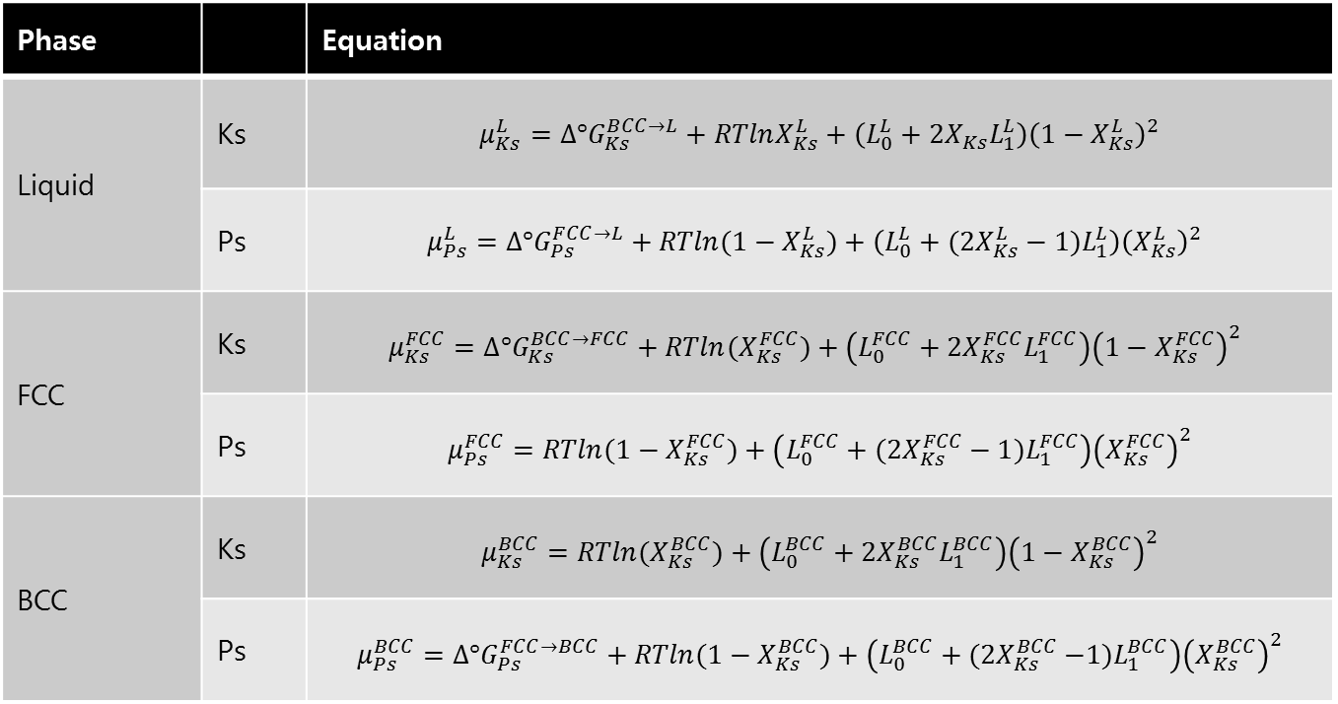
Gibbs free energy, Chemical potential equation
Ps-Ks 2원계 상태도
Reference state : Ps (FCC), Ks (BCC)
Phase |  | Equation
Liquid | Ks | $$μ_{Ks}^{L}=∆°G_{Ks}^{BCC→L}+RTlnX_{Ks}^{L}+\left(L_{0}^{L}+{2X}_{Ks}L_{1}^{L}\right){\left(1−X_{Ks}^{L}\right)}^{2}$$
 | Ps | $$μ_{Ps}^{L}=∆°G_{Ps}^{FCC→L}+RTln({1−X}_{Ks}^{L})+\left(L_{0}^{L}+({2X}_{Ks}^{L}−1{)L}_{1}^{L}\right){\left(X_{Ks}^{L}\right)}^{2}$$
FCC | Ks | $$μ_{Ks}^{FCC}=∆°G_{Ks}^{BCC→FCC}+RTln(X_{Ks}^{FCC})+\left(L_{0}^{FCC}+2X_{Ks}^{FCC}L_{1}^{FCC}\right){\left(1−X_{Ks}^{FCC}\right)}^{2}$$
 | Ps | $$μ_{Ps}^{FCC}=RTln(1−X_{Ks}^{FCC})+\left(L_{0}^{FCC}+({2X}_{Ks}^{FCC}−1{)L}_{1}^{FCC}\right){\left(X_{Ks}^{FCC}\right)}^{2}$$
BCC | Ks | $$μ_{Ks}^{BCC}=RTln(X_{Ks}^{BCC})+\left(L_{0}^{BCC}+2X_{Ks}^{BCC}L_{1}^{BCC}\right){\left(1−X_{Ks}^{BCC}\right)}^{2}$$
 | Ps | $$μ_{Ps}^{BCC}=∆°G_{Ps}^{FCC→BCC}+RTln(1−X_{Ks}^{BCC})+\left(L_{0}^{BCC}+({2X}_{Ks}^{BCC}{−1)L}_{1}^{BCC}\right){\left(X_{Ks}^{BCC}\right)}^{2}$$

Slide 8
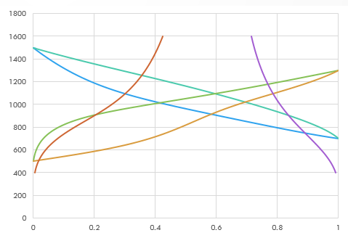
Result(1)
Ps-Ks 2원계 상태도
$μ_{Ks}^{L}=μ_{Ks}^{Fcc}$, $μ_{Ps}^{L}=μ_{Ps}^{Fcc}$
$μ_{Ks}^{L}=μ_{Ks}^{Bcc}$, $μ_{Ps}^{L}=μ_{Ps}^{Bcc}$ + Newton’s Method
$μ_{Ks}^{Bcc}=μ_{Ks}^{Fcc}$,${ μ}_{Ps}^{Bcc}=μ_{Ps}^{Fcc}$
Eutectic point
-> 정확히 구해보자

Slide 9
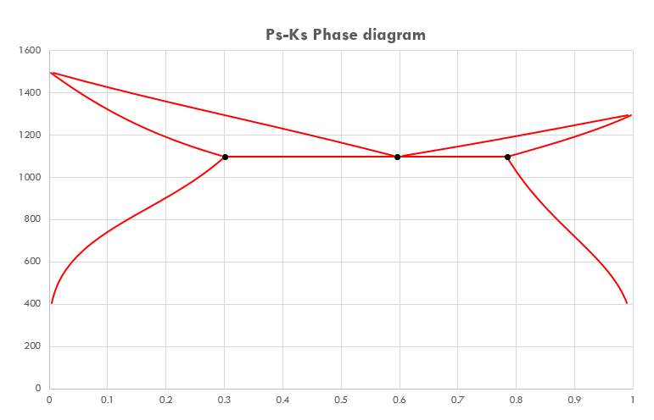
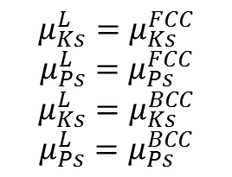
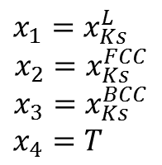
Result(2)
Ps-Ks 2원계 상태도
$$μ_{Ks}^{L}=μ_{Ks}^{FCC}$$
$$μ_{Ps}^{L}=μ_{Ps}^{FCC}$$
$$μ_{Ks}^{L}=μ_{Ks}^{BCC}$$
$$μ_{Ps}^{L}=μ_{Ps}^{BCC}$$
$$x_{1}=x_{Ks}^{L}$$
$$x_{2}=x_{Ks}^{FCC}$$
$$x_{3}=x_{Ks}^{BCC}$$
$$x_{4}=T$$
Ks-Ps Phase Diagram
Liquid
L+fcc
L+bcc
fcc
bcc
Fcc+bcc
 | eutectic | X-fcc | X_bcc | T
실제 값 | 0.595539 | 0.2998793 | 0.7839786 | 1095.4077
계산 값 | 0.595592 | 0.299871 | 0.783979 | 1095.3991
상대 오차 | 0.008899% | 0.0027678 | 0.0000512 | 0.0007851

Slide 10
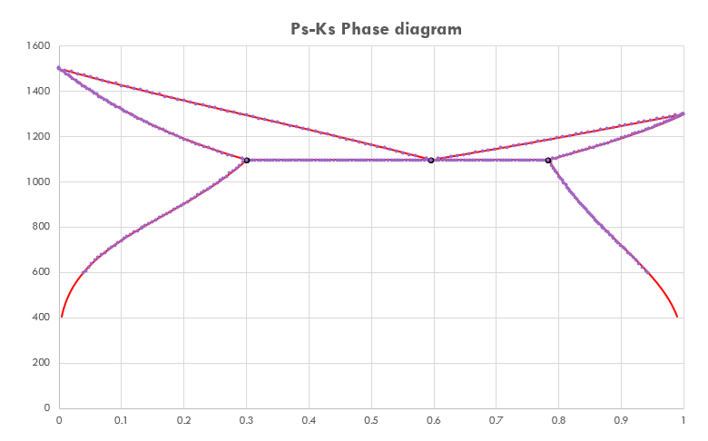
Result(3)
Ps-Ks 2원계 상태도
Ks-Ps Phase Diagram
Almost perfect!
Liquid
L+fcc
L+bcc
fcc
bcc
Fcc+bcc

Slide 11
Conclusion
Ps-Ks 2원계 상태도
4 by 4를 구할 때 초기값에 민감하게 반응하여 초기값을 잘 선택해야 했다.
Bcc 상에서는 regular solution 모델을 이용해야 했다.
Chemical potential을 이용하여 오차가 작은 phase diagram을 그릴 수 있다.
Ks-Ps Phase Diagram
Liquid
L+fcc
L+bcc
fcc
bcc
Fcc+bcc
 | eutectic | X-fcc | X_bcc | T
실제 값 | 0.595539 | 0.2998793 | 0.7839786 | 1095.4077
계산 값 | 0.595592 | 0.299871 | 0.783979 | 1095.3991
상대 오차 | 0.008899% | 0.0027678 | 0.0000512 | 0.0007851

