Slide 1
System of Nonlinear Equations
Multicomponent Phase Equilibria
Seungpyo Hong
Flow Physics and Engineering Lab.
Department of Mechanical Engineering
POSTECH

Slide 2
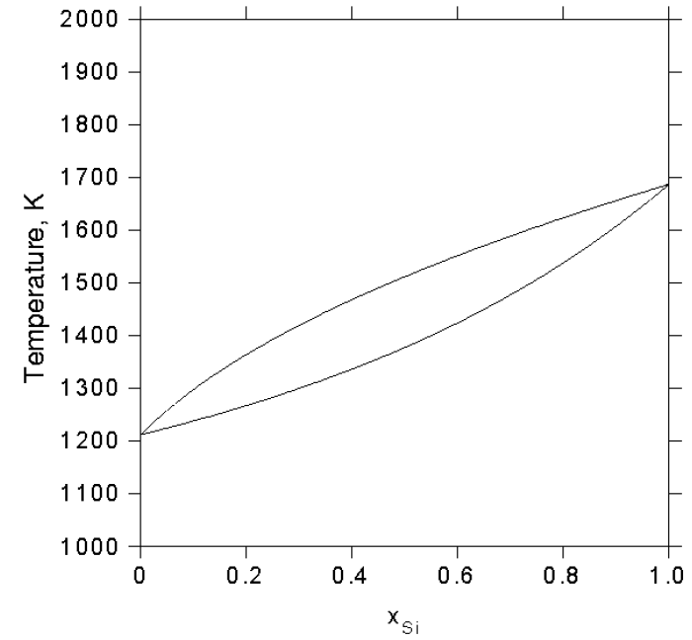
Problem
Make a program that solves system of nonlinear equations.
Obtain composition of solid and liquid Si-Ge depending on the temperature.

Slide 3
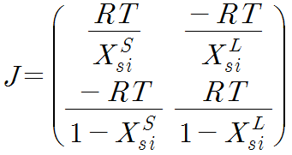
Formulation
By assuming ideal solution, we can have two non-linear equations in terms of and
e

Slide 4
Structure of the program
PROGRAM Gibbsenergy
END PROGRAM Gibbsenergy
Take the size of the sys, array, initial temp, step size
Allocate arrays
Outer loop : loop over various temperature
Update temperature and indices
Save temperature, compositions on the global array
Truncate global array and write the data on to the file
Inner loop : loop over specific temperature
1. Calculate funcion values
2. Calculate Jacobian matrix
3. Obtain inverse matrix
4. Update values
5. Iteration until the value goes under a certain tolerance
Deallocate arrays

Slide 5
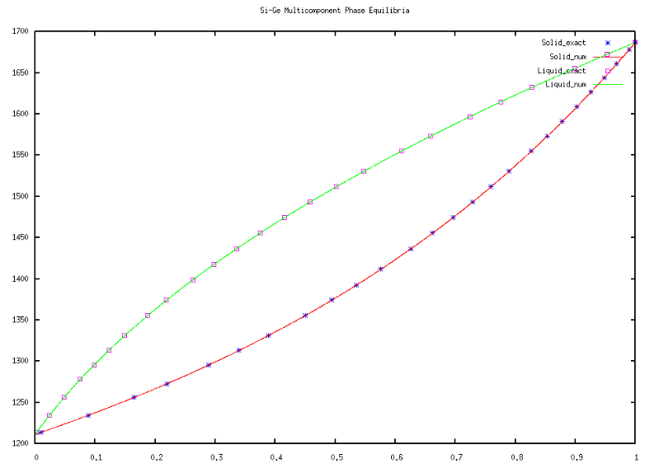
Results
Temperature(K)
X_si

