Slide 1
Homework 5
Doyoon Kim
Department of Materials Science and Engineering

Slide 2
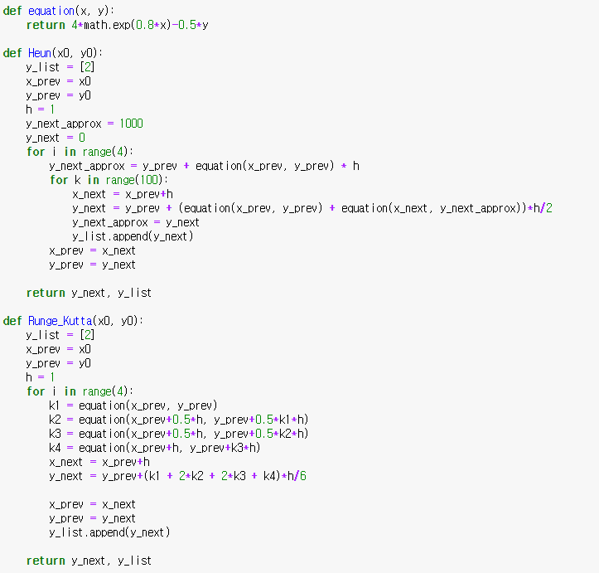
01
Method
Heun
4th Runge-Kutta

Slide 3
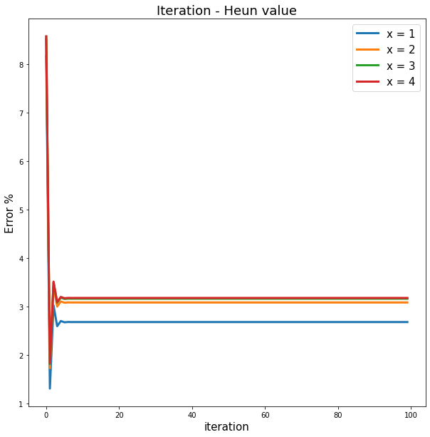
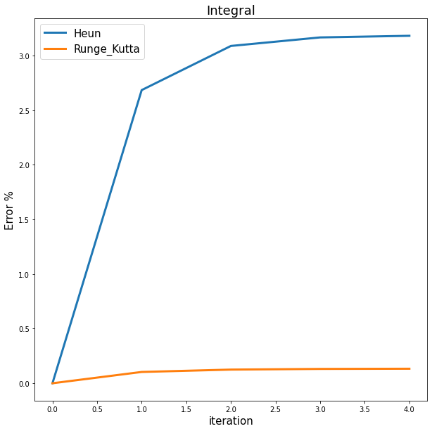
02
Result

