Slide 1
재료수치해석 Final
20100114 박재혁

Slide 2
Common Problem

Slide 3
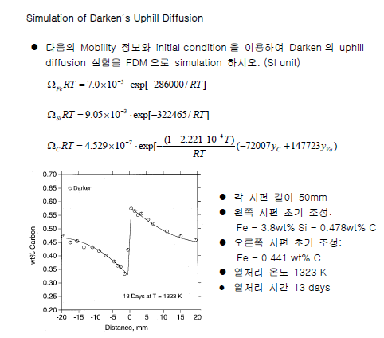
Problem.

Slide 4
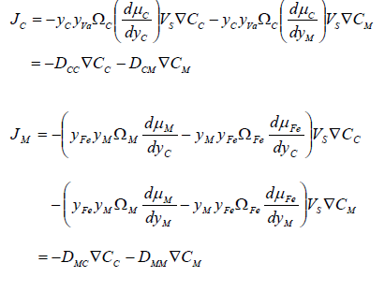
Theory
Fick’s 2nd law for numerical Methods (for F.D.M)

Slide 5
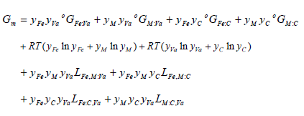
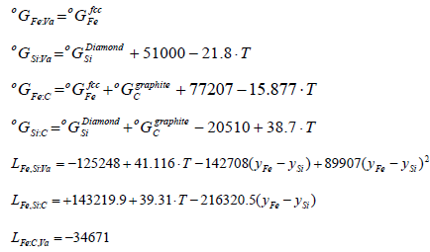
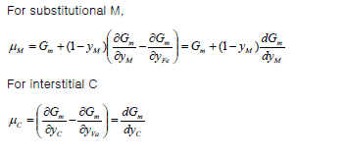
Thermo dynamic terms

Slide 6
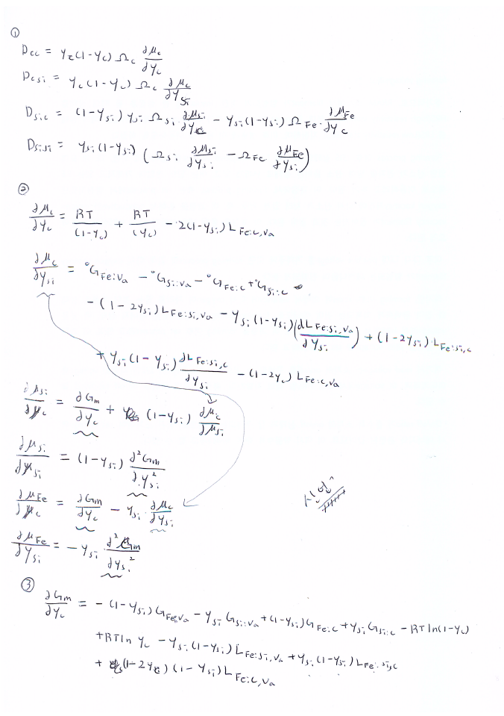

Slide 7
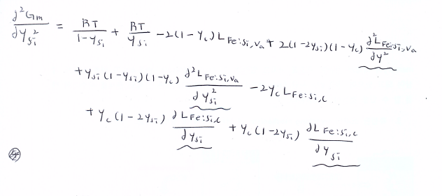

Slide 8
Result.
<Carbon concentration>

Slide 9
Result.
<Silicon concentration>

Slide 10
Free Topic

Slide 11
Simulation of ReRAM Switching Mechanism (compact-COMSOL MODEL)

Slide 12
Simulation of ReRAM Switching Mechanism (compact-COMSOL MODEL)

Slide 13
Simulation of ReRAM Switching Mechanism (compact-COMSOL MODEL)
(Using Backward-differential Method)
$$\frac{r_{i+1}−r_{i} }{∆t}=\frac{r_{maximum}−r_{i+1}}{τ_{Red}}−\frac{r_{i+1}}{τ_{ox}} \\ r_{i+1}=\left(\frac{r_{i}}{∆t}+\frac{r_{maximum}}{τ_{Red}}\right){\left(\frac{1}{∆t}+\frac{1}{τ_{Red}(i+1)}+\frac{1}{τ_{ox}(i+1)}\right)}^{−1}$$
$$τ_{Ox}{\left(i\right)}^{−1}=A_{RedOx}exp⁡(−\frac{E_{a}+α_{Ox}qV_{cell}\left(j\right)}{kT_{i}})$$
$$τ_{Red}{\left(i\right)}^{−1}=A_{RedOx}exp⁡(−\frac{E_{a}−α_{Red}qV_{cell}\left(j\right)}{kT_{i}})$$

Slide 14
Simulation of ReRAM Switching Mechanism (compact-COMSOL MODEL)
$T_{i}=T_{amb}+\frac{V_{cell}^{}{\left(j\right)}^{2}}{8K_{th}}(\frac{r_{i}^{2}(σ_{CF0}−σ_{Ox}}{r_{maximum}}−σ_{Ox}$)

Slide 15
$$\frac{r_{i+1}−r_{i} }{∆t}=\frac{r_{maximum}−r_{i+1}}{τ_{Red}}−\frac{r_{i+1}}{τ_{ox}} \\ r_{i+1}=\left(\frac{r_{i}}{∆t}+\frac{r_{maximum}}{τ_{Red}}\right){\left(\frac{1}{∆t}+\frac{1}{τ_{Red}(i+1)}+\frac{1}{τ_{ox}(i+1)}\right)}^{−1}$$
<계산 순서>
화살표 표시.
<계산 조건>
dt=1E-6 for 1000 cycle
dV=0.001
즉 1ms 당 0.001 V의 voltage가 swift 하는 모델이다.
$$τ_{Ox}{\left(i\right)}^{−1}=A_{RedOx}exp⁡(−\frac{E_{a}+α_{Ox}qV_{cell}\left(j\right)}{kT_{i}})$$
$$τ_{Red}{\left(i\right)}^{−1}=A_{RedOx}exp⁡(−\frac{E_{a}−α_{Red}qV_{cell}\left(j\right)}{kT_{i}})$$
$T_{i}=T_{amb}+\frac{V_{cell}^{}{\left(j\right)}^{2}}{8K_{th}}(\frac{r_{i}^{2}(σ_{CF0}−σ_{Ox}}{r_{maximum}}−σ_{Ox}$)

Slide 16
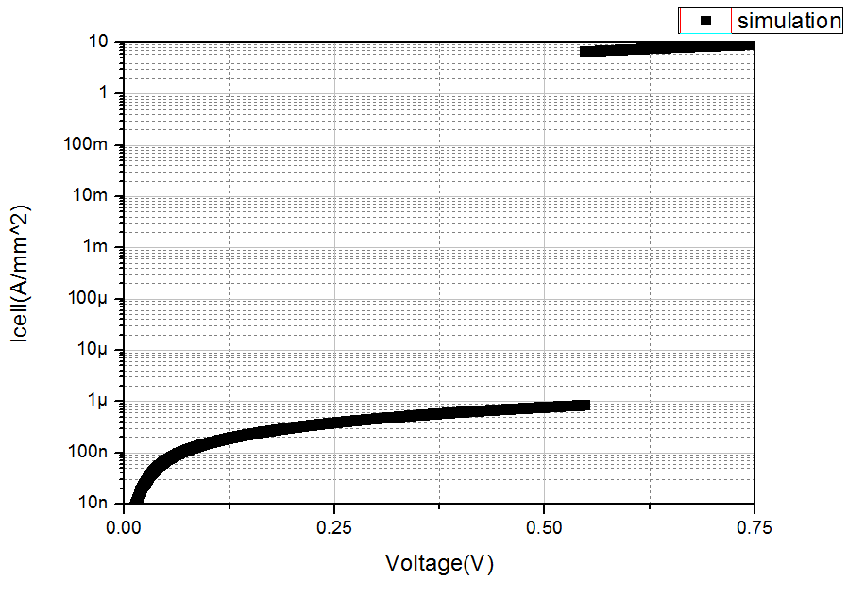
Simulation of ReRAM Switching Mechanism (compact-COMSOL MODEL)
<Reference Data>

