Slide 1
Assignment #3
20100389
MSE
박재용

Slide 2
One variable Equation
Clausis-Clapeyron Equation
Bisection Method
Secant Method
False Position Method
Newton-Raphson Method
Etc.

Slide 3
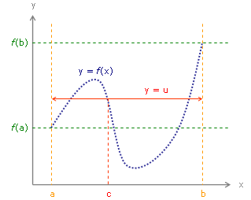
Bisection method
Introduction
Intermediate Value Theorem
f(x) is continuous between [a,b]
then,
c exists in (a,b)
such that f(a) < f(c) < f(b)

Slide 4
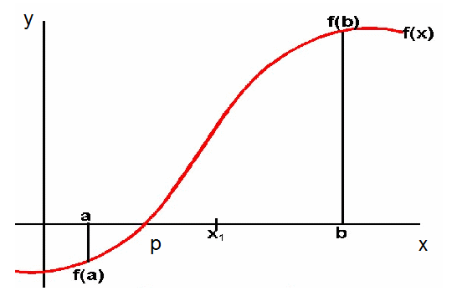
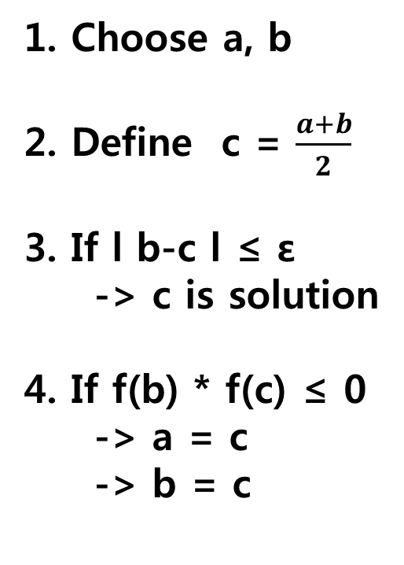
Bisection method
Introduction
1. Choose a, b
2. Define c = $\frac{a+b}{2}$
3. If l b-c l ≤ ε
-> c is solution
4. If f(b) * f(c) ≤ 0
-> a = c
-> b = c
c

Slide 5
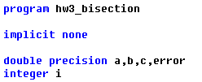
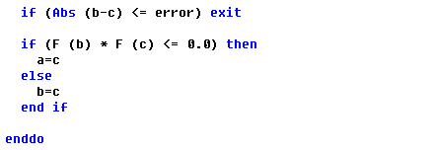
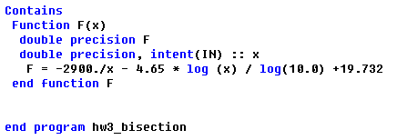
Bisection method
Coding

Slide 6
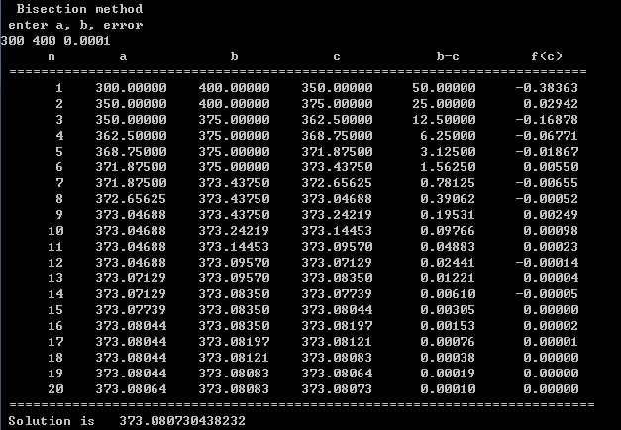
Bisection method
Results

Slide 7
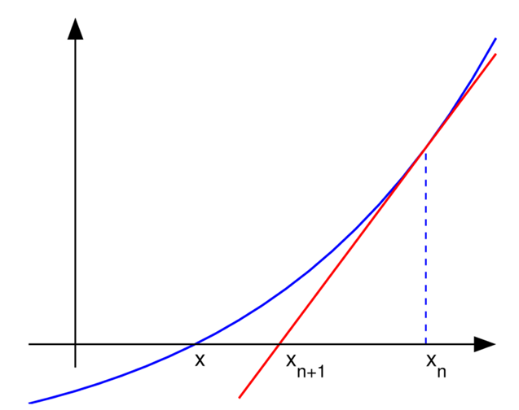
Newton-Raphson method
Introduction
1st order Taylor Approximation
$x_{n+1}$ is solution of this equation.

Slide 8
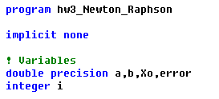
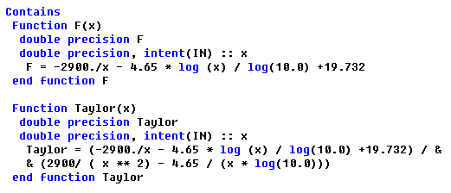
Newton-Raphson method
Coding

Slide 9
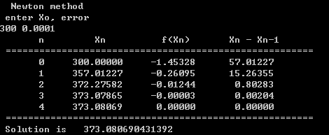
Newton-Raphson method
Results
Very Fast! (Efficient)

Slide 10
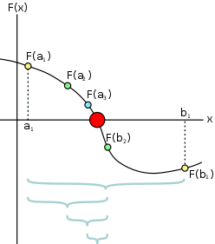
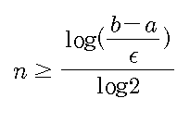
Discussion
How many calculations in Bisection method?
=19.932

Slide 11
Bisection method
Results

Slide 13
Thank you ^-^

