Slide 1
재료수치해석 hw9
20100098 최원미

Slide 2
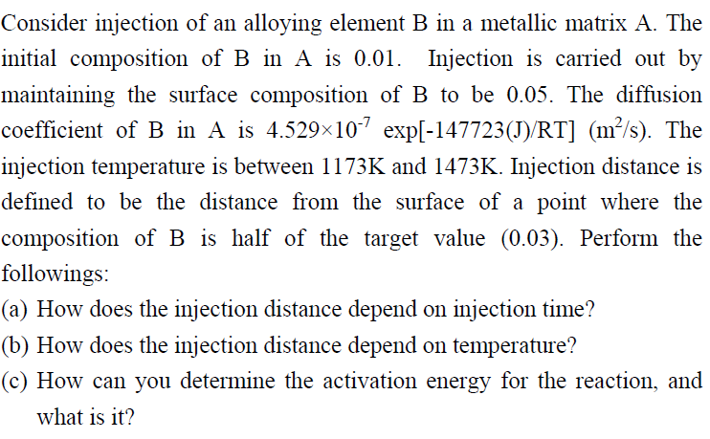
question,

Slide 3
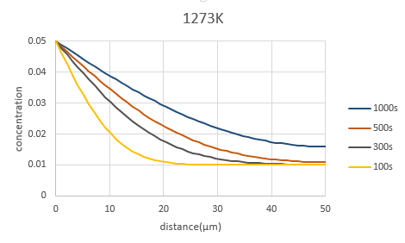
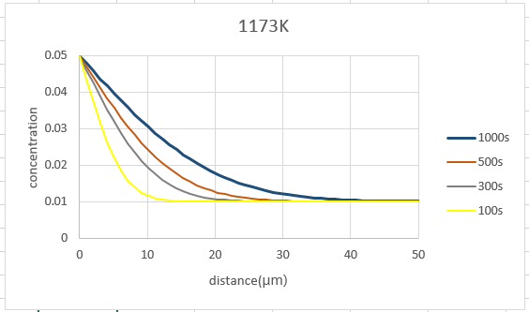
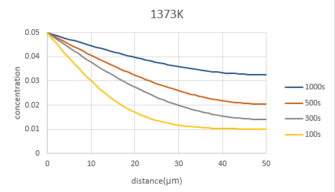
result,

Slide 4
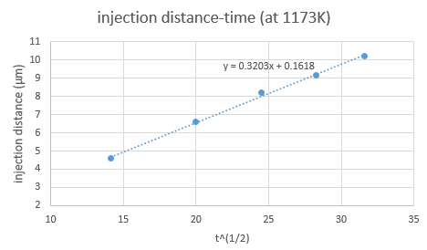
result,

Slide 5
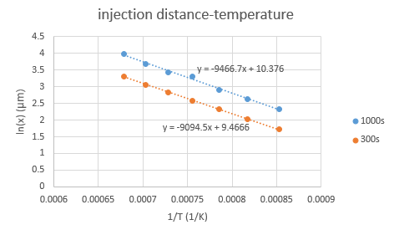
result,

Slide 6
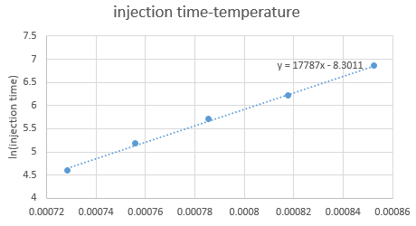
result,
$$Q^{reac}=R×\frac{∂(lnt_{f})}{∂(\frac{1}{T})}=8.3144×17787=147890$$
$$error=\frac{\left|147720−147890\right|}{147720}=1.2×{10}^{−3}$$
* injection distance 10μm

