Slide 1
HW6
20100109
김재유

Slide 2
회귀분석

Slide 3
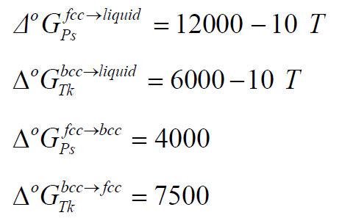
엔탈피의 이용 방법(예시: 액상)
IDEAL
ㅜ
ㅜ
엔탈피
활동도의 이용 방법(예시: 액상)

Slide 4
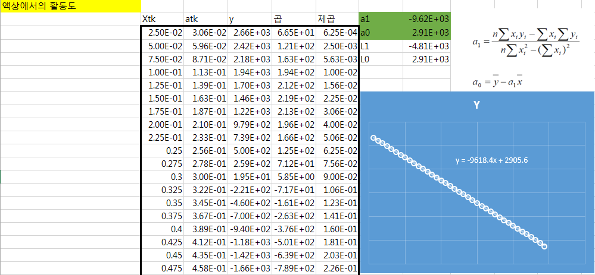
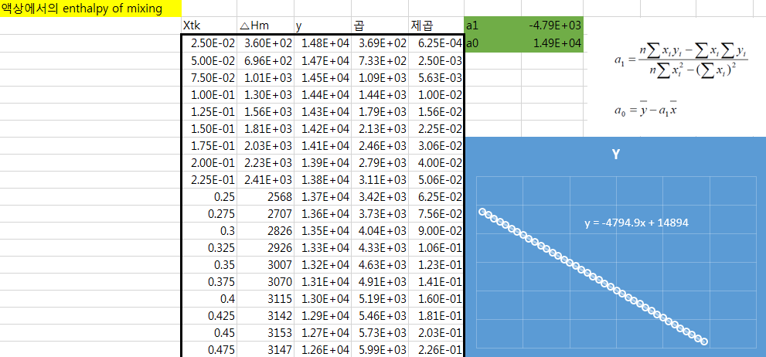
Liquid
1500K

Slide 5
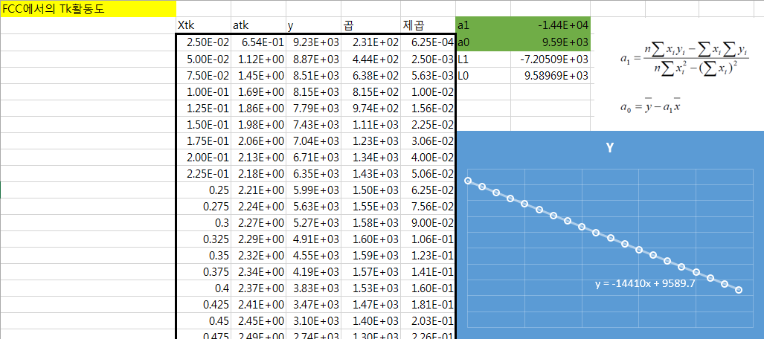
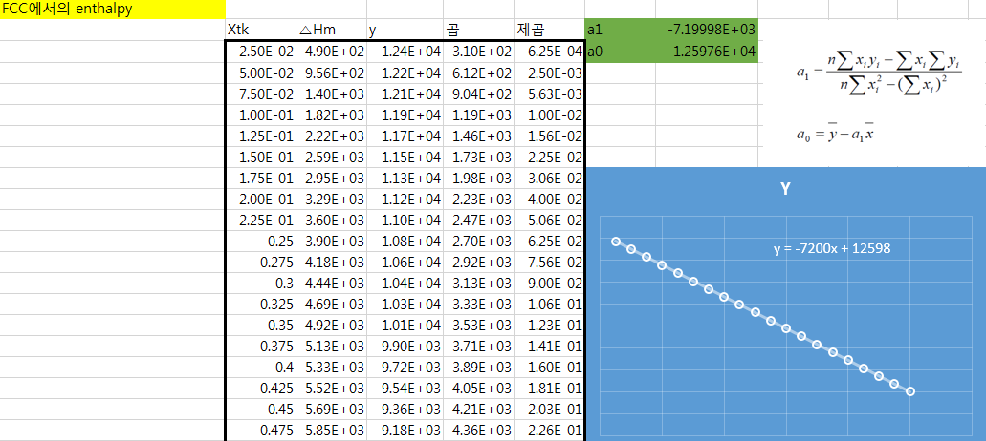
FCC
600K

Slide 6
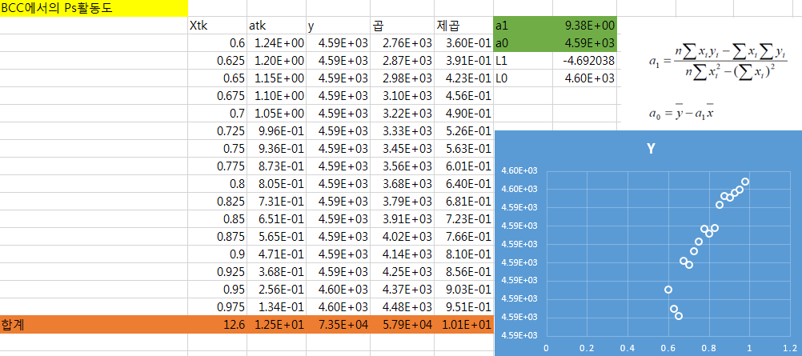
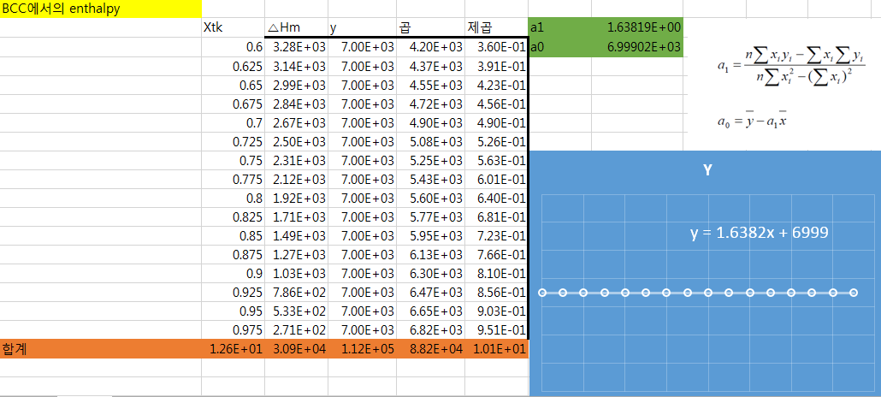
BCC
600K

Slide 7
상태도

Slide 8
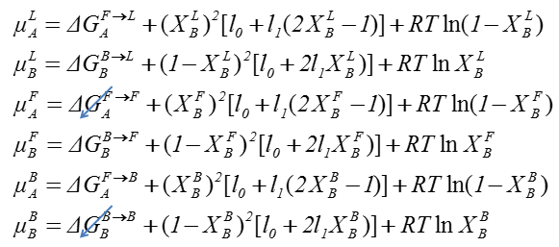
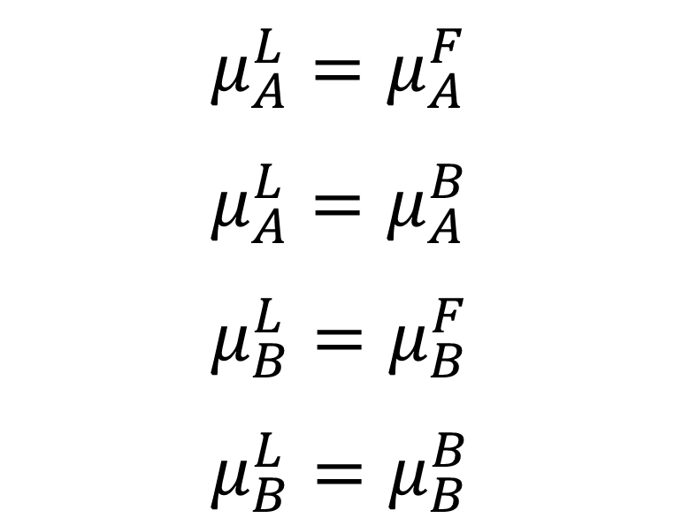
$$μ_{A}^{L}=μ_{A}^{F} \\ μ_{A}^{L}=μ_{A}^{B} \\ μ_{B}^{L}=μ_{B}^{F} \\ μ_{B}^{L}=μ_{B}^{B}$$

Slide 9
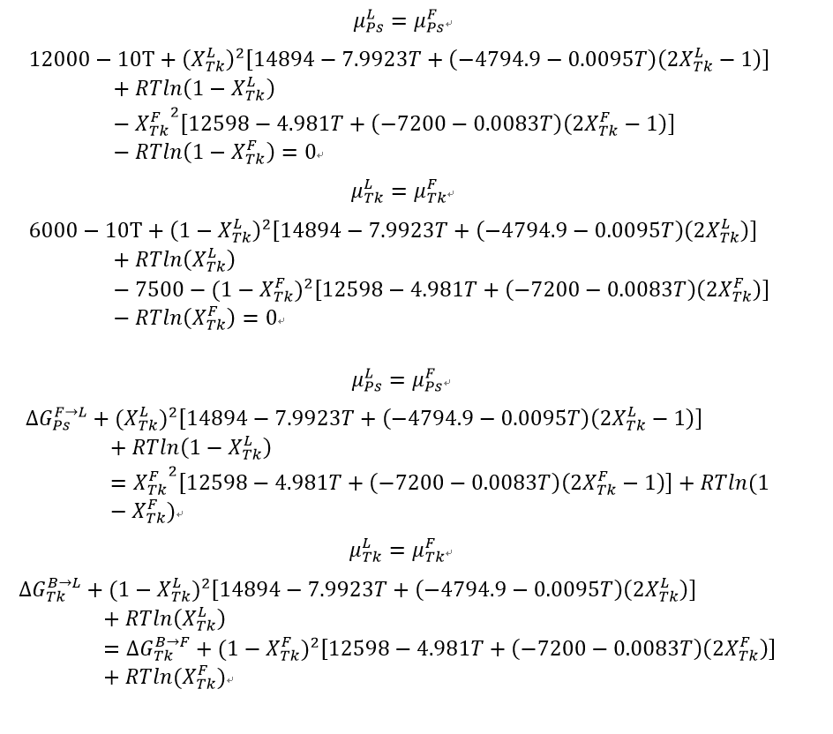
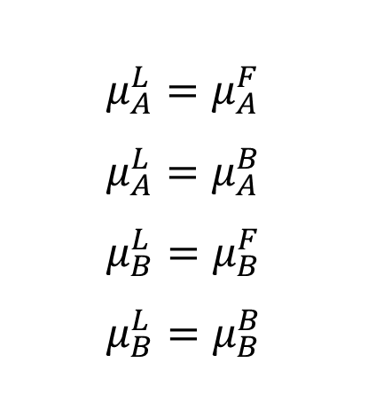
$$μ_{A}^{L}=μ_{A}^{F} \\ μ_{A}^{L}=μ_{A}^{B} \\ μ_{B}^{L}=μ_{B}^{F} \\ μ_{B}^{L}=μ_{B}^{B}$$

Slide 10
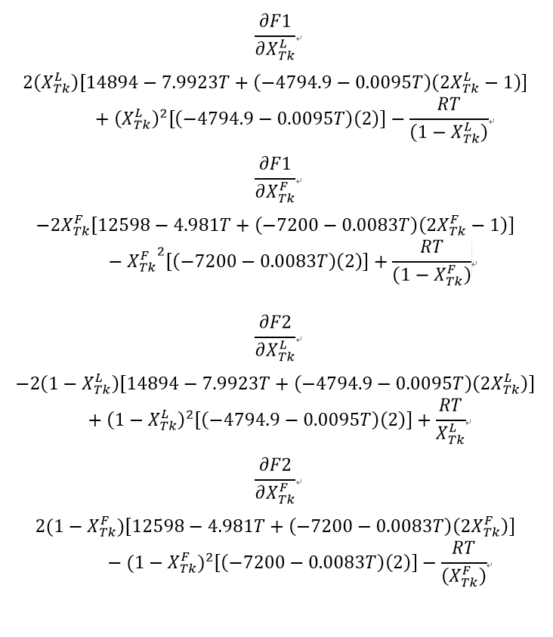

Slide 11
더 이상의 자세한 설명은 생략한다.

Slide 12
c*******************************3FB*************************************
T=200
n=1
m=1
62 x_liq=1-rand()
x_sol=0+rand()
c***********************************************************************
82 IF (ABS(+4000+x_liq**2*(6999-3.998*T+(1.6382-0.0106*T)*(2*x_liq-1)
a)+R*T*ALOG(1-x_liq)-x_sol**2*(12598-4.981*T+(-7200-0.0083*T)*(2*x_
asol-1))-R*T*ALOG(1-x_sol))<10e-2 .and. ABS((1-x_liq)**2*(6999-3.99
a8*T+(1.6382-0.0106*T)*(2*x_liq))+R*T*ALOG(x_liq)-7500-(1-x_sol)**2
a*(12598-4.981*T+(-7200-0.0083*T)*(2*x_sol))-R*T*ALOG(x_sol))<10e-2
a) THEN
WRITE(3, 100), T, x_liq, x_sol
92 T=T+5
GO TO 62
ELSE IF (n>1000) THEN
n=1
GO TO 92
ELSE IF (x_liq>1 .or. x_sol>1 .or. x_liq<0 .or. x_sol<0) THEN
n=n+1
GO TO 62
ELSE IF (m>100) THEN
m=1
x_liq=1-rand()
x_sol=0+rand()
GO TO 88
ELSE IF (T>800) THEN
GO TO 72
ELSE
c***********************************************************************
88 A(1,1)=2*x_liq*(6999-3.998*T+(1.6382-0.0106*T)*(2*x_liq-1))+x_liq*
a*2*(1.6382-0.0106*T)*2-R*T/(1-x_liq)
A(2,1)=-2*x_sol*(12598-4.981*T+(-7200-0.0083*T)*(2*x_sol-1))-x_sol
a**2*(-7200-0.0083*T)*2-R*T/(1-x_sol)
A(1,2)=-2*(1-x_liq)*(6999-3.998*T+(1.6382-0.0106*T)*(2*x_liq))+(1-
ax_liq)**2*(1.6382-0.0106*T)*2+R*T/(x_liq)
A(2,2)=2*(1-x_sol)*(12598-4.981*T+(-7200-0.0083*T)*(2*x_sol))-(1-x
a_sol)**2*(-7200-0.0083*T)*2-R*T/(x_sol)
A(3,1)=1
A(4,1)=0
A(3,2)=0
A(4,2)=1
c***********************************************************************
F(1,1)=+4000+x_liq**2*(6999-3.998*T+(1.6382-0.0106*T)*(2*x_liq-1))
a+R*T*ALOG(1-x_liq)-x_sol**2*(12598-4.981*T+(-7200-0.0083*T)*(2*x_s
aol-1))-R*T*ALOG(1-x_sol)
F(1,2)=(1-x_liq)**2*(6999-3.998*T+(1.6382-0.0106*T)*(2*x_liq))+R*T
a*ALOG(x_liq)-7500-(1-x_sol)**2*(12598-4.981*T+(-7200-0.0083*T)*(2*
ax_sol))-R*T*ALOG(x_sol)
CALL INVERSE(A, A_)
CALL MULTI(A_, F, B)
x_liq=x_liq-B(1,1)
x_sol=x_sol-B(1,2)
n=n+1
m=m+1
GO TO 82
72 END IF
CLOSE(UNIT=1, STATUS="KEEP")
CLOSE(UNIT=2, STATUS="KEEP")
CLOSE(UNIT=3, STATUS="KEEP")
20 END PROGRAM
c*******************************2LB*************************************
T=500
n=1
m=1
61 x_liq=1-rand()
x_sol=0+rand()
c***********************************************************************
81 IF (ABS(12000-10*T+x_liq**2*(14894-7.9923*T+(-4794.9-0.0095*T)*(2*
ax_liq-1))+R*T*ALOG(1-x_liq)-4000-x_sol**2*(6999-3.998*T+(1.6382-0.
a0106*T)*(2*x_sol-1))-R*T*ALOG(1-x_sol))<10e-2 .and. ABS(6000-10*T+
a(1-x_liq)**2*(14894-7.9923*T+(-4794.9-0.0095*T)*(2*x_liq))+R*T*ALO
aG(x_liq)-(1-x_sol)**2*(6999-3.998*T+(1.6382-0.0106*T)*(2*x_sol))-R
a*T*ALOG(x_sol))<10e-2) THEN
WRITE(2, 100), T, x_liq, x_sol
91 T=T+5
GO TO 61
ELSE IF (n>1000) THEN
n=1
GO TO 91
ELSE IF (x_liq>1 .or. x_sol>1 .or. x_liq<0 .or. x_sol<0) THEN
n=n+1
GO TO 61
ELSE IF (m>100) THEN
m=1
x_liq=1-rand()
x_sol=0+rand()
GO TO 999
ELSE IF (T>800) THEN
GO TO 71
ELSE
999 A(1,1)=2*x_liq*(14894-7.9923*T+(-4794.9-0.0095*T)*(2*x_liq-1))+x_l
aiq**2*(-4794.9-0.0095*T)*2-R*T/(1-x_liq)
A(2,1)=-2*x_sol*(6999-3.998*T+(1.6382-0.0106*T)*(2*x_sol-1))-x_sol
a**2*(1.6382-0.0106*T)*2+R*T/(1-x_sol)
A(1,2)=-2*(1-x_liq)*(14894-7.9923*T+(-4794.9-0.0095*T)*(2*x_liq))+
a(1-x_liq)**2*(-4794.9-0.0095*T)*2+R*T/(x_liq)
A(2,2)=2*(1-x_sol)*(6999-3.998*T+(1.6382-0.0106*T)*(2*x_sol))-(1-x
a_sol)**2*(1.6382-0.0106*T)*2-R*T/(x_sol)
A(3,1)=1
A(4,1)=0
A(3,2)=0
A(4,2)=1
c***********************************************************************
F(1,1)=12000-10*T+x_liq**2*(14894-7.9923*T+(-4794.9-0.0095*T)*(2*x
a_liq-1))+R*T*ALOG(1-x_liq)-4000-x_sol**2*(6999-3.998*T+(1.6382-0.0
a106*T)*(2*x_sol-1))-R*T*ALOG(1-x_sol)
F(1,2)=6000-10*T+(1-x_liq)**2*(14894-7.9923*T+(-4794.9-0.0095*T)*(
a2*x_liq))+R*T*ALOG(x_liq)-(1-x_sol)**2*(6999-3.998*T+(1.6382-0.010
a6*T)*(2*x_sol))-R*T*ALOG(x_sol)
CALL INVERSE(A, A_)
CALL MULTI(A_, F, B)
x_liq=x_liq-B(1,1)
x_sol=x_sol-B(1,2)
n=n+1
m=m+1
GO TO 81
71 END IF
c********************************1LF************************************
T=713
n=1
m=1
60 x_liq=1-rand()
x_sol=0+rand()
80 IF (ABS(12000-10*T+x_liq**2*(14894-7.9923*T+(-4794.9-0.0095*T)*(2*
ax_liq-1))+R*T*ALOG(1-x_liq)-x_sol**2*(12598-4.981*T+(-7200-0.0083*
aT)*(2*x_sol-1))-R*T*ALOG(1-x_sol))<10e-2 .and. ABS(6000-10*T+(1-x_
aliq)**2*(14894-7.9923*T+(-4794.9-0.0095*T)*(2*x_liq))+R*T*ALOG(x_l
aiq)-7500-(1-x_sol)**2*(12598-4.981*T+(-7200-0.0083*T)*(2*x_sol))-R
a*T*ALOG(x_sol))<10e-2) THEN
WRITE(1, 100), T, x_liq, x_sol
90 T=T+5
GO TO 60
ELSE IF (n>1000) THEN
n=1
GO TO 90
ELSE IF (x_liq>1 .or. x_sol>1 .or. x_liq<0 .or. x_sol<0) THEN
n=n+1
GO TO 60
ELSE IF (m>100) THEN
m=1
x_liq=1-rand()
x_sol=0+rand()
GO TO 99
ELSE IF (T>1300) THEN
GO TO 70
ELSE
99 A(1,1)=2*x_liq*(14894-7.9923*T+(-4794.9-0.0095*T)*(2*x_liq-1))+x_l
aiq**2*(-4794.9-0.0095*T)*2-R*T/(1-x_liq)
A(2,1)=-2*x_sol*(12598-4.981*T+(-7200-0.0083*T)*(2*x_sol-1))-x_sol
a**2*(-7200-0.0083*T)*2-R*T/(1-x_sol)
A(1,2)=-2*(1-x_liq)*(14894-7.9923*T+(-4794.9-0.0095*T)*(2*x_liq))+
a(1-x_liq)**2*(-4794.9-0.0095*T)*2+R*T/(x_liq)
A(2,2)=2*(1-x_sol)*(12598-4.981*T+(-7200-0.0083*T)*(2*x_sol))-(1-x
a_sol)**2*(-7200-0.0083*T)*2-R*T/(x_sol)
A(3,1)=1
A(4,1)=0
A(3,2)=0
A(4,2)=1
F(1,1)=12000-10*T+x_liq**2*(14894-7.9923*T+(-4794.9-0.0095*T)*(2*x
a_liq-1))+R*T*ALOG(1-x_liq)-x_sol**2*(12598-4.981*T+(-7200-0.0083*T
a)*(2*x_sol-1))-R*T*ALOG(1-x_sol)
F(1,2)=6000-10*T+(1-x_liq)**2*(14894-7.9923*T+(-4794.9-0.0095*T)*(
a2*x_liq))+R*T*ALOG(x_liq)-7500-(1-x_sol)**2*(12598-4.981*T+(-7200-
a0.0083*T)*(2*x_sol))-R*T*ALOG(x_sol)
CALL INVERSE(A, A_)
CALL MULTI(A_, F, B)
x_liq=x_liq-B(1,1)
x_sol=x_sol-B(1,2)
n=n+1
m=m+1
GO TO 80
70 END IF
코딩

