Slide 1
Assignment #5
MSE
20100389
Park Jae Yong

Slide 2
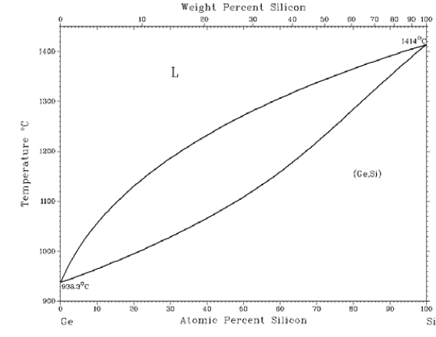
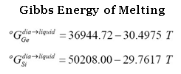
Problem
Solve the Non-linear equation system
Ge-Si Phase Diagram

Slide 3
Introduction
In Thermodynamics,

Slide 4
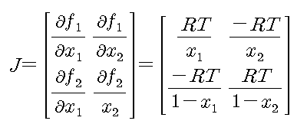
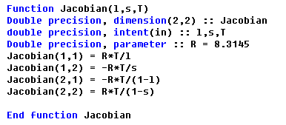
Coding

Slide 5
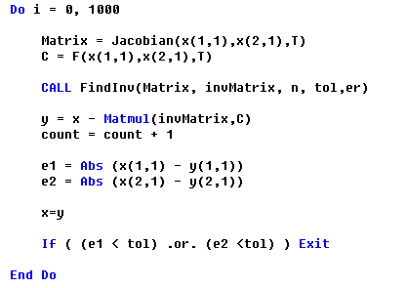
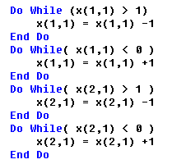
Coding
Error처리
X1,X2 (Fraction)이 0보다 작거나 1보다 커지는 경우

Slide 6
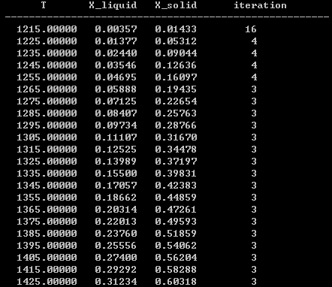
Result
Temperature : 1215~1675, Step = 10
Initial value : x1 = 0.4, x2 = 0.6
Tol = 0.000001

Slide 7
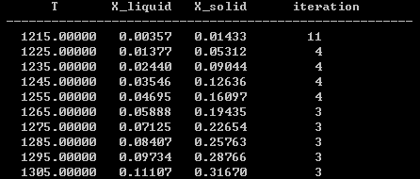
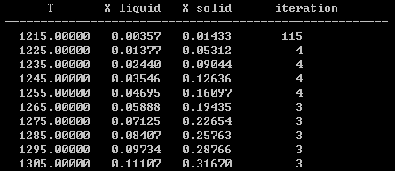
Change the initial value
Initial value : x1 = 0.1, x2 = 0.9
Initial value : x1 = 0.9, x2 = 0.1
Tol = 0.000001
Tol = 0.000001

Slide 8
Thank you ^-^

