Slide 1
Solution of Ordinary
Differential Equation
Euler, Heun, Midpoint, Runge-Kutta
Seungpyo Hong
Flow Physics and Engineering Lab.
Department of Mechanical Engineering
POSTECH

Slide 2
Problem
1. Solve the following ODE via Euler, Heun, Midpoint, Runge-kutta method.
2. Repeat with various step size and analyze error.

Slide 3
Techniques to solve ODE (1)
Euler method
1st order
(1) Using higher order
(2) Decreasing step size
2nd order
The values of derivatives are changing
with advancing independent variables
Heun method
Midpoint method
: averaging the two derivatives
at the end
: obtaining derivatives at mid point of the section

Slide 4
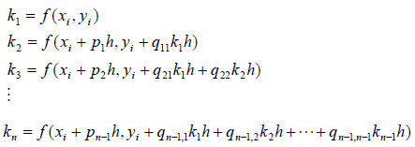
Techniques to solve ODE (2)
Still, we need to…
1. Increase the order of accuracy
2. Without calculating the derivatives of the functions
Runge-Kutta method (1)
Derivative
at a certain point
Weighting factor

Slide 5
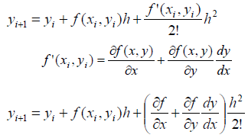
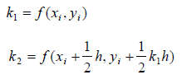
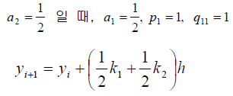
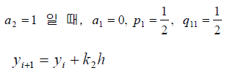
Techniques to solve ODE (3)
Runge-Kutta method (2)
2nd order RK
Taylor Series Expansion
Runge-Kutta
Equation
Huen
Midpoint

Slide 6
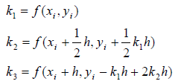
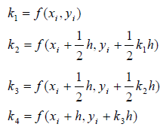
Techniques to solve ODE (3)
Runge-Kutta method (3)
3rd order RK
4th order RK

Slide 7
Structure of the program
PROGRAM Ordinary
1. Euler
2. Heun
3. Midpoint
4. RK4
END PROGRAM Ordinary
Select the method (1: Euler 2: Heun 3: Midpoint 4:RK4 )
Assign initial condition, step size, section interested
Write results

Slide 8
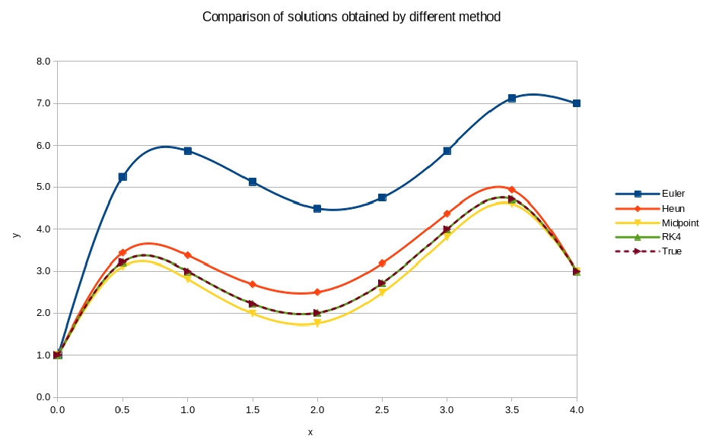
Results
dx = 0.5

Slide 9
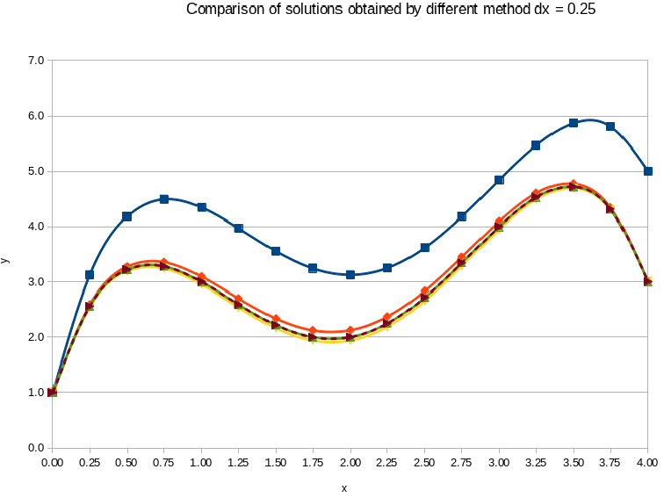
Results
dx = 0.5
dx = 0.25

Slide 10
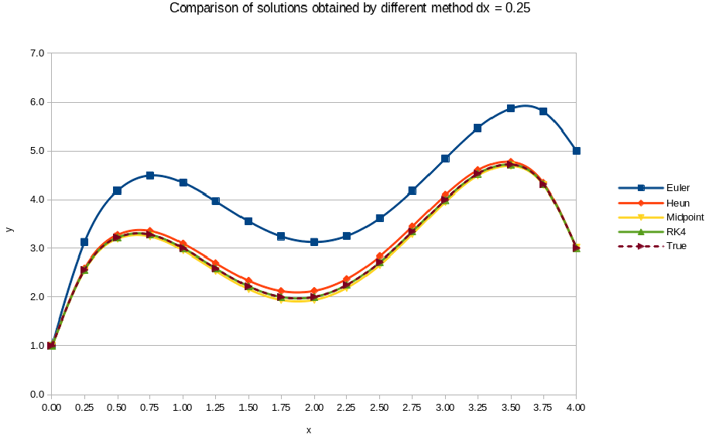
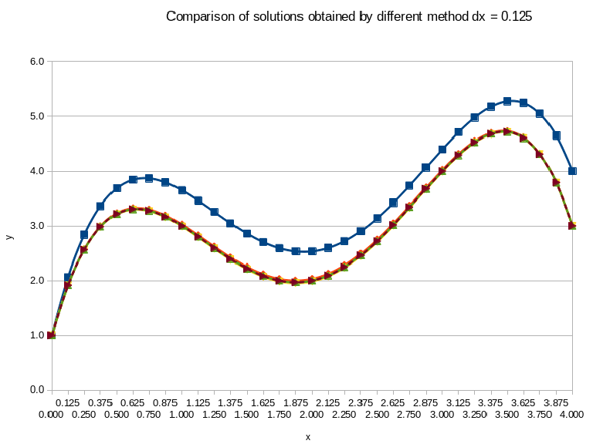
Results
dx = 0.25
dx = 0.125

Slide 11
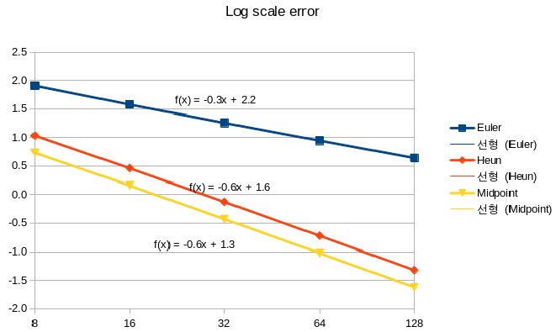
Results

Slide 12
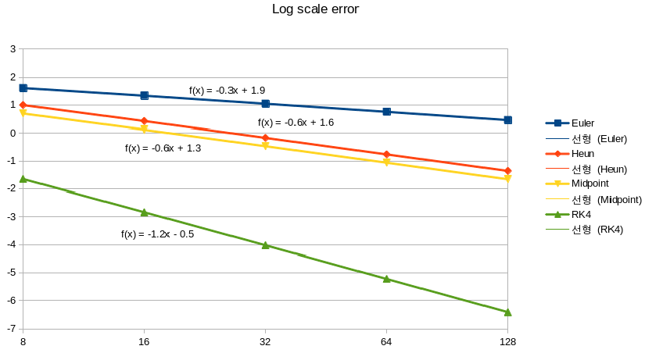
Results
x⁵

