Slide 1
Numerical
Analysis
for Materials
Homework No.7
20130528
Dept. of Materials Science and Engineering
Cheolhee Han

Slide 2
01 Algorithm
Numerical Solution of 1st ODE(Initial Value Problem)
Numerical Methods
Euler Method
Heun Method
Midpoint Method
4th Runge-Kutta method
#define xi 0//initial x value
#define yi 2//initial y value
#define xf 4//final x value
double dydx(double x, double y)
{
double e = exp(1);
return 4 * pow(e, 0.8*x) - 0.5*y;
}
double ans(double x)
{
double e = exp(1);
return pow(e, (-0.5)*x)*((4 / 1.3)*pow(e, 1.3*x) - 1.4 / 1.3);
}

Slide 3
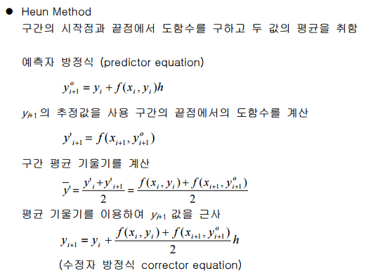
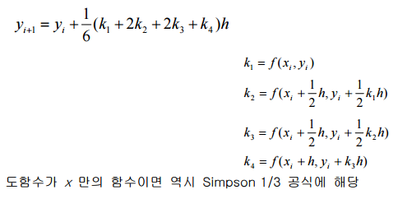
02 Code
Source Codes
double euler(double dx)
{
int i = 0;
double x = 0, y = 0;
x = xi;
y = yi;
for (i = 0; i < (xf - xi) / dx; i++)
{
y += dydx(x, y)*dx;
x += dx;
}
return y;
}
double heun(double dx)
{
double x, y, y1_pre, y0_pre;
double TOL = 0.0001;
double err;
double maxit = 20;
int iter;
y = yi;
for (x = xi; x < xf; x += dx)
{
y1_pre = y + dydx(x, y)*dx;
iter = 0;
while (1)
{
y0_pre = y1_pre;
y1_pre = y + (dydx(x, y) + dydx(x + dx, y1_pre)) / 2 *dx;
err = fabs((y1_pre - y0_pre) / y1_pre);
if (err <= TOL || iter > maxit)
break;
}
y = y1_pre;
}
return y;
}
double midpoint(double dx)
{
double x, y, ym;
y = yi;
for (x = xi; x < xf; x += dx)
{
ym = y + dydx(x, y)*dx / 2;
y += dydx(x + dx / 2, ym)*dx;
}
return y;
}
double RK4(double dx)
{
double x, y, k1, k2, k3, k4, slope;
y = yi;
for (x = xi; x < xf; x += dx)
{
k1 = dydx(x, y);
k2 = dydx(x + dx / 2, y + k1*dx / 2);
k3 = dydx(x + dx / 2, y + k2*dx / 2);
k4 = dydx(x + dx, y + k3*dx);
slope = (k1 + 2 * k2 + 2 * k3 + k4) / 6;
y += slope*dx;
}
return y;
}

Slide 4
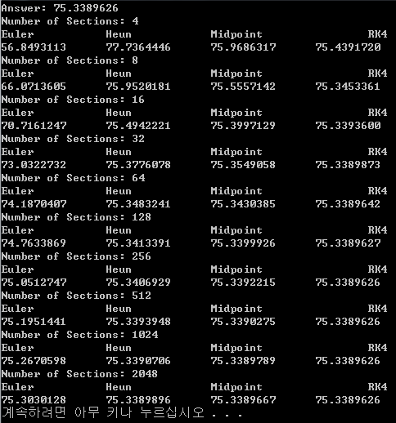
03 Calculation Results
Data & Plot

Slide 5
03 Calculation Results
Data & Plot

Slide 6
04 Conclusion
Investigation & Conclusion
Answers
다양한 방법을 통해 1차 상미분방정식(IVP)을 풀 수 있으며 그 정확도는 4th RK – Midpoint – Heun - Euler 순이다.
Midpoint method와 Heun method의 error order는 유사하다.
모든 방법은 구간을 증가시킴에 따라 정확도가 증가한다.
구간의 수를 증가시키더라도 정확도의 순서는 1과 동일하다.

