Slide 1
Numerical Analysis for Materials (AMSE318-01)
HOmework #8
Doan Minh Quan - 49004023

Slide 2
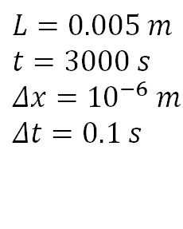
Problems (Parabolic PDE)
$$\frac{∂C(x,t)}{∂x}=D\frac{∂^{2}C(x,t)}{∂x^{2}}$$
Consider injection of an alloying element B in a metallic matrix A. The initial composition of B in A is 0.01. Injection is carried out by maintaining the surface composition of B to be 0.05. The diffusion coefficient of B in A is 4.529×10-7 exp[-147723(J)/RT] (m2 /s). The injection temperature is between 1173K and 1473K. Injection distance is defined to be the distance from the surface of a point where the composition of B is half of the target value (0.03). Perform the followings: (a) How does the injection distance depend on injection time? (b) How does the injection distance depend on temperature? (c) How can you determine the activation energy for the reaction, and what is it?
$$D=4.529×{10}^{−7}\exp\left(\frac{−147723}{RT}\right)$$
$$C\left(0, t\right)=0.05$$
$$L=0.005 m$$
$$t=3000 s$$
$$Δx={10}^{−6} m$$
$$Δt=0.1 s$$
$$C\left(L, t\right)=0.01$$
$$C\left(x, 0\right)=0.01$$
$$T: 1173K→1473K$$

Slide 3

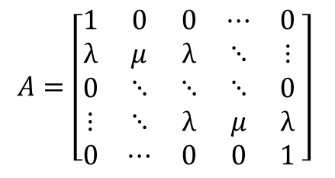
Finite Difference Method
function solve(Cx0, CxL, Ct0, T, L, t, dx, dt)
D = 4.529e-7 * exp(-147723 / (R * T))
λ = D * dt / dx^2
nx = round(Int, L / dx) + 1
nt = round(Int, t / dt) + 1
C = zeros(nx, nt)
C[:, 1] .= Ct0
C[1, 1] = Cx0
C[nx, 1] = CxL
A = sparse([1:nx; 2:(nx-1); 2:(nx-1)],
[1:nx; 1:(nx-2); 3:nx],
[1; fill(1 - 2λ, nx - 2); 1;
fill(λ, nx - 2);
fill(λ, nx - 2)])
for i in 2:nt
C[:, i] = A * C[:, i-1]
end
return C
end
$$A=\left[\begin{matrix}1 & 0 & 0 & ⋯ & 0 \\ λ & μ & λ & ⋱ & ⋮ \\ 0 & ⋱ & ⋱ & ⋱ & 0 \\ ⋮ & ⋱ & λ & μ & λ \\ 0 & ⋯ & 0 & 0 & 1\end{matrix} \right]$$
$$μ=1−2λ$$
$$w^{(j)}={Aw}^{(j−1)}$$

Slide 4
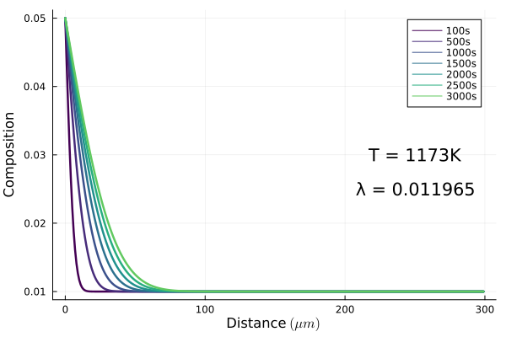
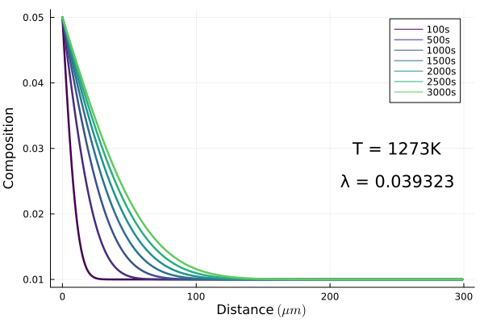
Results

Slide 5
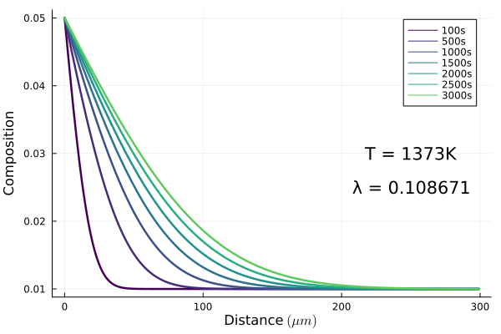
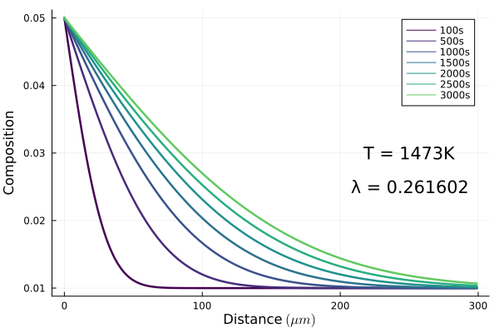
Results

Slide 6
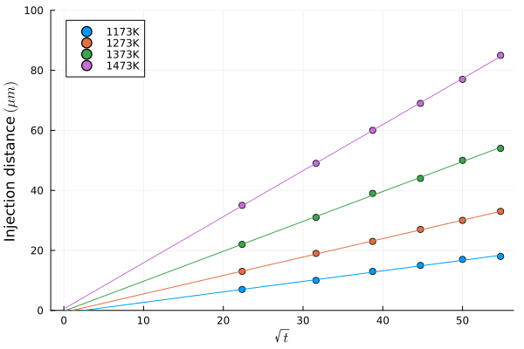
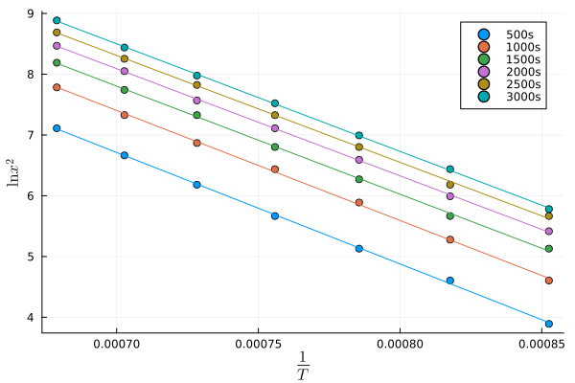
Injection distance
$$x=\sqrt{Dt}=\sqrt{D_{0}\exp\left(\frac{−Q}{RT}\right)t}$$
$$\ln{x^{2}}=\ln{D_{0}t} − \frac{Q}{RT}$$
Time dependence
Temperature dependence

Slide 7
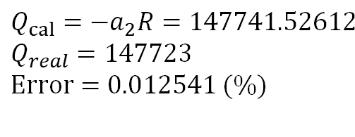
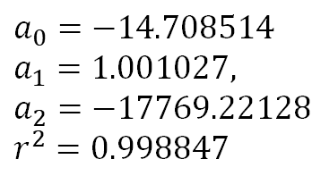
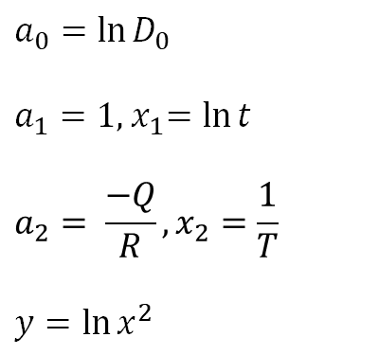
1Activation Energy
$$\ln{x^{2}}=\ln{D_{0}}+\ln{t} − \frac{Q}{RT}$$
Result:
$$a_{0}=−14.708514$$
$$a_{1}=1.001027,$$
$$a_{2}=−17769.221284$$
$$r^{2}=0.998847$$
Linear regression
$$a_{0}=\ln{D_{0}}$$
$a_{1}=1$,${ x}_{1}=\ln{t}$
$$a_{2}= \frac{−Q}{R}, x_{2}=\frac{1}{T}$$
$$y=\ln{x^{2}}$$
$$y={a_{0}+a}_{1}x_{1}+{a_{2}x}_{2}$$
$$Q_{cal}=−a_{2}R=147741.526123$$
$$Q_{real}=147723$$
$$Error=0.012541 (\%)$$
$$T: 1173→1473, step=10$$
$$t: 500→3000, step=100$$

